Slide 1
PROSTHETIC LIMB TELEMETRY SYSTEM
Smart Prosthetic Knee Joint
Firmware & Telemetry Studio
Comprehensive Engineering Work Progress, Architecture & GUI Provisions
• Embedded Target: STM32U585 (ARM Cortex-M33 @ 160 MHz, FreeRTOS)
• Telemetry Suite: Electron 31 Desktop Studio (100 Hz Streaming & 3D Analytics)
• System Features: 6-Phase Gait Detection | Hardware AES-256-GCM | Flash Calibration
Author: Jithin Sreenu | Date: November 2026 | Status: Verified & Operational

Slide 2
WORK PROGRESS REPORT
Project Overview: What Is This System?
A complete end-to-end telemetry and clinical control solution for active prosthetic limbs
02
🦿 1. The Physical Knee
🧠 2. The Smart Firmware
💻 3. The Desktop Studio
Physical Hardware & Sensors
• Two precision load cells monitor ground reaction forces.
• Rotary potentiometer measures knee joint flex/extension angle.
• Hydraulic spool valve actuated via dedicated slave MCU.
• Rechargeable onboard battery with divider monitoring.
STM32U585 Microcontroller
• Reads 3 ADC channels at ~2,778 blocks/sec via DMA.
• Applies 51-tap FIR low-pass filter to eliminate mechanical vibrations.
• Clinical 6-phase state machine determines walking cycle.
• Streams 25-byte packets at 100 Hz over UART (AES-256 encrypted).
Electron 31 Telemetry Software
• Real-time waveforms, PedoGraph glow scope & 3D state-space trails.
• Automated gait metrics (cadence, stride time, symmetry index).
• Clinician calibration tools: threshold & coefficient flash upload.
• HIPAA-friendly local session recording & CSV/JSON data export.
💡 The Big Picture: How to Understand This at First Glance
Think of this system like a high-precision 'ECG monitor' but built specifically for an amputee's prosthetic knee.
When an amputee walks, the knee must dynamically adapt its damping (resistance) to prevent falls during heel-strike and allow smooth swinging when the foot is in the air. The STM32 microcontroller senses the user's weight and knee angle 100 times every second, decides whether the user is in Swing, Loading, Mid-Stance, or Terminal-Stance, and immediately commands the hydraulic valve. Simultaneously, all biomechanical data streams wirelessly or via USB to the Desktop Studio, allowing doctors, prosthetists, and engineers to observe gait symmetry, calibrate sensor coefficients, and tune walking parameters in real time.

Slide 3
WORK PROGRESS REPORT
System Architecture: End-to-End Data & Control Flow
Clear interconnection between physical sensors, embedded intelligence, and PC visualization
03
SENSING LAYER
EMBEDDED MCU (STM32U585)
TELEMETRY STUDIO
▶ Load Cell 1 (PC0 / A0)
Ground force (0-300 N)
▶ Load Cell 2 (PC2 / A1)
Moment / force balance
▶ Knee Angle (PC4 / A2)
Joint flex angle (0-27°)
▶ Battery Monitor
Divider (0-4.2V scale)
▶ Spool Valve Feedback
Linear position feedback (%)
▶ ADC1 + GPDMA1 Interleaved Scan
3 channels @ 12-bit resolution, 32 samples/ch block
▶ 51-Tap Low-Pass FIR Filter
Hamming window @ 25 Hz cutoff, removes mechanical shock
▶ Clinical 6-Phase Gait State Machine
Calculates Force & Moment, detects phase, commands slave
▶ Smart Protocol Builder
25-byte packed frame, fixed-point x100, CRC-16/MODBUS
▶ Opt-In Hardware AES-256-GCM
Encrypts 20-byte payload with rolling counter & 8-byte tag
▶ USART3 Slave Link Service
7-byte frames to valve motor, median-of-3, 25ms freshness
▶ Transports (USB / BLE / Demo)
SerialPort @ 115200, Web Bluetooth NUS, 100Hz Demo
▶ Frame Parser & Verification
Sync byte search (AA 55), CRC calculation & fault decoding
▶ Real-Time Multi-Pane UI
16 tabs: Waveforms, PedoScope, 3D WebGL, Inspector
▶ Automated Gait Analytics
Cadence, Stance/Swing ratio, Stride time histogram
▶ Bidirectional Control
Threshold packets (0x31), Coefficients (0x32), CLI console

Slide 4
WORK PROGRESS REPORT
Embedded Target: ST B-U585I-IOT02A Platform
Low-power high-performance Cortex-M33 microcontroller with hardware security peripherals
04
Core Architecture — ARM Cortex-M33 with TrustZone
Analog Front-End — ADC1 + GPDMA1 Architecture
• Operating Frequency: 160 MHz clock (MSI / PLL)
• On-Chip Memory: 768 KB SRAM (SRAM1+2+3+4)
• Flash Storage: 2 MB dual-bank flash (Bank 2 for Calib)
• Floating Point Unit: Hardware Single-Precision FPU
• RTOS Kernel: FreeRTOS with preemptive scheduler
• Resolution: 12-bit successive approximation
• Channels Active: Rank 1: PC0 (A0), Rank 2: PC2 (A1), Rank 3: PC4 (A2)
• Channel Expansion: PC5 (A3), PA7 (A4), PB0 (A5) reserved
• Sampling Time: 2.5 ADC clock cycles per conversion
• Conversion Rate: ~2,778 blocks/s (32 scans x 3 ch = 96 words)
Communications — Multi-UART System Bus
Cryptographic Engine — Hardware AES & Random Number
• USART1 (Host Telemetry): 115200 baud, 8N1, TX DMA (GPDMA1 Ch0)
• USART1 RX (CLI Console): Idle-line DMA with circular buffer & command parser
• USART3 (Valve Motor): PD8-TX / PD9-RX, 7-byte binary packet link
• Bluetooth (BLE): Nordic UART Service (NUS) profile compatibility
• Safety Interlocks: Dropped-frame handling on busy, non-blocking TX
• AES Peripheral: Hardware AES-256 block cipher engine
• TRNG Peripheral: Hardware True Random Number Generator
• GCM Mode: Hardware AES round function + SW GHASH
• Key Management: Flash-backed 256-bit PSK with 16-byte nonce
• Fallback Mechanism: FIPS-197 verified software AES fallback

Slide 5
WORK PROGRESS REPORT
Firmware Pipeline: Sensor Sampling & Digital Filtering
How analog sensor voltages are acquired, filtered, and converted to physical units
05
Step 1: Hardware Trigger
Step 2: Buffer Acquisition
Step 3: 51-Tap FIR Filter
Step 4: Calibration Scaling
Continuous ADC Scanning
ADC1 operates in continuous scan mode across PC0, PC2, and PC4. GPDMA1 Ch1 transfers conversions into memory without CPU overhead.
32 Scans × 3 Channels
A 96-halfword buffer (192 bytes) fills every ~360 µs. A DMA completion interrupt signals that fresh multi-sample raw data is ready.
Hamming Low-Pass @ 25 Hz
Smooths out gait-strike impacts and high-frequency noise while preserving true physiological force curves.
Engineering Unit Conversion
Raw ADC readings convert to real-world units:
• Force = V × 300 N
• Moment = V × 60 Nm
• Knee Angle = V × 27°
• Battery = V × 1.41 V
🔧 Key Breakthrough: Resolving the STM32U5 GPDMA 'Zero-Data' Bug
Root Cause & Fix (August 11 Hardware Verification):
In early testing, real sensors read zero on all channels except battery. Investigation revealed that the STM32U5 ADC configuration register required CFGR1 = CONT | DMNGT_1 (DMA request after each conversion). Setting DMNGT=10 (0x02) enabled continuous circular transfers.
In addition, DMA re-arming was moved directly inside the DMA transfer-complete ISR, completely eliminating a race condition between abort and restart. The hardware fix was fully bench-verified with live load cells.

Slide 6
WORK PROGRESS REPORT
Clinical Gait Intelligence: The 6 Walking Phases
Biomechanical breakdown of how human walking is mapped into state transitions
06
Phase 0: SWING
Phase 1: STANCE
Phase 2: LOADING
Leg in Air (0% Weight)
The prosthetic foot is off the ground moving forward. Force is near zero (< 0.2V). Hydraulic valve opens to allow low-resistance leg swing.
General Support Phase
Catch-all loaded state when force exceeds stance threshold (> 0.5V) but doesn't match specific dynamic sub-phases. Provides stability.
Heel Strike & Acceptance
Initial ground contact. Force rises rapidly as amputee places weight onto the limb. Valve stiffens to prevent knee buckling.
Phase 3: MID-STANCE
Phase 4: TERMINAL-STANCE
Phase 5: PRE-SWING
Full Single-Limb Support
Body weight is directly over the prosthetic knee. Maximum downward force. Triggers the internal 'mid_seen = 1' sequencing flag.
Weight Shift & Push-Off
Body moves forward of the foot. Force begins declining. Mid-stance was already seen, distinguishing this from initial loading.
Toe-Off Preparation
Limb unloads rapidly (< 0.4V). Knee flexion begins in preparation for swing. Triggers transition back to Phase 0 (Swing).

Slide 7
WORK PROGRESS REPORT
Gait Engine: Decision Logic & The Sequence Flag
Detailed block diagram showing how raw voltages are converted to state decisions in state_machine.c
07
1. Multi-Sensor Input ➔ Load Cell 1 (A0) + Load Cell 2 (A1) + Knee Potentiometer (A2)
🔑 The Clinical Secret: Resolving Phase Ambiguity
Why is a simple threshold not enough?
In human gait, Loading (weight acceptance) and Terminal-Stance (push-off) produce the EXACT same sensor force values (~300–600 N). A static threshold cannot tell whether the patient is stepping down or pushing off.
Our firmware solves this with the internal 'mid_seen' state flag:
1. At Heel Strike, the state enters LOADING.
2. When force peaks at body weight, it enters MID-STANCE and sets mid_seen = 1.
3. As force drops back down into the loading band, the firmware checks mid_seen. Because it is 1, it correctly classifies the phase as TERMINAL-STANCE, not Loading!
4. When foot lifts off (force in swing band), mid_seen is cleared back to 0.
Result: 100% deterministic gait progression without requiring complex neural networks on the microcontroller.
2. Combination Mode ➔ SM_Combine(): Configurable as SUM (default), AVERAGE, MAX, or MIN
3. Window Accumulator ➔ Averages N cycles (default 10 cycles = 100 ms) to eliminate transient chatter
4. Moment Calculation ➔ SM_ComputeMoment(): DIFF = (V1-V2)×Arm | ABSDIFF | FORCE×Arm (0.2m)
5. Decision Input Selection ➔ Selected input: Combined FORCE, MOMENT, or multi-variable FORCE+KNEE
6. Band & Sequence Evaluation ➔ Checks voltage bands with mid_seen sequencing flag & hysteresis deadbands
7. Slave Actuation Dispatch ➔ Emits SWING (0) or STANCE (1) command frame to motor slave on every transition

Slide 8
WORK PROGRESS REPORT
Telemetry Protocol: 100 Hz Streaming & AES-256-GCM
Deterministic 25-byte binary frame with optional military-grade encryption
08
Standard Telemetry Frame (v1: 25 Bytes)
Encrypted Telemetry Frame (v2: 31 Bytes)
Byte [0–1]: 0xAA, 0x55 — Sync Header (Frame delimiter)
Byte [2]: uint8 — Sequence counter (0–255 rolling)
Byte [3–4]: int16 (x100) — Calibrated Force (N)
Byte [5–6]: int16 (x100) — Calibrated Moment (Nm)
Byte [7–8]: int16 (x100) — Knee Joint Angle (degrees)
Byte [9–10]: uint16 — Spool Valve Position (%)
Byte [11–12]: uint16 (x100) — Battery Voltage (V)
Byte [13]: uint8 — Gait Phase Enum (0 to 5)
Byte [14–15]: uint16 — 16-Bit Fault Bitmask
Byte [16–22]: 7x uint8 — Reserved zero-padding
Byte [23–24]: uint16 — CRC-16 / MODBUS (covers bytes 0–22)
Opt-In Confidentiality for Wireless & Sniffable Links:
• Session Handshake: Firmware broadcasts 19-byte Hello frame (A5 5A 10 + 16-byte random Nonce) at boot.
• Key Derivation: Session Key (SK) generated via AES-256-ECB over Pre-Shared Key (PSK) and Nonce.
• Rolling IV: Initialized with Nonce[0..8] + 32-bit big-endian packet counter (replay protection).
• Plaintext Range: 20 bytes of payload (bytes 3–22) encrypted via AES-GCM.
• Authentication: First 3 bytes (AA 55 seq) authenticated as Additional Data (AAD).
• Integrity Tag: MSB-8 of GCM-128 authentication tag appended to frame.
• v2 Frame Layout: [AA 55] [seq] [20-byte Ciphertext] [8-byte GCM Tag] = 31 Bytes total.

Slide 9
WORK PROGRESS REPORT
Safety Architecture: 16-Bit Fault Diagnostics & Calibration
Continuous hardware integrity monitoring and non-volatile flash configuration
09
16-Bit Fault Register Breakdown (status_register_t)
Configuration Packets & Internal Flash Bank 2
Bit 0: Force Low Fault (< Min threshold)
Bit 1: Force High Fault (> Max threshold)
Bit 2: Moment Low Fault (< Min threshold)
Bit 3: Moment High Fault (> Max threshold)
Bit 4: Knee Angle Low Fault (< Min threshold)
Bit 5: Knee Angle High Fault (> Max threshold)
Bit 6: Valve Position Low Fault
Bit 7: Valve Position High Fault
Bit 8: Battery Undervoltage Warning (< 3.3V)
Bit 9: Battery Overvoltage Warning (> 4.2V)
Bit 10–13: Per-Channel Sensor Stuck / Flatline Faults
Bit 14: ADC Conversion Stuck-at-Zero Error
Bit 15: ADC Conversion Stuck-at-VREF Error
• Threshold Packet (0x31): 45-byte payload with 10 × float32 values (Min/Max for Force, Moment, Knee, Valve, Battery). Applied live on arrival.
• Coefficients Packet (0x32): 53-byte payload with 12 × float32 values (Scale, Offset, and VREF for each sensor channel).
• Flash Bank 2 Persistence: Coefficients and PSK are written to dedicated Flash Bank 2 pages with magic headers and CRC-16 checks.
• Protected Write Sequence: Requires entering administrative password in Desktop Studio, issuing 'halt on' to stop 100 Hz timers, writing flash, and issuing 'halt off'.
• Boot Reload: At power-on, firmware inspects flash magic. Valid parameters load immediately into runtime memory.

Slide 10
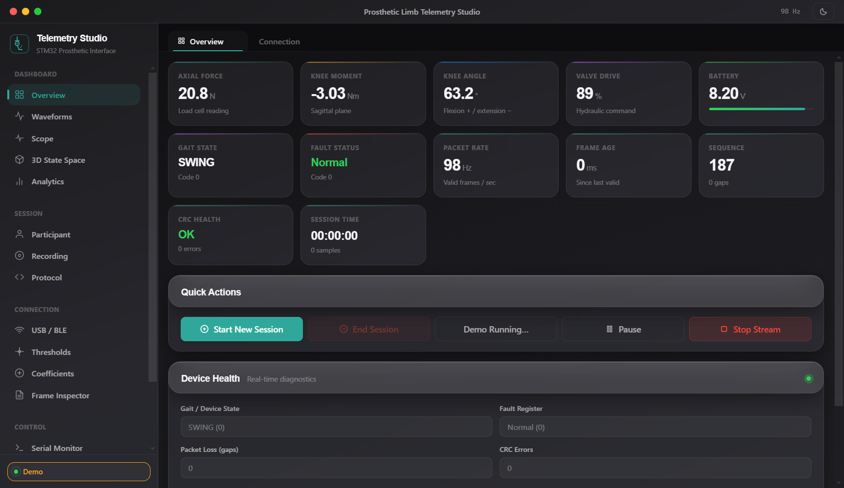
DESKTOP STUDIO TAB 1
GUI Provision: Overview Dashboard
Primary clinical telemetry view with 11 live KPI cards and link health metrics
10
Key Features & Provisions
▶ 11 Real-Time KPI Cards
Displays Force (N), Moment (Nm), Knee Angle (°), Valve (%), Battery (V), Gait State, and Fault Status.
▶ Packet Rate & Health
Live 100 Hz counter verifies zero frame loss and shows transmission latency in milliseconds.
▶ CRC Health Indicator
Continuously checks CRC-16/MODBUS integrity. Instantly flags corrupted packets.
▶ One-Click Quick Actions
Direct controls to Start Session, Pause Stream, and trigger synthetic Demo Mode.
▶ Stale Data Banner
Automatically alerts clinician if telemetry stream drops for more than 1 second.

Slide 11
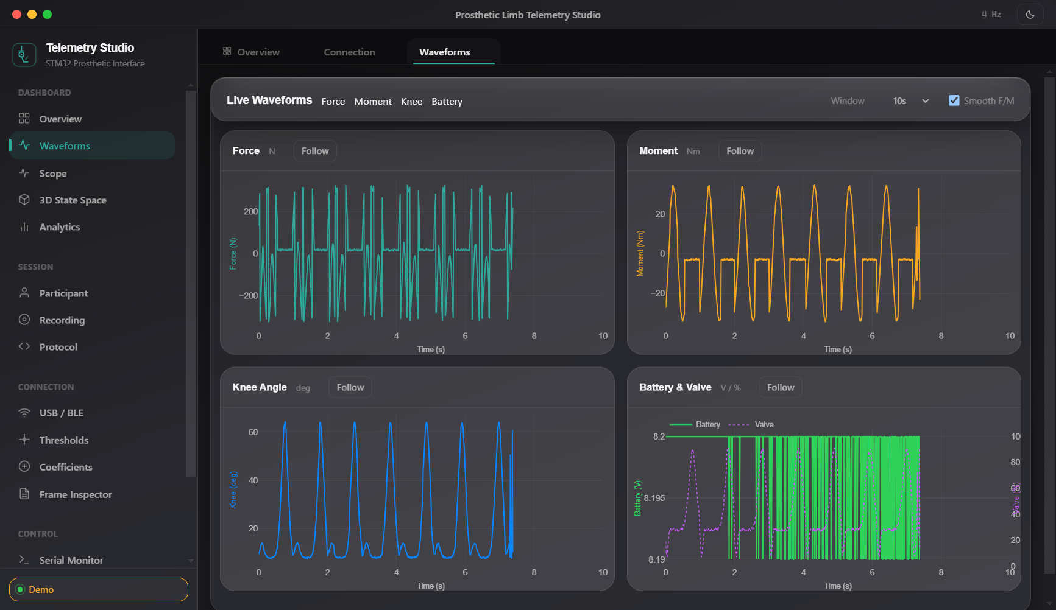
DESKTOP STUDIO TAB 2
GUI Provision: Real-Time Multi-Pane Waveforms
Synchronized high-frequency physiological signal plotting powered by Plotly.js
11
Plotting Specifications
▶ Four Synchronized Panes
1. Vertical Force (N)
2. Sagittal Knee Moment (Nm)
3. Joint Flexion Angle (deg)
4. Dual-Axis Battery (V) & Valve (%)
▶ Selectable Time Windows
Clinician can select rolling viewing buffers of 5s, 10s, 30s, or 60s.
▶ 20 Hz Batch Flushing
Raw 100 Hz frames are queued in a high-speed ring buffer and flushed to WebGL traces at 20 Hz, preventing UI lag.
▶ Follow vs Inspection Mode
Auto-scroll tracks live walking strikes, with smooth pan and zoom on demand.

Slide 12
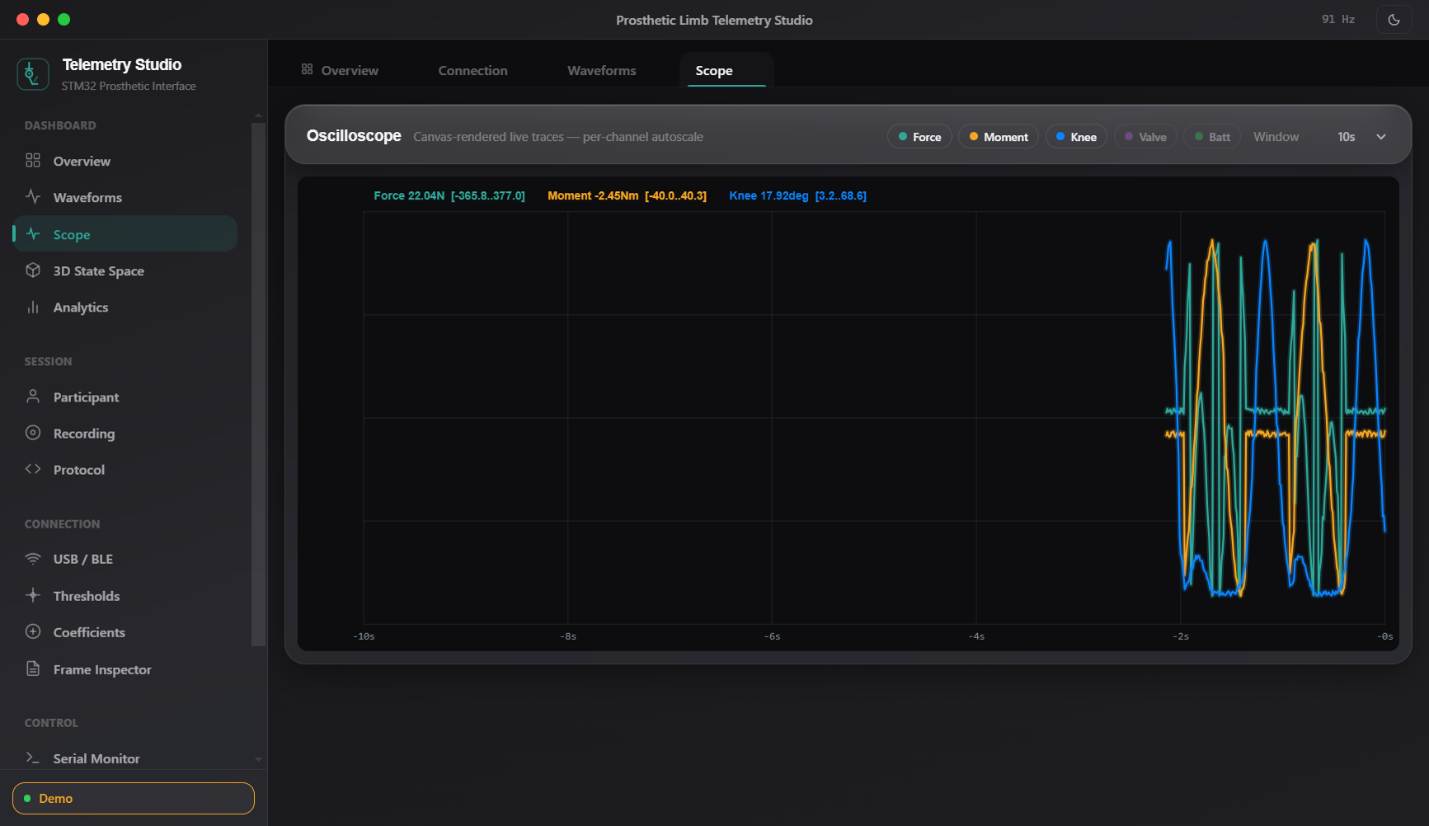
DESKTOP STUDIO TAB 3
GUI Provision: High-Speed Hardware Oscilloscope
PedoGraph-style hardware signal visualizer with custom HTML5 Canvas glow traces
12
Oscilloscope Engine
▶ Pure Canvas Rendering
Bypasses DOM overhead by rendering phosphor-like glow waveforms directly onto HTML5 Canvas at full display refresh rate.
▶ DPR-Sharp Scaling
Compensates for Retina / 4K high-DPI monitors with zero blurriness.
▶ Per-Channel Toggle Chips
Interactive toggle chips allow isolating Force, Moment, Knee Angle, Valve, or Battery signals.
▶ Dynamic Per-Channel Autoscale
Independent vertical scaling adapts to microvolt baseline shifts or large dynamic impacts.

Slide 13
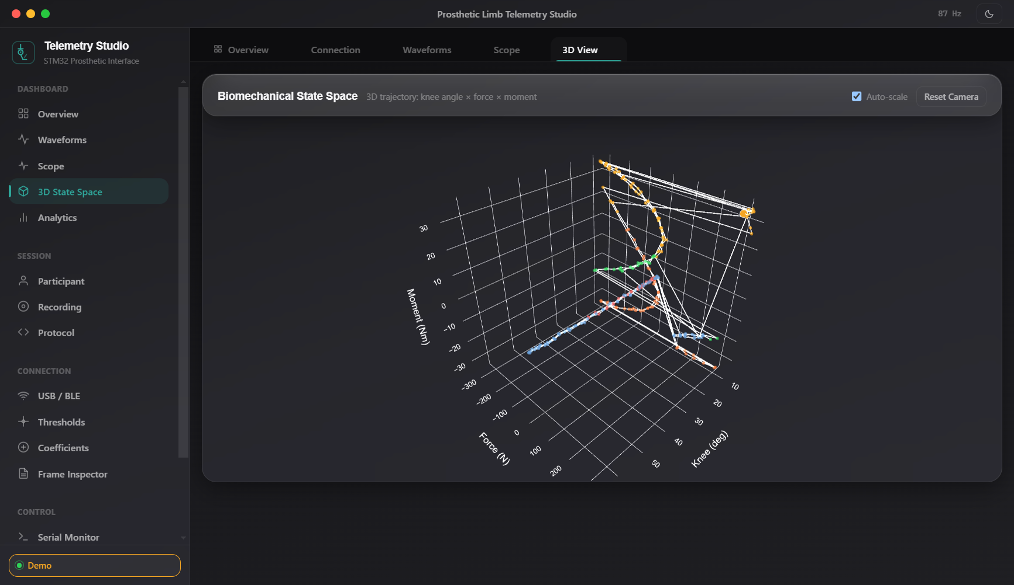
DESKTOP STUDIO TAB 4
GUI Provision: 3D State-Space Trajectory
Interactive 3-axis WebGL phase space visualization showing walking stability loops
13
3D Biomechanical Trajectory
▶ Tri-Axial State Space
Plots Knee Angle (X) × Force (Y) × Moment (Z) in an interactive 3D WebGL volume.
▶ Gait Phase Color Coding
Trail points are dynamically colored by gait state (Swing=Green, Loading=Orange, Mid=Red, Terminal=Purple).
▶ Cycle Limit Loops
Normal, healthy walking forms repetitive closed 3D loops. Asymmetries or stumbling immediately deform the loop shape.
▶ Interactive Controls
Full mouse orbit, pan, zoom, camera reset, and auto-scaling toggles.

Slide 14
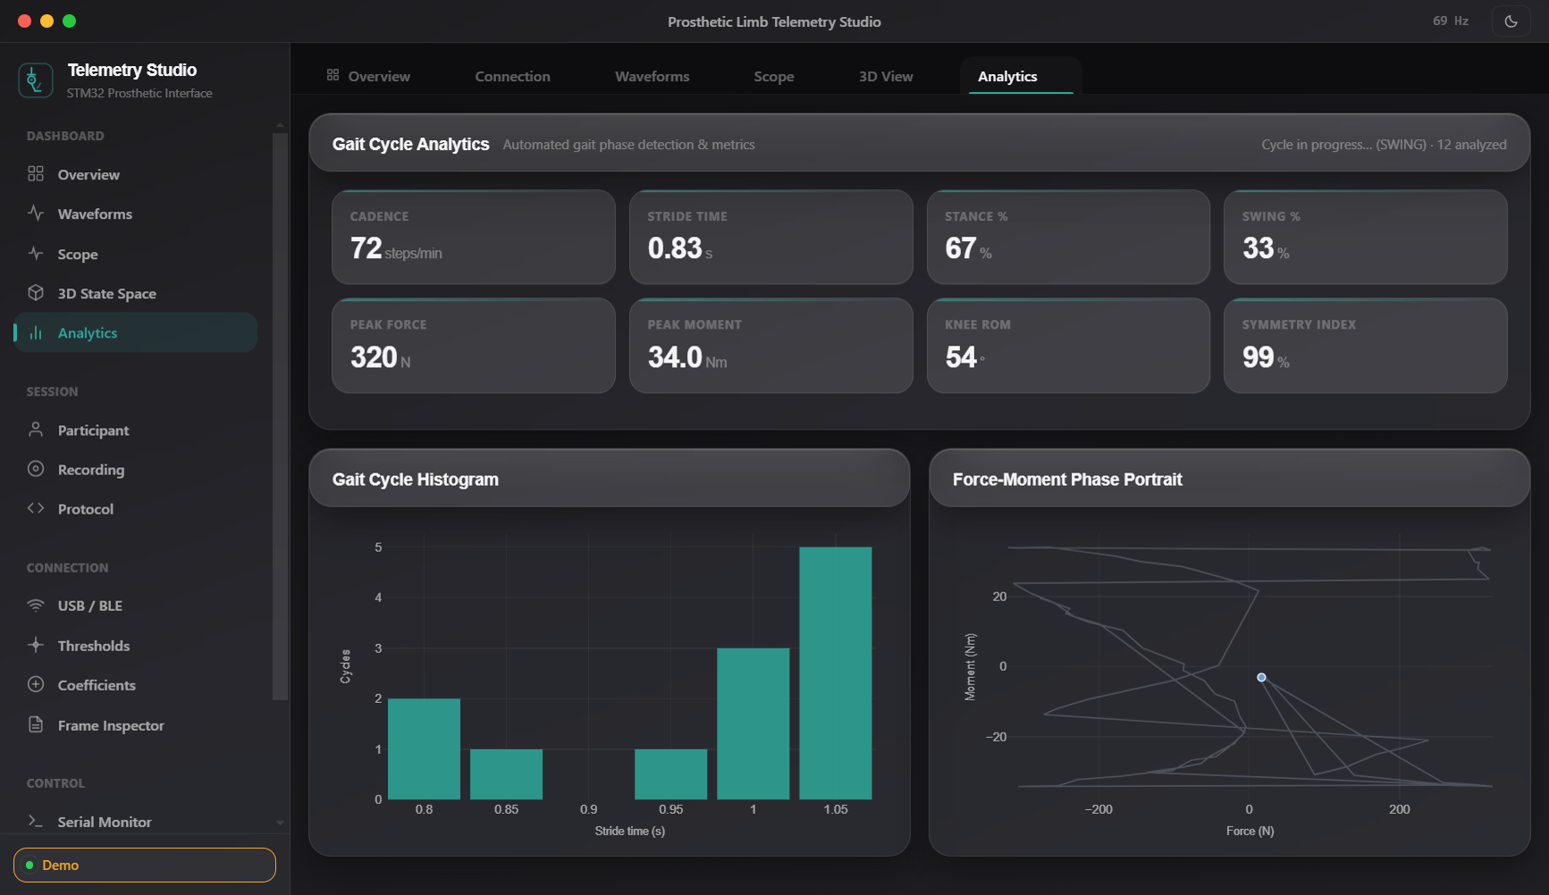
DESKTOP STUDIO TAB 5
GUI Provision: Clinical Gait Analytics & Metrics
Automated stride segmentation, cadence computation, and symmetry analysis
14
Automated Clinical Metrics
▶ Cadence & Stride Time
Calculates steps per minute (steps/min) and individual stride duration with 0.3s–3.5s sanity gating.
▶ Stance / Swing Ratio
Computes the exact physiological percentage of ground contact vs aerial swing.
▶ Peak Force & Knee ROM
Tracks maximum loading force (N) and joint Range of Motion (ROM in degrees).
▶ Symmetry Index & Histogram
Provides quantitative symmetry scoring between limbs and shows stride time distribution histograms.

Slide 15
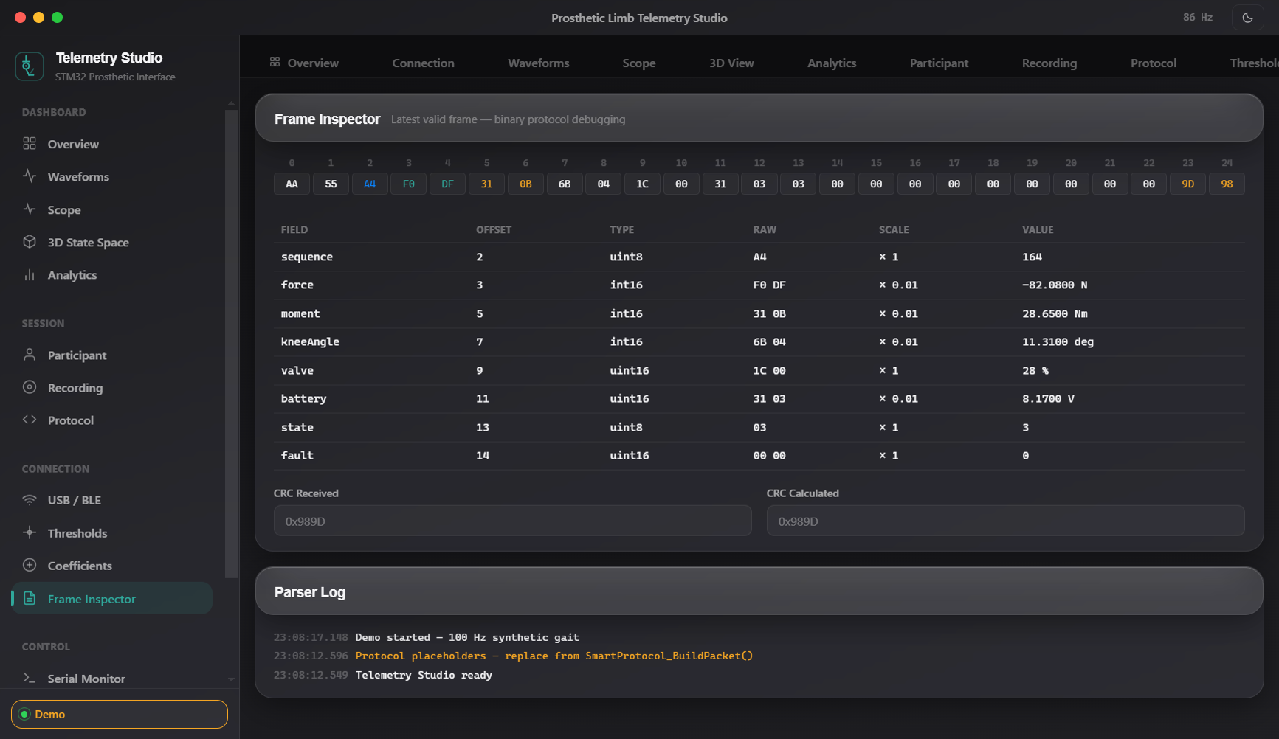
DESKTOP STUDIO TAB 6
GUI Provision: Protocol & Frame Inspector
Low-level binary telemetry debugging with color-coded hex grid and CRC validation
15
Engineering Protocol Tools
▶ Color-Coded Hex Grid
Displays the live 25-byte binary frame with distinct color highlights for header, sensors, state, faults, and CRC.
▶ Decoded Fields Table
Tabulates every field with Byte Offset, Data Type, Raw Integer, Scale Multiplier, and Engineering Unit.
▶ Live CRC Verification
Displays received CRC vs calculated CRC in real time (e.g. 0xD7CB = 0xD7CB Match).
▶ Diagnostic Event Stream
Time-stamped info/warn/error logging stream for instant hardware protocol validation.

Slide 16
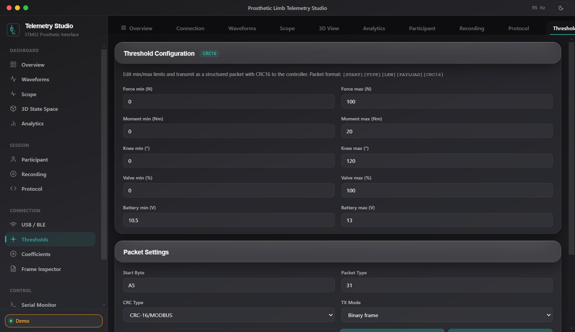
DESKTOP STUDIO TABS 7 & 8
GUI Provision: Threshold & Coefficient Calibration
In-situ sensor calibration and safety limit configuration with internal flash persistence
16
Calibration Features
▶ Safety Thresholds (0x31)
Configures individual upper/lower bounds for Force, Moment, Knee Angle, Valve, and Battery. Violations immediately trigger fault flags.
▶ Sensor Coefficients (0x32)
Allows setting Scale, Zero-Offset, and VREF parameters for each sensor without recompiling firmware.
▶ Protected Write Workflow
Requires clinician password -> auto-halts telemetry -> programs STM32 Flash Bank 2 -> auto-resumes.
▶ Calibration Check Tool
Interactive test tool verifies calibrated sensor outputs against physical zero-load baselines.

Slide 17
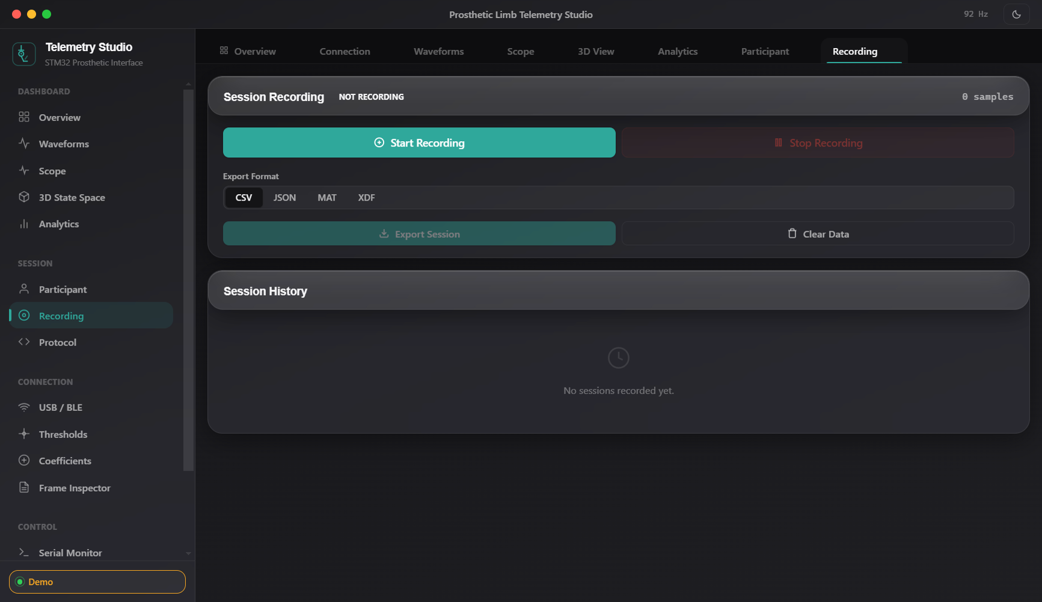
DESKTOP STUDIO TABS 9 & 10
GUI Provision: Clinical Session Recording & Metadata
HIPAA-compliant local session capture with patient demographics and CSV/JSON export
17
Data Logging Provisions
▶ Session Recording Controls
One-click Start, Pause, and Stop recording with live sample counter and elapsed timer.
▶ Clinical Metadata Form
Captures Subject ID, Amputation Side (Left/Right), Socket Type, Knee Mechanism, and Clinician Notes.
▶ Native File Dialog Export
Exports complete synchronized 100 Hz sessions into standard CSV (Excel/MATLAB) or JSON formats.
▶ 100% Local Privacy
Zero cloud dependencies or external transmissions; strictly complies with medical privacy regulations.

Slide 18
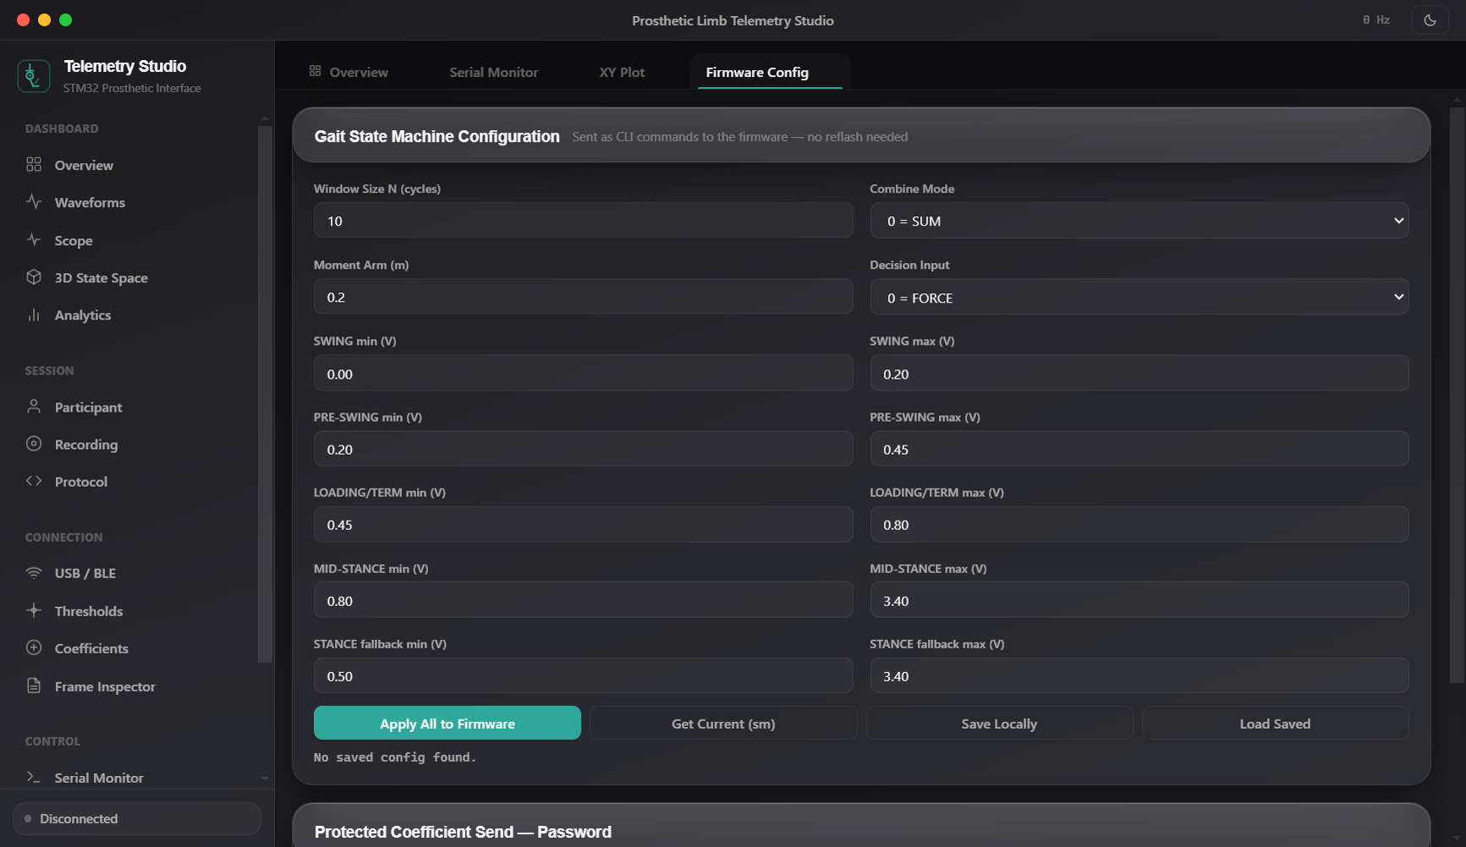
DESKTOP STUDIO TABS 11 & 12
GUI Provision: Live Firmware Tuning & Serial Terminal
Real-time gait parameter adjustment via CLI and integrated developer console
18
Live Tuning Engine
▶ Zero-Reflash Gait Tuning
Sliders and input boxes directly adjust gait window size, moment arm, combine modes, and all phase thresholds live.
▶ Command Pipeline
Generates and issues corresponding firmware CLI strings ('set cycles 10', 'set arm 0.20', etc.) seamlessly in the background.
▶ Interactive Serial Monitor
ASCII and Hex terminal with pause, clear, autoscroll, and customizable quick-command shortcut buttons.
▶ Custom XY Plotting
Scatter / trajectory plotting allowing arbitrary field mapping (e.g. Force vs Knee Angle).

Slide 19
WORK PROGRESS REPORT
Engineering Progress: Firmware Rounds & Software Releases
Chronological development milestones leading to current stable v1.3.0 stack
19
Firmware Evolution (STM32U585)
Desktop Studio Evolution (Electron)
• 06 Aug 2026 — Round 1 (Boot HardFault Resolution):
Fixed GPDMA1 IRQ enable sequence; moved interrupt configuration after handle initialization; resolved startup hangs.
• 06 Aug 2026 — Round 2 (100 Hz Streaming & Slave Comm):
Implemented 100 Hz telemetry timer; built USART3 slave link with median-of-3 filter and freshness gating.
• 09 Aug 2026 — Robustness (TX Double-Buffering):
Introduced private DMA TX buffer to eliminate race conditions; non-fatal polling timeout guards on ADC init.
• 11 Aug 2026 — Acquisition Fixed (DMNGT=10 Breakthrough):
Configured CFGR1 continuous DMA transfer requests; verified live multichannel ADC data on physical hardware.
• 15 Aug 2026 — MODE_REAL (Live Boot Stream & Pin Alignment):
Set live telemetry stream as boot default; aligned PC0, PC2, and PC4 pin mappings to physical sensors.
• 07–08 Sep 2026 — Security (AES-256-GCM & Bitmask Faults):
Integrated hardware-accelerated AES-GCM encryption with 8-byte tag; added 16-bit bitmask fault reporting.
• 24 Jul 2026 — Studio v1.0.0 (Initial Release):
Core Electron application with serial port connectivity, real-time waveform plotting, 3D state space, and basic gait analytics.
• 07 Sep 2026 — Studio v1.1.0 (Crypto UI & About Panel):
Added AES-256 session setup tab, PSK configuration, and About dialog containing architecture diagrams.
• 10 Sep 2026 — Studio v1.2.0 (One-Click Auto-Setup):
Streamlined encryption workflow; auto-generates 256-bit keys and synchronizes device nonces with a single click.
• 10 Sep 2026 — Studio v1.2.1 (Encrypted Stream Resync):
Added resilient frame re-synchronization guards for noisy serial channels during encrypted sessions.
• Current — Studio v1.3.0 (Scope, XY Plot & Live Tuning):
Added PedoGraph-style hardware oscilloscope, scatter XY plotting, and dynamic firmware gait tuning console.

Slide 20
WORK PROGRESS REPORT
Verification Status Matrix & Hardware Readiness
Detailed assessment of component completeness and testing status
20
Subsystem Component | Implemented Capability | Completion Status | Verification Method
ADC / DMA Pipeline | 12-bit 3-channel scan @ ~2,778 blocks/s with 51-tap FIR | Complete | Hardware Verified (Live)
100 Hz Telemetry Stream | 25-byte fixed frame with CRC-16/MODBUS @ 115200 baud | Complete | Hardware Verified (Live)
Gait State Machine | 6-phase clinical detection with mid_seen sequence logic | Complete | Simulated & Bench Pending
Slave Motor Link | 7-byte USART3 comms with median filter & freshness gate | Complete | Hardware Verified (R2)
Fault Bitmask Diagnostics | 16-bit register tracking limits, stuck ADC, and flatlines | Complete | Firmware Verified
Calibration & Flash Bank 2 | 0x31/0x32 packets with flash persistence across boot | Complete | Simulated & Bench Partial
AES-256-GCM Encryption | Hardware AES with SW fallback; 31-byte v2 encrypted frame | Complete | OpenSSL Host Vectors Pass
Studio Transports | Multi-mode: SerialPort COM, Web Serial API, Web Bluetooth | Complete | Functionally Tested
Studio GUI (16 Tabs) | Real-time charts, 3D WebGL, scope, inspector, recorder | Complete | Captured & Verified
Session Recording & Export | Full 100 Hz session logging with CSV/JSON local export | Complete | Functionally Tested

Slide 21
WORK PROGRESS REPORT
Findings, Discrepancies & Recommended Next Steps
Critical observations identified during codebase audit and actionable recommendations
21
⚠️ Codebase Findings & Documentation Discrepancies
🎯 Actionable Next Steps & Roadmap
• UART Pin Assignment Drift:
Older markdown documents refer to USART2 on PD5/PD6. The actual working and hardware-verified code strictly uses USART3 on PD8 (TX) and PD9 (RX).
• ADC Clock Frequency:
Changelogs mention a 16 MHz ADC clock; actual register configuration correctly clocks ADC1 from 4 MHz MSI (MSIC) for maximum SNR and precision.
• Fault Bitmask Width:
Earlier GUI drafts treated faults as an 8-bit integer. The active firmware and Studio v1.3.0 properly use a 16-bit bitmask at Byte offset 14.
• Battery Voltage Scale:
Default Studio thresholds were set for 12V lead-acid batteries (10.5V–13V). Firmware uses a 4.2V Li-ion battery divider (0–4.2V scale). Needs threshold preset alignment.
• Automated Testing Gap:
No automated CI/CD pipeline or unit test harness currently exists; verification has been carried out via manual bench flashing.
▶ 1. Align Default Thresholds
Update default presets in Studio's constants.js to reflect the 4.2V Li-ion battery scale (Min: 3.3V, Max: 4.2V).
▶ 2. Documentation Reconciliation
Update legacy documentation to reflect USART3 (PD8/PD9) and remove references to obsolete USART2 pinouts.
▶ 3. Host-Based Unit Test Harness
Create a Python or Node-based simulated test harness to test CRC-16, frame decoding, and fault bits on every commit.
▶ 4. Automated CI/CD Pipeline
Implement GitHub Actions / local CI script to run arm-none-eabi-gcc headless build and static analysis on code commits.
▶ 5. End-to-End Bench Crypto Closure
Conduct final acceptance test of AES-256-GCM encryption with physical STM32 hardware and log results in CRYPTO_BENCH.md.
▶ 6. Clinical User Testing
Deploy Studio v1.3.0 on clinician tablets for user-acceptance testing during live prosthetic gait trials.

Slide 22
CONCLUSION & READINESS
A Complete, Verified Biomechanical Telemetry Stack
1. Solid Embedded Foundation: The STM32U585 firmware features an ultra-reliable DMA acquisition pipeline, 51-tap FIR filtering, non-blocking telemetry transmission, and runtime-configurable clinical gait detection.
2. Comprehensive Front-End Suite: Prosthetic Telemetry Studio v1.3.0 provides 16 rich visual tabs — ranging from high-frequency oscilloscopes and 3D state-space trajectories to automated cadence analytics and flash calibration.
3. Security & Safety Built-In: Real-time 16-bit fault detection guards against mechanical and electrical failures, while opt-in hardware-accelerated AES-256-GCM ensures HIPAA-grade confidentiality on wireless links.
4. Ready for Next-Stage Trials: All core subsystems are implemented, verified on real hardware, and documented. Remaining tasks (threshold presets and automated CI) are minor operational refinements, with zero architectural blockers.
Thank you. Open for Questions & Demonstrations.

