Slide 1
PROJECT 9 · PHASE 1
Indoor Location Prediction
Using Wi-Fi Signals
Team T084 | Section D
Gauri Mehrotra
Ansh
Agnik Misra
Kartikey Gupta
Lokendra Singh
2401010170
2401010077
2401010044
2401010214
2401010254
Newton School of Technology, Rishihood University
T084 | Phase 1
1 / 11
Notes:
Presenter: Gauri Mehrotra (about 0.5 min)
- Hello, we are Team T084, Section D. Our project: indoor location prediction using Wi-Fi signals.
- I am Gauri Mehrotra; after me come Ansh, Agnik Misra, Kartikey Gupta and Lokendra Singh.
- This is Phase 1, where we use classical machine learning.

Slide 2
02 · THE PROBLEM · GAURI MEHROTRA
Where is this phone indoors?
• GPS works poorly indoors: walls and roofs weaken satellite signals
• Wi-Fi is in most buildings; a phone hears many WAPs (access points)
• One scan = the signal strength (RSSI, in dBm) of every WAP
• Building and floor: classification; (x, y) position: regression
Wi-Fi scan
Model
Answer
RSSI of 520 WAPs, most of them “not heard”
kNN, Random Forest or XGBoost
building · floor · (x, y) position
Data: UJIIndoorLoc (UCI): 3 buildings, 19,937 training scans, 1,111 test scans
T084 | Phase 1
2 / 11
Notes:
Presenter: Gauri Mehrotra (about 1 min)
- GPS works poorly indoors because walls and roofs weaken the satellite signals.
- A phone measures how strongly it hears each Wi-Fi access point (WAP), in dBm; closer to 0 is stronger. That list of readings is one scan.
- From one scan we predict building and floor (classification) and the (x, y) position (regression).

Slide 3
03 · RELATED WORK · GAURI MEHROTRA
What others did, and the gap
Work | What they did
RADAR (2000) | Match a new scan to the closest stored fingerprints
UJIIndoorLoc (2014, 2015) | Public multi-building dataset; kNN with many distances
Classifier comparison (2015) | kNN best; bagged or boosted trees close behind
Neural networks (2017–2019) | Autoencoder, one shared network, CNN on UJIIndoorLoc
Gap 1 · Random splits look too good
Gap 2 · Our tasks are learned separately
One network: 98.2% building-and-floor accuracy on a random split, 91.1% on the later test file
Our three task models share nothing; Kim et al. (2018) trained one shared network on UJIIndoorLoc
Sources: Bahl & Padmanabhan 2000; Torres-Sospedra et al. 2014, 2015; Bozkurt et al. 2015; Nowicki & Wietrzykowski 2017; Kim et al. 2018; Song et al. 2019
T084 | Phase 1
3 / 11
Notes:
Presenter: Gauri Mehrotra (about 1 min)
- RADAR (2000), the classic method, answers with the closest stored scans: the idea behind kNN.
- UJIIndoorLoc gave a public benchmark and a kNN study; a classifier comparison found kNN best, with trees close behind; later work used neural networks.
- Two gaps: random splits look too good (98.2% against 91.1% in one study), and our three task models share nothing, while one shared network has been shown to work on this data (Kim et al., 2018).

Slide 4
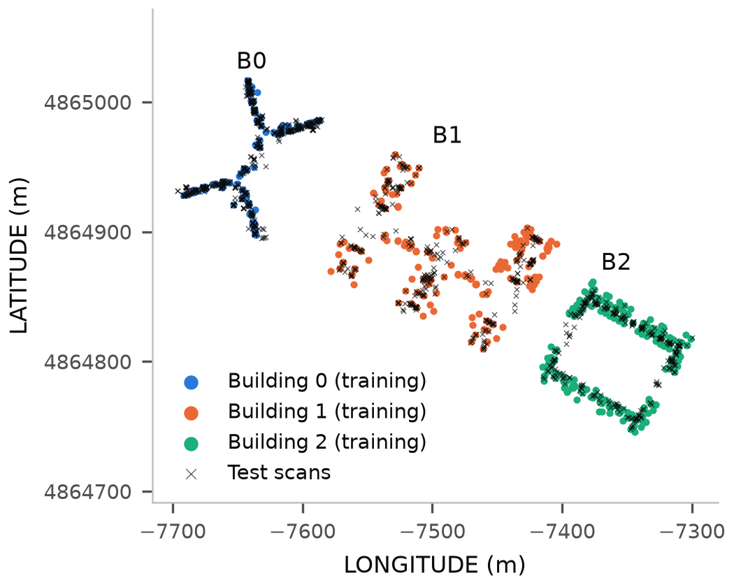
04 · THE DATA · ANSH
The data: UJIIndoorLoc
 | Training | Test set
Scans | 18,719 (cleaned) | 1,111
Phones | 16 | 11 (9 new)
Recorded | May–Jun 2013 | Sep–Oct 2013
• 3 buildings, 13 building-floor classes
• 520 WAPs; a scan hears 17.8 on average
• 96.6% of training readings: “not heard”
• 64.3% of test scans from new phones
Test set = the UCI file validationData.csv
Web-Mercator meters: 1 m ≈ 0.77 m on the ground
T084 | Phase 1
4 / 11
Notes:
Presenter: Ansh (about 1 min)
- The map: colored dots are training positions, crosses are test scans.
- A scan hears only 17.8 of the 520 WAPs on average; the file codes “not heard” as 100, and we use −110 dBm instead, weaker than any real reading.
- The test set, validationData.csv, was recorded months later, mostly with new phones: a realistic exam. One data meter is about 0.77 m on the ground.

Slide 5
05 · CLEANING AND CV · ANSH
Cleaning and a fair split
1 · Cleaning (training file only)
2 · A fair split: user-group cross-validation (CV)
Rule | Removed
No WAP heard | 76
Exact duplicate | 634
Reading of −30 dBm or stronger | 508
• 5 folds; each holds out whole users with their phones
• Shared phone = one group: 18 users → 16 groups
Baseline RF | Building | Floor | Mean 2D error
Random CV | 100.0% | 99.9% | 3.67 m
User-group CV | 99.7% | 78.0% | 15.87 m
Test set | 99.8% | 91.2% | 12.52 m
19,937 → 18,719 scans
• The test set is never cleaned
• Kept: the 464 WAPs heard in training
Random CV promises 3.67 m; the test set gives 12.52 m
T084 | Phase 1
5 / 11
Notes:
Presenter: Ansh (about 1.5 min)
- Three fixed rules clean the training file only: 19,937 scans become 18,719; the test set stays as is.
- Cross-validation (CV): split the training scans into 5 parts (folds), train on 4, test on the 5th, five times. User-group CV: each fold holds out whole users and their phones, like the new test phones.
- Random CV is too optimistic: one person scanned each spot many times, so near-copies land on both sides of a split. It promises 3.67 m; the test set gives 12.52 m. User-group CV (15.87 m) errs on the safe side.

Slide 6
06 · FEATURES · AGNIK MISRA
Features: from a scan to location clues
RSSI · 464 columns
Signal statistics · 3 columns
Signal strength of each WAP heard in training; not heard = −110 dBm
WAPs heard, strongest reading, mean of the heard readings
AP-affinity (our idea) · 8 columns
1 · Learn where each WAP is
2 · Average the profiles
3 · Add the strongest WAP
From the training scans that hear it: building, floor, location
Of the WAPs the scan hears; stronger readings count more
Learned location of the strongest known WAP the scan hears
AP-affinity is learned from training scans only, again inside every CV fold, so held-out scans never shape their own features.
T084 | Phase 1
6 / 11
Notes:
Presenter: Agnik Misra (about 1.5 min)
- RSSI: one column per WAP heard in training; signal statistics: WAPs heard, strongest and mean reading.
- AP-affinity, our idea: every WAP heard in at least 5 training scans gets a profile (building shares, mean floor, mean location), learned from the scans that hear it; stronger readings count more.
- A scan gets the weighted average of its WAPs' profiles plus the location of its strongest known WAP (one with a profile): 8 columns, learned inside every CV fold.

Slide 7
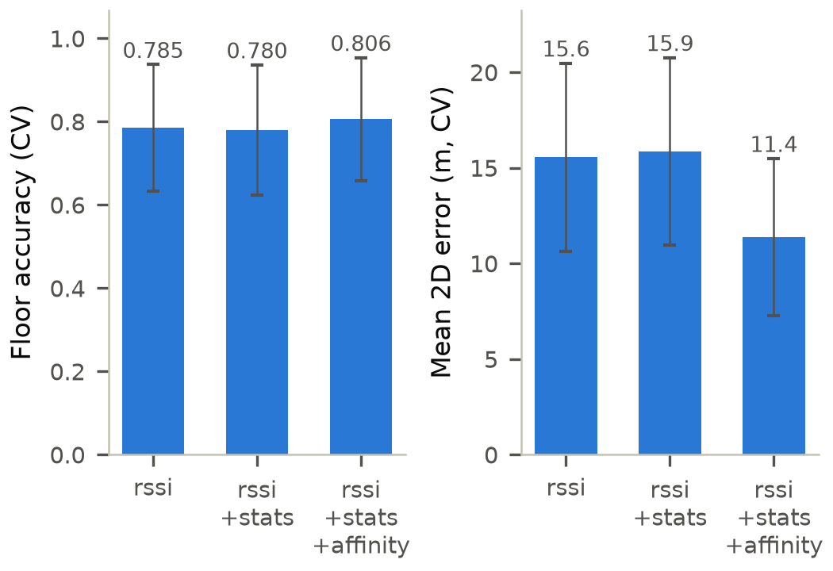
07 · FEATURE CHECK · AGNIK MISRA
Feature check: AP-affinity helps
Baseline RF settings · user-group CV
Adding AP-affinity
15.87 → 11.38 m
CV mean 2D error, 28.3% lower; floor accuracy 78.0% → 80.6%
Adding signal statistics
15.55 → 15.87 m
No gain: CV mean 2D error slightly higher; floor accuracy 78.5% → 78.0%
Alone, no model: 99.9% building, 14.20 m (test)
T084 | Phase 1
7 / 11
Notes:
Presenter: Agnik Misra (about 1 min)
- Same Baseline RF settings; only the feature set changes; scored with user-group CV.
- AP-affinity: CV error 15.87 m → 11.38 m (28.3% lower), floors 78.0% → 80.6%.
- Honestly, the signal statistics did not help: CV error 15.55 m → 15.87 m, floors 78.5% → 78.0%.
- We still keep them: the three sets are nested and the full set scored best (we did not test rssi plus AP-affinity alone).
- Even alone, with no model, AP-affinity gets 99.9% of test buildings right and a 14.20 m mean 2D error (notebook 02).

Slide 8
08 · MODELS AND TUNING · KARTIKEY GUPTA
Four models, tuned fairly
Model | Features | Tuned with user-group CV | Settings tried
Baseline RF | rssi + stats | nothing: 300 trees, default settings | 1
kNN | rssi | k, weights, distance | 28
Random Forest | rssi + stats + affinity | features per split, leaf size | 6
XGBoost | rssi + stats + affinity | tree depth, number of trees | 6
• Three separate models per method: building, floor and position
• Small grids; each task keeps its own best CV setting
Final-model rule, fixed before testing: lowest CV mean 2D error
Random Forest 11.09 m · XGBoost 11.25 m · kNN 12.75 m → final model: Random Forest
T084 | Phase 1
8 / 11
Notes:
Presenter: Kartikey Gupta (about 1.5 min)
- Each method has three separate models: building, floor and position.
- kNN copies the most similar training scans; Random Forest averages many trees; XGBoost adds trees that fix earlier errors. Baseline RF is a Random Forest with default settings.
- Small grids, scored with the same user-group CV; each task keeps its best setting. The rule fixed before testing picked Random Forest (11.09 m).

Slide 9
09 · RESULTS · KARTIKEY GUPTA
Test set results (1,111 scans, used once)
Model | Building | Floor | Mean 2D error | Median 2D error
Baseline RF | 99.8% | 91.2% | 12.52 m | 7.70 m
kNN | 99.8% | 87.5% | 9.22 m | 5.88 m
Random Forest (final model) | 100.0% | 92.2% | 7.42 m | 5.34 m
XGBoost | 100.0% | 95.2% | 7.86 m | 6.19 m
Random Forest, picked before testing, has the lowest error: 7.42 m (Baseline RF 12.52 m). XGBoost gets the most floors right: 95.2%.
Mean 2D error: straight-line distance between predicted and true position
T084 | Phase 1
9 / 11
Notes:
Presenter: Kartikey Gupta (about 1 min)
- The test set is used once: 1,111 scans.
- Random Forest has the lowest mean 2D error, the average straight-line distance to the true position: 7.42 m vs 12.52 m for the Baseline RF.
- XGBoost gets the most floors right (95.2%), so no model is best at every task.

Slide 10
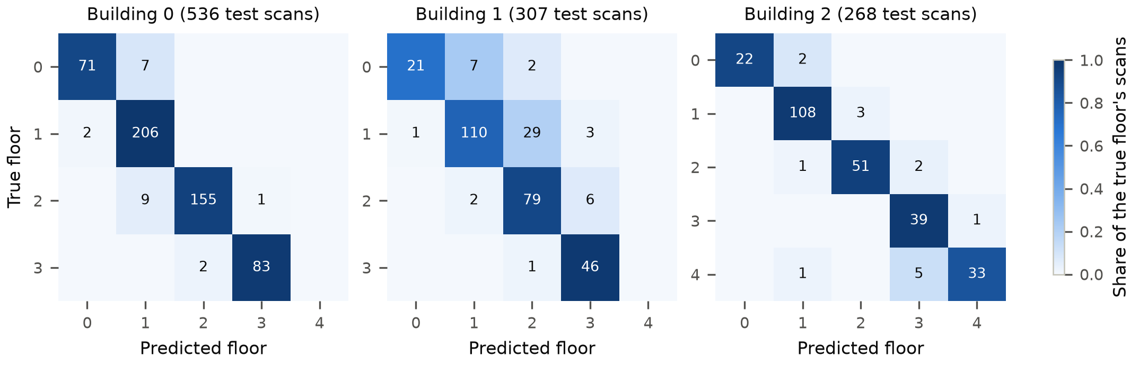
10 · ERROR ANALYSIS · LOKENDRA SINGH
Where the errors are
Case (Random Forest, test set) | Share of scans | Mean 2D error | Share of error
Building wrong | 0.0% | – | 0.0%
Building right, floor wrong | 7.8% | 13.06 m | 13.8%
Both right | 92.2% | 6.94 m | 86.2%
81 of 87
floor mistakes are one floor off
8.30 m
on new phones; 5.84 m on seen phones
T084 | Phase 1
10 / 11
Notes:
Presenter: Lokendra Singh (about 1 min)
- The building is never wrong; a wrong floor costs more (13.06 m), but only 7.8% of scans have one.
- 86.2% of the error is on scans with building and floor right: fine position is the main problem.
- 81 of the 87 floor mistakes are one floor off; new phones are harder (8.30 m vs 5.84 m).

Slide 11
11 · PHASE 2 GAP · LOKENDRA SINGH
What Phase 1 showed, and Phase 2
What Phase 1 showed
Wi-Fi scan
• AP-affinity helped most: CV error 15.87 → 11.38 m
• No single best model: Random Forest for position, XGBoost for floors
• 86.2% of the error is on scans with building and floor right
Shared layers (learned together)
The gap: our three task models share nothing.
AP-affinity shares location knowledge between them, but only by hand.
Building
Floor
Position
Phase 2: one multi-task neural network, with the same split, test set and metrics, compared with Phase 1
Thank you!
T084 | Phase 1
11 / 11
Notes:
Presenter: Lokendra Singh (about 1 min)
- Phase 1 showed: AP-affinity helped most, no model wins every task, and most error is fine position.
- The gap: the three task models share nothing; AP-affinity shares location knowledge only by hand.
- Phase 2: one multi-task network, shared layers and three heads; same split, test set and metrics; compared with Phase 1. Thank you.

