Slide 1


A Scheduler for Efficiently Sharing GPU Clusters for Deep Learning Workloads
Deepak Narayanan *, Keshav Santhanam *, Amar Phanishayee §, Matei Zaharia *
* Stanford University § Microsoft Research

Slide 2
DL training is important…

Slide 3
DL training is important…but GPUs are expensive!
Common solution to reduce cost = Multi-tenant GPU clusters
Often have GPUs of different types (e.g., V100s, P100s, Titan 1080 Tis)
Use a FIFO scheduler
Users request a fixed number of GPUs of a particular type
Applications in queues until resources are available, and then granted exclusive access to resources
Applications locked into their resource choice

Slide 4
Challenge: GPUs often poorly utilized!
High Queuing Delay: Jobs stuck in queues on the scheduler waiting for requested resources to become available
Multi-tenant GPU Clusters for Deep Learning Workloads: Analysis and Implications, Jeon et al.

Slide 5
Challenge: GPUs often poorly utilized!
High Queuing Delay: Jobs stuck in queues on the scheduler waiting for requested resources to become available
Poor GPU Utilization: Even once scheduled, throughput much lower than peak device throughput
Multi-tenant GPU Clusters for Deep Learning Workloads: Analysis and Implications, Jeon et al.

Slide 6
Solution: Time- and Space- sharing of GPU resources
Leverage the fact that DL training is iterative!
Time-sharing: Helps to reduce queuing delays and give every user a share of the cluster
Space-sharing: Packs multiple applications onto the same GPU, helping to improve GPU utilization
Not easy to determine how to time-share, and which applications to space-share together

Slide 7
How to time-share?
K80 -> V100, NMT 1.47x faster
K80 -> V100, ResNet-50 4.23x faster
K80 -> V100, AlexNet 1.64x faster
K80 -> V100, LM 4.47x faster
Can run NMT and AlexNet on K80s with minimum penalty

Slide 8
How to space-share?
NMT + NMT = 1.84x
ResNet-50 + ResNet-50 = 1.04x
ResNet-50 + NMT = 1.6x

Slide 9
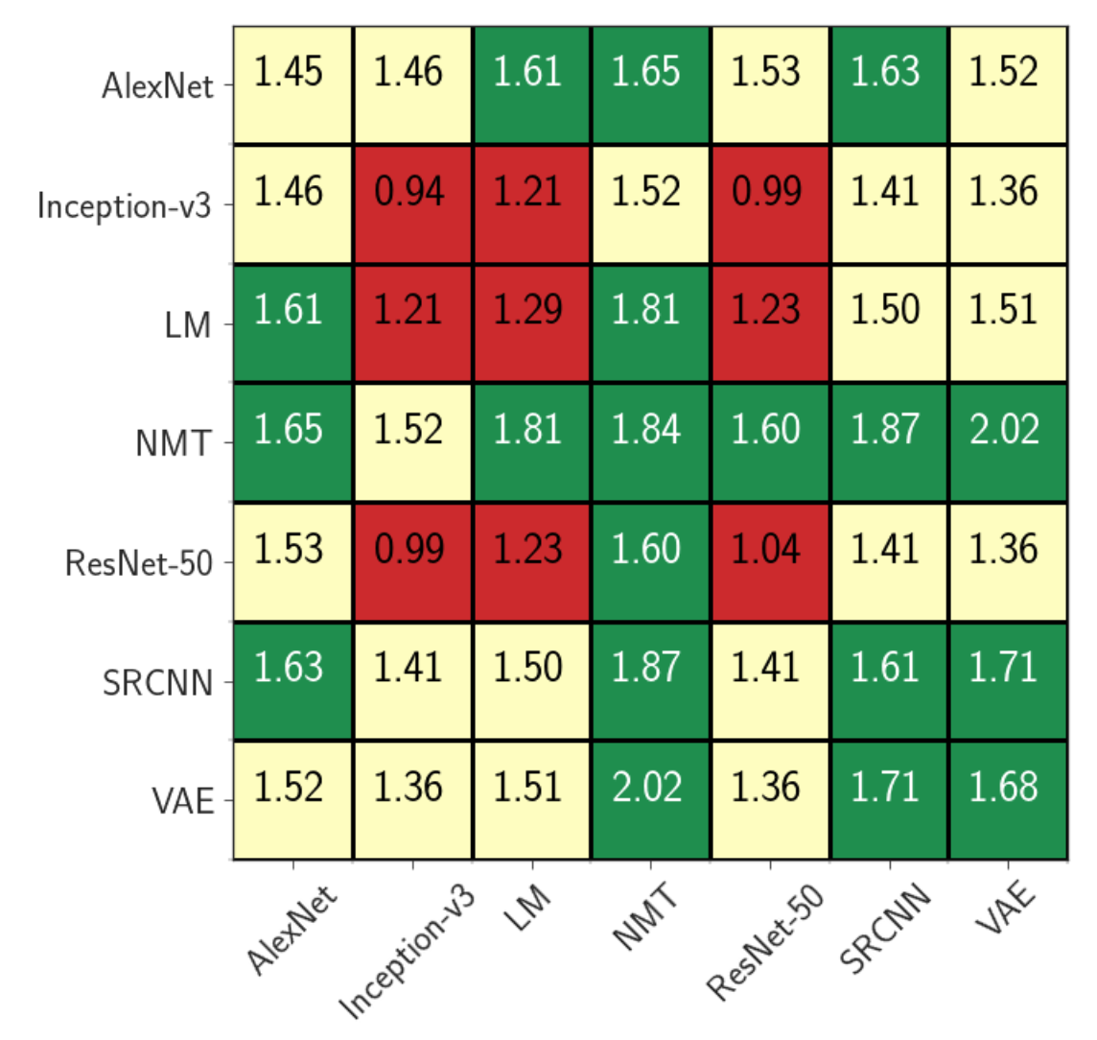
How to space-share?
Throughput increase from colocation shows wide variance from 1x to 2x

Slide 10
This talk: How do we time- and space- share in a principled way optimizing an admin-provided metric?

Slide 11



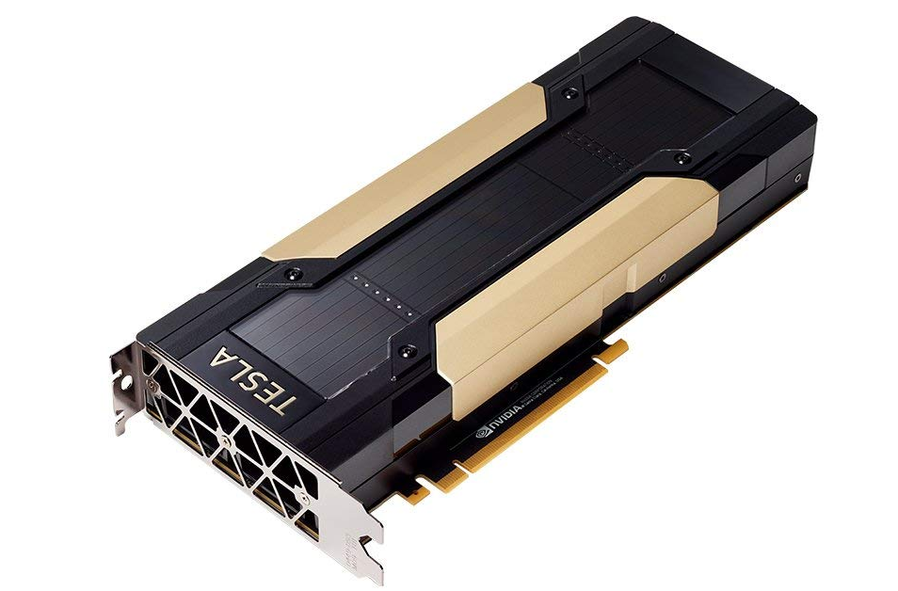
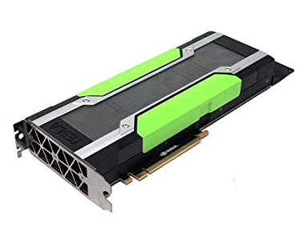
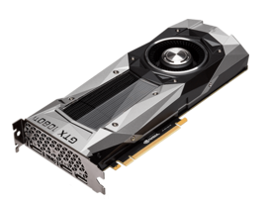
Applications written in existing frameworks
Profiler
The scheduler assigns applications to worker GPUs according to computed allocation
Performance
measurements
Policy
Allocation
{
resnet50: {v100: 200,
p100: 100},
nmt: {v100: 50,
p100: 50},
resnet50 + nmt: {}
}
{
resnet50: {v100: 0.2,
p100: 0.6},
nmt: {v100: 0.5,
p100: 0.2},
resnet50 + nmt: {}
}
Cluster of heterogeneous GPUs

Slide 12
Applications written in existing frameworks
Profiler
The scheduler assigns applications to worker GPUs according to computed allocation
Performance
measurements
Policy
Allocation
Cluster of heterogeneous GPUs

Slide 13
Supported Policies
Fairness: Maximize the minimum throughput across users / applications
Throughput: Maximize total throughput
Weighted Fairness: Maximize the minimum weighted throughput across users / applications

Slide 14
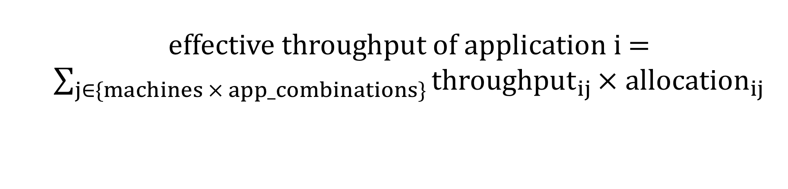
Policy 1: Fairness
$$\max{\min_{i}{ effective throughput of application i}}$$
effective throughput of application i = $\sum_{j∈\{machines × app_combinations\}}{{throughput}_{ij}}× allocation_{ij}$

Slide 15
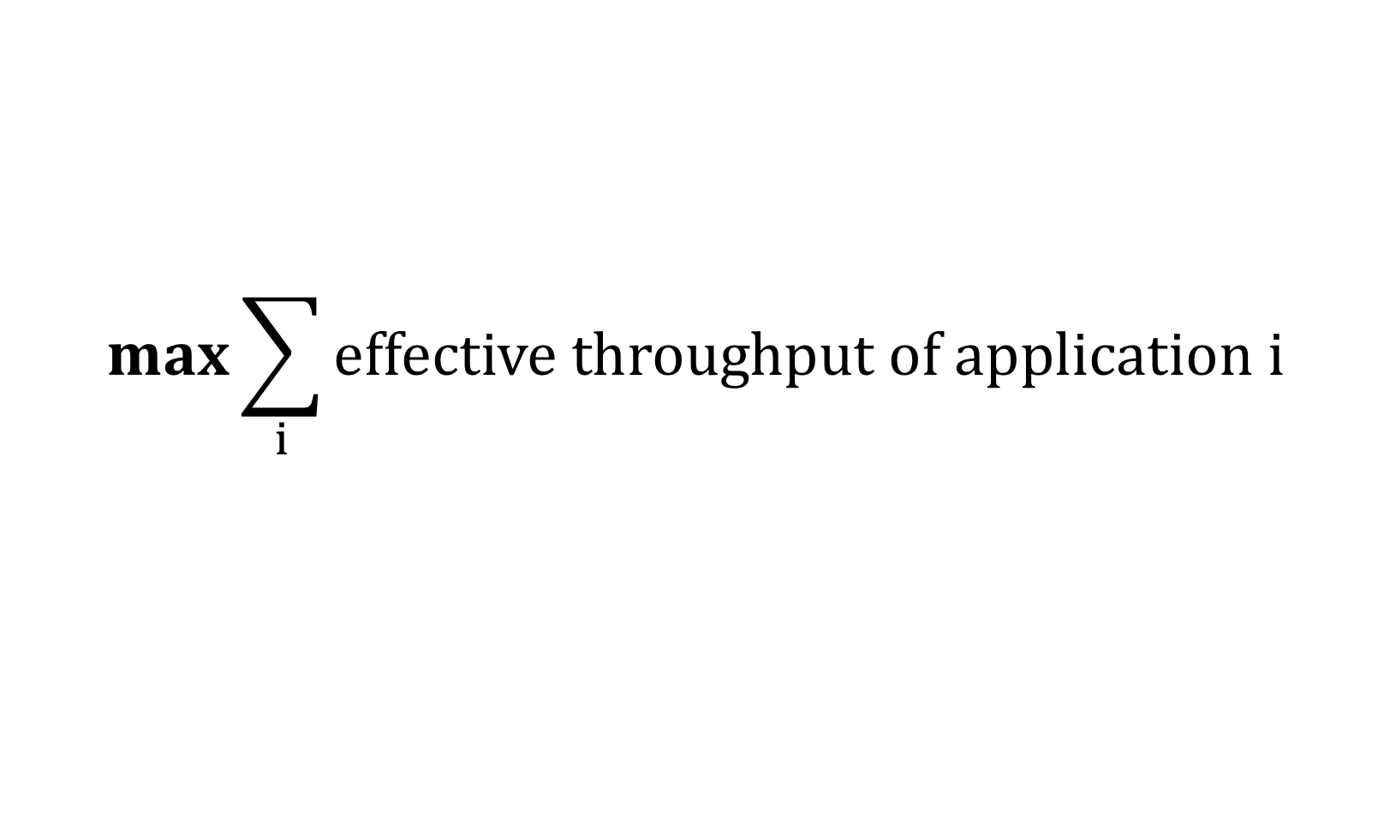
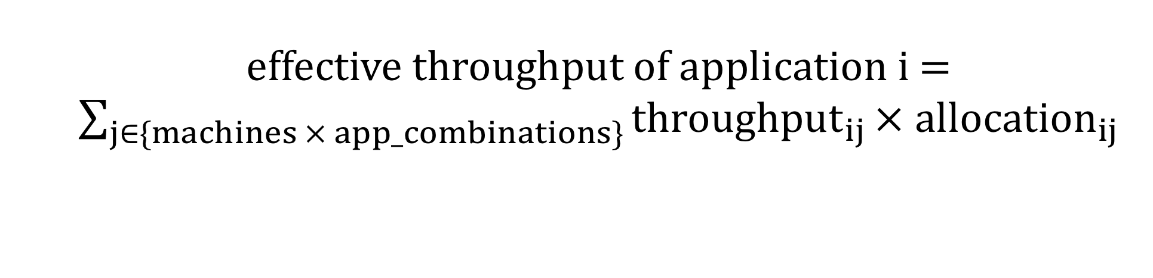
Policy 2: Throughput
$$\max{\sum_{i}{effective throughput of application i}}$$
effective throughput of application i = $\sum_{j∈\{machines × app_combinations\}}{{throughput}_{ij}}× allocation_{ij}$

Slide 16
Policy 3: Weighted Fairness
$$\max{\min_{i}{ effective throughput of application⋅w_{i}}}$$
effective throughput of application i = $\sum_{j∈\{machines × app_combinations\}}{{throughput}_{ij}}× allocation_{ij}$

Slide 17
Applications written in existing frameworks
Profiler
The scheduler assigns applications to worker GPUs according to computed allocation
Performance
measurements
Policy
Allocation
Cluster of heterogeneous GPUs

Slide 18
Time- and Space- Sharing in action
ResNet-50
Run for 100 seconds
{
resnet50: {v100: 0.2,
p100: 0.6},
nmt: {v100: 0.5,
p100: 0.2},
resnet50 + nmt: {v100: 0.1,
p100: 0.2},
}
P100
V100
1080Ti
NMT
P100
V100
V100
Allocation
Applications
Run for 300 seconds
Cluster

Slide 19
Time- and Space- Sharing in action
ResNet-50
Run for 50 seconds
{
resnet50: {v100: 0.2,
p100: 0.6},
nmt: {v100: 0.5,
p100: 0.2},
resnet50 + nmt: {v100: 0.1,
p100: 0.2},
}
P100
V100
1080Ti
NMT
P100
V100
V100
Allocation
Applications
Run for 100 seconds
Cluster

Slide 20
How does this do?

Slide 21
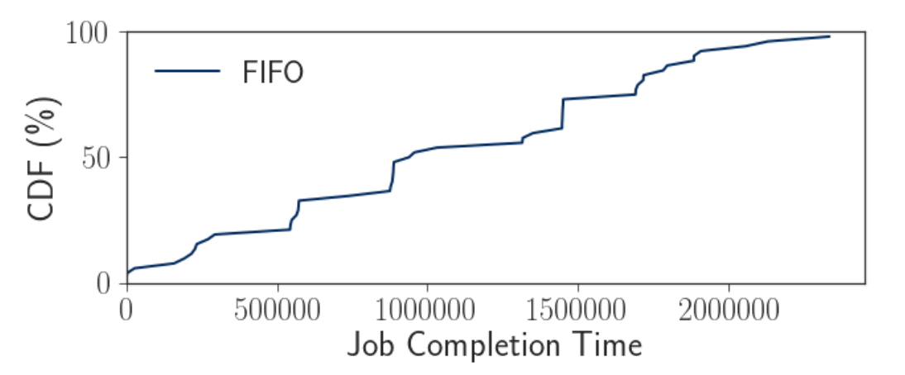
Fairness with packing reduces average job completion time

Slide 22
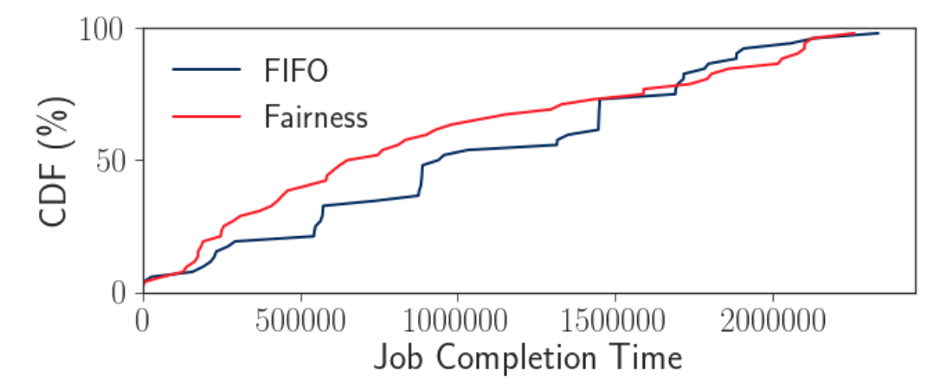
Fairness with packing reduces average job completion time
Fairness policy without packing reduces overall average JCT by 1.18x, compared to a FIFO scheduler

Slide 23
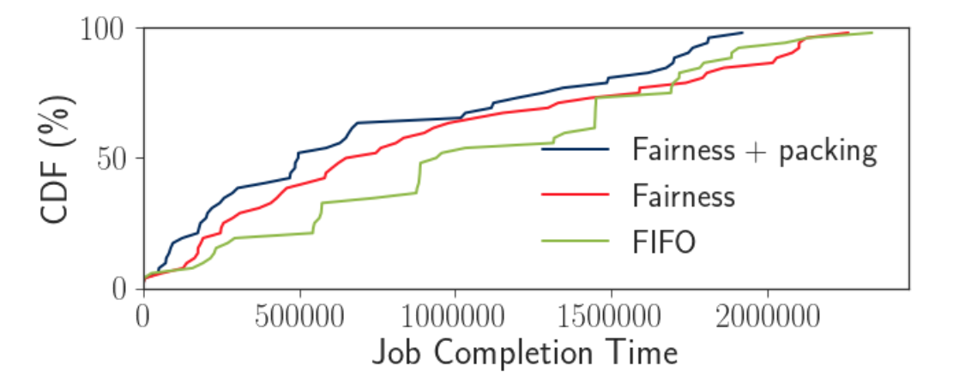
Fairness with packing reduces average job completion time
Fairness policy with packing reduces overall average JCT by 1.45x, compared to a FIFO scheduler

Slide 24
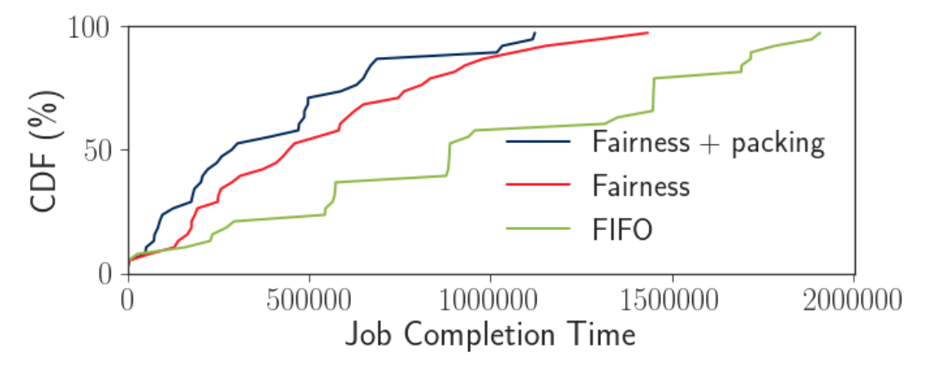
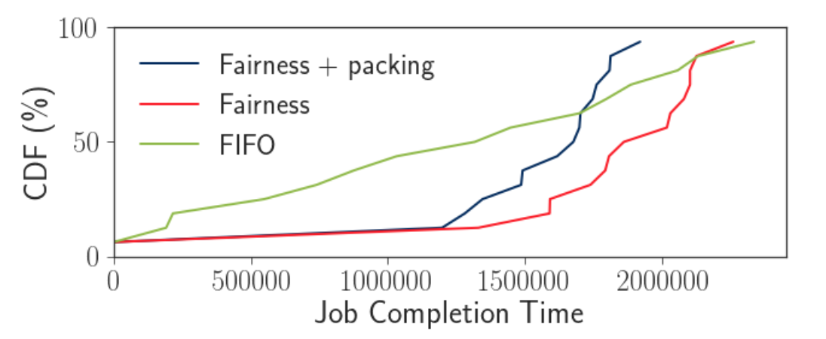
Fairness policy reduces queuing delay for short jobs
(a) Short Jobs
(b) Long Jobs
Fairness with packing decrease average JCT for short jobs by 2.47x

Slide 25
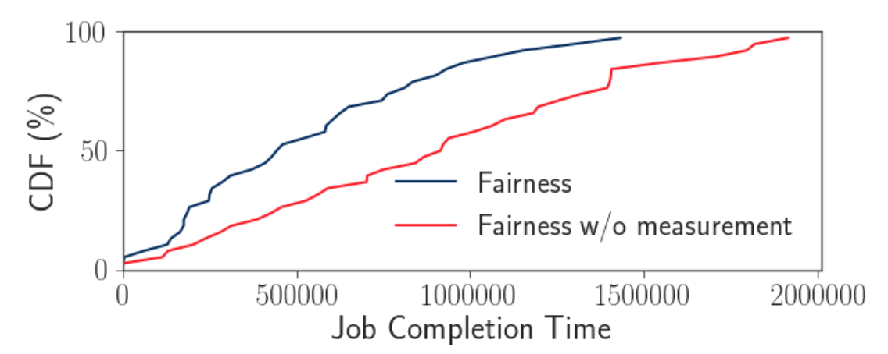
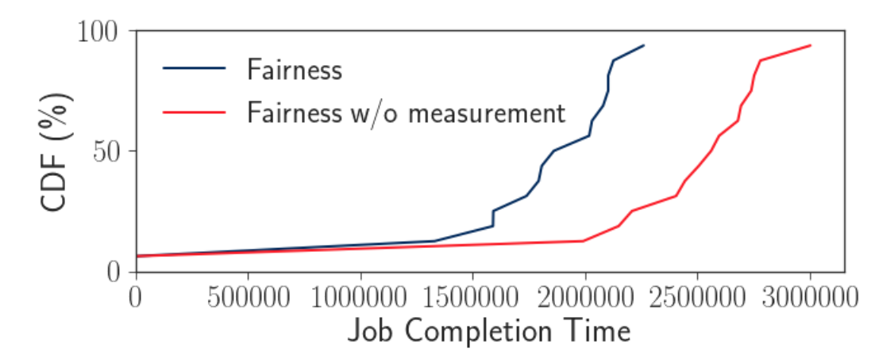
Fairness with and without knowledge of affinities
(a) Short Jobs
(b) Long Jobs
Throughput measurements help compute better performing fair policies, decreasing overall average JCT by 1.51x

Slide 26
Future Work
Application autoscaling: Scale applications up and down while keeping application semantics the same
Use more resources when available, and less resources when overloaded
Throughput measurement: Do we have to run all combinations of applications on all available hardware types?
Can we use techniques like tensor decomposition to predict throughputs from only a few bootstrapping measurements?

Slide 27



Conclusion
Multi-tenant clusters with heterogeneous GPUs pose a number of interesting challenges
Smart time- and space- sharing GPUs among many users can help reduce average job completion time by as much as 1.45x over a FIFO scheduler
deepakn@cs.stanford.edu
https://cs.stanford.edu/~deepakn/
@deepakn94

