Slide 1
A Scheduler for Efficiently Sharing GPU Clusters for Deep Learning Workloads
Deepak Narayanan, Keshav Santhanam,
Amar Phanishayee, Matei Zaharia

Slide 2
Deep learning is an increasingly important computational workload

Slide 3
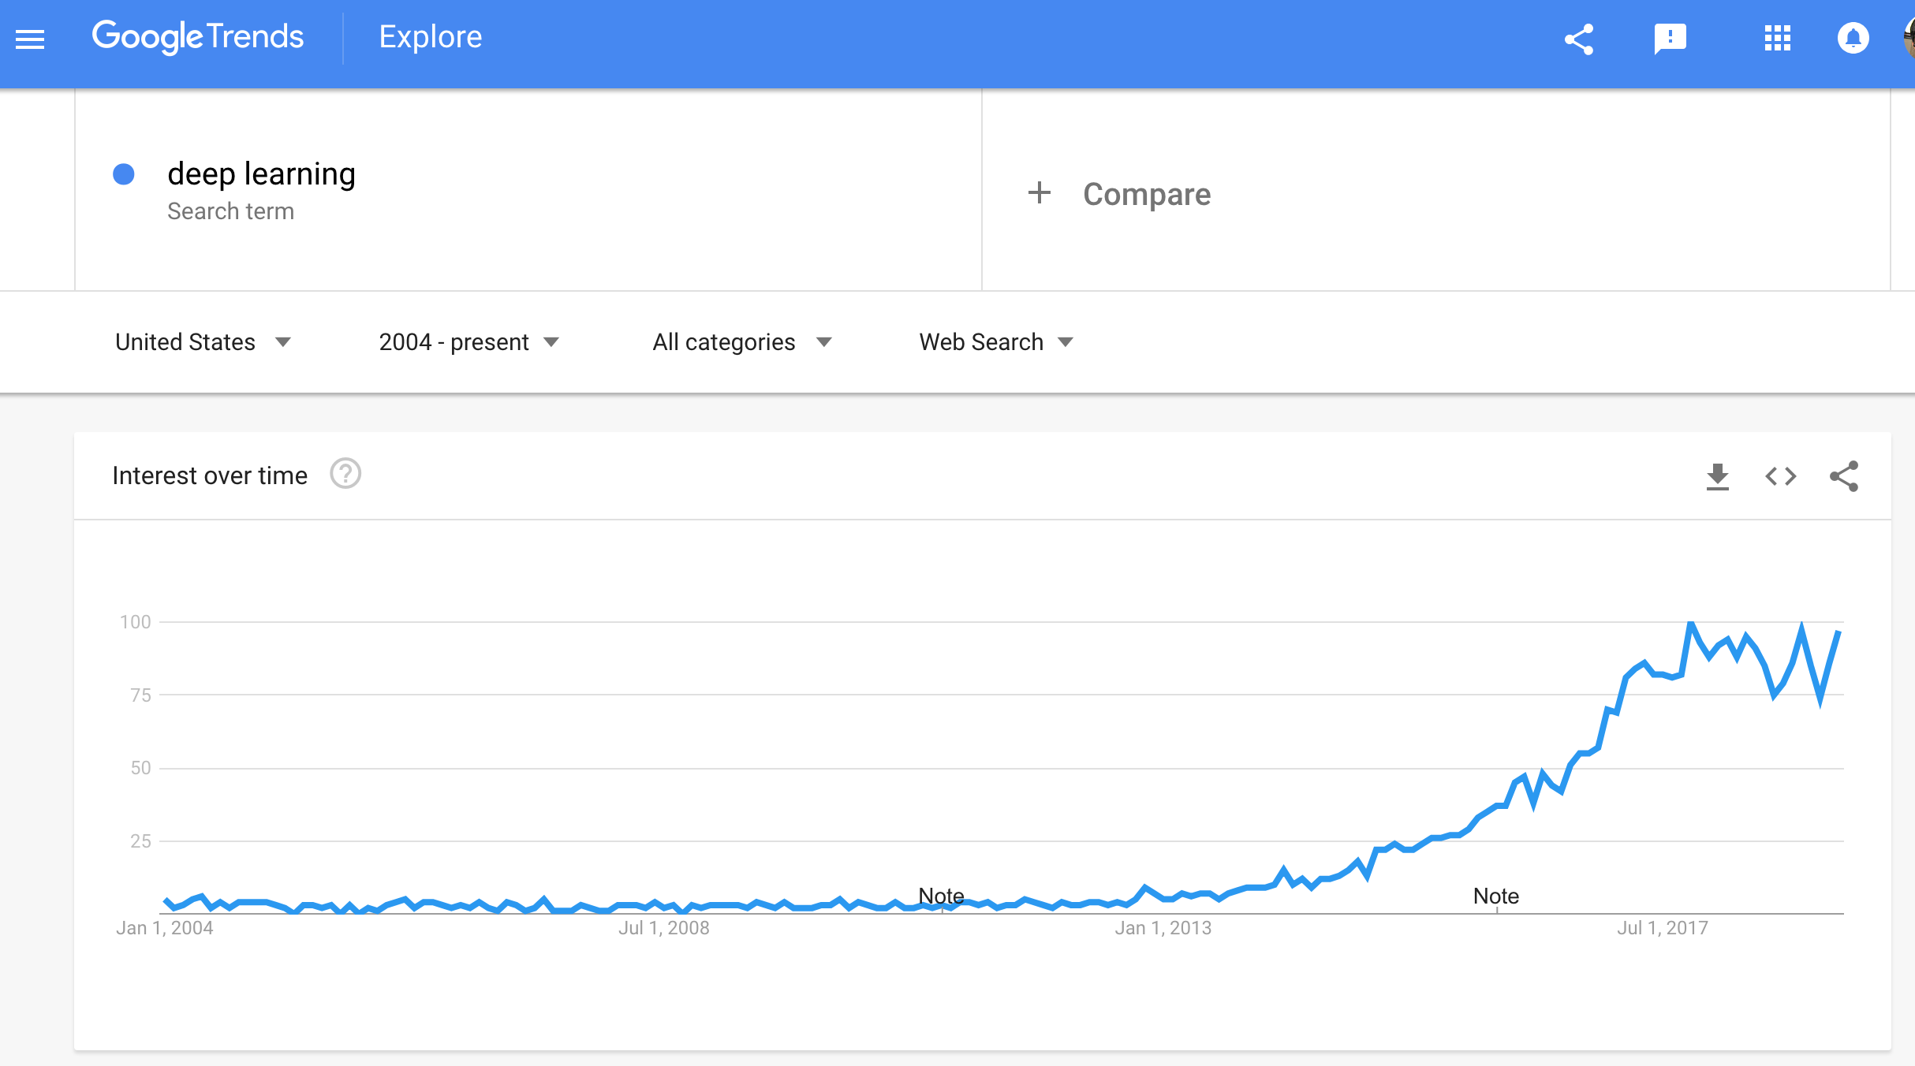

Slide 4
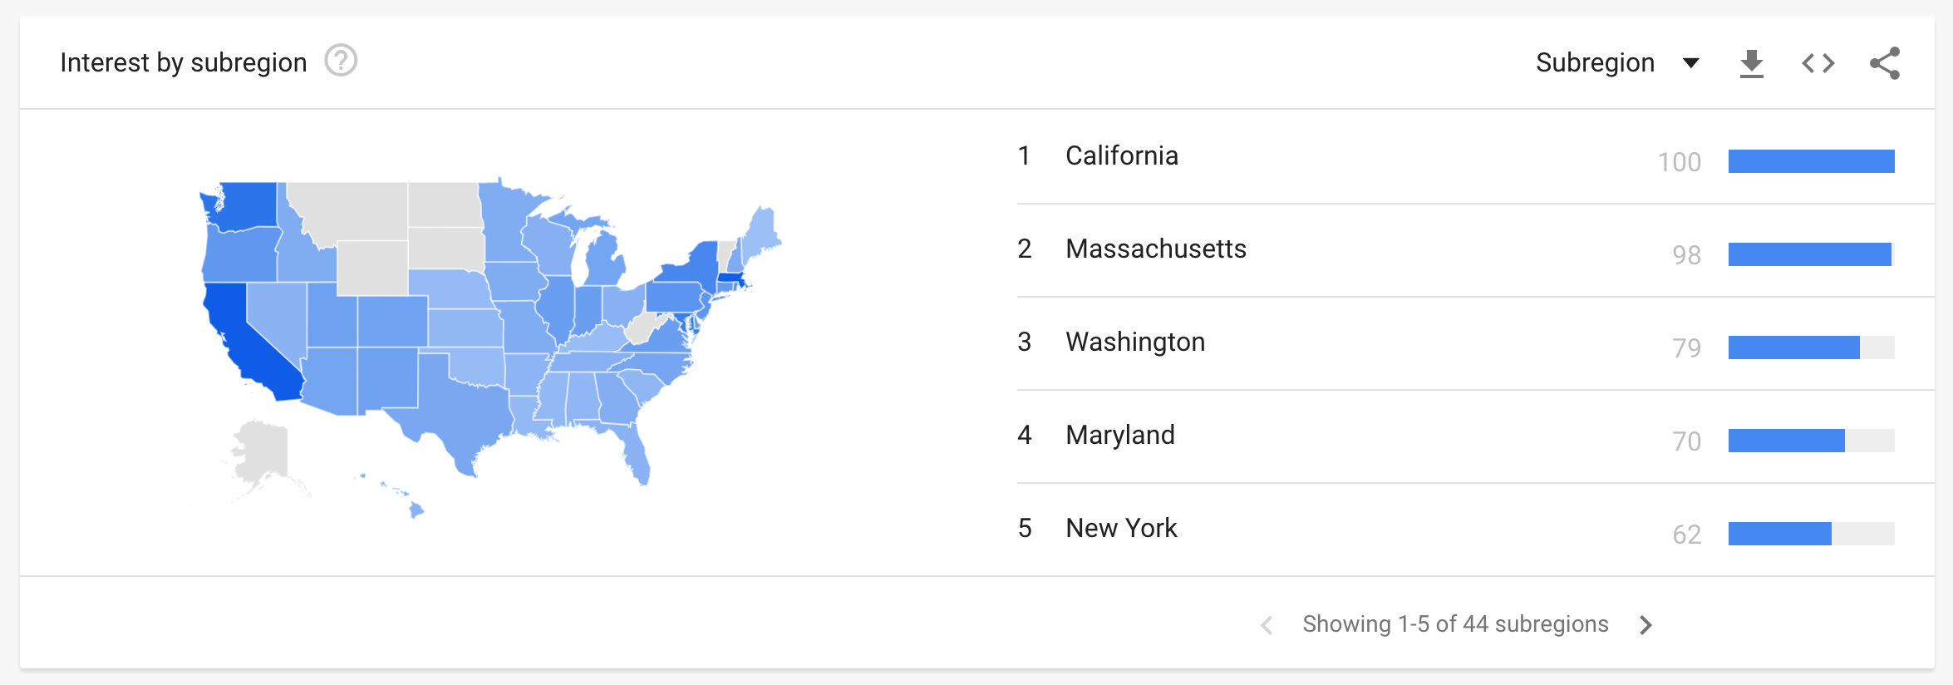
!

Slide 5
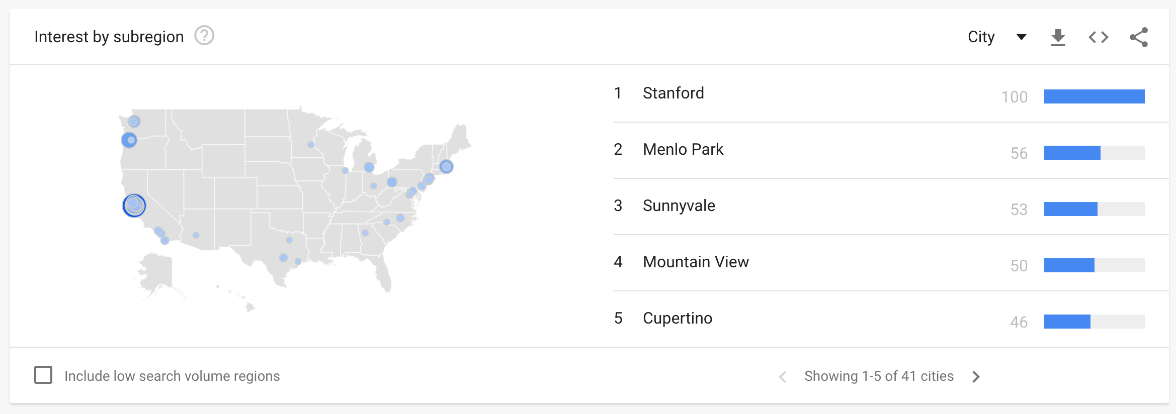
!!!

Slide 6
To keep up with this demand, GPUs have been pushed into service

Slide 7
GPU Clusters
Servers with single and multiple GPUs
GPUs of different types (e.g., V100s, P100s, Titan 1080 Tis)
Applications can run on a single server, or distributed across multiple servers
Research Problem: How to allocate GPU resources to applications?

Slide 8
GPUs as a Compute Substrate
Not easy to partition (can’t allocate 32 cores to one application and 32 cores to another application)
Performance hard to reason about for an end user
If I go from GPU A to GPU B, how will performance change?
If I double the number of GPUs, how will performance change?

Slide 9
Status Quo*
Users request a fixed number of GPUs of a particular type
Applications in queues until resources are available, and then granted exclusive access to resources
Applications locked into their resource choice
Users usually pick the fastest GPU resource available

Slide 10
Failure Modes
A single user uses all GPU resources in the cluster for three days
All GPU resources in the cluster at uniform 10% utilization
A user only uses a single GPU in an otherwise unused cluster
Slower GPUs in the cluster are never used, even for applications with a small slowdown on slower GPUs
Notes:
After this slide, we need something that says we can make use of the fact that deep learning jobs are highly iterative and easily preemptible (that is, low preemption overhead)

Slide 11
Our Solution
Fairness: Ensure that every user does at least as well as having a fair share of the cluster

Slide 12
Our Solution
Applications + Resources
Policy
Allocation
For each worker, fraction of time spent on each application
Time slice between applications (at granularity of 100s of iterations) to ensure that each application receives its computed fair share

Slide 13
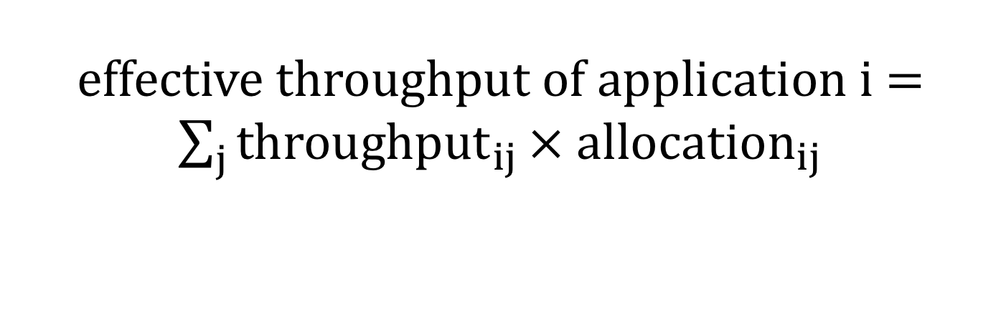
Our Solution
Applications + Resources
Policy
Allocation
$$\max{\min_{i}{ effective throughput of application i}}$$
effective throughput of application i = $\sum_{j}{{throughput}_{ij}}× allocation_{ij}$

Slide 14
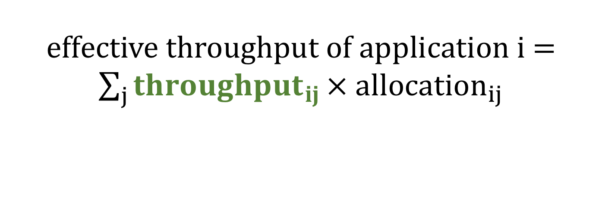
Our Solution
Applications + Resources
Policy
Allocation
$$\max{\min_{i}{ effective throughput of application i}}$$
effective throughput of application i = $\sum_{j}{{throughput}_{ij}}× allocation_{ij}$

Slide 15
Our Solution
Fairness: Ensure that every user does at least as well as having a fair share of the cluster
Application Packing: Improve GPU utilization by packing multiple applications on the same GPU/server when possible
Application Scaling: Scale applications up and down while keeping application semantics the same
Policy needs to be modified to determine how to pack and scale applications

Slide 16




Conclusion
Clusters with GPUs are becoming common
How do we share resources amongst different users in a fair and resource-efficient way?
deepakn@cs.stanford.edu
https://cs.stanford.edu/~deepakn/
@deepakn94
Gates 432

