Slide 1
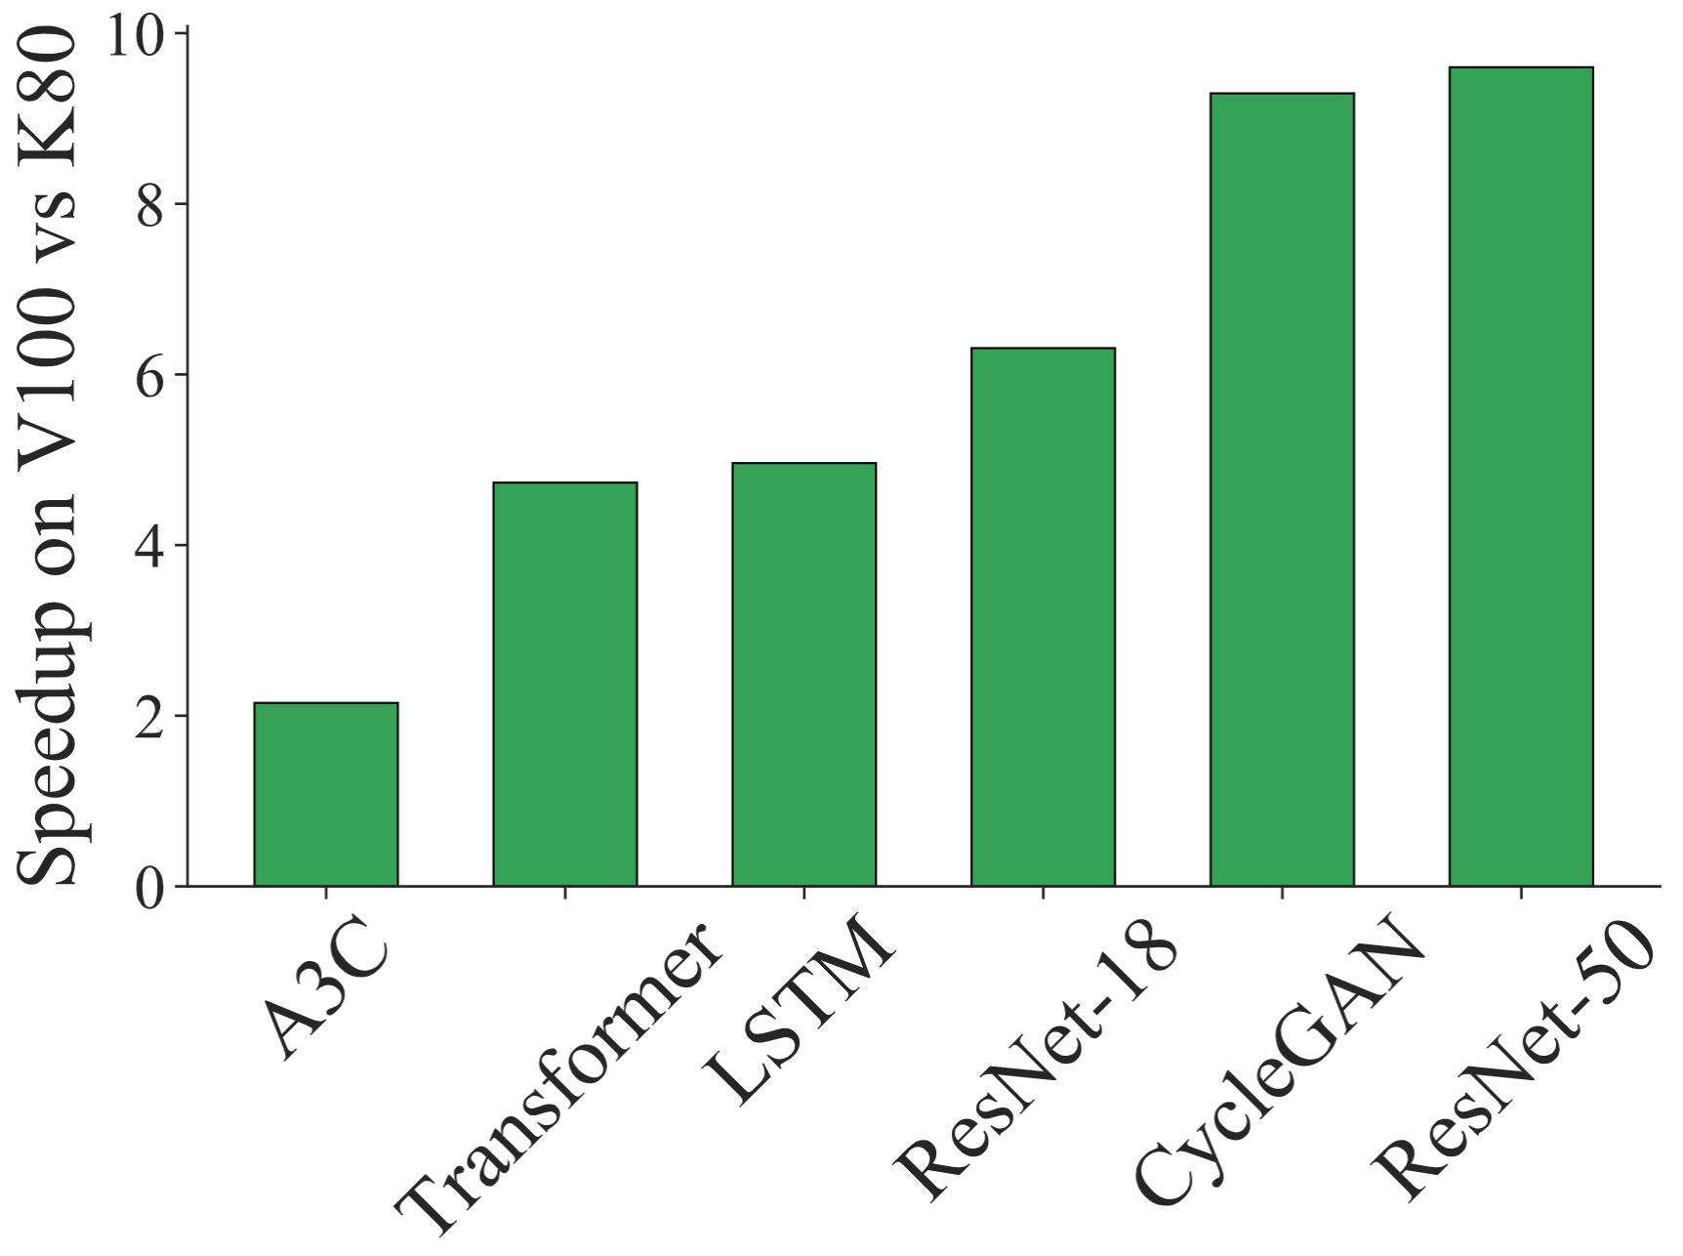
Efficient Scheduling of DNN Training on Multitenant Clusters
Deepak Narayanan*, Keshav Santhanam*, Amar Phanishayee†, Matei Zaharia*
*Stanford University, †Microsoft Research
Different jobs experience different speedups
when using a newer GPU generation
Different combinations of jobs experience
different speedups when packed together
Multitenant clusters with ML chips can help reduce cost,
but compute resources are becoming more heterogeneous!

Slide 2
Efficient Scheduling of DNN Training on Multitenant Clusters
Deepak Narayanan*, Keshav Santhanam*, Amar Phanishayee†, Matei Zaharia*
*Stanford University, †Microsoft Research
This work: How do we allocate resources to different jobs in a principled way according to a user-specified policy given workload and hardware heterogeneity?
Different jobs experience different speedups
when using a newer GPU generation
Different combinations of jobs experience
different speedups when packed together
Multitenant clusters with ML chips can help reduce cost,
but compute resources are becoming more heterogeneous!

