Slide 1
CNNs

Slide 2
Data Augmentation
Data augmentation is a process of artificially increasing the amount of data by generating new data points from existing data.
https://iq.opengenus.org/data-augmentation/

Slide 3
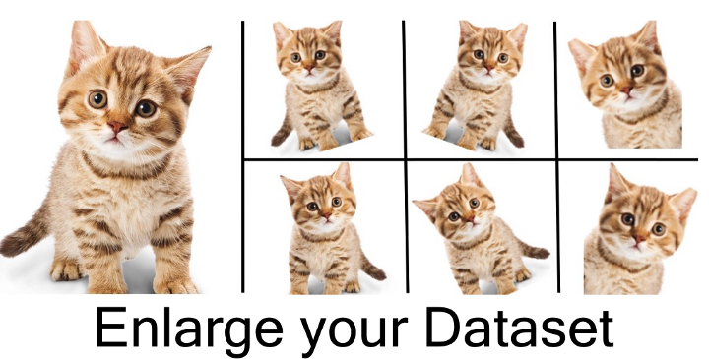

Slide 4
Position Augmentation
1. Position Augmentation
Center Crop: Crops the given image at the center. Size is the parameter given by the user.
Random Crop: Crop the given image at a random location.
Random Vertical Flip: Vertically flips the given image randomly with a given probability.
Random Horizontal flip: Horizontally flip the given image randomly with a given probability.
Random Rotation: Rotate the image by some angle.
Resize: Resize the size of the input image to a given size.
Random Affine: Random affine transformation of the image keeping center invariant.

Slide 5
Color Augmentation
Brightness: One way to augment is to change the brightness of the image. The resultant image becomes darker or lighter compared to the original one.
Contrast: The contrast is defined as the degree of separation between the darkest and brightest areas of an image. The contrast of the image can also be changed.
Saturation: Saturation is the separation between the colors of an image.

Slide 6
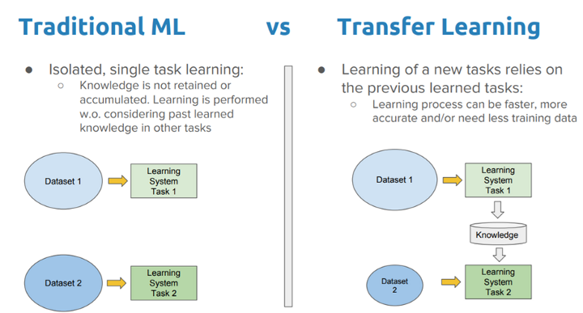

Slide 7
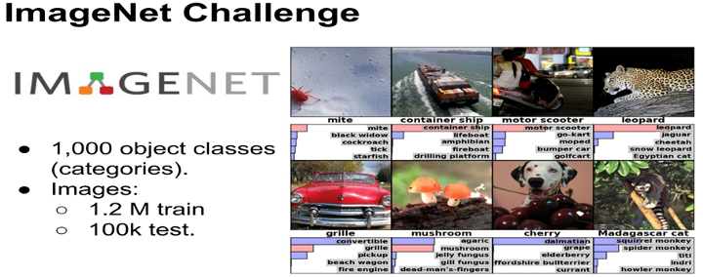

Slide 8
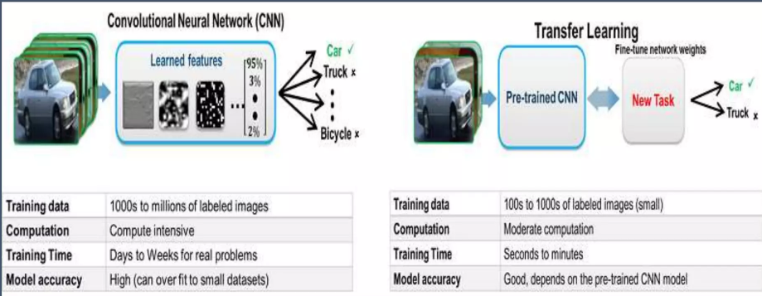

Slide 9
Examples
Know how to ride a cycle —> Learn how to ride a scooter
Know how to play classic piano —-> Learn how to play jazz piano
Know math and statistics —--> Learn machine learning

Slide 10
Why Transfer Learning?
Transfer learning is essential in any kind of learning. Humans are not taught every single task or problem in order to be successful at it. Everyone gets into situations that have never been encountered, and we still manage to solve problems in an ad-hoc manner. The ability to learn from a large number of experiences, and exporting ‘knowledge’ into new environments is exactly what transfer learning is all about.
Deep learning techniques require massive amounts of data in order to tune the millions of parameters in a neural network.Transfer learning is one way of reducing the required size of datasets in order for neural networks to be a viable option.

Slide 11
END

