Slide 1
Word Embeddings
- Sajjan Adhikari

Slide 2
Why we need word embedding?
Wouldn’t it be incredible if computers could start understanding Shakespeare? Or write fiction like J.K Rowling?
Recent advancements in Natural Language Processing have made computers to better understand text-based content
To understand and generate text, NLP-powered systems must be
- able to recognize words, grammar, and a whole lot of language nuances.
So, NLP experts developed a technique called word embeddings

Slide 3
Introduction
Word embeddings represents words and documents in the form of numeric vectors
- allowing similar words to have similar vector representations.
The extracted features are fed into a machine learning model
- so as to work with text data and preserve the semantic and syntactic information.
This information once received in its converted form is used by NLP algorithms
- that easily digest these learned representations and process textual information.

Slide 4
Introduction
Word embeddings captures inter-word semantics
Each word is represented by a real-valued vector with tens or hundreds of dimensions
Example : Glove vectors has 300 dimension

Slide 5
One Hot Encoding
One-hot encoding is a process whereby categorical variables are converted into a form
- that can be provided as an input to machine learning models.
The goal of one-hot encoding is to transform data from a categorical representation to a numeric representation
Sometimes, we encounter columns that contain categorical features
- for example parameter Gender will have categorical parameters like Male, Female.
- Male and Female mapped to 0 and 1

Slide 6
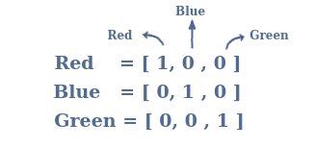

Slide 7
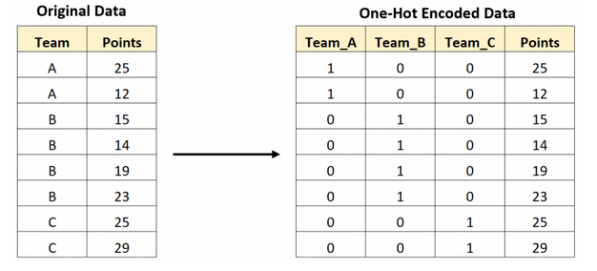

Slide 8
Bag of Words
Bag of Words model is used to preprocess the text by converting it into a bag of words
keeps a count of the total occurrences of most frequently used words.

Slide 9
Limitations of BOW
Semantic meaning
- does not consider the meaning of the word in the document
- It completely ignores the context in which it’s used
Vector size
- For a large document, the vector size can be huge
- resulting in a lot of computation and time

Slide 10
TF-IDF
TF-IDF stands for Term Frequency Inverse Document Frequency of records
It can be defined as the calculation of how relevant a word in a series or corpus is to a text.
The meaning increases proportionally to the number of times in the text a word appears
- but is compensated by the word frequency in the corpus (data-set)

Slide 11
common words in in a document are ranked low if they appear many times
The term frequency of a word in a document is calculated
- by raw count of instances a word appears in a document.
The inverse document frequency gives how common or rare a word is in the entire document set.
- The closer it is to 0, the more common a word is.
- This metric can be calculated by taking the total number of documents,
dividing it by the number of documents that contain a word, and calculating the logarithm.

Slide 12
Multiplying value of tf-idf results in the TF-IDF score of a word in a document
The higher the score, the more relevant that word is in that particular document.

Slide 13
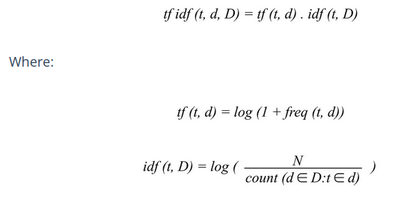

Slide 14
Applications
Information Retrieval
Text mining
Keyword Extraction
Search Engine

Slide 15
Word2Vec
was created by Tomas Mikolov and teams at Google
implements the Neural Network architecture for generating the word embeddings
unsupervised learning, neural network algorithms for obtaining vector representation of words

Slide 16
it is trained on a large corpus of text
Embeddings generated are dense
- many embeddings generates sparse vectors
- dense vectors give a better result than the sparse vector

