Slide 1

Word Embeddings
- Sajjan Adhikari

Slide 2
Why we need word embedding?
Wouldn’t it be incredible if computers could start understanding Shakespeare? Or write fiction like J.K Rowling?
Recent advancements in Natural Language Processing have made computers to better understand text-based content
To understand and generate text, NLP-powered systems must be
- able to recognize words, grammar, and a whole lot of language nuances.
So, NLP experts developed a technique called word embeddings

Slide 3
Introduction
Word embeddings represents words and documents in the form of numeric vectors
- allowing similar words to have similar vector representations.
The extracted features are fed into a machine learning model
- so as to work with text data and preserve the semantic and syntactic information.
This information once received in its converted form is used by NLP algorithms
- that easily digest these learned representations and process textual information.

Slide 4
Introduction
Word embeddings captures inter-word semantics
Each word is represented by a real-valued vector with tens or hundreds of dimensions
Example : Glove vectors has 300 dimension

Slide 5
One Hot Encoding
One-hot encoding is a process whereby categorical variables are converted into a form
- that can be provided as an input to machine learning models.
The goal of one-hot encoding is to transform data from a categorical representation to a numeric representation
Sometimes, we encounter columns that contain categorical features
- for example parameter Gender will have categorical parameters like Male, Female.
- Male and Female mapped to 0 and 1

Slide 6
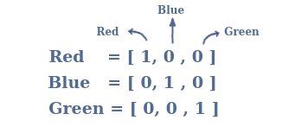

Slide 7
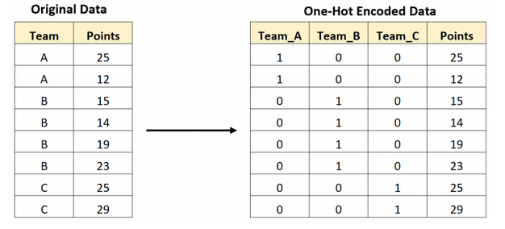

Slide 8
Bag of Words
Bag of Words model is used to preprocess the text by converting it into a bag of words
keeps a count of the total occurrences of most frequently used words.

Slide 9
Limitations of BOW
Semantic meaning
- does not consider the meaning of the word in the document
- It completely ignores the context in which it’s used
Vector size
- For a large document, the vector size can be huge
- resulting in a lot of computation and time

Slide 10
TF-IDF
TF-IDF stands for Term Frequency Inverse Document Frequency of records
It can be defined as the calculation of how relevant a word in a series or corpus is to a text.
The meaning increases proportionally to the number of times in the text a word appears
- but is compensated by the word frequency in the corpus (data-set)

Slide 11
common words in in a document are ranked low if they appear many times
The term frequency of a word in a document is calculated
- by raw count of instances a word appears in a document.
The inverse document frequency gives how common or rare a word is in the entire document set.
- The closer it is to 0, the more common a word is.
- This metric can be calculated by taking the total number of documents,
dividing it by the number of documents that contain a word, and calculating the logarithm.

Slide 12
Multiplying value of tf-idf results in the TF-IDF score of a word in a document
The higher the score, the more relevant that word is in that particular document.

Slide 13
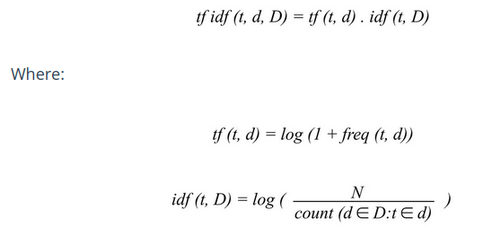

Slide 14
Applications
Information Retrieval
Text mining
Keyword Extraction
Search Engine

Slide 15
Word2Vec
was created by Tomas Mikolov and teams at Google
implements the Neural Network architecture for generating the word embeddings
unsupervised learning, neural network algorithms for obtaining vector representation of words

Slide 16
it is trained on a large corpus of text
Embeddings generated are dense
- many embeddings generates sparse vectors
- dense vectors give a better result than the sparse vector

Slide 17
Types of word2vec
CBOW
Skip-gram

Slide 18
CBOW
Continuous Bag of Words uses the context of each word (the phrase in which the word is used) in a database to predict the word
For example, Paul likes eating dark chocolate.
The input is [Paul, likes , dark, chocolate] and the output is eating
The network has C number of words as input and hᵢ is the word embedding for that word, in this case eating

Slide 19
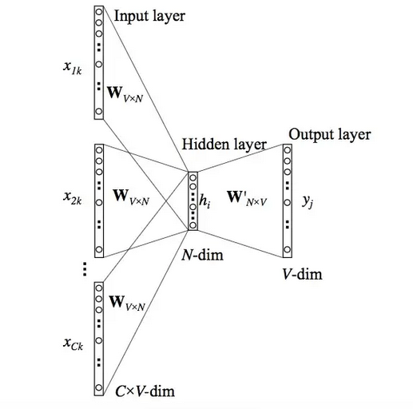

Slide 20
Skip-gram
Skip-gram uses the word as the input and it tries to predict the context of the word
For example, Paul likes eating dark chocolate.
the input is eating and the output is [Paul, likes , dark, chocolate]. Similar to CBOW, hᵢ is the word embedding for the word eating.

Slide 21
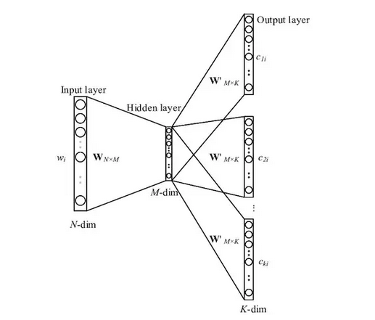

Slide 22
GloVe
GloVe stands for Global Vectors for word representation
It is an unsupervised learning algorithm
developed by researchers at Stanford University
generate word embeddings by aggregating global word co-occurrence matrices from a given corpus

Slide 23
generates word embeddings by aggregating global word-word co-occurrence matrix from a corpus
the co-occurrence matrix is a square matrix
the co-occurrence matrix is also sometimes called the term-term matrix

Slide 24
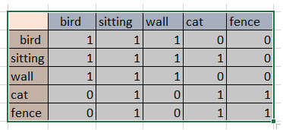
There is a bird sitting on a wall. The cat is sitting on the fence.
After pre-processing stop words removal the vocabulary is:
bird, sitting, wall, cat, fence

Slide 25
ELMO
Developed in 2018, in “Deep Contextualized Word Embeddings”
state-of-the-art performance on many popular tasks including question-answering, sentiment analysis, and named-entity extraction
Elmo is able to identify:
complex characteristics of word use (e.g., syntax and semantics)
how these uses vary across linguistic contexts (to model polysemy)

Slide 26
It uses a bi-directional LSTM trained on a specific task, to be able to create contextual word embedding
It is character based
ELMo gained its language understanding from being trained to predict the next word in a sequence of words - a task called Language Modeling

Slide 27
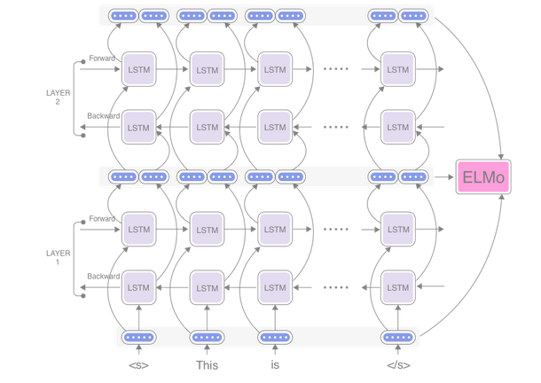

Slide 28
Why is ELMo so good?
ELMo can uniquely account for a word’s context
GloVe, Bag of Words, and Word2Vec simply produce an embedding based on the literal spelling of a word
The bucket was filled with water.
He kicked the bucket.
I have yet to cross-off all the items on my bucket list.
ELMo was trained on a lot of data
ELMo model was trained on a corpus of 5.5 billion words
“small” version had a training set of 1 billion words

Slide 29

Thank You

