Slide 1
PYTHON
By: Sagar Lamichhane

Slide 2
Agenda
Introduction
Functions
Fruitful and void functions
Flow of execution
Parameter and argument
Why to use a function
Conditionals and recursion
Iterations
Data types
Strings, lists, dictionaries, tuples
Debugging

Slide 3
Python Introduction
Initially designed by Guido Van Rossum in 1991 and developed by Python Software Foundation
High level programming language
Mainly developed for emphasis on code readability
Allows programmers to express concepts in fewer lines of code
object oriented and functional from the beginning

Slide 4
Some basic informations
Indentation matters to code meaning
Assignment is = and comparison is ==
Basic operators are + - * / %
Logical operators are words (and, or, not)
Basic printing command is print

Slide 5
Basic Data types
Integers
number_of_students = 5
Floats
pi = 3.1415
Strings
“Apple”, ‘apple’
Can use both “” or ‘’ to specify
use “““Use triple quotes for multiline strings ”””

Slide 6
Strings
Properties:
Immutable
Methods:
len
Upper, lower, islower,

Slide 7
Functions
A function is a named sequence of statements that performs a specific task
It is common to say that a function “takes” an argument and “returns” a result. The result is also called the return value.
Eg: type(4), int(‘3’)

Slide 8
Math functions
Python has a math module that provides most of the familiar mathematical functions. A module is a file that contains a collection of related functions.
Eg: math.pi, math.sin(value), math.sqrt(25)

Slide 9

Creating new function

Slide 10
Flow of execution
To ensure that a function is defined before its first use, you have to know the order statements run in, which is called the flow of execution.
Execution always begins at the first statement of the program. Statements are run one at a time, in order from top to bottom.
Statements inside the function don’t run until the function is called.
A function call is like a detour in the flow of execution. Instead of going to the next statement, the flow jumps to the body of the function, runs the statements there, and then comes back to pick up where it left off.

Slide 11

Parameters and arguments
Some functions require arguments
Inside the function, the arguments are assigned to variables called parameters.
This function assigns the argument to a parameter named bruce.
When you create a variable inside a function, it is local, which means that it only exists inside the function.

Slide 12
Fruitful and void functions
Some of the functions we have used, such as the math functions, return results. There is no appropriate name for these so let’s call them fruitful functions.
Other functions, like print_twice , perform an action but don’t return a value. They are called void functions.

Slide 13
Why functions?
Creating a new function gives you an opportunity to name a group of statements, which makes your program easier to read and debug.
Functions can make a program smaller by eliminating repetitive code. Later, if you make a change, you only have to make it in one place.
Dividing a long program into functions allows you to debug the parts one at a time and then assemble them into a working whole.
Well-designed functions are often useful for many programs. Once you write and debug one, you can reuse it.

Slide 14
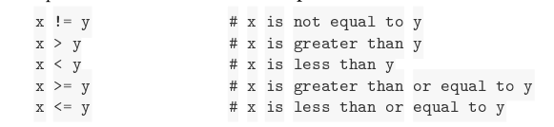
Conditionals
Boolean Expression
5 == 5
Operators

Slide 15
Logical Operators
There are three logical operators: and , or , and not . The semantics (meaning) of these operators is similar to their meaning in English. For example, x > 0 and x < 10 is true only if x is greater than 0 and less than 10.

Slide 16
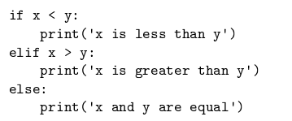
Conditional statements

Slide 17
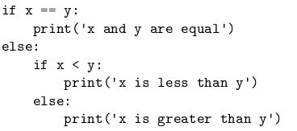
Nested conditionals

Slide 18
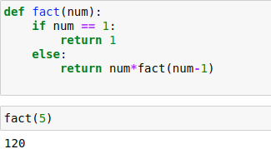
Recursion
It is legal for one function to call another; it is also legal for a function to call itself.

Slide 19
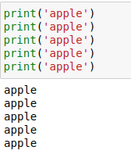
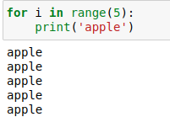
Iteration
Computers are often used to automate repetitive tasks. Repeating identical or similar tasks without making errors is something that computers do well and people do poorly. In a computer program, repetition is also called iteration.

Slide 20
Lists
Like a string, a list is a sequence of values. In a string, the values are characters; in a list, they can be any type. The values in a list are called elements or sometimes items.
List are mutable
Slicing and operations
.append(), .insert(), .extend(), .remove(), .pop(), .clear(), .reverse()

Slide 21
Dictionaries
A dictionary consists of a collection of key-value pairs
A dictionary is like a list, but more general. In a list, the indices have to be integers; in a dictionary they can be (almost) any type.
A dictionary contains a collection of indices, which are called keys, and a collection of values. Each key is associated with a single value. The association of a key and a value is called a key-value pair or sometimes an item.
.get(), .update(), .pop(), popitem()

Slide 22
Tuples
Tuples are immutable
t = ‘a’, ‘b’, ‘c’, ‘d’
Or inside parentheses:
t = tuple()
Tuple as return value
.count(), .index()

Slide 23
Sets
A set is a collection which is unordered, unchangeable and unindexed
Duplicates are not allowed
Fruits = {‘apple’,’banana’,’papaya’}
Or inside parentheses:
t = set((‘apple’))
.len(), .add(), .update(), .remove(), .discard(), .pop()

Slide 24
Assignment
If you are given three sticks, you may or may not be able to arrange them in a triangle.
For example, if one of the sticks is 12 inches long and the other two are one inch long, you will not
be able to get the short sticks to meet in the middle. For any three lengths, there is a simple test to
see if it is possible to form a triangle:
If any of the three lengths is greater than the sum of the other two, then you cannot
form a triangle. Otherwise, you can. (If the sum of two lengths equals the third, they
form what is called a “degenerate” triangle.)
1. Write a function named is_triangle that takes three integers as arguments, and that prints
either “Yes” or “No”, depending on whether you can or cannot form a triangle from sticks
with the given lengths.
2. Write a function that prompts the user to input three stick lengths, converts them to integers,
and uses is_triangle to check whether sticks with the given lengths can form a triangle.

Slide 25
Find out if the letter entered by the user is in the given string.
Histogram:
Zebra - {‘z’:1, ‘e’:1, …}

