Slide 1
Info Developers WICC
git
By: Python team
Jenish Acharya

Slide 2

What is Version Control ?
Practice of tracking and managing changes made in code

Slide 3


Benefits of Version Control
A long-term change history
Branching and Merging
Traceability

Slide 4
GIT - EARLY HISTORY
Git was born out of Linux Kernel Community’s frustrations with available VCSs.
Initially, Linux Kernel Community used BitKeeper as VCSs but on early 2005 free license of BitKeeper was revoked.
Git was initially released on April 2005.

Slide 5
How to install Git ?

Slide 6
Debian distros
sudo apt-get update
sudo apt-get install git

Slide 7
Windows
Git for Windows stand-alone installer
When you've successfully started the installer, you should see the Git Setup wizard screen. Follow the Next and Finish prompts to complete the installation. The default options are sensible for most users.
Open a Command Prompt (or Git Bash if during installation you elected not to use Git from the Windows Command Prompt).

Slide 8
For Other Systems
https://www.atlassian.com/git/tutorials/install-git

Slide 9
Getting Started git init/git clone/git config

Slide 10
Git init
git init command creates a new Git repository
creates a .git subdirectory in the current working directory
Commands :
git init
Git init <directory>

Slide 11
Git init vs Git Clone
Both Command Initializes a new git repository
Git clone depends on git init
Internally, Git calls Git init to create a new repository
Git Clone will then copy the data from existing repository

Slide 12
Git Clone
Commands :-
git clone <repo link>

Slide 13
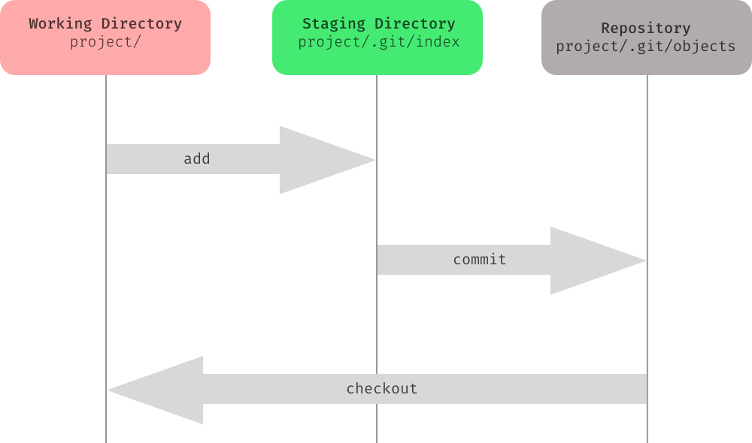
GIT - SAVING CHANGES
git add / git commit / git diff / git stash / .gitignore

Slide 14
GIT - SAVING CHANGES
git add /
The git add command adds a change in the working directory to the staging area.
git add <file>
Stage all changes in <file> for the next commit.
git add <directory>
Stage all changes in <directory> for the next commit.

Slide 15
GIT - SAVING CHANGES
git commit/
git commit
Commit the staged snapshot. This will launch a text editor prompting you for a commit message.
git commit -m “commit message”
A shortcut command that immediately creates a commit with a passed commit message.
git commit -am “commit message”
A power user shortcut command that combines the -a and -m options

Slide 16
GIT - config
git config
used to set git configuration values on global or project level
git config --global user.email "jenish.acharya@infodevelopers.com.np
git config --global user.name "jenishacharya"

Slide 17
GIT - STATUS
- Displays state of the working directory and staging area.
- Good practice to check state of repository
before committing changes.

Slide 18
GIT - SAVING CHANGES
git diff /
Diffing is a function that takes two input data sets and outputs the changes between them.
Git diff is a multi-use git command than when executed runs a diff function on git data sources. Sources can be commits, branches, files and more.
The git diff command is often used along with git status and git log to analyze the current state of git repo.
Comparing files: git diff file
By default, git diff will compare working directory changes with index.

Slide 19
GIT - SAVING CHANGES
git diff /
git diff 777ea61 25de5f0
Compares two different commits
git diff branch1 other-feature-branch
Compares two different branches.
git diff master feature-branch ./diff_test.txt
Compares files from two different branches

Slide 20
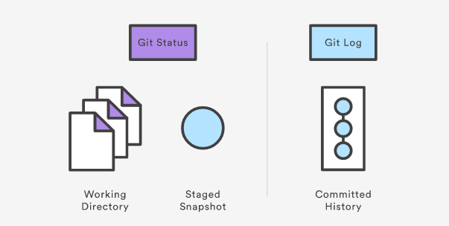
git log
Displays committed snapshots.
For listing project history, filtering and searching for specific changes.

Slide 21
git log
Display entire commit history
git log
Limit number of commits displayed
git log -n 3
Display single line of commits
git log --oneline

Slide 22
GIT - SAVING CHANGES
git stash /
The git stash command takes your uncommitted changes (both staged and unstaged), saves them away for later use. Stashes are not transferred to server when you push.
$ git stash
Saves staged and unstaged changes
$ git stash pop
Removes the changes from you stash and re-applies them to working copy.

Slide 23
GIT - Ignore it!
.gitignore
Ignored files are usually build artifacts and machine generated files that can be derived from your repository source or should otherwise not be committed.
caches
compiled code (.pyc, .class)
build output directories (/bin, /out)
files generated at runtime (.log,, .tmp)
IDE config files (.idea, .vstore)
Ignore patterns
**/logs
**/logs/debug.log
*.log
*.log
!important.log
/debug.log
debug.log
gitignore.io

Slide 24
git push
git push command is used to upload local repository
content to a remote repository.
Pushing is how you transfer commits from your
local repository to a remote repo.
git push <remote> <branch>
Push changes to the remote branch

Slide 25
git pull
git pull command is used to fetch and download
content from a remote repository and immediately
update the local repository to match that content.
Merging remote upstream changes into your
local repository is a common task in Git-based
collaboration workflows.
git pull command is actually a combination of
two other commands, git fetch followed by
git merge.

Slide 26
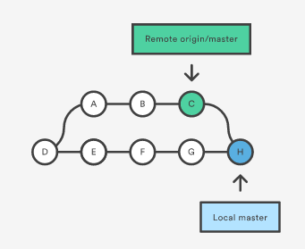
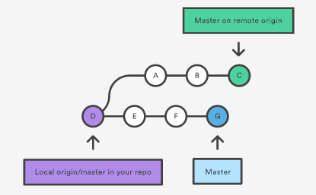
git pull

Slide 27
git fetch
The git fetch command downloads commits, files,
and refs from a remote repository into your local repo.
Fetched content has to be explicitly checked out
using the git checkout command.
This makes fetching a safe way to review commits
before integrating them with your local repository.

Slide 28
git fetch
git fetch <remote>
Fetch all branches of the remote
git fetch <remote> <branch>
Fetch specific branch from remote

Slide 29
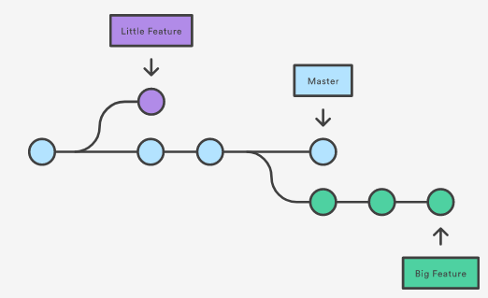
git branch
- Git branches are effectively a pointer to a snapshot
of your changes.
- When you want to add a new feature or fix a
bug—no matter
how big or how small—you spawn a new branch
to encapsulate your changes.

Slide 30
git branch
A branch represents an independent line
of development.
Branches serve as an abstraction for the
edit/stage/commit process.
You can think of them as a way to request a
brand new working directory, staging area,
and project history.
New commits are recorded in the history for
the current branch, which results in a fork in
the history of the project.

Slide 31
git branch
git branch
List of branches in repo
git branch <branch>
Create a new branch
git branch -d <branch>
Delete the specified branch. This is a “safe”
operation in that Git prevents you from
deleting the branch if it has unmerged changes.
git branch -D <branch>
Force delete specified branch

Slide 32
git checkout
git checkout <branch>
Checkout to existing branch
git checkout -b <branch>
Create a new branch and check out to the branch

Slide 33
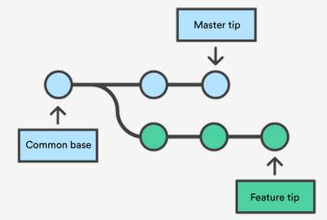
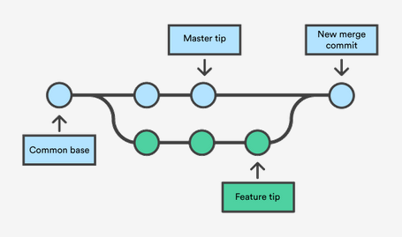
git merge

Slide 34
Thank you
Any Questions?

