Slide 1
Fullstack Geo-visualization 101: How to Make Productive Webmaps
Luyu Liu
Department of Geography
The Ohio State University
Notes:
Hellow everyone, welcome to my presentation today! My name is luyuliu, my title is ///////

Slide 2
Learning Objectives
By the end of this workshop, you should be able to:
Explain the structure of web pages
Report the functions of HTML, JavaScript, and CSS
Define common JS libraries for mapping
Reproduce a simple static webmap
Share the webmap with GitHub Pages
Reproduce a simple back-end with MongoDB and python-eve (for back-end part only)

Slide 3
Agenda
Minilecture (4:00 – 4:30pm EST)
Front-end lab (4:30pm – 5:10pm)
Short break and Q&A for front-end part (5:10 – 5:20pm)
Back-end lab (5:20pm – 5:50pm)
Free Q&A time (5:50pm – 6:00pm)

Slide 4



Front-end checklist before we started
You should already install these software
Visual Studio Code
GitHub Desktop and your GitHub account
Firefox browser developer edition
This slide
Our demo package. Fork this project: https://github.com/luyuliu/UCGIS-Fullstack-Geovisualization-Workshop

Slide 5
Geovisualization

Slide 6
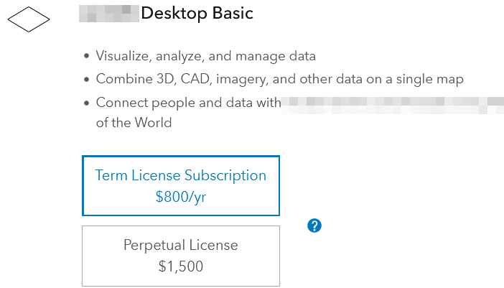

Why web-map? Accessible
Open source
- No cost for users
- Reusable for developers
Few dependency
- Only browser
- No installation
- No prerequisites

Slide 7
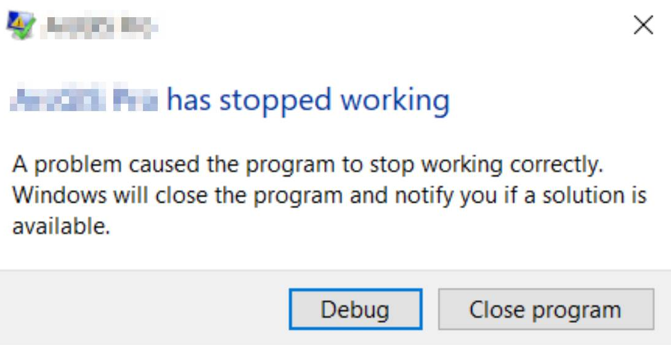

Why web-map? Robustness
Persistent
- Online 24/7
- Low risk of failing
Compatible
- Cross platforms
- Touching screen
friendly

Slide 8
Webpage basics

Slide 9

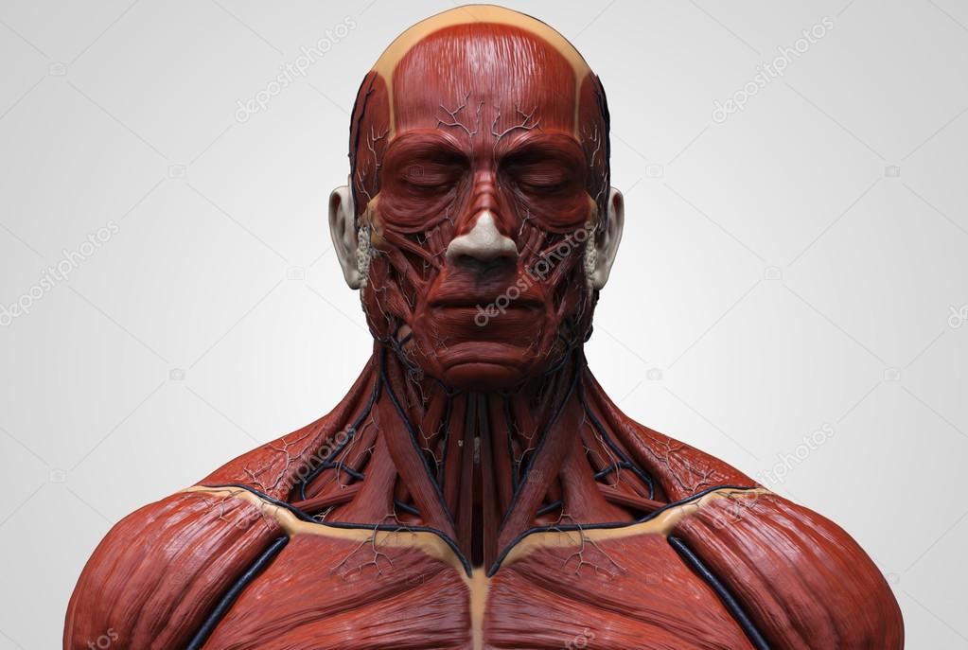
Web page
A typical web page consists of three parts:
HTML
JavaScript
CSS
We can think this webpage as a human’s face:
Bone
Muscle and skin
Make-up
Web page is essentially contents in web browser

Slide 10
HTML – your bones
Hyper Text Markup Language
Is essentially a rich-text file with some media
Very similar to a word document, but written in codes

Slide 11
Thanks!
liu.6544@osu.edu

