Slide 1

Fullstack Geo-visualization 101: How to Make Productive Webmaps
Luyu Liu
Department of Geography
The Ohio State University

Slide 2
Learning Objectives
By the end of this workshop, you should be able to:
Explain the structure of web pages
Report HTML, JavaScript, and CSS’s usages
Reproduce a simple static webmap
Share the webmap with GitHub Pages
Report the functions of an API (for backend part only)
Reproduce a simple back-end with MongoDB and python-eve (for backend part only)

Slide 3
Agenda
0. Short survey (2:00 – 2:05pm EST)
Frontend minilecture (2:05 – 2:50pm)
Frontend lab (2:50pm – 3:30pm)
Backend minilecture (3:30 – 3:40pm)
Backend lab (3:40pm – 3:55pm)
Free Q&A time and short survey (3:55pm – 4:00pm)

Slide 4
0. Pre-workshop Survey
2:00 – 2:05

Slide 5
1. Frontend Lecture
2:05 – 2:50

Slide 6


Frontend Checklist
You should already install these software
Visual Studio Code
GitHub Desktop and your GitHub account
Fork this project: https://github.com/luyuliu/UCGIS-Fullstack-Geovisualization-Workshop
Open the GitHub Pages option
Instruction: https://luyuliu.github.io/UCGIS-Fullstack-Geovisualization-Workshop/

Slide 7
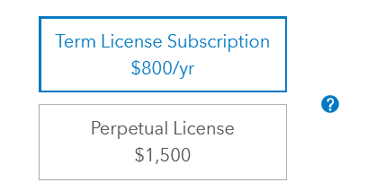
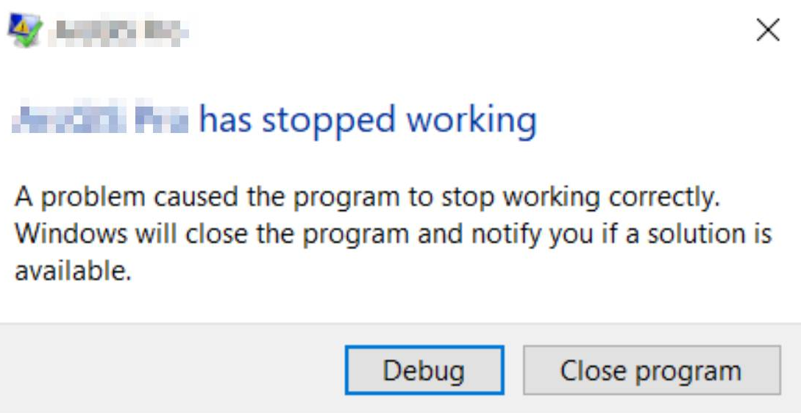

Why web-map?
Accessible
No cost for users
Low cost for developers
Few dependencies
Persistent
Online 24/7
Low risk of failing
Compatible
Cross platforms
Touching screen friendly

Slide 8
What is Front- and Backend?
In web development, generally:
Frontend focus on user interface
Anything that happens in your web browser
HTML, JS, CSS
Backend focus on server and infrastructure
Database
API that serves the data in the database
MongoDB and Python-eve

Slide 9
1.1. Webpage Basics

Slide 10
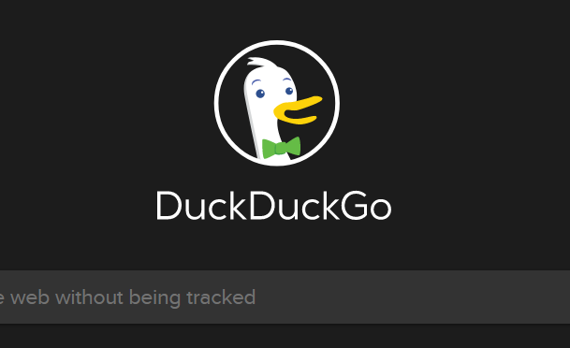

Webpage
Web page is essentially contents in web browser
A typical web page consists of three parts:
HTML
JavaScript
CSS
We can think this webpage as a human’s face:
Bone
Muscle and senses
Make-up

Slide 11
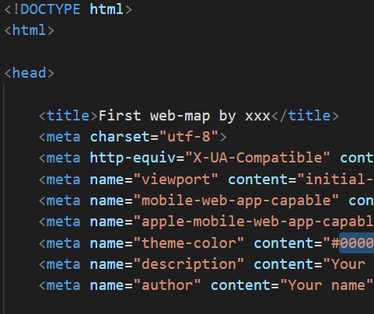
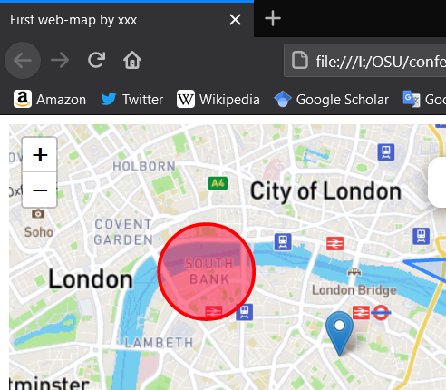
HTML – Your Bones
Hyper Text Markup Language (HTML)
Is essentially a rich-text file with some media
Like a word document, but written in codes
HTML is the foundation of the webpages
Translated by your web browser

Slide 12
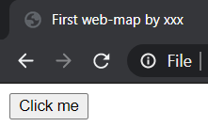
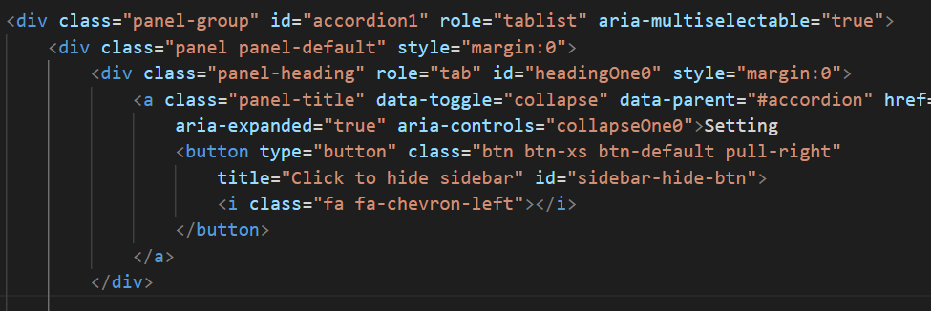

HTML Element and Tag
A webpage consists of different elements
Indicated by a part of tags, represent its type
<button>Click me</button>
<button> shows it is a button
“Click me” is the text on the element
Can further include other elements inside, like onion
1
2
3
4
5
6

Slide 13

HTML Tag Attributes
Like a record in shapefile, a tag also have attributes
<a class="link" id="this-link" href="#">I am a link!</a>
<a>: the tag name
id: a name for this specific element
Useful to select a specific element
class: a name for a group of elements
Useful to select or apply settings on many elements
href: the hyperlink attached to this element
There are many other attributes for different uses

Slide 14
HTML Alone is not Enough
HTML alone is static
Hard to interact
HTML alone can still show videos and GIFs
HTML alone is ugly
It is not good-looking
Hard to read, write, and maintain
HTML is NOT a programming language
It is a markup language

Slide 15
JavaScript – Muscles and Senses
JavaScript (JS) is a programming language
To support and manipulate HTML
Actions (functions)
Can change contents
Reactions (events)
Can detect and react to a change or input
e.g.: background change after click a button
“JavaScript is not Java, just like ham is not hamster”
More on: http://javascriptisnotjava.com/

Slide 16
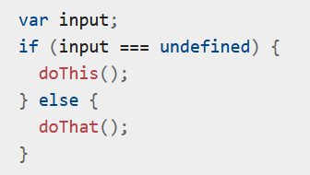
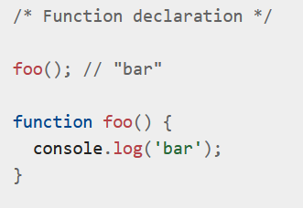
JS – Basic Grammar
JS has a very similar grammar like other scripting language like python/R
‘var’ or ‘let’: declare a variable
‘if’: conditional clause
‘function foo()’: define a function
‘foo()’: execute a function
Semicolon: recommended, but not necessary
Comment: ‘//’ (for a line) or ‘/* */’ (for many lines)
Source

Slide 17

JS – Important Data Structure
List:
Square bracket: []
Simple and efficient to enumerate
But hard to find a specific one
Object:
Curly bracket: {}
Attribute-value pairs
Simple to enumerate and fast to find a specific one
But take twice space to store the same information
Source

Slide 18
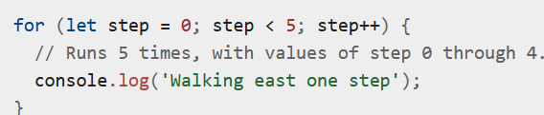
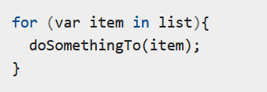
JS – For Loop
Useful to repeat or enumerate data structure
Repeat for certain times
Start from 0, end at 5,
The value will be 0, 1, 2, 3, 4
Enumerate
Variable ‘item’ is an item in the ‘list’
Source

Slide 19
JS Library: jQuery
Native JS is not enough sometimes
jQuery is a very useful library
Its function starts with a dollar sign ($) and usually two steps
Step 1: Select the object(s)
Step 2: Do something or ask it react to something
Examples
Step 1
Select an object: $("#the_id")
Select a class of objects: $(".the_class")
Step 2
Change the value of an input box: $("#input").val(“text changed!”)
Add an event to a button that when a user clicks it, show a text

Slide 20
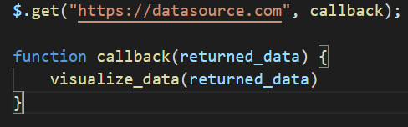
JS – Make a Request
We cannot store everything in our code
Need to make requests to get data
$.get: the jQuery function to GET data. It has two parameters:
“datasource.com”: the online dataset URL
callback (a function): what you will do to the data if data is available
returned_data: the returned data structure

Slide 21
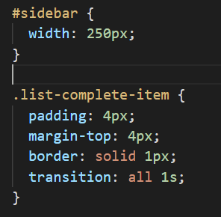
CSS – Make-up On the Face
Cascading Style Sheets (CSS)
Layout: position and sequence of HTML elements
Colors and fonts
For a specific object
Change its width to 250 pixel
For objects with this class name
Change padding to 4px
Change margin to the top to 4px
Change border style
Change transition style

Slide 22
CSS is Hard
CSS seems trivial among the three, but requires much more work
Just like makeup, buy from professional
Try CSS framework and libraries
Bootstrap: Great for arranging layout and simple style
Font Awesome: Vector icons and logos

Slide 23
Summary
HTML is the bone
Foundation of a website
JS is the muscle and senses
Actions and reactions
CSS is the makeup
Layout and style

Slide 24

Combining the Three
We need to include JS and CSS files and libraries to our main HTML to make them work
For JS:
For CSS:
Make sure adding your main JS and CSS AFTER other libraries to not fail the dependencies.

Slide 25
1.2. Web Browser

Slide 26

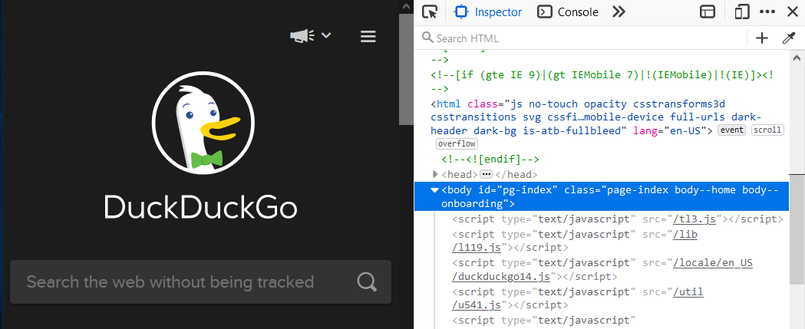
Understand Your Browser
It is a software that translate online HTML/JS/CSS codes into contents
Debug window: press F12 or right click -> inspect
Inspector: show elements in current HTML
: pick element on page and show HTML code
Important:
Current HTML may be different from the original HTML file you wrote, because your JS files will add and change the contents

Slide 27
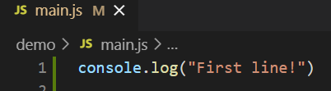
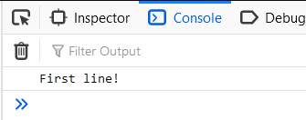
Web Console
This is the JavaScript console for the current page
console.log(): equivalent to print() in Python and R
Console will show the information printed from your JS code
Very useful for simple debug
You can change the current HTML contents by typing commands
For example, try typing document.body.innerHTML = “” in any page

Slide 28
CORS Restrictions
Cross-origin resource sharing (CORS) is a rule that websites cannot request resources from other domains
aaa.com cannot directly request a CSV file hosted on bbb.com unless bbb.com explicitly says so, even if it is a public file. This includes local files.
Instead, aaa.com can only request resources with aaa.com domains, such as aaa.com/file.csv
It is enforced by most web browsers
Solutions for local development:
Start a local server (localhost)
Use Firefox developer edition and CORS everywhere plugin

Slide 29
1.3. Mapping Library

Slide 30
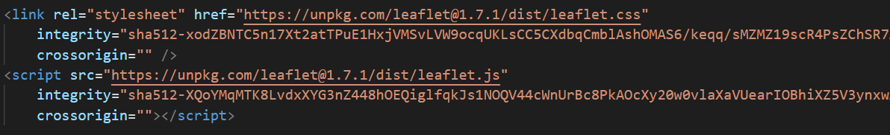
Leaflet
A very useful JavaScript library to support mapping
Adding the library:
Just like jQuery’s $, Leaflet’s functions start with L
e.g. Adding a map object to HTML element with id = “mapid”
A JS leaflet map
Leaflet’s create map function
Targeted HTML element
Method to set the map to a specific view
The view’s latlng
The Zoom level
Human language translate: Leaflet, create a map on the HTML element called “mapid”, and set my view to this place with this zoom level

Slide 31
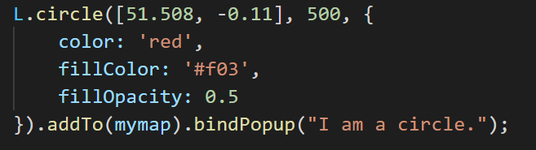
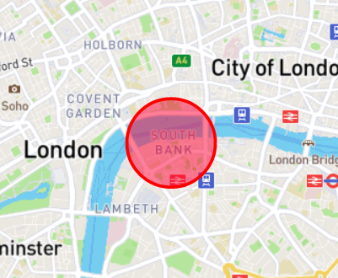
Leaflet Function Logic
All elements must addTo(mymap) to show on the map
Layer: Raster layer (L.tileLayer, including base layers), vector layer…
Other single symbols: circle (L.circle), polygon…
Information media: popup
Structure: L.function(important parameters, {optional parameters...})
Desired location
Radius
Add to the map
Add a popup with this content on this circle

Slide 32
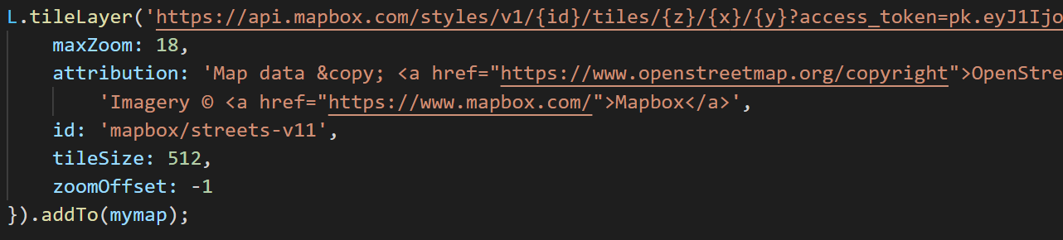
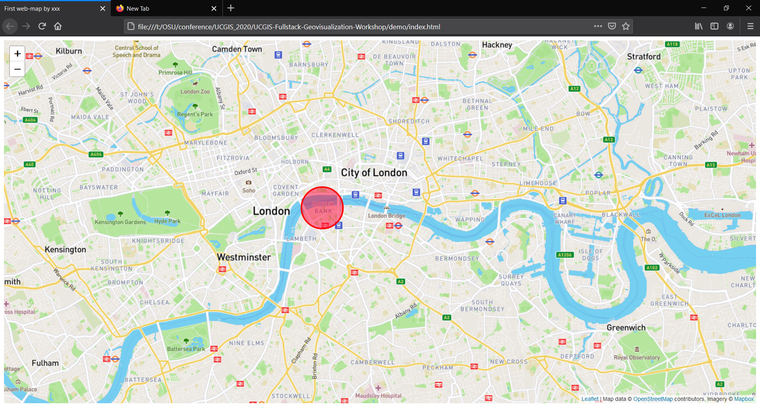
Add a map box base Layer
You now have a web-map!

Slide 33
1.4. Going Online?

Slide 34
Solutions to Host a Website
Borrow or buy a server
- A server is an online computer that works 24/7.
- It can support a back-end and more actions
GitHub Pages
- Can only support a website without back-end
- Free and persistent
- Go to your forked GitHub page -> settings -> Pages -> Source -> select main
- access by: youname.github.io/UCGIS-Fullstack-Geovisualization-Workshop/demo

Slide 35
GitHub and Git
Git is a version control software
Record your every committed change
GitHub is a website that can:
Record your committed changes to an online server
Host static webpage
To save your changes on the online map:
Commit: record your current change to local
Push: upload your files to the GitHub server
In few minutes, the Pages will update your change

Slide 36
2. Frontend Lab
2:50 – 3:30

Slide 37
Frontend Lab Agenda
Follow the instruction on https://luyuliu.github.io/UCGIS-Fullstack-Geovisualization-Workshop/
Goals:
Host the demo on GitHub Page and confirm
Retrieve and visualize a GeoJSON
Host the updated web page
Any questions about the frontend lecture?

Slide 38
3. Backend Lecture
3:30 – 3:40

Slide 39
What is Front- and Backend?
In web development, generally:
Frontend focus on user interface
Anything that happens in your web browser
HTML, JS, CSS
Backend focus on server and infrastructure
Database
API that serves the data in the database
MongoDB and Python-eve

Slide 40
Backend Checklist
Python 3
EVE library in Python: pip install eve
MongoDB
MongoDB Compass
Firefox Developer edition
CORS everywhere plugin
Instruction: https://luyuliu.github.io/UCGIS-Fullstack-Geovisualization-Workshop/

Slide 41
How Can a Backend Support Your research?
Scales well for big data
Compatible for different platforms
Python, R, NodeJS, webpage...…
Easier to manage compared to separate files
Easy to use for different purposes
Scientific calculation, visualization……

Slide 42

Database
Reasons to use a database
Scalable
Organized
Easy to read and write
Secure
……
E.g. PostgreSQL, mySQL, MS access
No-SQL: MongoDB
Not a SQL database
Not relational
Flexible
Fast
Distributed
“Basically csv files”

Slide 43
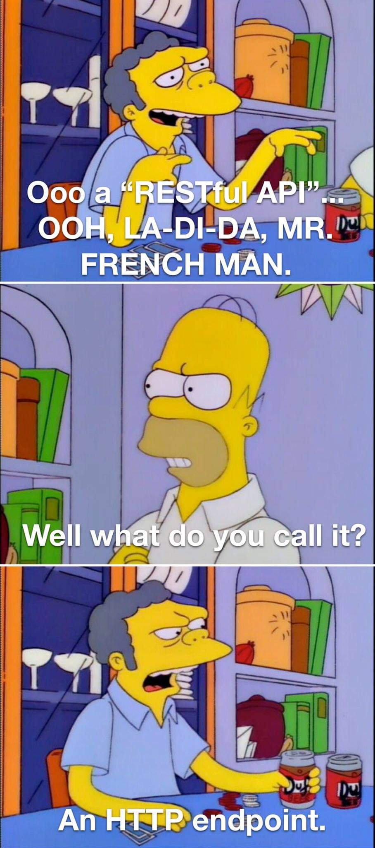
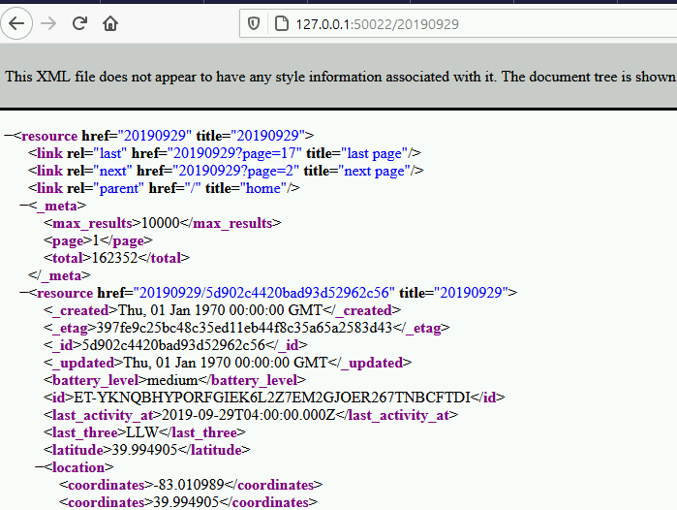
REST API for Database
API: application programming interface
A running service to feed the data in your database to other applications
Other services can access data by an http address (URL) like:
API returns data as a JSON or xml file
An example of a returned record:

Slide 44
API Structure
HTML
Other analysis codes
JavaScript
RESTful
API
CSS
MongoDB
Frontend
Backend

Slide 45
4. Backend Lab
3:40 – 4:55

Slide 46
Backend Lab Goals
Populate the MongoDB database
Reproduce a RESTful API and run it locally
Connect the backend and frontend
Questions about the backend lecture?

Slide 47
5. Post-Workshop Survey

