Slide 1
Fullstack Geo-visualization 101: How to Make Productive Webmaps
Luyu Liu
Department of Geography
The Ohio State University
Notes:
Hellow everyone, welcome to my presentation today! My name is luyuliu, my title is ///////

Slide 2
Learning Objectives
By the end of this workshop, you should be able to:
Explain the structure of web pages
Report HTML, JavaScript, and CSS’s usages
Define
Reproduce a simple static webmap
Share the webmap with GitHub Pages
Reproduce a simple back-end with MongoDB and python-eve (for back-end part only)

Slide 3
Agenda
0. Short survey
Minilecture (4:05 – 4:35pm EST)
Front-end lab (4:35pm – 5:10pm)
Short break and Q&A for front-end part (5:10 – 5:20pm)
Back-end lab (5:20pm – 5:50pm)
Free Q&A time and short survey (5:50pm – 6:00pm)

Slide 4
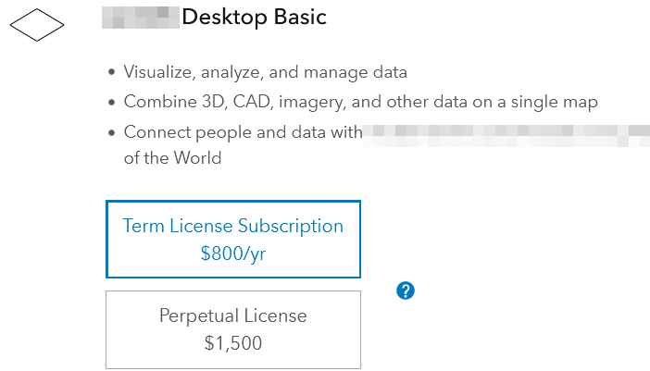

Why web-map? Accessible
Open source
- No cost for users
- Reusable for developers
Few dependency
- Only browser
- No installation
- No prerequisites

Slide 5
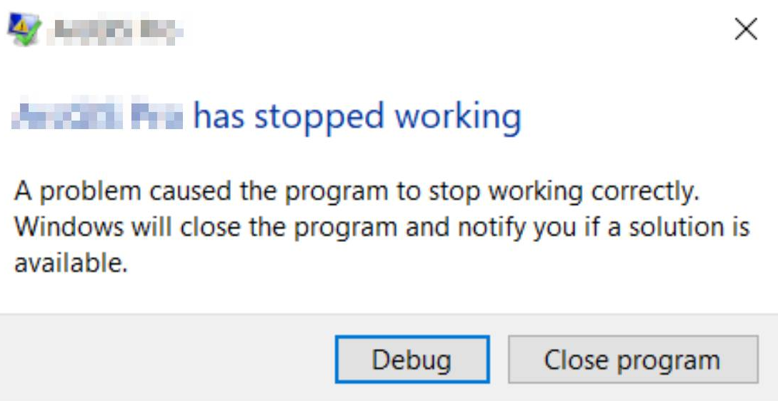

Why web-map? Robustness
Persistent
- Online 24/7
- Low risk of failing
Compatible
- Cross platforms
- Touching screen
friendly

Slide 6
Front-end lecture

Slide 7



Front-end checklist before we started
You should already install these software
Visual Studio Code
GitHub Desktop and your GitHub account
Firefox browser developer edition
This slide
Our demo package. Fork this project: https://github.com/luyuliu/UCGIS-Fullstack-Geovisualization-Workshop

Slide 8
What is front- and back-end?
In web development, generally:
Front-end focus on user interface
Anything that happens in your web browser
- HTML, JS, CSS
Back-end focus on server and infrastructure
- Database
- API that serves the data in the database
- MongoDB and Python-eve

Slide 9
Webpage basics - HTML

Slide 10

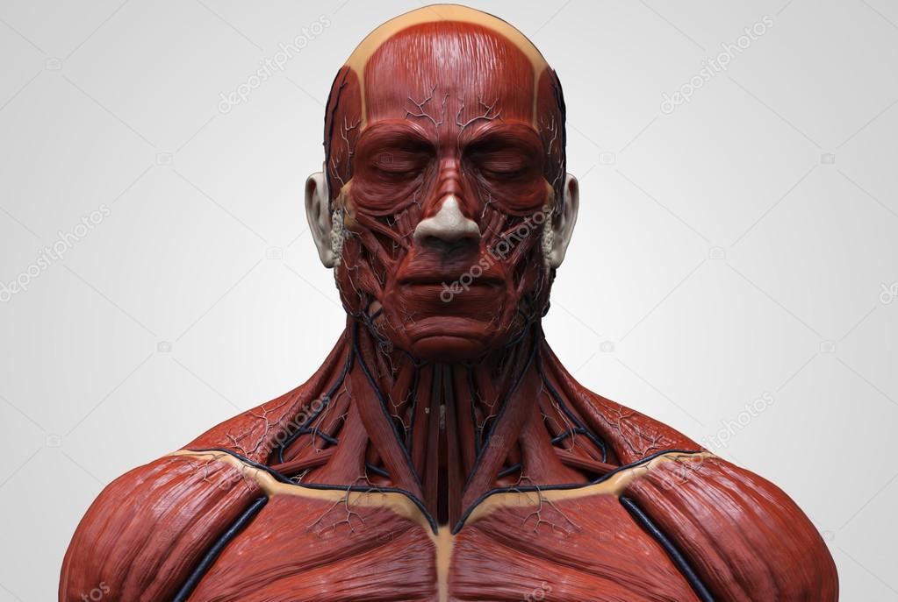
Web page
A typical web page consists of three parts:
HTML
JavaScript
CSS
We can think this webpage as a human’s face:
Bone
Muscle and skin
Make-up
Web page is essentially contents in web browser

Slide 11
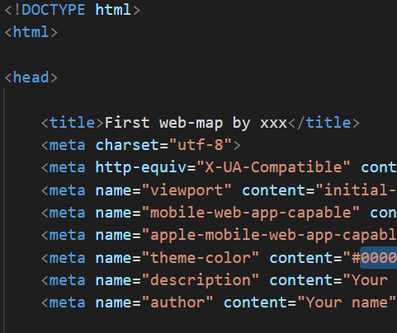
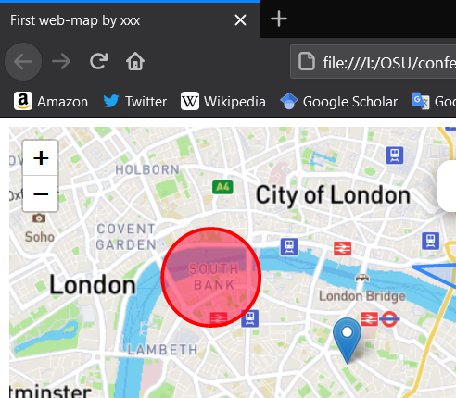
HTML – your bones
Hyper Text Markup Language (HTML)
Is essentially a rich-text file with some media
Like a word document, but written in codes
HTML is the foundation of the webpages
Translate by your web browser

Slide 12
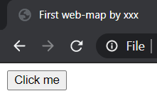
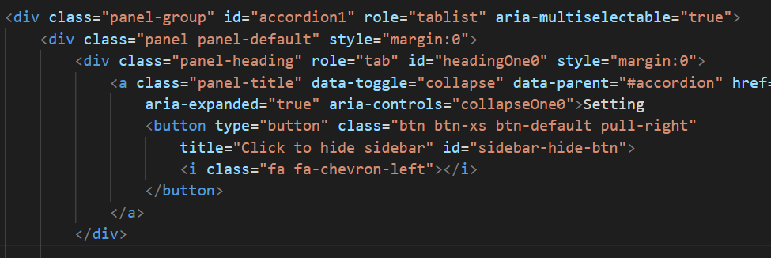

HTML element and tag
A webpage consists of different elements
Indicated by a part of tags, represent its type
<button>Click me</button>
- <button> shows it is a button
- “Click me” is the text on the element
Can include other elements, like onion
1
2
3
4
5
6

Slide 13
HTML tag attributes
Like a record in shapefile, a tag also have attributes
<a class="link" id="this-link" href="#">I am a link!</a>
Class -> a name for a group of elements
Useful to select or apply settings on many elements
Id -> a name for this specific element
Useful to select a specific element
Href -> the hyperlink attached to this element
There are many other attributes for different uses

Slide 14
HTML alone is not enough
HTML alone is static
- Hard to interact
- HTML alone can still show videos and GIFs
HTML alone is ugly
- It is not good-looking
- Hard to read, write, and maintain
HTML is NOT a programming language
- It is a markup language

Slide 15
Webpage basics - JavaScript

Slide 16
JavaScript – muscles and senses
JavaScript (JS) is a programming language
To support and manipulate HTML
Actions (functions)
- Can change contents
Reactions (events)
- Can detect and react to a change or input
- e.g.: background change after click a button
“JavaScript is not Java, just like ham is not hamster”
More on: http://javascriptisnotjava.com/

Slide 17
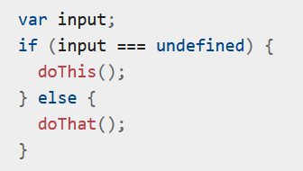
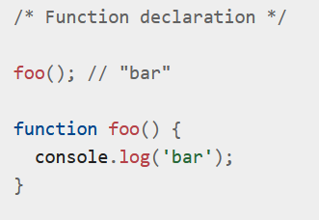
JS – basic grammar
JS has a very similar grammar like other scripting language
‘var’ or ‘let’: declare a variable
‘if’: conditional clause
‘function foo()’: define a function
‘foo()’: execute a function
Semicolon: recommended, but
not necessary
Comment: ‘//’(for a line)
or ‘/* */’ (for many lines)
Source: https://developer.mozilla.org/en-US/docs/Web/JavaScript/Guide/Grammar_and_types

Slide 18

JS – important data structure
List:
Square bracket: []
Simple and efficient to enumerate
But hard to find a specific one
Object:
Curly bracket: {}
Attribute-value pairs
Simple to enumerate and fast to find a specific one
But take twice space to store the same information
Source: https://developer.mozilla.org/en-US/docs/Web/JavaScript/Guide/Grammar_and_types

Slide 19
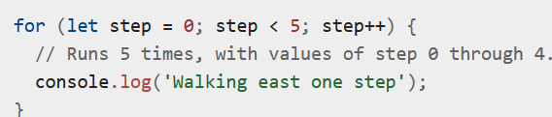
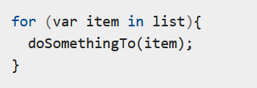
JS – for loop
Useful to repeat and enumerate data structure
Repeat for certain times
Start from 0, end at 5,
so the value will be
0, 1, 2, 3, 4
Enumerate
Variable ‘item’ is an item in the ‘list’
Source: https://developer.mozilla.org/en-US/docs/Web/JavaScript/Guide/Loops_and_iteration

Slide 20
JS library: jQuery
jQuery is a very useful library. Its function starts with a dollar sign ($) and usually two steps
Step 1: select the object(s)
Select an object: $.("#the_id")
Select a class of objects: $.(".the_class")
Step 2: do something or ask it react to something
Change the value of an input box:
$.("#input").val(“text changed!”)
Add an event to a button that when a user clicks it, show a text

Slide 21
JS – callback
JS has an anti-intuitive feature: many functions are asynchronous by default, for example:
Function A, B, and C; but B will take very long time.
Run:
A(): take 1 sec
B(): take 5 min
C(): take human
2 min
Python results:
0:01 - A is finished.
(human wait 5 min)
5:01 - B is finished.
7:01 - C is finished.
JS results:
0:01 - A is finished.
(human wait 1 sec)
2.01 - C is finished. 5:01 - B is finished.

Slide 22
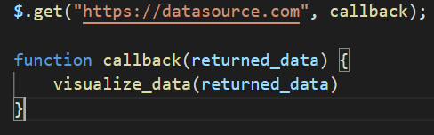
JS – make a request
Need to make requests to get data
$.get: the jQuery function to GET data. Has two parameters:
“datasource.com”: the online dataset URL
callback (function): what you will do to the data if data is available
returned_data: the returned data structure

Slide 23
Webpage basics - CSS

Slide 24
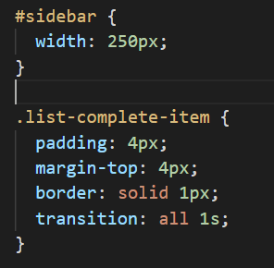
CSS – make-up on the face
Cascading Style Sheets (CSS)
Layout: position and sequence of HTML elements
Colors and fonts
For a specific object
Change its width to 250 pixel
For objects with this class name
Change padding to 4px
Change margin to the top to 4px
Change border style
Change transition style

Slide 25
CSS is hard
CSS seems trivial among the three, but requires much more work
Just like makeup, buy from professional
Try templates and libraries (bootstrap)
Can adjust according to demands

Slide 26
Summary
HTML is the bone
Foundation of a website
JS is the muscle and senses
Actions and reactions
CSS is the makeup
Layout and style

Slide 27

Combining the three
We need to include JS and css files and libraries to our main HTML to make them work
For JS:
For css:
Make sure adding your main JS and css AFTER other libraries to not fail the dependencies.

Slide 28
Web Browser

Slide 29

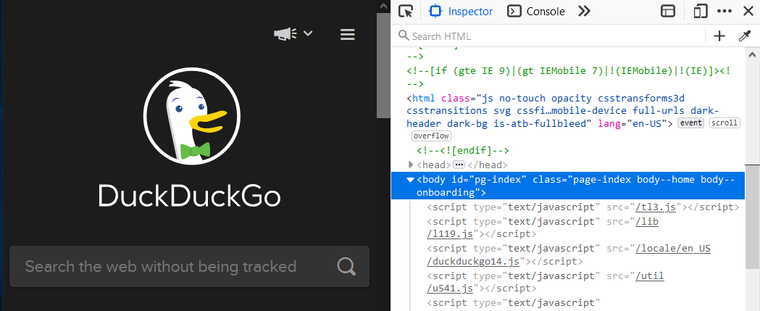
Understand your browser
It is a software that translate online HTML/JS/CSS codes into contents
Debug window: press F12 or right click -> inspect
Inspector: show elements in current HTML
: pick element on page and show HTML code
Important:
Current HTML may be different from the original HTML file you wrote, because your JS files will add and change the contents

Slide 30
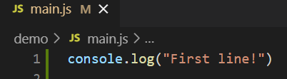
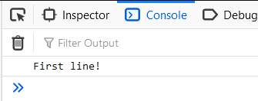
Web console
This is the JavaScript console for the current page
console.log(): Like print() in Python and R
Console will show the information printed from your JS code. Very useful for simple debug
You can change the current HTML contents by typing commands
For example, type document.body.innerHTML = “” in any page

Slide 31
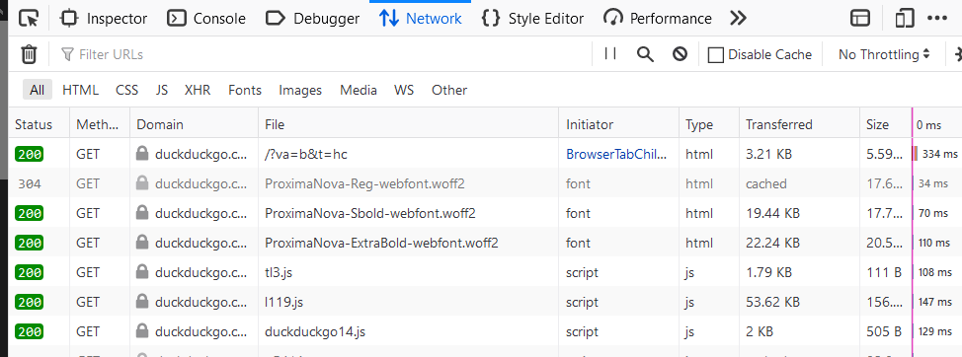
Network monitor
It will show all the traffic in the page
It is useful to see whether a file is loaded

Slide 32
CORS restrictions
Cross-origin resource sharing (CORS) is a rule that websites cannot request resources from other domains
aaa.com cannot directly request a CSV file hosted on bbb.com, even if it is a public file. This includes local files.
Instead, aaa.com can only request resources with aaa.com domains, such as aaa.com/file.csv
It is enforced by most web browsers
Solutions for local development:
Start a local server (localhost)
Use Firefox developer edition and CORS everywhere plugin

Slide 33
Mapping library

Slide 34
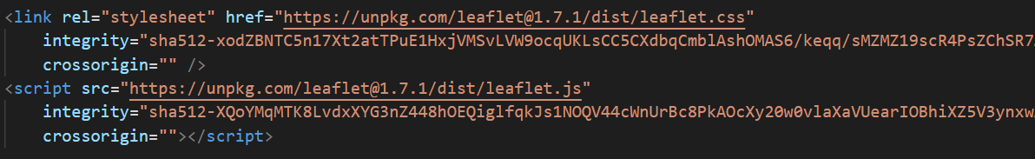
Leaflet
A very useful JavaScript library to support mapping
Adding the library:
Just like jQuery’s $, Leaflet’s functions start with L
e.g. Adding a map object to HTML element with id = “mapid”
A JS leaflet map
Leaflet’s create map function
Targeted HTML element
Method to set the map to a specific view
The view’s latlng
The Zoom level
Human language translate: Leaflet, create a map on the HTML element called “mapid”, and set my view to this place with this zoom level

Slide 35
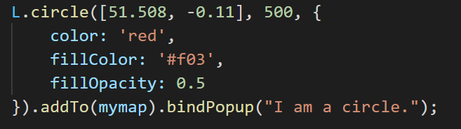
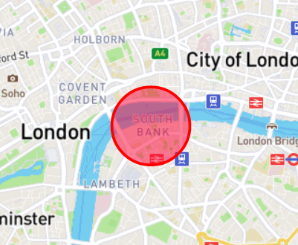
Other leaflet components
Layer: Raster layer (L.tileLayer, including base layers), vector layer…
Other single symbols: circle (L.circle), polygon…
Information media: popup
All elements must addTo(mymap) to show on the map
Desired location
Radius
Add to the map
Add a popup with this content on this circle

Slide 36
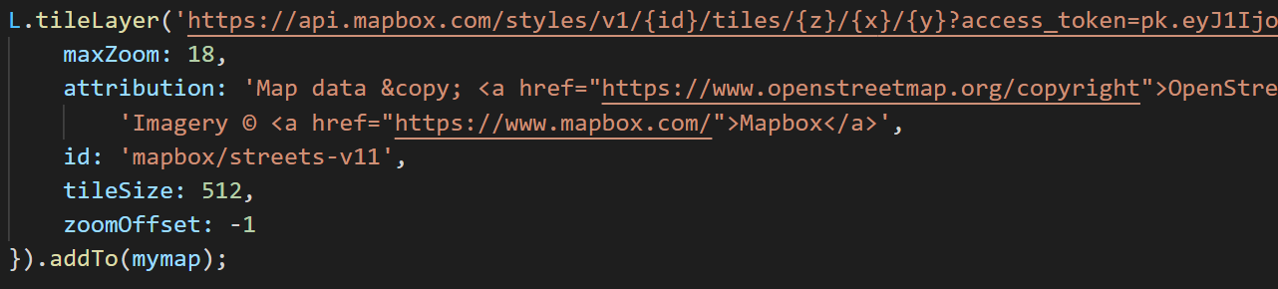
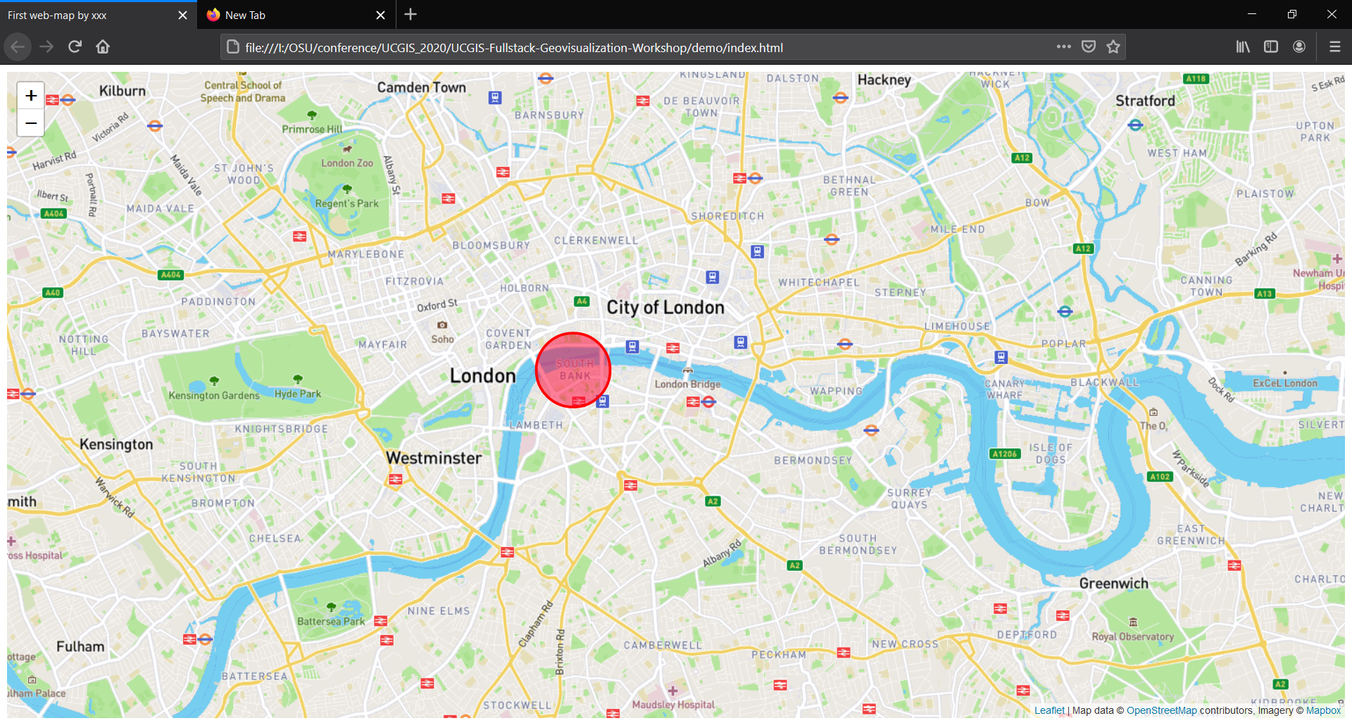
Add a map box base Layer
You now have a web-map!

Slide 37
Frontend lab agenda
Fork the repository in GitHub
Open project in Visual Studio Code
Follow the frontend_instruction.docx or the video
Goals:
Host the demo on GitHub Page and confirm
Retrieve and visualize a geoJSON
Host the updated web page

Slide 38
Go online?

Slide 39
Solutions to host a website
Borrow or buy a server
- A server is an online computer that works 24/7.
- It can support a back-end and more actions
GitHub Pages
- Can only support a website without back-end
- Free and persistent
- Go to your forked GitHub page -> settings -> Pages -> Source -> select main
- access by: youname.github.io/UCGIS-Fullstack-Geovisualization-Workshop/demo

Slide 40
GitHub and Git
Git is a version control software
Record your every committed change
GitHub is a free website to host these changes
To save your changes on the online map:
Commit: record your current change to local
Push: upload your files to the GitHub server
In few minutes, the Pages will update your change

Slide 41
Back-end lecture

Slide 42
What is front- and back-end?
In web development, generally:
Front-end focus on user interface
Anything that happens in your web browser
- HTML, JS, CSS
Back-end focus on server and infrastructure
- Database
- API that serves the data in the database
- MongoDB and Python-eve

Slide 43
Backend checklist
Python 3
EVE library in Python: pip install eve
MongoDB
Robo3T: MongoDB

Slide 44
How a good backend support your research?
Scales well for big data
Compatible for different platforms
- Python, R, NodeJS, webpage...…
Easier to manage compared to separate files
Easy to use for different purposes
- Scientific calculation, visualization……

Slide 45

Database
Reasons to use a database
Scalable
Organized
Easy to read and write
Secure
……
e.g. PostgreSQL, mySQL,
MC access
No-SQL: MongoDB
Not a SQL database
Not relational
Flexible
Fast
Distributed
“basically a csv file”

Slide 46
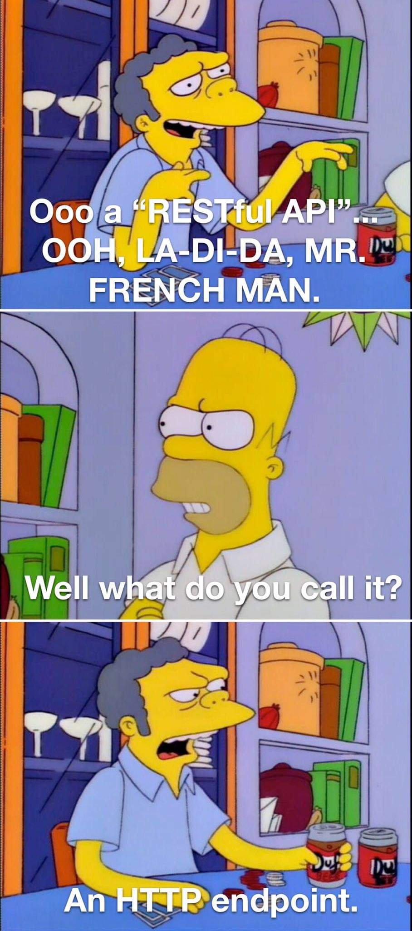
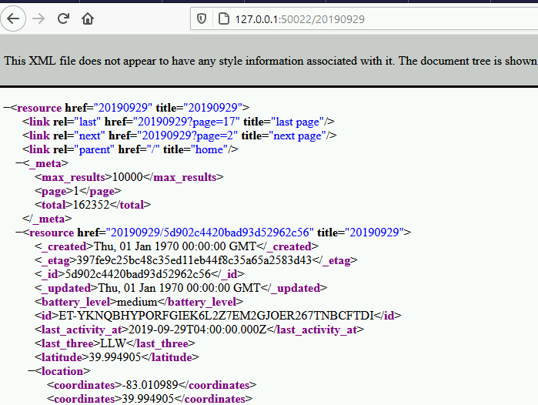
REST API for database
API: application programming interface
A running service to feed the data in your database
Other services can access data by an http address (URL)
API returns data as a JSON or xml file

Slide 47
Structure
HTML
Other analysis codes
JavaScript
API
Css
MongoDB
Frontend
Backend

Slide 48
Backend lab goals
Import the csv file to MongoDB
Reproduce an eve mongoDB REST API and run it locally
Connect the backend and frontend

Slide 49
Thanks!
liu.6544@osu.edu

