Slide 1
Fullstack Geo-visualization 101: How to Make Productive Webmaps
Luyu Liu
Department of Geography
The Ohio State University
Notes:
Hellow everyone, welcome to my presentation today! My name is luyuliu, my title is ///////

Slide 2
Learning Objectives
By the end of this workshop, you should be able to:
Explain the structure of web pages
Report the functions of HTML, JavaScript, and CSS
Define common JS libraries for mapping
Reproduce a simple static webmap
Share the webmap with GitHub Pages
Reproduce a simple back-end with MongoDB and python-eve (for back-end part only)

Slide 3
Agenda
Minilecture (4:00 – 4:30pm EST)
Front-end lab (4:30pm – 5:10pm)
Short break and Q&A for front-end part (5:10 – 5:20pm)
Back-end lab (5:20pm – 5:50pm)
Free Q&A time (5:50pm – 6:00pm)

Slide 4



Front-end checklist before we started
You should already install these software
Visual Studio Code
GitHub Desktop and your GitHub account
Firefox browser developer edition
This slide
Our demo package. Fork this project: https://github.com/luyuliu/UCGIS-Fullstack-Geovisualization-Workshop

Slide 5
Geovisualization

Slide 6
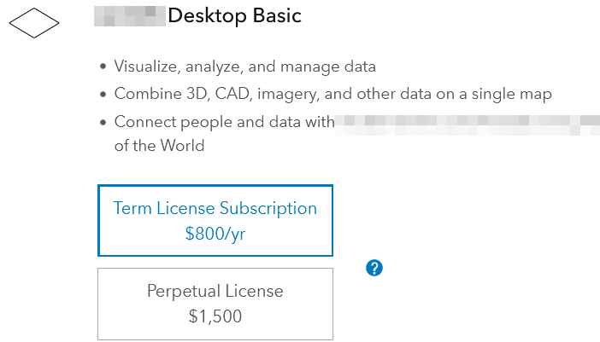

Why web-map? Accessible
Open source
- No cost for users
- Reusable for developers
Few dependency
- Only browser
- No installation
- No prerequisites

Slide 7
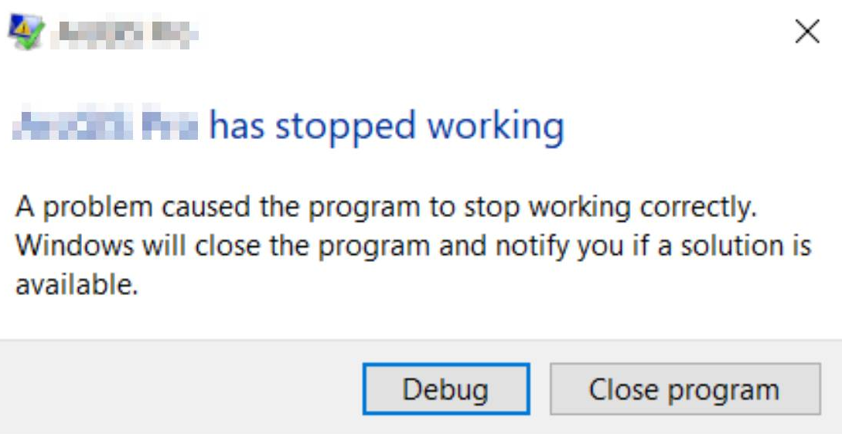

Why web-map? Robustness
Persistent
- Online 24/7
- Low risk of failing
Compatible
- Cross platforms
- Touching screen
friendly

Slide 8
Webpage basics

Slide 9

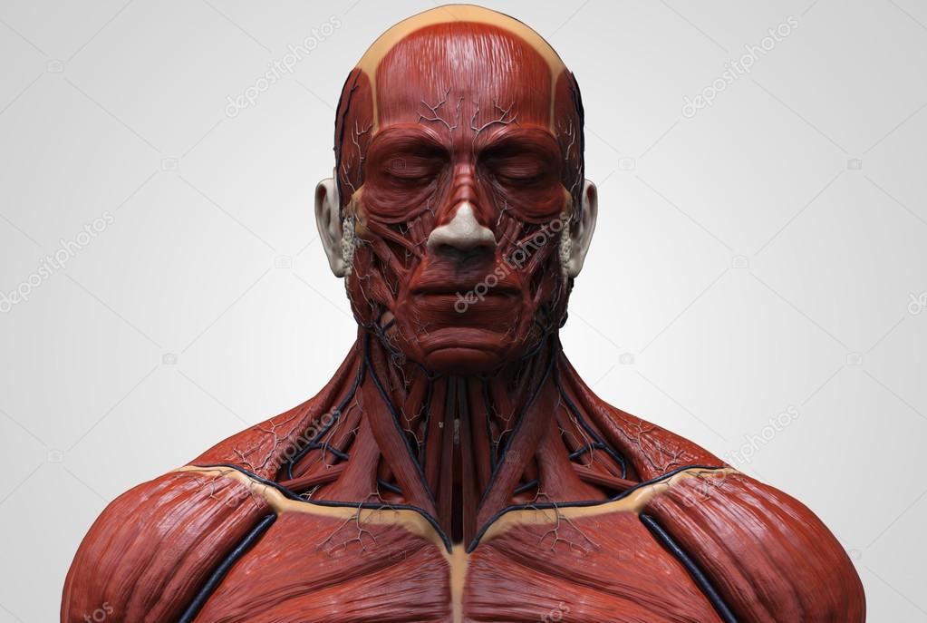
Web page
A typical web page consists of three parts:
HTML
JavaScript
CSS
We can think this webpage as a human’s face:
Bone
Muscle and skin
Make-up
Web page is essentially contents in web browser

Slide 10
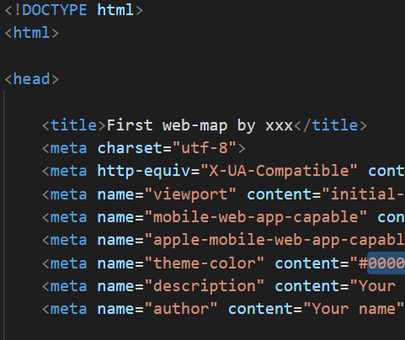
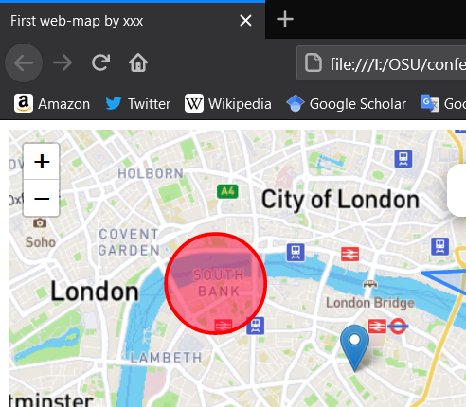
HTML – your bones
Hyper Text Markup Language (HTML)
Is essentially a rich-text file with some media
Like a word document, but written in codes
HTML is the foundation of the webpages
Translate by your web browser

Slide 11
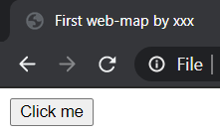
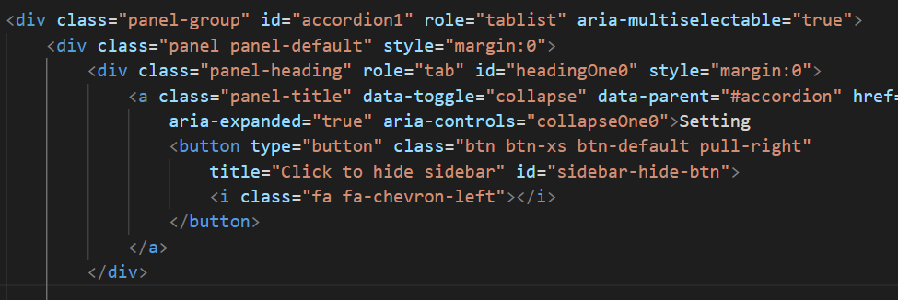
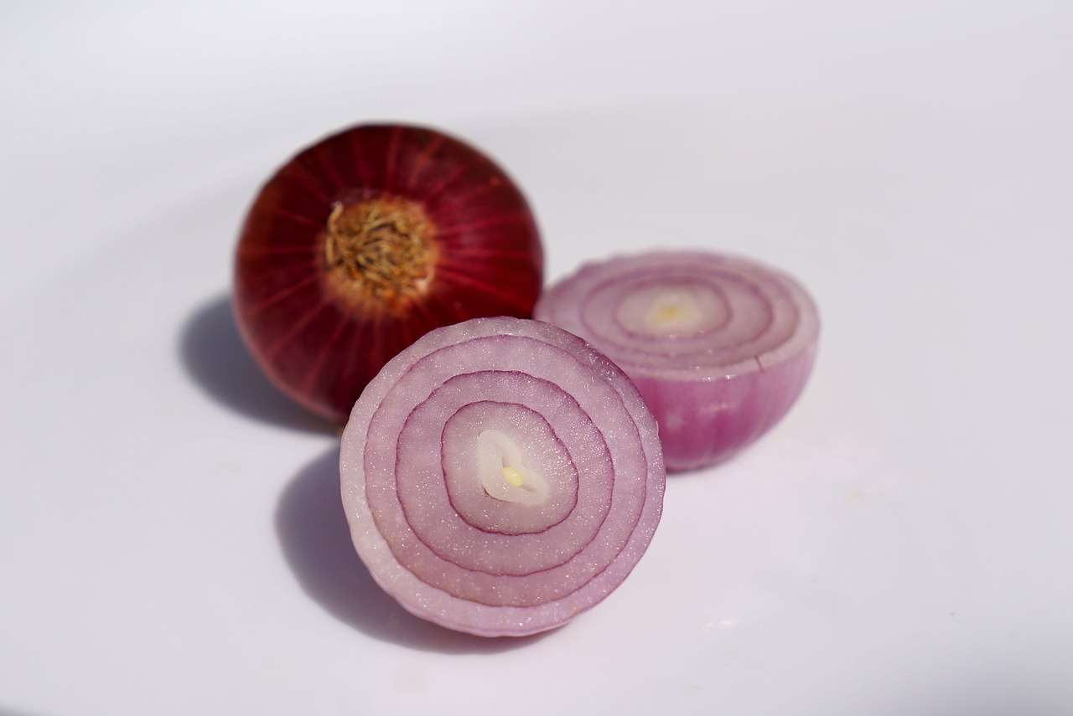
HTML element and tag
A webpage consists of different elements
Indicated by a part of tags, represent its type
<button>Click me</button>
- <button> shows it is a button
- “Click me” is the text on the element
Can include other elements, like onion
1
2
3
4
5
6

Slide 12
HTML tag attributes
Like a record in shapefile, a tag also have attributes
<a class="link" id="this-link" href="#">I am a link!</a>
Class -> a name for a group of elements
Useful to select or apply settings on many elements
Id -> a name for this specific element
Useful to select a specific element
Href -> the hyperlink attached to this element
There are many other attributes for different uses

Slide 13
HTML alone is not enough
HTML alone is static
- Hard to interact
- Hard to read, write, and maintain
- However, HTML alone can still show videos and GIFs
HTML alone is … ugly

Slide 14
Thanks!
liu.6544@osu.edu

