Slide 1
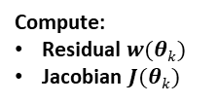







Start
Initialise: $k=0$; $θk$
Model:$\dot{x}=f(x\left(t\right),θ)$
Synthetic Data:$x$
Simulate Model:
$$\hat{f}(x\left(t\right),θk)$$
Compute:
Residual $w(θk)$
Jacobian $J(θk)$
$k=k+1$
Compute:
Next Step $θk+1$
If
No
Meet stopping criterion
Yes
Output $θk$

