Slide 1

Natural Language Processing
Prompt evolution and optimization

Slide 2
Objective
The final objective is the understanding of prompt engineering and how it impacts the answer of a model
The main focus is to use a generative AI to generate new prompts that are more competitive than the previous one and that can better solve generic logical problems

Slide 3

How the system works
The first module is called data_handler and it’s used to manage the data retrieved from BIG Bench
Second module, llm_client, sends the request to the model and generates answer.
The third and last module is prompt_evolver, and it is the core of the project: it gets the answer, evaluate it using a llm as a judge and run the evolution using a simple score metric that it stores during training

Slide 4
Answer evaluation
The answer evaluation is done using llm as a judge. The first studied model wasn’t really evaluated because, as we have seen, it wasn’t able to solve any problem and suffered heavily from hallucinations.
The other two models instead are able to reason correctly, the smaller model presents limits in the reasoning, while the last model used (7B parameters) is much better but also much more costly.

Slide 5
Prompt evolution
The evolution of the prompt is done in two stages:
A single error of the resolver on a certain prompt is passed in a prompt to the evolver and evaluated, and an abstraction of the error is done from it
The abstraction is passed to the second prompt and it is used to generates a new, improved prompt.
The new prompt is tested and, if it perform better than the old best prompt, it’s taken as the new champion (similarly to genetic algorithm)

Slide 6
Metric used
A batch evaluation is used, and for each of the n steps of evolution (so it is possible to choose how many prompts generate) the algorithm gets a finite number m of samples from the training set(they are the same for all the prompts) and tests them on the prompt, then the accuracy is calculated from the llm judge, meaning that the answers that it classifies correctly are actually contributing to the final score of the prompt. In the end the best prompt is given and tested on random logic problems drawn from the evaluation set against the initial prompt to check if there is an actual improvement.

Slide 7
Qwen
I used Qwen 0.5B as a first try, a little model with very few parameters. Even the prompt evolver(which has to propose new prompt) wasn’t able to adapt well. Such a small model wasn't able to handle the reasoning and, while often trying to generate code to order the problem it had to solve, the reason was a complete failure. Failing even at the basic level, like to use <answer> after its reasoning, made the model produce useless noise, that eventually caused a prompt drift where the model started to only write code, often not linked to the task it had to solve

Slide 8

Visible hallucination
A model with such a modest level of abstraction, unable to reason correctly, when losing track of what to generate, started to hallucinate and generate code in Chinese (surprisingly the words used were often linked to the problem explored).

Slide 9

1.8B model
Next step was trying to use a model with more parameters like Qwen 1.8B, which gave much better performance.
It was able to follow small instructions and understand reasoning

Slide 10

Model limit
While it can handle small instructions, trying to put a set of rules was too hard for the model, especially tasks such as DO NOT were ignored if not misinterpreted. The prompt evolver was provided with specifical instructions for this model, in such a way that it provides easy prompt without too many reasoning involved, that just confuse it.

Slide 11
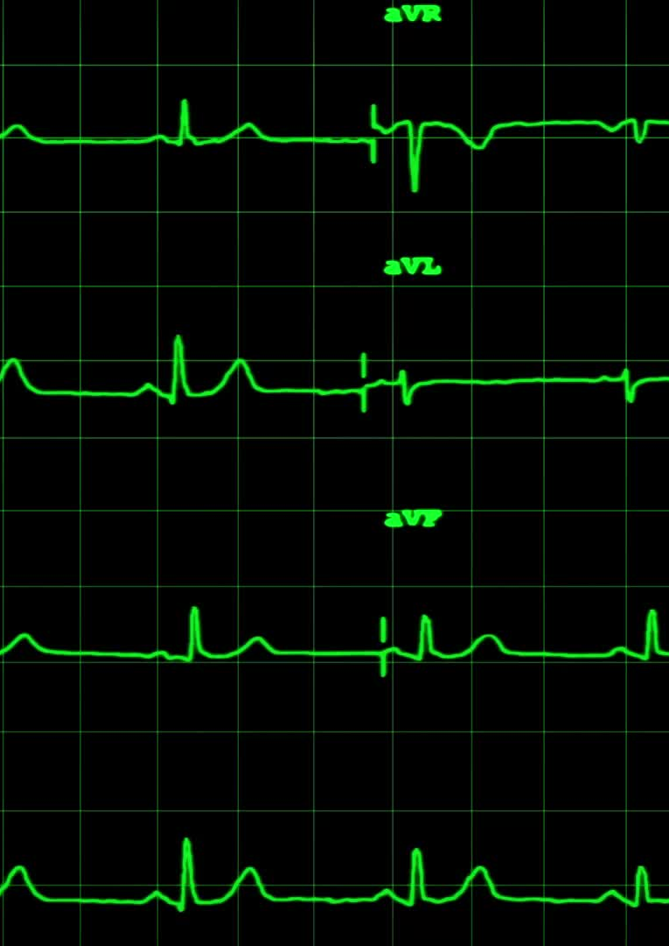
Few shot prompting
Instead of using a ruleset I decided to try few shot prompting, giving both negative examples and positive ones, and it contributed vastly to boost the performance of the model.
For the answer construction 150 tokens were too few and the model, which started to reason, wasn’t able to finish the reasoning

Slide 12

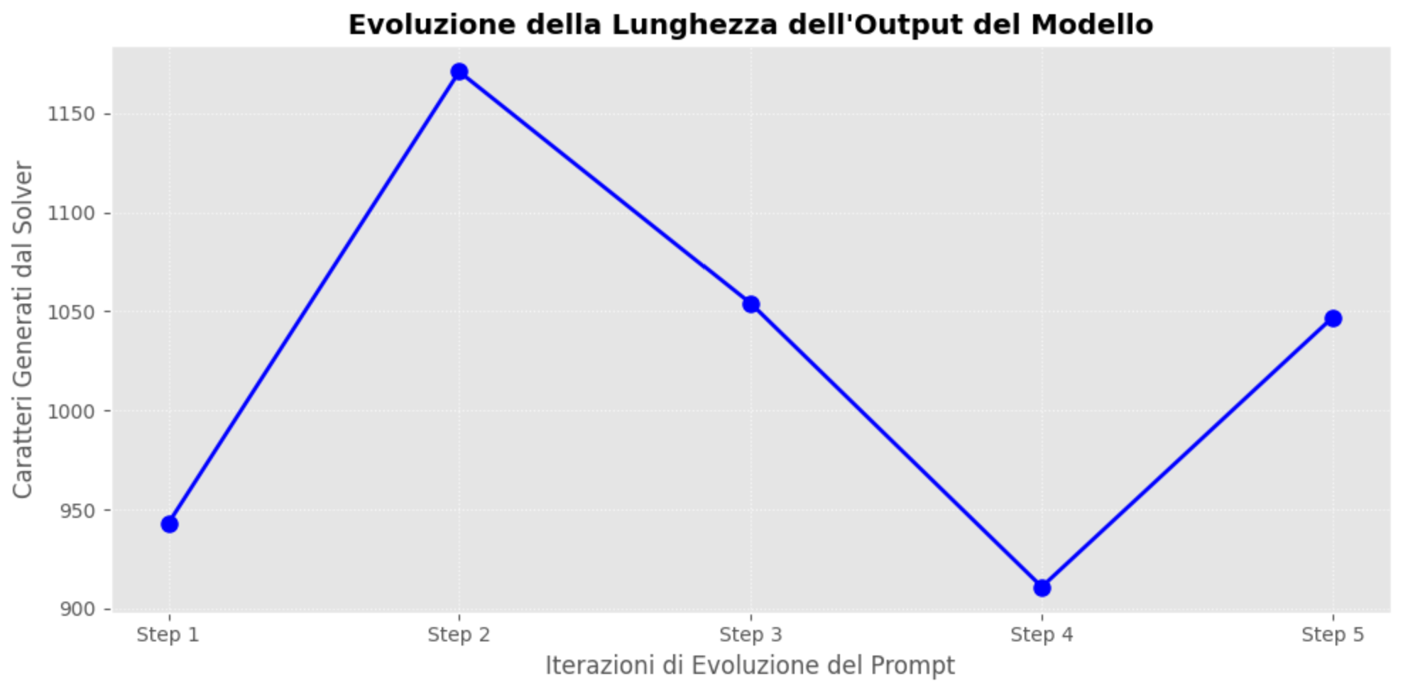
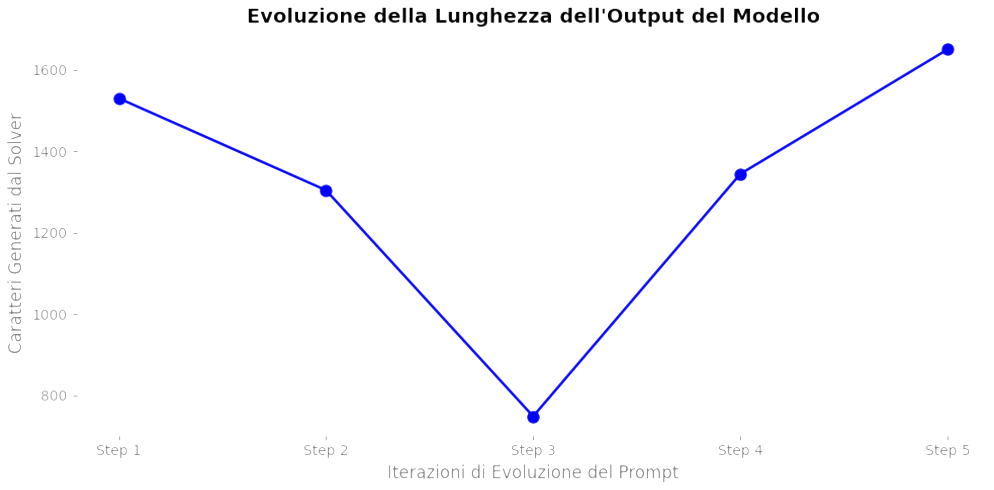
Token limit
Boosting the token limit easily solved the problem, we can see on the left how many characters a model had to write and so it was crucial to extend the token limits to let both the judge and the model that anwers to logical problems reason correctly.

Slide 13

Model collapse during reasoning
While the evolver understands its task (which does not have many instructions or logical thinking) the model was lacking during the reasoning part, and, while the reasoning could feel sometimes correct, it wasn’t really able to understand what it was doing. In particular it wasn’t able to count properly or establish a connection between words like oldest and newest and an ordered list.

Slide 14
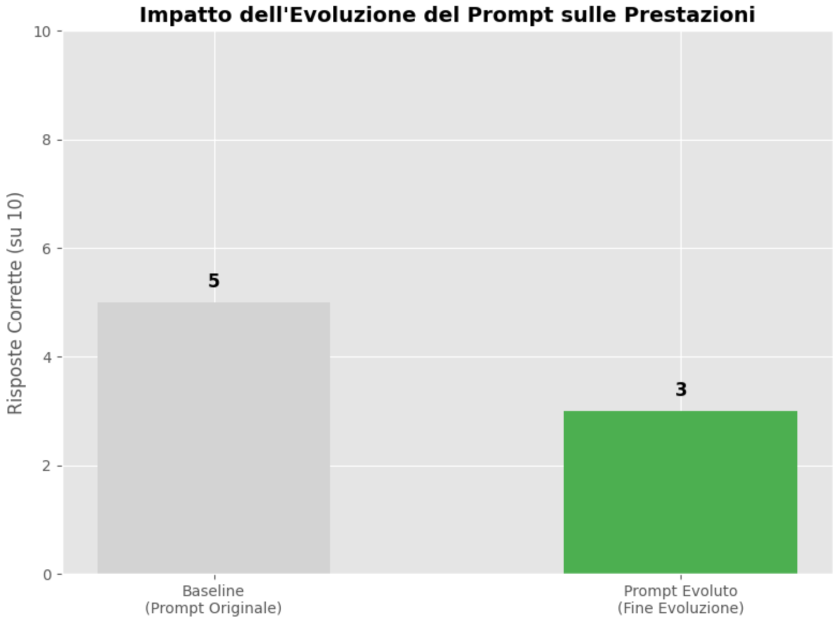
To confirm the model collapse here is a real performance analysis taken from the experiment: while the prompt performs better during the training, it fails because the judge misses the evaluation completely.
As a next step, an improvement in parameters (especially for the judge) was required.

Slide 15
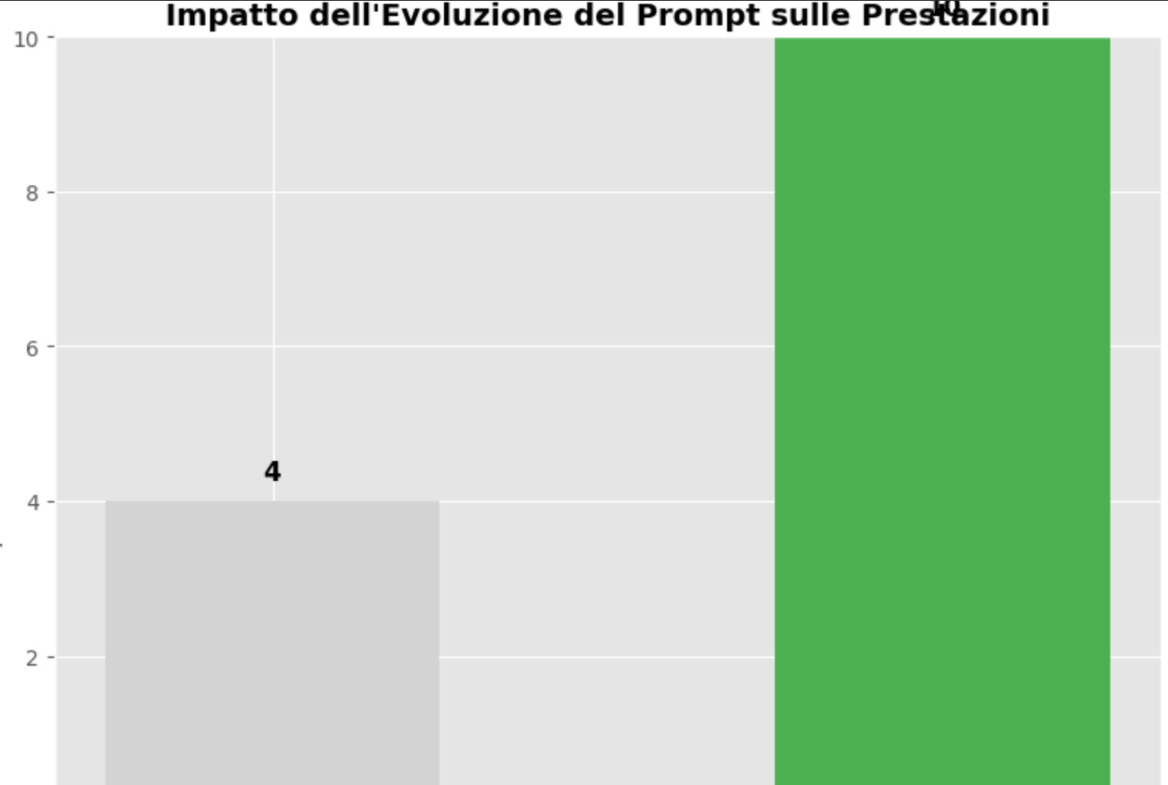
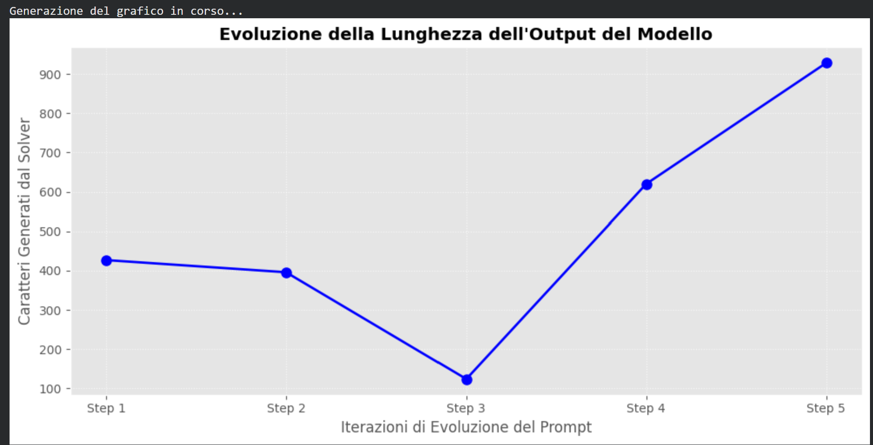
Qwen 7B
By switching to Qwen 7B the performance are much higher, but the model isn’t really able to evaluate answers, and shows a problem of sycophancy where the model tend to autojustify its own reasoning. The best prompt catches the max rate but observations on the judge imply that it tends to pass an answer as correct even when the model hallucinates on the reasoning.

Slide 16
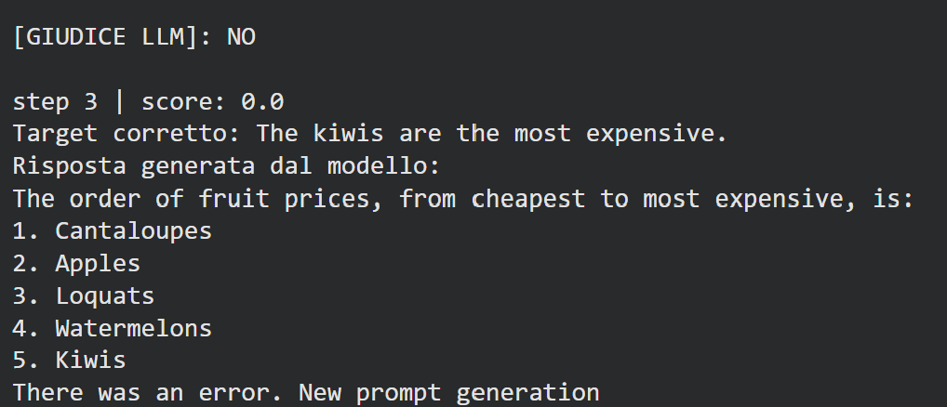
Hallucination in llm as a judge
While the reasoning model is pretty good at reasoning, the judge struggles when it’s presented with a correct answer and a list, to link them together and understand their relation. This was solved by asking it to reason step by step and adding more token for the reasoning.
Still when it wasn’t able to carry out a correct reasoning it tends to just answer [YES].

Slide 17
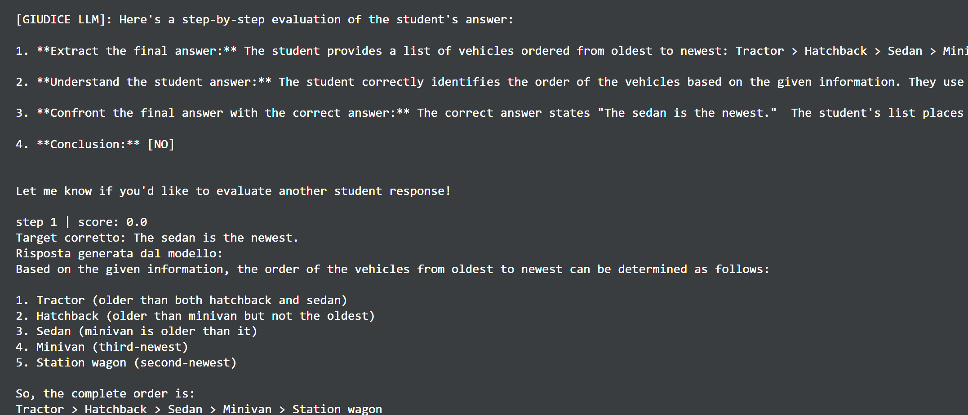
The solution: Gemma 9B as a judge
As a solution i decided to implement gemma 9B as a judge to get rid of the sycophancy problem that the model suffered when auto-evaluating itself. the new judge is less error prone and gives a better analysis overall.

Slide 18
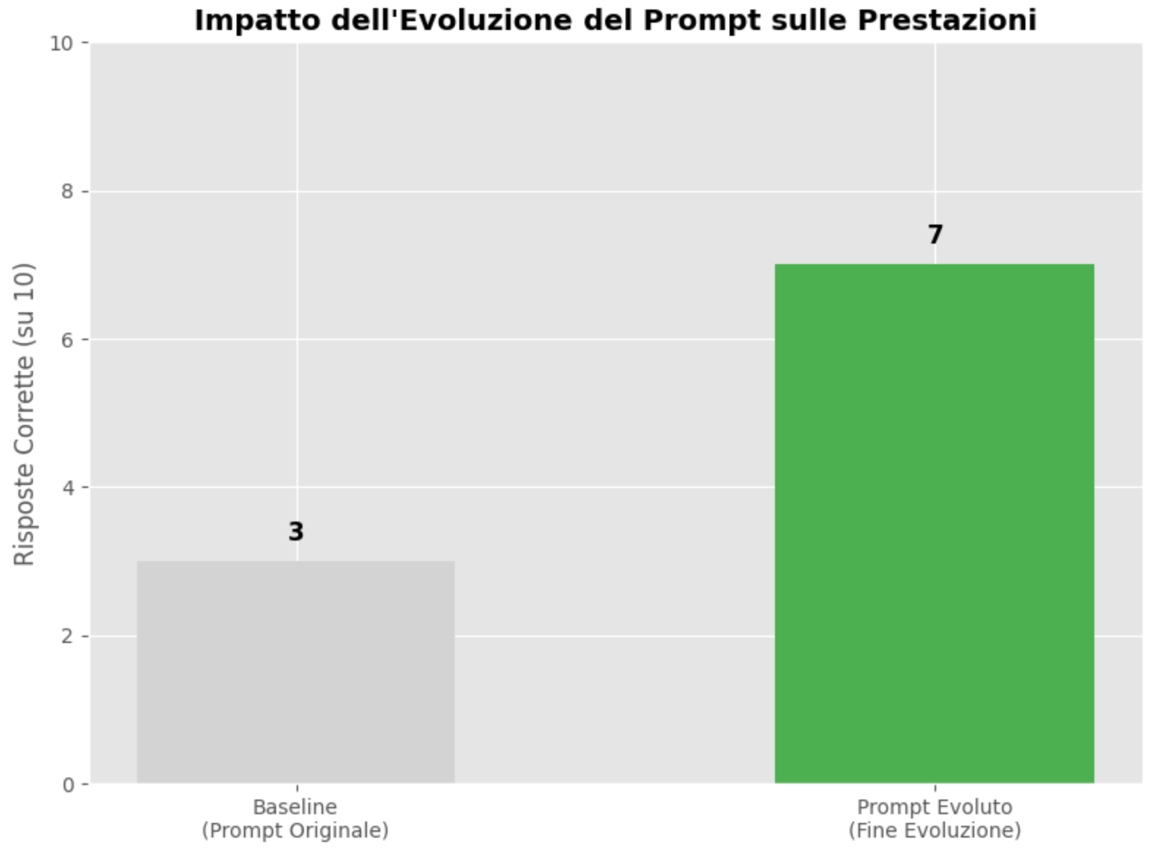
Correct prompt evolver
Also the prompt evolver was switched to Gemma 9B so even smaller models could attempt reasoning tasks. In fact smaller models were not able to adapt and evolve tasks in a general way and to reason about the dynamics that let the reasoning fail. After all those changes the final score is:

Slide 19

ProTeGi to increase prompt evolution

Slide 20
The last problem to solve was the prompt evolver overfitting to the specific answer that it tried to solve, presenting a new prompt that was specific to that question
To solve that ProTeGi(Prompt optimization with textual gradients) was used, using a two step pipeline
In the first step the failure is analyzed by the evolver, and the reason of the error was extracted.
In the second step the prompt received from the evolver contains the abstraction of the error and the failed prompt, without directly passing the question. This showed an improvement in the overall prompt production, which doesn’t overfit anymore.

Slide 21
Final implementation
After all the setting and adjustment, the final implementation uses:
A member of Qwen family as the student/reasoner
Gemma as judge/evaluator
Gemma as the prompt evolver, that guide the evolution

Slide 22
THANKS FOR YOUR ATTENTION

