Slide 1
INTRODUCTION
Name : Harmesh Pandya
Project Name : Building Python Based Calculator
Organisation : NextHikes IT Solutions

Slide 2
WHAT HAVE I CREATED
I have created Python Based Calculator.
I have created GUI based Calculator.
Calculator which I have created has 16 Buttons through which user can interact.
It has addition +, Subtraction-, Multiplication *, Divisoin /, Equal = & C functions.

Slide 3
LIBRARY USED
I have used Tkinter library.
I found it easy for beginner like me.
Tkinter in included in Python, so no need to install seperatly

Slide 4
CHALLENGES I FACED
While I looked first at the project, I got completely blank as if from where to start the project.
I recalled the days when I was learning to use Computer, MS Excel & MS Word for the first time.
After that I have gone through python lessons and some of you tube videos to understand the coding.
This is the first time where I have tried to create something exciting though Coding.
While doing this project - I came across Tkinter library for very first time & hence, not been able to understand whole part of it. But, I actually leaned how to set the coding and think about putting coding logically.
Github is again all new concept for me which I learned.
At the end I felt like I learned some good creative concept after long time of my professional career and really excited to learn more concepts like this.

Slide 5
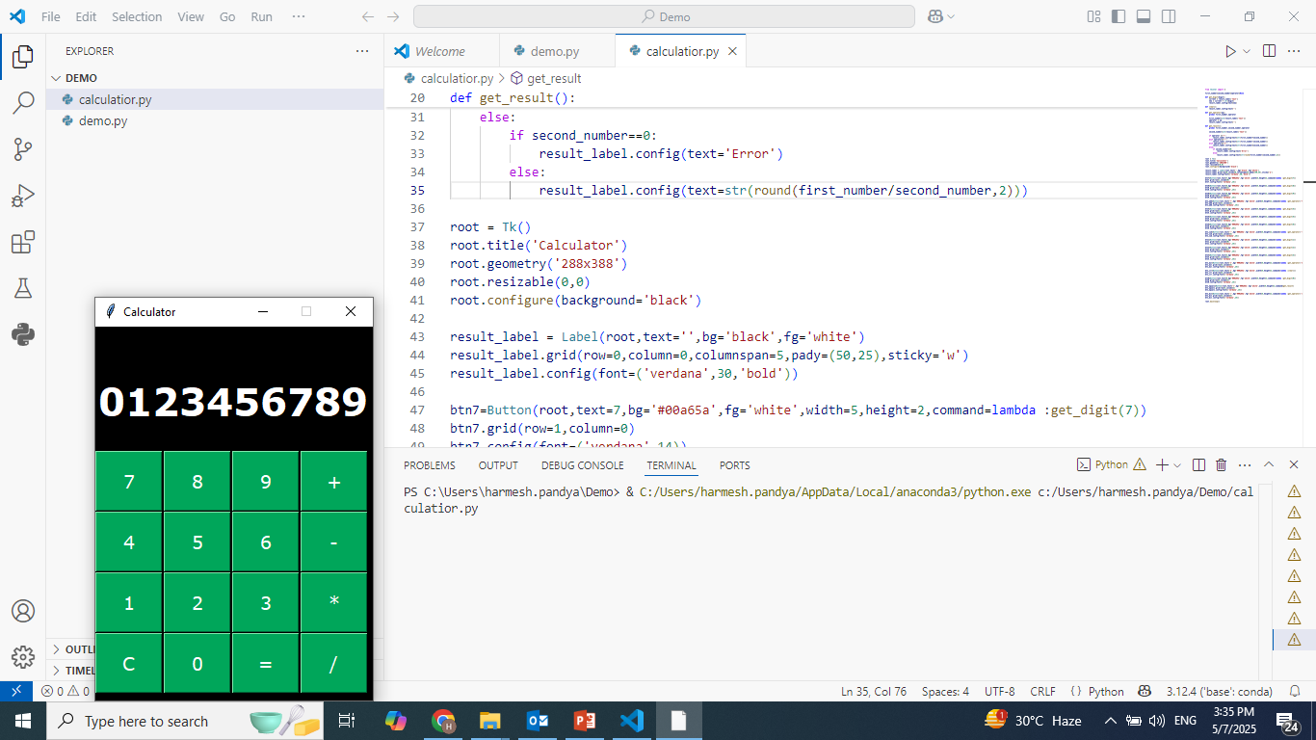
SCREEN SHOT OF CALCULATOR

Slide 6
THANK YOU

