Slide 1
INTRODUCTION
Name : Harmesh Pandya
Project Name : Data Wrangling on given Data sets
Organisation : NextHikes IT Solutions

Slide 2
LIBRARY USED
Numpy
Pandas
Matplotlib
Seaborn

Slide 3
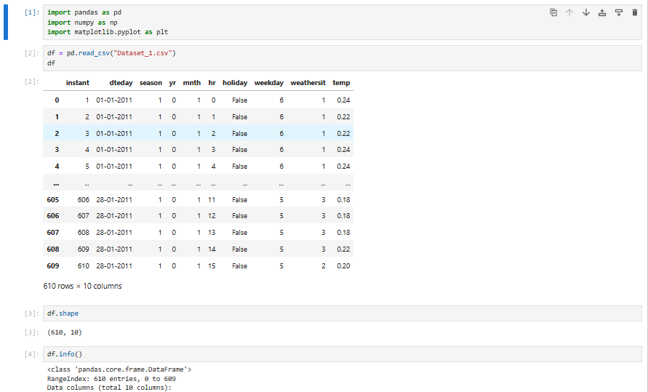
DOWNLOADED DATA SET 1

Slide 4
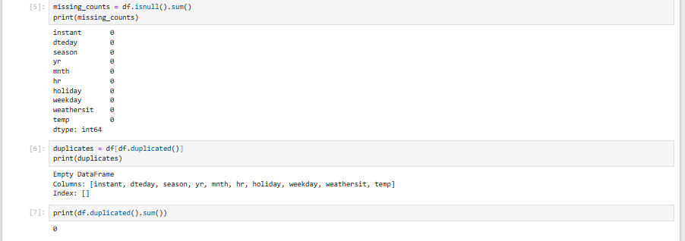
FOUND MISSING COUNTS OF DATA SET 1

Slide 5
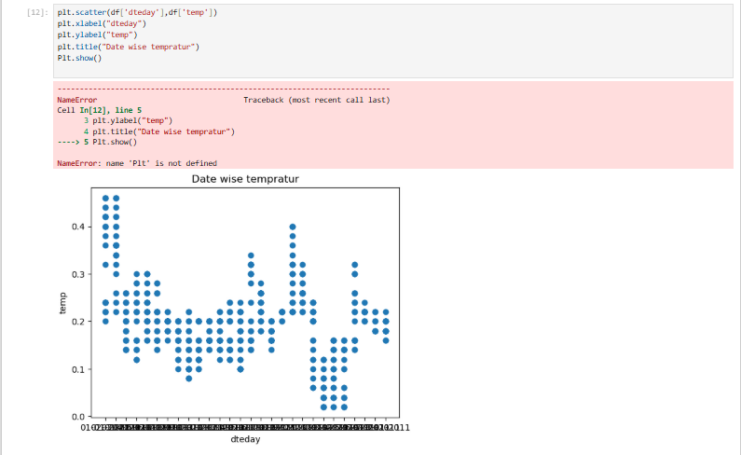
DATA VISUALISATION – DATE WISE TEMPRATURE

Slide 6
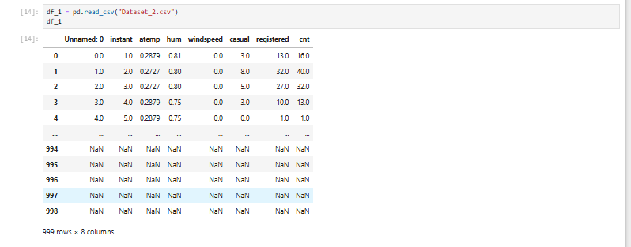
DOWNLOADED DATA SET 2

Slide 7
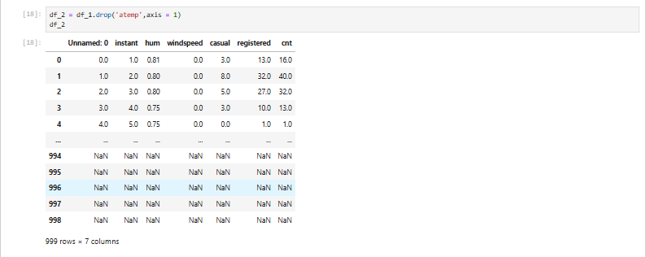
DROPPED “atemp” COLUMN

Slide 8
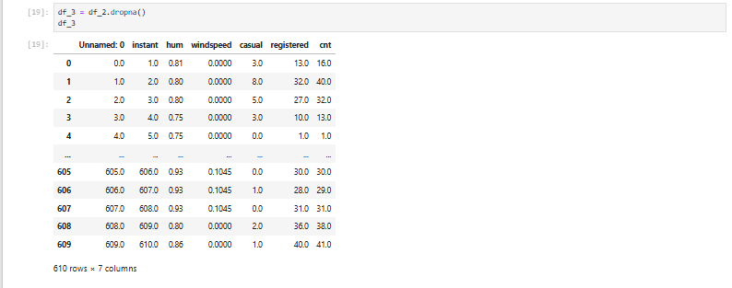
DROPPED ROWS WITH “NaN”

Slide 9
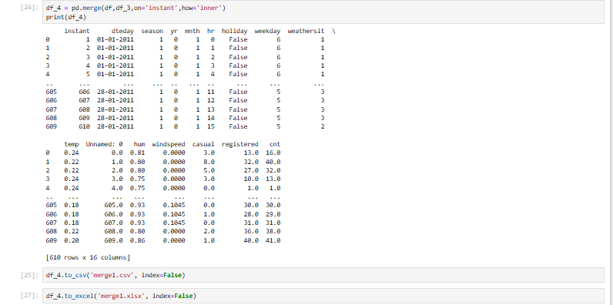
MERGED DATA SET 1 & 2

Slide 10
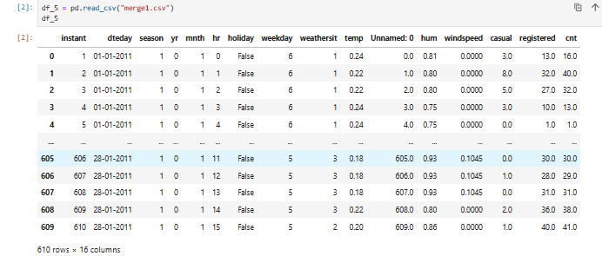
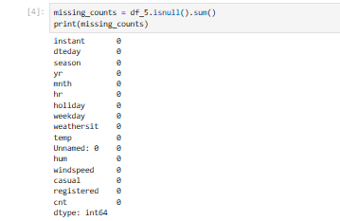
DOWNMOADED MERGED DATA SET 1 IN NEW NOTE BOOK & CHECKED MISSING VALUES

Slide 11
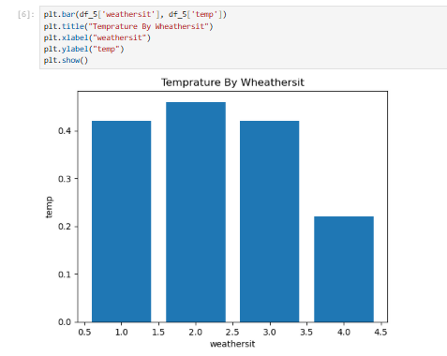
HAVE CHECKED TEMPRATURE BY WEATHER

Slide 12
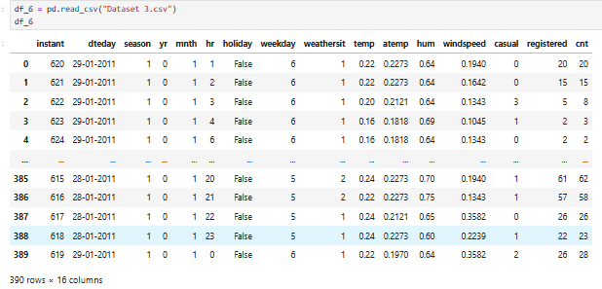
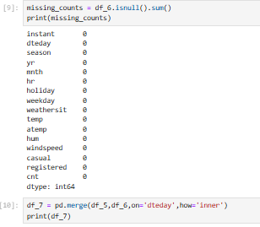
DOWNLOADED DAT SET 3 & CHECKED MISSING VALUES OF DATA SET 3 & MERGED THE DATA OF MERGED DATA SET 1+ DATA SET 3

Slide 13
CHECKED THE OUTLIER & SKEWNESS OF EACH COLUMN OF MERGED DATA SET 2
Have removed Outliers by following steps
Have checked the box plot of the each Column
Calculated skewness of each column
Calculated 25th & 75th Percentile
Calculated IQR
Calculated the upper Limit and Lower Limit
Crated new data frame
Replaced the Outlier values with Logic that if Outlier Value is greater than Upper Limit then it will be replaced with upper limit else if it is lower than lower limit then it will be replaced with lower limit else if it is within upper and lower limit then it will remain unchanged
Finally checked & compared column status before and after removing outliers
Screen shot of such column is shown in slide below

Slide 14
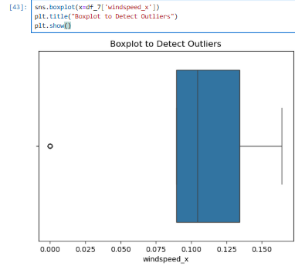
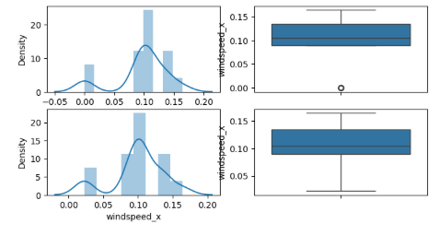

Slide 15
THANK YOU

