Slide 1
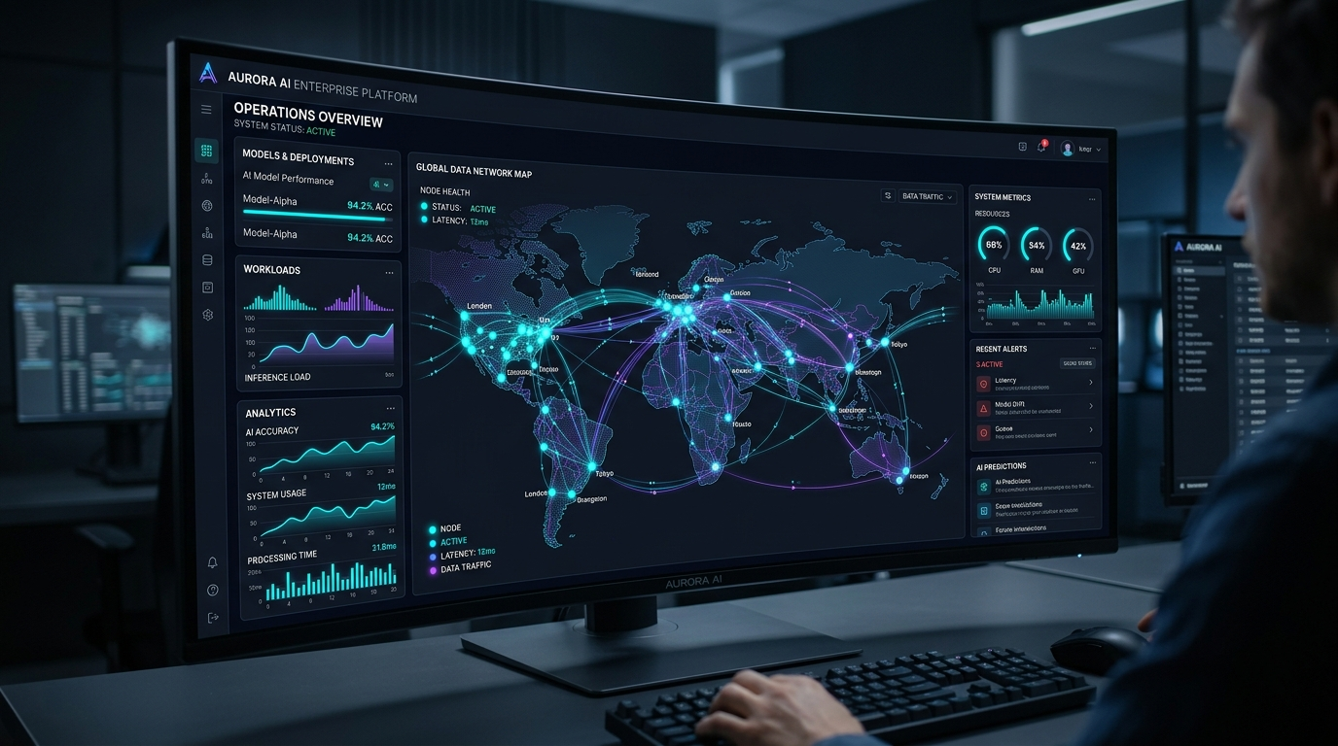
VENUS GLOBAL TECHNOLOGY | EXECUTIVE PITCH DECK
EXECUTIVE COMPANY PITCH DECK
VENUS GLOBAL TECHNOLOGY
AI Skills, Capabilities & Enterprise Solutions
Empowering modern organizations with autonomous multi-agent networks, domain-tuned LLM reasoning, and deep ERP integration across finance, supply chain, and operations.
45%
3.8x
70%
99.8%
Operational Speedup
Average Enterprise ROI
Process Latency Cut
Audit Accuracy
SLIDE 01 / 31

Slide 2
VENUS GLOBAL TECHNOLOGY | EXECUTIVE PITCH DECK
02 — EXECUTIVE SUMMARY
Building Intelligent Enterprises
Modern organizations sit on vast amounts of structured and unstructured data, but traditional enterprise systems remain passive. Venus Global Technology bridges this gap by embedding active AI capabilities into core operations.
CORE MISSION
TECHNOLOGY EDGE
PARTNERSHIP VALUE
Active Enterprise Intelligence
Domain-Trained Models
Kraey Globe Synergy
Transform static databases into self-reasoning workflows that execute transactions, spot anomalies, and trigger proactive alerts.
Custom fine-tuned LLMs trained on finance, supply chain, and compliance schemas to ensure deterministic precision without hallucinations.
Combining Venus's AI engineering prowess with Kraey Globe's deep functional enterprise consulting to deliver rapid transformation.
SLIDE 02 / 31

Slide 3
VENUS GLOBAL TECHNOLOGY | EXECUTIVE PITCH DECK
03 — INDUSTRY CONTEXT
Why Enterprises Need Intelligent Transformation
Legacy enterprise software creates operational friction. Business velocity is throttled by disconnected silos, manual approvals, and reactive reporting.
THE LEGACY CHALLENGE
THE VENUS SOLUTION
Passive Systems & Data Silos
Autonomous & Connected AI
Traditional ERPs require manual user input for every transaction. Data sits locked in static tables, forcing decision-makers to rely on outdated end-of-month reports.
AI agents operate directly inside your software ecosystem—continuously monitoring data streams, executing routine tasks, and delivering instant predictive insights.
SLIDE 03 / 31

Slide 4
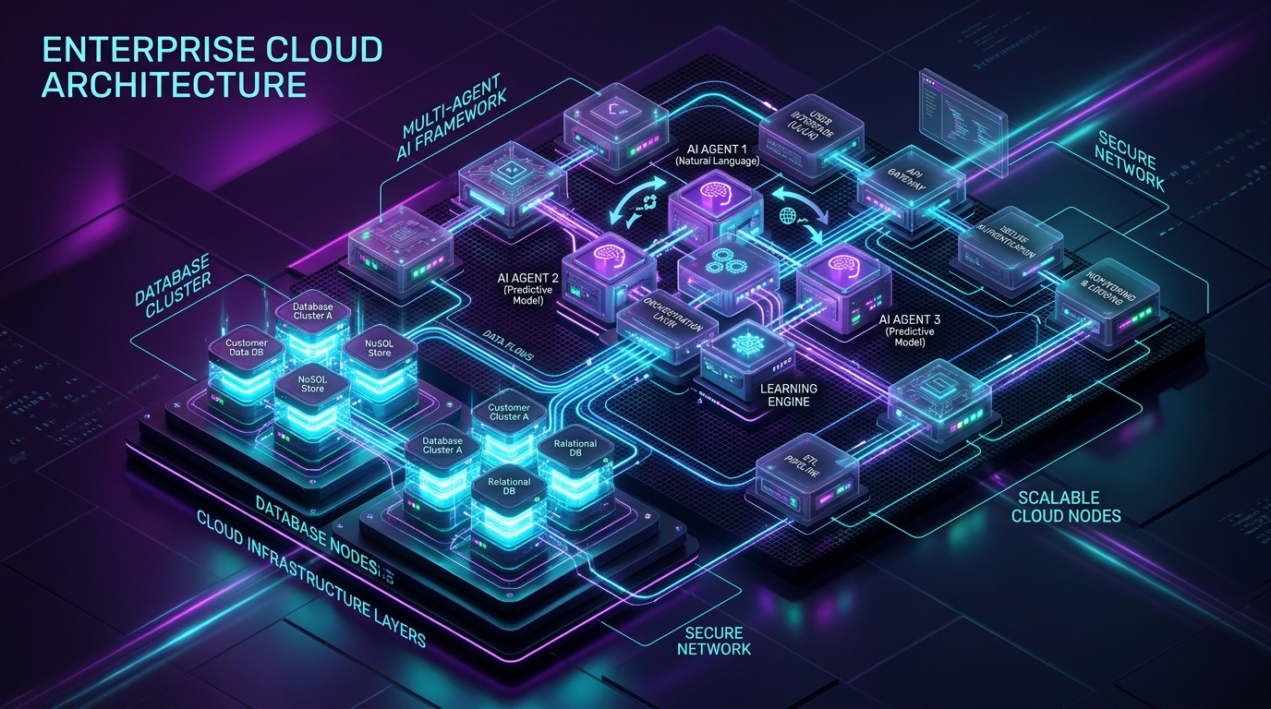
VENUS GLOBAL TECHNOLOGY | EXECUTIVE PITCH DECK
04 — THE OPPORTUNITY
From Traditional Systems to Intelligent Enterprises
Unlocking hidden business value by layering intelligence over existing ERP, operational data, and cloud assets without replacing core infrastructure.
STRATEGY
Layered Intelligence
Rather than replacing legacy SAP/Oracle installations, Venus injects an autonomous multi-agent reasoning layer over existing SQL tables and APIs.
SLIDE 04 / 31

Slide 5
VENUS GLOBAL TECHNOLOGY | EXECUTIVE PITCH DECK
05 — INTERACTIVE AGENT CONTROL CENTER
Connecting AI With Enterprise Operations
Watch natural language business prompts translate instantly into multi-agent intent routing, deterministic SQL synthesis, and live SAP/Oracle ERP API executions.
SCENARIO 1
SCENARIO 2
Unpaid Invoice Audit
Logistics Bottlenecks
Executing SQL on SAP BSEG table. Matched PO #99401 with Vendor Invoice #INV-88320 (Confidence: 99.8%). Triggered PostJournalEntry() -> Tx #00928174.
Rotterdam Depot delayed 4.2 days. Automatically re-routed 1,200 urgent shipments through Antwerp hub. Saved $142,000 in demurrage fees.
SLIDE 05 / 31

Slide 6
VENUS GLOBAL TECHNOLOGY | EXECUTIVE PITCH DECK
06 — CORE SPECIALIZATION
Venus Global Technology Specialization
Our deep focus spans four core technical domains engineered specifically for large-scale enterprise deployments.
DOMAIN 01
DOMAIN 02
DOMAIN 03
DOMAIN 04
Domain Fine-Tuning
Multi-Agent Networks
Vector Knowledge Graph
Deterministic Guardrails
Custom LLM weights trained on SAP, Oracle, and enterprise schemas.
Specialized autonomous workers executing multi-step business logic.
Hybrid semantic and relational data retrieval engine.
SOC2 & GDPR compliant permission enforcement layer.
SLIDE 06 / 31

Slide 7
VENUS GLOBAL TECHNOLOGY | EXECUTIVE PITCH DECK
07 — ARCHITECTURAL PILLARS
Four Pillars of Enterprise Intelligence
A holistic architectural foundation ensuring scalability, governance, speed, and business alignment.
PILLAR 01
PILLAR 02
PILLAR 03
PILLAR 04
Cognitive Data Layer
Autonomous Agents
Unified API Gateway
Enterprise Security
Real-time CDC transactional ingest turning records into live vectors.
Multi-step reasoning agents with automated exception handling.
Connectors for SAP S/4HANA, Oracle Cloud, D365, and REST endpoints.
Zero-trust role permission inheritance and immutable audit logging.
SLIDE 07 / 31

Slide 8
VENUS GLOBAL TECHNOLOGY | EXECUTIVE PITCH DECK
08 — VALUE CREATION
Building Intelligence Into Core Business
AI shouldn't be a separate dashboard—it must be embedded directly into daily operational workflows.
01. INGEST
02. REASON
03. EXECUTE
Real-Time Ingestion
Contextual Evaluation
Automated Action
Stream database CDC change logs into vector memory store.
Agents evaluate triggers against SLA thresholds and corporate policy.
Execute transactions directly in ERP with full audit trace logs.
SLIDE 08 / 31

Slide 9
VENUS GLOBAL TECHNOLOGY | EXECUTIVE PITCH DECK
09 — PARADIGM SHIFT
From AI Assistance to Intelligent Action
Moving beyond basic chatbots that only answer questions to autonomous agent teams that complete entire business processes.
GEN 1 — CHATBOTS
GEN 2 — VENUS AGENTS
Passive Q&A Chat
Autonomous Action
Summarizes documents but requires human manual data copying and entry.
Executes SAP/Oracle transactions directly with guaranteed deterministic SQL.
SLIDE 09 / 31

Slide 10
VENUS GLOBAL TECHNOLOGY | EXECUTIVE PITCH DECK
10 — MATURITY ROADMAP
The Journey Toward Autonomous Operations
A structured 4-stage maturity framework designed to safely scale AI adoption without enterprise risk.
STAGE 01
STAGE 02
STAGE 03
STAGE 04
Augmented Insight
Guided Automation
Autonomous Execution
Self-Healing Enterprise
Conversational natural language querying of ERP databases.
AI proposes actions; managers approve with 1 click.
Agents handle transactions under $50k thresholds automatically.
Predictive agents resolve bottlenecks before operational impact.
SLIDE 10 / 31

Slide 11
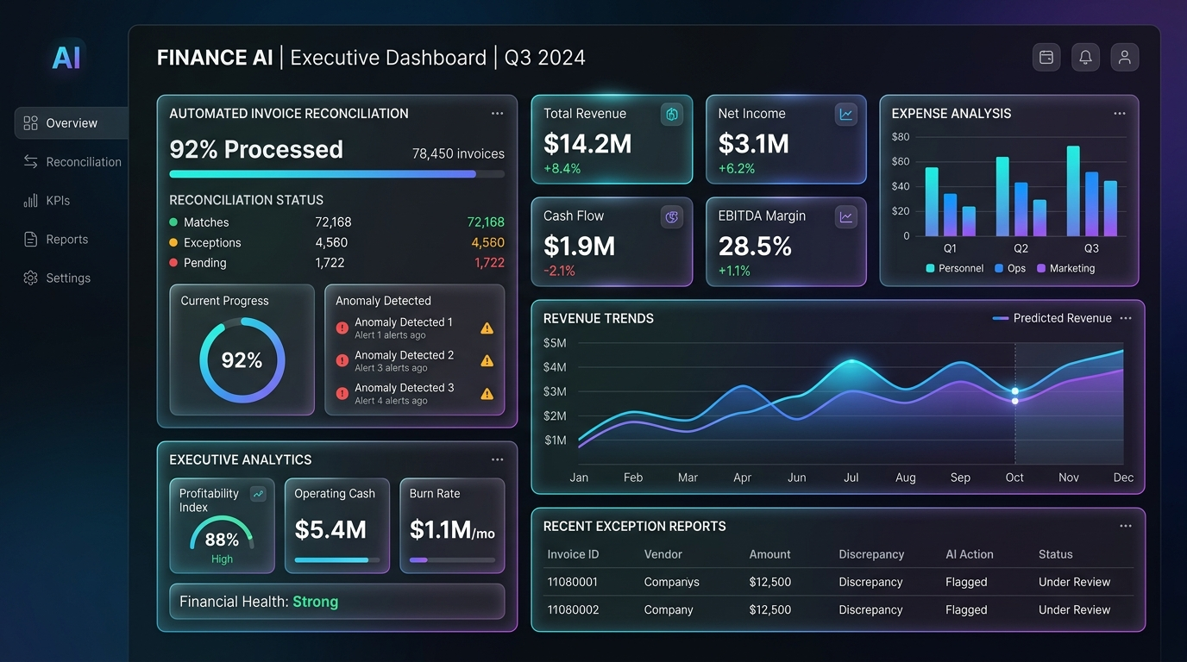
VENUS GLOBAL TECHNOLOGY | EXECUTIVE PITCH DECK
11 — USE CASES & PROTOTYPE
AI Agents & Enterprise Functional Prototype
Explore live mock data representation of automated invoice reconciliation handled by Venus AI Agents.
PROTOTYPE DATA
Automated Invoice Matching
Invoice #INV-9021 ($42,500) -> Matched PO #4401 [Approved]
Invoice #INV-9022 ($128,000) -> Tax Audit [Flagged]
Invoice #INV-9023 ($18,400) -> Matched PO #4405 [Approved]
SLIDE 11 / 31

Slide 12
VENUS GLOBAL TECHNOLOGY | EXECUTIVE PITCH DECK
12 — MODERNIZATION ARCHITECTURE
Making Enterprise Systems More Intelligent
Modernizing legacy infrastructure without expensive full-system tear-and-replace projects.
LAYER 1
LAYER 2
Legacy Wrapping Layer
Real-Time Event Stream
Deploy light API wrappers around SAP ECC 6.0 and AS/400 mainframes, exposing clean GraphQL and REST endpoints.
Streaming enterprise updates via Kafka into Vector Memory Engine for zero-latency AI awareness.
SLIDE 12 / 31

Slide 13
VENUS GLOBAL TECHNOLOGY | EXECUTIVE PITCH DECK
13 — ERP EVOLUTION
The Evolution of ERP Systems
How enterprise software has transformed from basic record-keeping to intelligent self-driving platforms.
1990s
2010s
2026+ VENUS
System of Record
Cloud ERP
Autonomous AI ERP
Manual data entry into static SQL tables.
Web dashboards and webhooks integration.
Self-executing workflows and multi-agents.
SLIDE 13 / 31

Slide 14
VENUS GLOBAL TECHNOLOGY | EXECUTIVE PITCH DECK
14 — ENTERPRISE ENGINE
Intelligence Across the Enterprise Engine
A unified AI layer connecting all core enterprise operational modules into a single nervous system.
MODULE A
MODULE B
MODULE C
Order-to-Cash (O2C)
Procure-to-Pay (P2P)
Record-to-Report (R2R)
Automating order intake, credit checks, and automated invoice payment chasing.
AI purchase order generation, contract evaluation, and 3-way matching.
Continuous trial balance monitoring and accelerated financial close.
SLIDE 14 / 31

Slide 15
VENUS GLOBAL TECHNOLOGY | EXECUTIVE PITCH DECK
15 — DEEP APPLICATIONS
AI Applications Across Business Functions
Realizing immediate operational throughput gains across administrative and high-value workflows.
FINANCE
OPERATIONS
Strategic Financial Planning
Predictive Maintenance
Running 1,000+ Monte Carlo scenario simulations based on real-time market data to guide budget allocations.
IoT sensor telemetry feeds directly into AI models, scheduling repair work orders before asset failure.
SLIDE 15 / 31

Slide 16
VENUS GLOBAL TECHNOLOGY | EXECUTIVE PITCH DECK
16 — OPERATIONAL VELOCITY
Automate Work. Accelerate Operations.
Eliminating manual bottleneck tasks to free up human talent for strategic, high-value decision-making.
12x
95%
4.5 Hrs
100%
Invoice Speed
Error Reduction
Hours Saved / Wk
Traceability
SLIDE 16 / 31

Slide 17
VENUS GLOBAL TECHNOLOGY | EXECUTIVE PITCH DECK
17 — WORKFLOW TRANSFORMATION
From Manual Work to Intelligent Operations
Redesigning key enterprise workflows from step-by-step human processing to autonomous AI-driven execution.
BEFORE
AFTER
Traditional Workflow (12 Days)
Venus AI Workflow (3 Minutes)
Email Invoice -> Manual Download -> Manual SAP Entry -> Physical Signature Approval -> Manual Transfer Request.
Email Ingested by OCR Agent -> 3-Way Matched with PO & Receipt -> Policy Check -> Auto-Approved.
SLIDE 17 / 31

Slide 18
VENUS GLOBAL TECHNOLOGY | EXECUTIVE PITCH DECK
18 — COMPATIBILITY
AI That Works With Existing Technology
Venus AI overlays seamlessly with your existing tech stack without forcing migrations or vendor lock-in.
SAP
ORACLE
MICROSOFT
CUSTOM
SAP Ecosystem
Oracle Cloud
MS Dynamics
Middleware
Native S/4HANA, ECC 6.0, BTP, and OData APIs.
Oracle ERP Cloud, NetSuite, and Database 23c Vector.
Dataverse, D365 Finance & Azure AI Search.
REST, gRPC, Kafka, and GraphQL support.
SLIDE 18 / 31

Slide 19
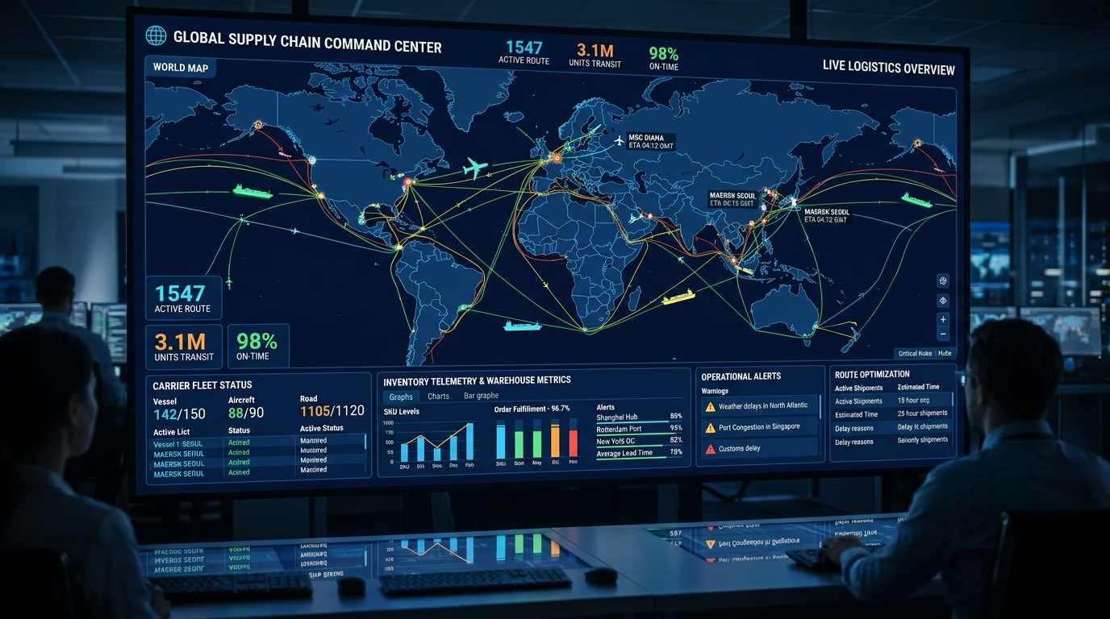
VENUS GLOBAL TECHNOLOGY | EXECUTIVE PITCH DECK
19 — ARCHITECTURE GRAPHIC
Connected Technology Ecosystem Architecture
End-to-end technical data flow from enterprise source databases up to cognitive AI user interfaces.
LOGISTICS
Autonomous Logistics Telemetry
Connecting warehouse WMS, shipping APIs, and demand forecasts into a unified real-time command dashboard with automated rerouting.
SLIDE 19 / 31

Slide 20
VENUS GLOBAL TECHNOLOGY | EXECUTIVE PITCH DECK
20 — GOVERNANCE & TRUST
Enterprise AI Must Be Intelligent and Trusted
Strict security, privacy, and compliance frameworks to guarantee safety for Fortune 500 deployments.
SECURITY
COMPLIANCE
CONTROL
Tenant Data Isolation
Full Audit Logging
Role Permission Mirroring
Your corporate data is never used to train public weights. Isolated KMS encryption.
Every prompt, query, confidence score, and transaction recorded in immutable ledger.
AI agents automatically inherit strict SAP/Oracle role permissions.
SLIDE 20 / 31

Slide 21
VENUS GLOBAL TECHNOLOGY | EXECUTIVE PITCH DECK
21 — ROADMAP & STRATEGY
From Opportunity to Enterprise Transformation
A pragmatic roadmap to deliver immediate quick wins in Phase 1 while building for long-term autonomous scale.
PHASE 1 (WKS 1-6)
PHASE 2 (WKS 7-16)
PHASE 3 (MOS 5+)
AI Discovery & MVP
Agent Deployment
Autonomous Scale
Connect vector search to 1 core ERP table for immediate value proof.
Deploy 3 multi-agent teams with human-in-the-loop approval workflows.
Full autonomous execution across business functions with feedback loops.
SLIDE 21 / 31

Slide 22
VENUS GLOBAL TECHNOLOGY | EXECUTIVE PITCH DECK
22 — INDUSTRY IMPACT
AI Solutions Across Industries
Tailored vertical models solving domain-specific challenges in manufacturing, retail, finance, and healthcare.
MANUFACTURING
RETAIL
FINANCE
HEALTHCARE
Smart Factory AI
Demand Sensing
Risk & Fraud AI
Compliance AI
Dynamic production scheduling and raw material alignment.
Real-time localized demand forecasting and auto-restocking.
Continuous transaction monitoring and AML pattern detection.
FDA audit trail validation and batch release automation.
SLIDE 22 / 31

Slide 23
VENUS GLOBAL TECHNOLOGY | EXECUTIVE PITCH DECK
23 — TECH STACK & SKILLS
Technology Capabilities & AI Skills Matrix
Our core technical competencies spanning deep learning, cloud infrastructure, and enterprise data platforms.
AI & DATA
ENTERPRISE
Engineering Stack
Integration Stack
PyTorch, vLLM, LangChain, LlamaIndex, AutoGen, Pinecone, Qdrant, Milvus, pgvector, Neo4j Graph DB, Custom LoRA fine-tuning.
SAP S/4HANA, BTP, ABAP RESTful, Oracle Fusion, NetSuite SuiteTalk, Kubernetes, Azure AI, AWS Bedrock, GCP Vertex.
SLIDE 23 / 31

Slide 24
VENUS GLOBAL TECHNOLOGY | EXECUTIVE PITCH DECK
24 — VALUE METRICS
Creating Measurable Enterprise Value
Quantifiable impact across cost reduction, speed acceleration, and working capital optimization.
$8.5M
4.2 Mos
45%
99.8%
Est. Cost Savings
Payback Period
Labor Efficiency
Audit Accuracy
SLIDE 24 / 31

Slide 25
VENUS GLOBAL TECHNOLOGY | EXECUTIVE PITCH DECK
25 — METHODOLOGY
A Practical Approach to Enterprise AI
Our proven 4-stage implementation framework ensuring zero downtime and smooth user adoption.
STAGE 1
STAGE 2
STAGE 3
STAGE 4
Assessment
Vector Graph
Agent Fine-Tuning
Go-Live
Mapping ERP schemas, APIs, and security boundaries.
Ingesting data into hybrid semantic vector memory.
Configuring weights and deterministic query testing.
Staged rollout with human oversight and SLA monitoring.
SLIDE 25 / 31

Slide 26
VENUS GLOBAL TECHNOLOGY | EXECUTIVE PITCH DECK
26 — PARTNERSHIP SYNERGY
Venus Global Technology + Kraey Globe
Combining cutting-edge AI engineering with deep functional enterprise consulting expertise.
VENUS GLOBAL
KRAEY GLOBE
AI Core Engineering & IP
Functional ERP Consulting
Multi-agent orchestration frameworks, custom domain fine-tuned models, and vector database architecture.
Deep SAP/Oracle domain expertise, enterprise process re-engineering, and executive governance.
SLIDE 26 / 31

Slide 27
VENUS GLOBAL TECHNOLOGY | EXECUTIVE PITCH DECK
27 — UNIFIED FRAMEWORK
One Integrated Transformation Approach
A seamless joint delivery model delivering speed, precision, and business accountability.
STEP 1
STEP 2
STEP 3
Joint Business Mapping
Co-Engineered Build
Managed Change
Kraey Globe identifies bottlenecks; Venus architects target AI agents.
Venus configures agent models; Kraey Globe validates business logic.
Kraey Globe leads training while Venus monitors model performance.
SLIDE 27 / 31

Slide 28
VENUS GLOBAL TECHNOLOGY | EXECUTIVE PITCH DECK
28 — SERVICES & OFFERINGS
AI-Powered ERP Service Portfolio
Tailored service packages designed for every stage of your enterprise AI journey.
SERVICE 01
SERVICE 02
SERVICE 03
AI Readiness Sprint
Agent Deployment MVP
Full Transformation
2-week evaluation of enterprise data quality and high-impact use cases.
6-week build delivering 2 functional multi-agent teams connected to ERP.
Enterprise-wide AI agent rollout across Finance & Supply Chain with 24/7 SLA.
SLIDE 28 / 31

Slide 29
VENUS GLOBAL TECHNOLOGY | EXECUTIVE PITCH DECK
29 — EXECUTIVE VISION
Creating the Intelligent Enterprise
Empowering leaders with real-time clarity, predictive foresight, and self-executing operational velocity.
VISION 1
VISION 2
Continuous Real-Time Awareness
Agile Market Responsiveness
Move from monthly backward-looking reports to instant continuous situational awareness across global operations.
Adapt to supply chain disruptions and demand surges instantly with autonomous self-adjusting workflows.
SLIDE 29 / 31

Slide 30
VENUS GLOBAL TECHNOLOGY | EXECUTIVE PITCH DECK
30 — IMMEDIATE ACTION PLAN
A Practical Path Toward Enterprise AI
Recommended next steps to launch your intelligent transformation journey with Venus & Kraey Globe.
WEEK 1
WEEKS 2-3
WEEK 4+
Alignment Workshop
Data & Schema Audit
MVP Kickoff
Strategic session with Venus AI architects and Kraey Globe leads.
Technical validation of ERP tables, REST endpoints, and permissions.
Initiate Phase 1 build for selected high-ROI enterprise workflow module.
SLIDE 30 / 31

Slide 31
VENUS GLOBAL TECHNOLOGY | EXECUTIVE PITCH DECK
31 — CONCLUSION & CLOSING
The Future of Enterprise is Intelligent
Partner with Venus Global Technology & Kraey Globe to transform passive software into active, autonomous enterprise competitive advantage.
CONTACT VENUS
CONTACT KRAEY
Venus Global Technology
Kraey Globe
Enterprise AI Engineering & Multi-Agent Innovation
Email: ai-solutions@venusglobal.tech
Enterprise ERP & Functional Transformation Leadership
Email: consulting@kraeyglobe.com
SLIDE 31 / 31

