Slide 1
Operating Systems
Lecturer: Evariste TWAHIRWA (PhD)
E-mail: evatwah@gmail.com

Slide 2
<<Module Name: Operating systems>> <<Module Code:CSC2162 >>

Slide 3
Assessment Pattern
Component | Weighting (%)
In-Course Assessment: | (50%)
Assignment, Quiz, Tutorial, Practical | 20%
MINI TESTS | 30%
Final Assessment | 50 %
TOTAL | 100%
NOTE: The pass mark should be 50 % and above

Slide 4
Recommended Course Textbooks
-Operating System Concepts(8th Edition)By Abraham Silberschatz, Peter Baer Galvin,Greg Gagne(Better to get and read)
Modern Operating System(Edition) by Andrew S.Tanenbaum

Slide 5
Course Tentative plan to be added later
W# | Date | TOPIC
1 | WEEK1 | Introduction to OS, Operating System Structures
2 | WEEK2 | Processes and Threads
3 | WEEK3 | Processes and Threads(After This Topic , Learner will sit for CAT 1)
4 | WEEK4 | CPU Scheduling
5 | WEEK5 | Synchronization
6 | WEEK6 | Deadlocking
7 | WEEK7 | Virtual Memory (After This Topic, Learners will sit for CAT 2)
8 | WEEK8 | Files Systems
9 | WEEK9 | Mass Storage Structure
10 | WEEK10 | Input/output
11 | WEEK11 | Protection
12 | WEEK12 | Distributed Systems(After This ,Each student must me confident to sit for Final Exam)

Slide 6
Some course Tips
Ask Questions
Attend all Course Lectures
Read The books provided(Especially Recommended Sections)
Work together to complete all Assignments that will be given during the course period
In case of a challenging exercise, be persistent do not just give up

Slide 7
Chapter 1
The Roles of Operating Systems
Computer-System Organization and Architecture
Operating System Structure and Operations
Major Operating Systems Concepts/Components(Functionalities)
Process Management
Memory Management
Storage Management
Protection and Security.
Computing Environments

Slide 8
What is an Operating System Anyway?
A program that acts as an intermediary between a user of a computer and the Computer hardware.
Operating System goals
Execute User Programs and allow users to solve their problems easily.
Make the computer system convenient to use
Utilize the computer hardware in an efficient manner

Slide 9
Computer system structure
Computer System can broadly be divided into four components
Hardware: Provides basic Computing Resources(CPU, Memory,I/0 Devices).
Operating System: Controls and Coordinates use of hardware among various applications and users.
Application Programs: Define the ways in which the system resources are used to solve the computing problems of the users
(Word Processors, Compilers, Web browsers, Database Systems, Video games, etc).
Users: (People, Machines, Other Computer)

Slide 10
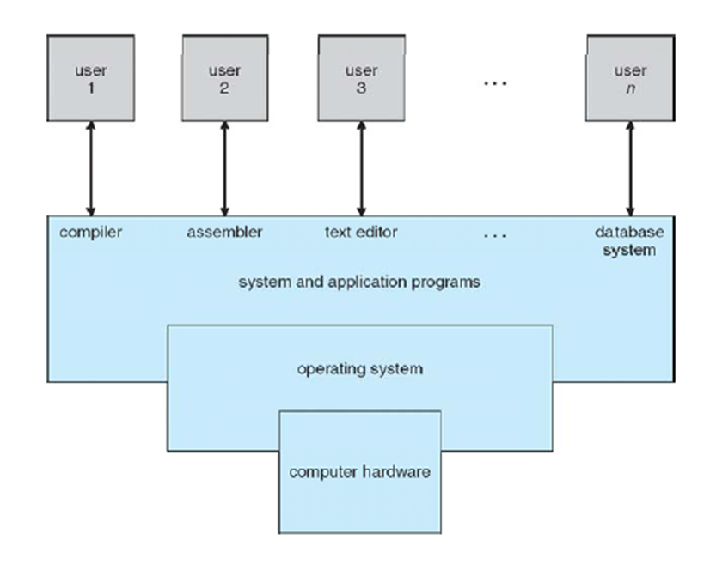
four components of a computer system

Slide 11
Operating System Definition
OS is a resource allocator
Manages all resources
Makes a decision between conflicting requests for efficient and fair resource use
OS is a control Program
Controls execution of programs to prevent errors and improper use of the computer.
I/O is accessed via the operating system.

Slide 12
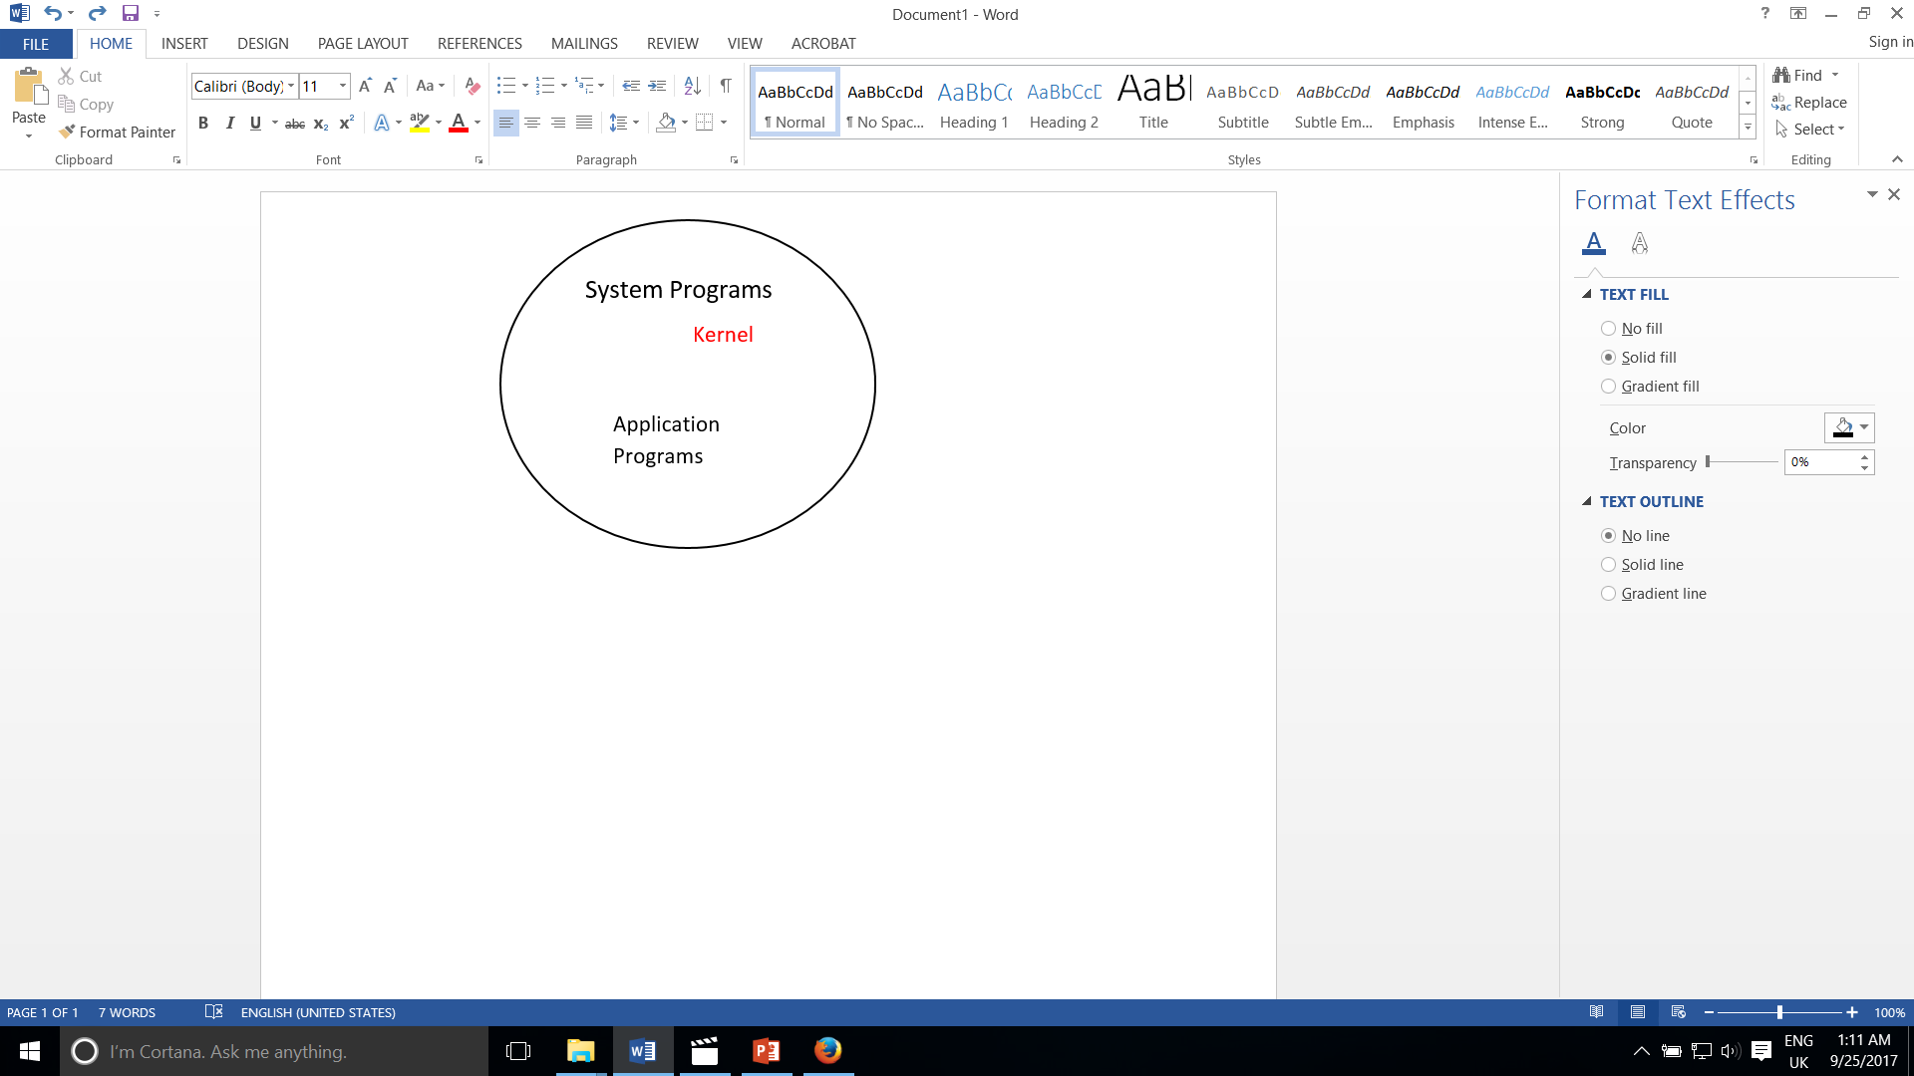
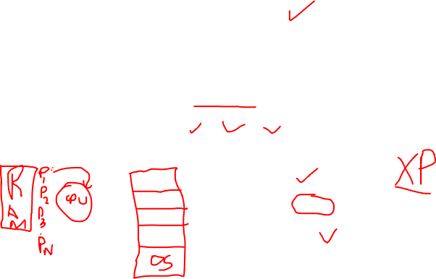
Operating System Definition Contd…
In actual Sens there is no accepted single definition for OS
Whatever you get directly from the manufacturer or a vendor when you press an order of OS is good approximation but varies from device to device and user to user all times, the Kernel is running on the computer. Others are either System Program or Application Program
Kernel: Is the central module of an Operating System(OS). It is the part of the operating system that loads first, and remains in main memory. It is better for the kernel to be small while still provides all the essential services required by other parts of OS and Applications. The Kernel is responsible for (Memory, Process , Task, and Disk Management).Translates commands into something that can be understood by the computer
OS CD Components

Slide 13
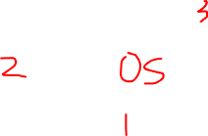
Computer Startup
Bootstrap Program is loaded at power-up or reboot( bootstrap is the program that initializes the operating system (OS) during startup)
Typically Stored in ROM or EPROM
Generally known as Firmware
Initializes all aspects of the System
Loads Operating System Kernel and starts execution
System/Application Programs
Kernel
Hardware

Slide 14
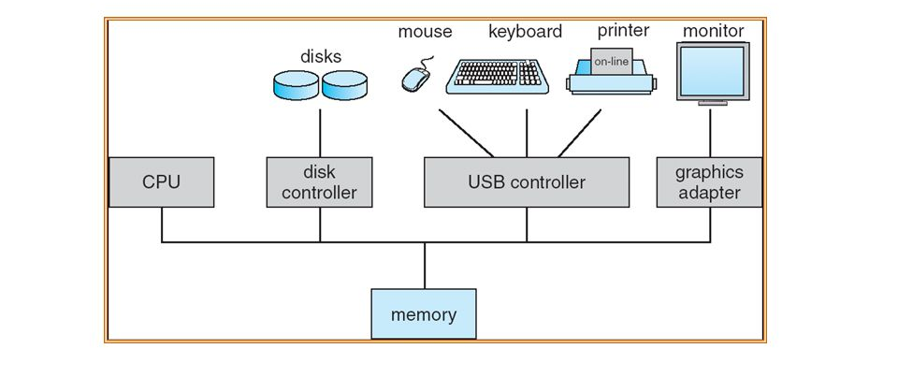
Computer System Organization
A computer System Consists of
One or More CPUs and a number of device controllers connected through a common bus providing access to shared memory
The CPU and the device Controllers execute Concurrently, thereby competing for memory cycles

Slide 15
Computer System Operation
I/O Devices and the CPU can execute concurrently
Each device Controller is in charge of a particular device type
Each device controller has a local buffer
CPU moves data From/to Main memory to/From Local Buffers
I/O is from the device to local buffer of controller
Device Controller informs CPU that it has finished its operation by causing an interrupts

Slide 16
Common Functions of Interrupts
An interrupt transfers control to the interrupt service routine generally, through the interrupt vector, which contains the addresses of all the service routines
Interrupt architecture must save the address of the interrupted instruction
Incoming interrupts are disabled while another interrupt is being processed to prevent a lost interrupt
A trap is a software-generated interrupt caused either by an error or a user request
An Operating System is Interrupt driven

Slide 17
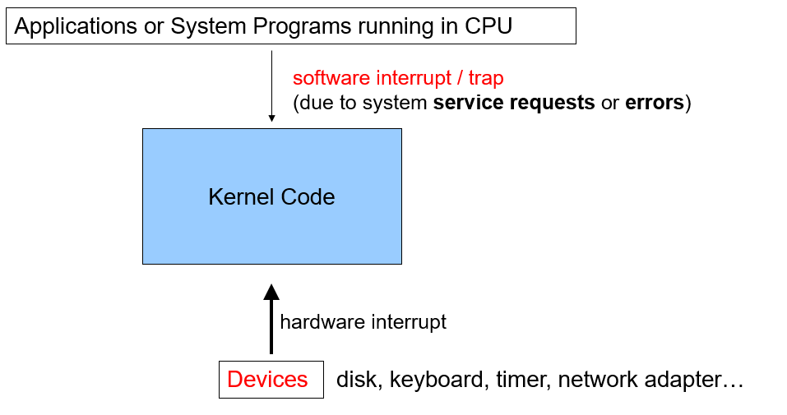
Interrupt-Driven OS

Slide 18
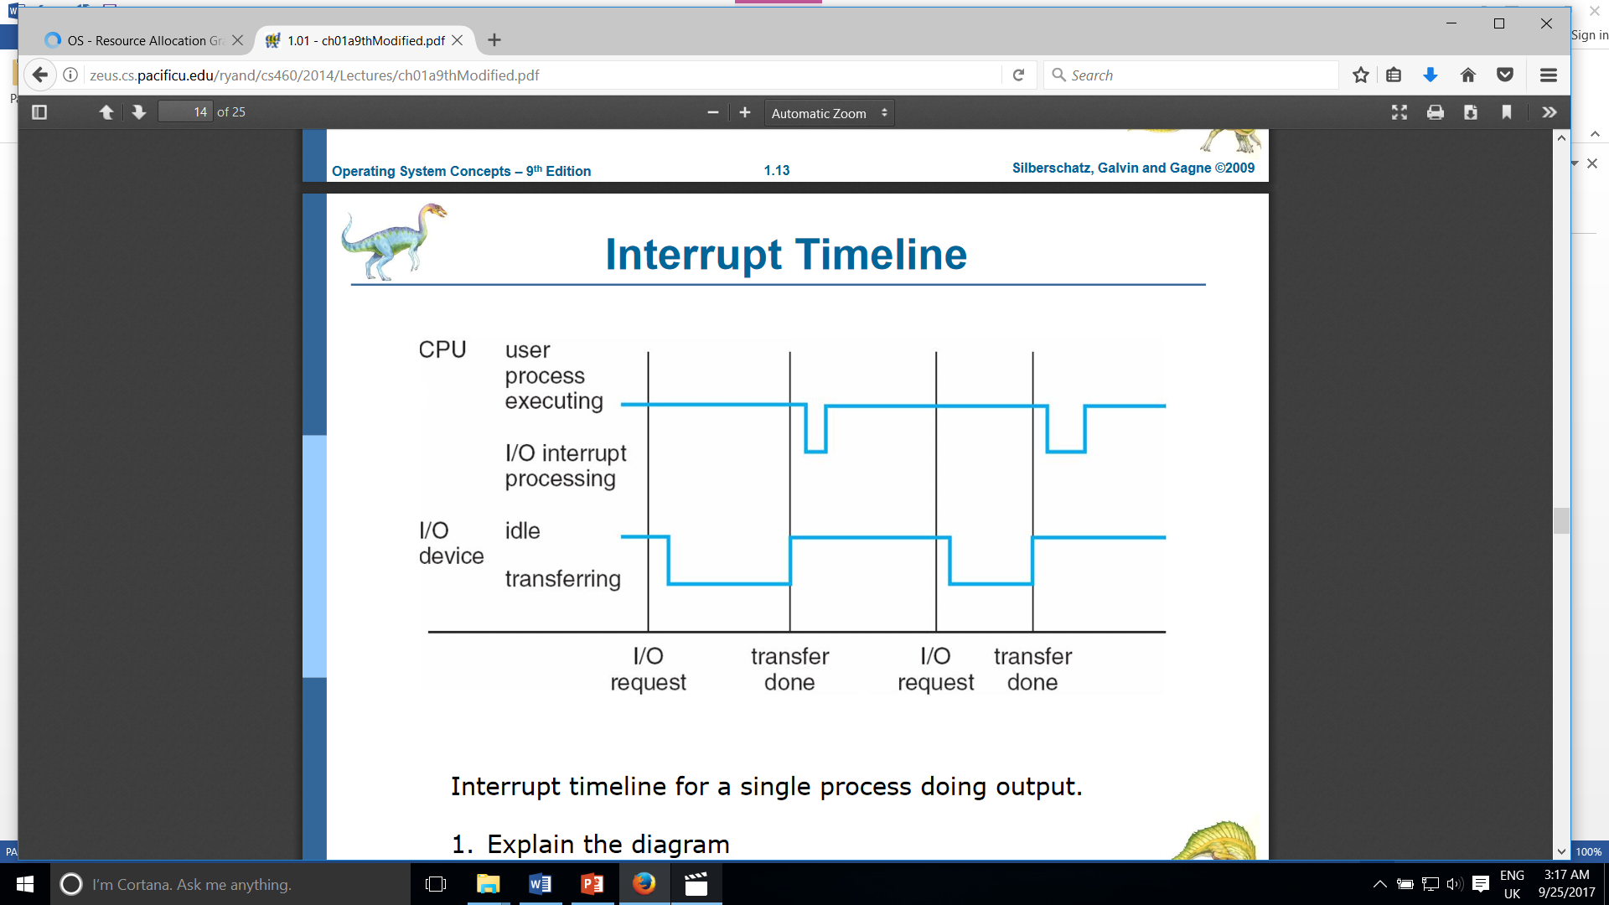
Interrupt Handling
The Operating System preserves the state of the CPU by storing registers and the program counter.
Determining which type of the interrupt has occurred
polling or Vectored interrupt system
Separate Segments of Code Determine What action should be taken for each type of interrupt

Slide 19
I/O Structure(Interrupt Timeline )
General-Purpose Computers consist of CPUs & Multiple device controllers connected through a common bus
Device controller is a bridge between OS and device
Device driver is part of OS( that provides communication with device controller0
I/O Operation
Device driver loads device controller registers
Controller examines registers to determine action
Controller starts data transfer/ to/from local buffer
Sends interrupt upon completion
OK for Moving Small Amounts of Data

Slide 20
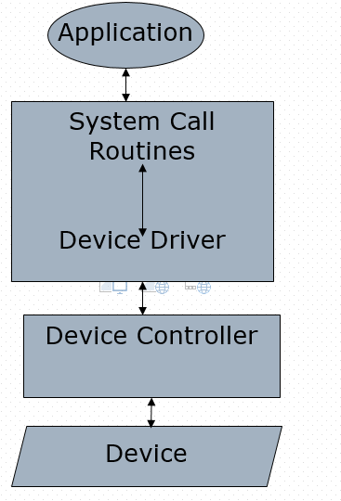
I/O Structure
Application Programs can request I/O
(Read from a device or write to a device)via the help of OS
The request is done by calling a system call (OS routine).
System call routine in OS performs the I/O via the help of device driver routines in OS.
OS maintains device status table ; one entry per device .The entry keeps the state of the device, etc.
After issuing a system call, an application may wait for the call to finish (blocking call) or may continue to do something else(non-blocking call).
OS

Slide 21
Direct Memory Access
Used for high-speed I/O devices able to transmit information at close to memory speeds
Device Controller transfers blocks of data from buffer storage directly to main memory without CPU Intervention
Only one interrupt is generated per block, rather than the one interrupt per byte
CPU
Main Memory
Device
Controller
DMA Controller Transfer

Slide 22
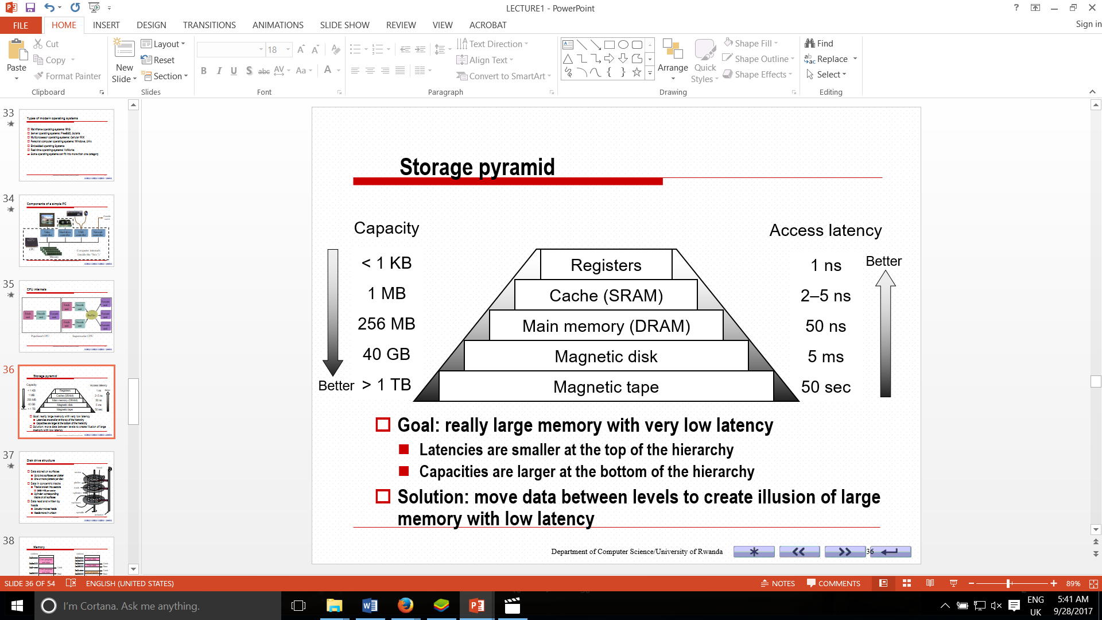

Storage Structure
Main Memory-Only large storage media that the CPU can access directly
Secondary Storage-Extension of main memory that provides large nonvolatile storage capacity.
Magnetic disks-rigid metal
-Disk Surface is logically divided into tracks, Which are divided into sectors.
-The Disk Controller determines the logical interaction between the device and the computer
Storage pyramid

Slide 23

Storage Hierarchy
Storage Systems organized in hierarchy
Speed
Cost
Volatility
Caching- Copying information into faster storage system, main memory can be viewed as a last cache for secondary storage
Results from tradeoff between size and speed
Large, Slow
Caching
Small, Fast

Slide 24
Caching
Important principle, performed at many levels in a computer(in hardware, operating system, software)
Information in use copied from slower to faster storage temporarily
Faster Storage(Cache) checked first to determine if information is there.
If it is, information used directly from the cache(fast)
If not, data copied to cache and used there
The cache is smaller than the storage being cached
Cache Management important design problem
Cache size and replacement policy
Size?
Cache
Replacement Policy

Slide 25

Caching
Large
Slower
Caching
Small, Fast
Registers
Main memory
Hardware Cache
L1,L2, etc
Main Memory
Main Memory
Hard Disk
Hard Disk
Tape

Slide 26
Computer System Architecture
Most Systems use a single general purpose processor
Multiprocessor Systems are increasing in use and in importance
-They are also known as parallel Systems, Tightly- coupled Systems
Advantages
1 Increased throughput
2. Economy of scale(Cheaper than using multiple computer)
3. Increased Reliability/Fault Tolerance
Two Types:
Symmetric Multiprocessing:
Asymmetric Multiprocessing:

Slide 27
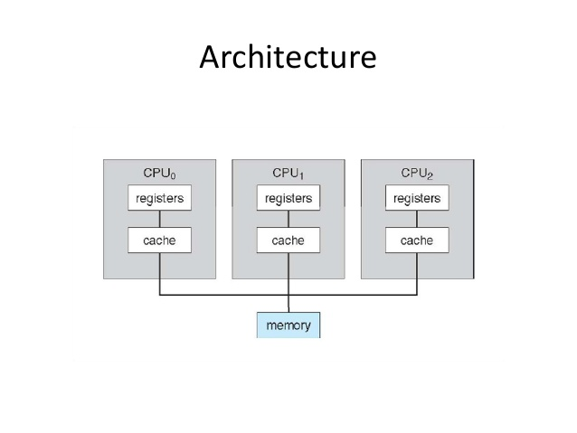
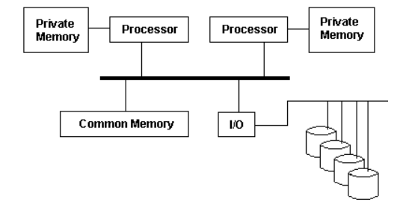
Symmetric Multiprocessing(SMP)
SMP is the processing of programs by multiple
processors that share a common operating system
and memory. In symmetric (or "tightly coupled")
multiprocessing, the processors share memory and
the I/O bus or data path. A single copy of the operating
system is in charge of all the processors.
Asymmetric Multiprocessing:
In asymmetric multiprocessing the program tasks are strictly divided by type between processors and typically, each processor has its own memory address space. These features make asymmetric multiprocessing difficult to implement.

Slide 28
Clustered Systems
Like Multiprocessor Systems, but Multiple systems working together
Usually sharing via a storage area network(SAN)
Provides a high-availability service which survives failures
Asymmetric clustering has one machine in host-standby mode
Symmetric clustering has multiple nodes running applications, monitoring each other
Some clusters are for high-performance Computing(HPC)
Application must be written to use parallelization
Storage
PC
SAN
PC
DISK
PC
PC

Slide 29
Operating System Structure
Multiprogramming needed for efficiency
Single user cannot keep CPU and I/O devices busy at all times
Multiprogramming organizes jobs(Code and data) so CPU always has one to execute
A Subset of total jobs in system is kept in memory
One job selected and run via job scheduling
OS selects which job
When it has to wait for I/O for example), OS switches to another job
Main Memory
CPU
Job
I/O Device
Job
Operating System
Job
I/O Device
Job
I/O Device

Slide 30
Operating System Structure
Timesharing (Multitasking) is logical extension in which CPU switches jobs so frequently that users can interact with each job while it is running, creating interactive computing
Response time should be <1 second
Each user has at least one program executing in memory(Processes)
If several jobs ready to run at the same time CPU Scheduling is performed
If processes do not fit in memory, swapping moves them in and out to run
Virtual memory allows execution of processes not completely in memory

Slide 31
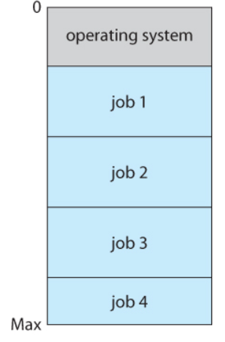

Memory Layout for multiprogrammed System
The figure at the left depicts the layout multiprogramming system.
The main memory allows 4 jobs at time, CPU executes one by one
Advantages.
Efficient Memory Utilization
Throughput Increase
CPU is never idle, so performance increases

Slide 32
Operating System Operations
Interrupt driven by hardware
Software error or request creates exception or trap
- Division by zero, for example(Exception)
Request for operating system service
Other process problems include:
-Processes Modifying each other or the operating system: Handle dual mode
-Infinite loop: Handle Infinite loop by use of timer interrupt.
Dual-mode, Operation allows OS to protect itself and other system components
-User mode and Kernel mode
Mode bit provided by hardware.
Provides ability to distinguish when system is running user code or Kernel code
Some instructions designated as privileged, only executable in kernel mode
System call changes mode to kernel, return from call resets it to user

Slide 33
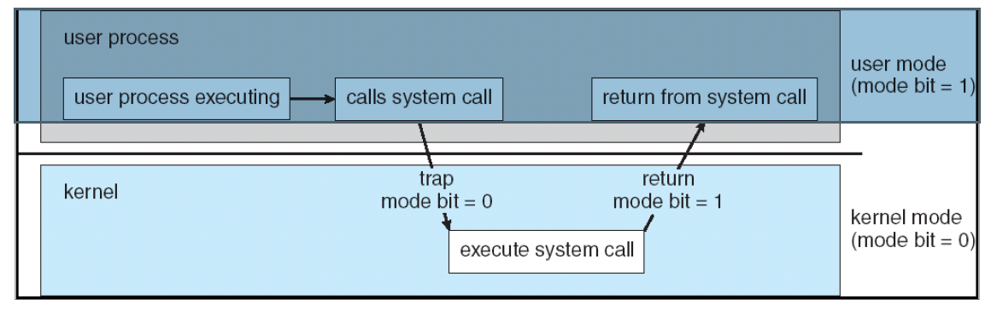
Dual mode system Operation

Slide 35
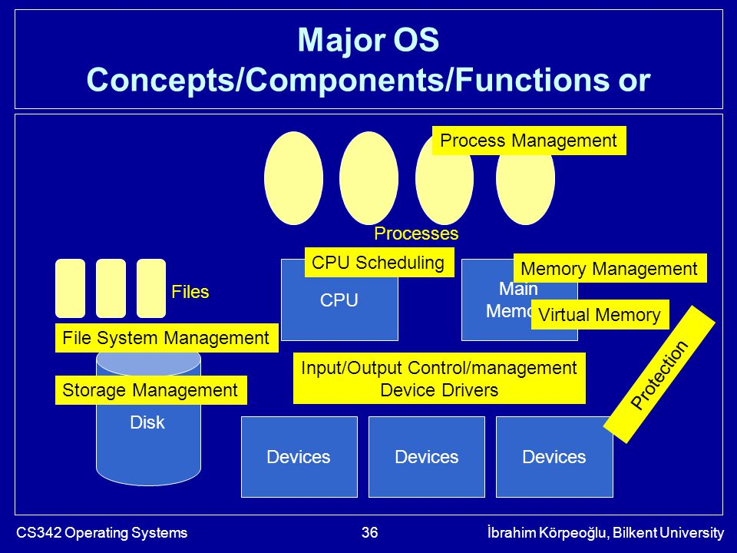
Major OS Concepts/Components/Functions
Process Management
Providing process abstraction and managing processes
Memory Management
Sharing memory among many processes
Storage(Disk) Management
Providing file abstraction, Managing files
Mapping files to disk blocks, disk scheduling
I/O Control and Management
Device Drivers, Buffering, providing uniform access interface
Protection and Security
Controlled access to resources, preventing processes interfering with each other and OS

Slide 36
Process Management
A process is a program in execution. It is a unit of work within the system, program is a passive entity while a process is an active entity
Process executes instructions sequentially, one at a time, until completion
Process needs resources to accomplish its task(CPU, Memory, I/O, Files).
Typically system has many processes(Some user, Some operating system) running concurrently on one or more CPUs
Concurrency by multiplexing the CPUs among the processes/Threads.
Upon Process completion, resources are released.
Process Management Activities
The operating System is responsible for the following activities in Process Management
Creating and deleting both user and system processes
Suspending and resuming process
Providing mechanisms for process synchronization
Providing mechanisms for process communication
Providing mechanisms for deadlock handling

Slide 37
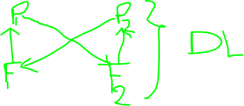
Memory Management
All data in memory before and after processing
All Instructions in memory in order to execute
Memory management determines what is in memory and when
Memory management activities
Keeping track of which parts of the memory are currently being used and by whom
Deciding which processes(or parts of a process) and data to move into and out of memory
Allocating and Deallocating Memory space as needed

Slide 38
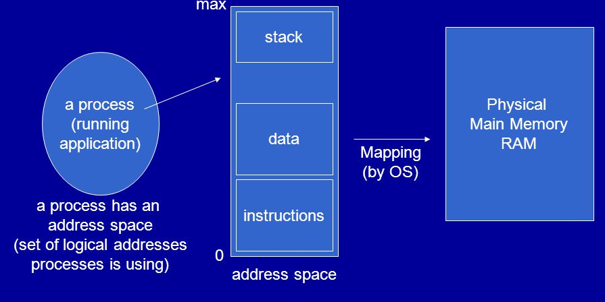
Process Address Space

Slide 39
Mass-Storage Management
Storage Management
OS provides uniform, logical view of information storage
Abstracts physical properties to logical storage unit-File
Each medium is controlled by device(i.e disk drive, tape drive)
Varying Properties include access speed, Capacity, data-transfer rate, access method(Sequential or random)
File System Management
Files Usually organized into directories
Access Control on most systems to determine who can access what
OS activities include
Creating ad deleting files and directories, primitives to manipulate files/dirs., Mapping files onto secondary storage
Mass Storage : Disk(Secondary), Tapes, CDs, etc ( tertiary)
Disk store data that does not fit into memory and to be stored for a long time; Proper management is of central importance
Entire Speed of computer operation may depend on the disk subsystem and its algorithms.
OS activities: (Free-Space management; storage allocation , Disk Scheduling)
Some storage need not to be fast
Tertiary storage includes optical storage, magnetic tape: Still has to be managed

Slide 40
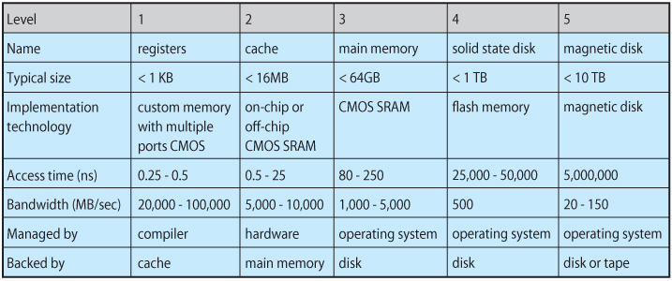
Performance of different levels of storage
Movement between levels of storage hierarchy can be explicit or implicit

Slide 41
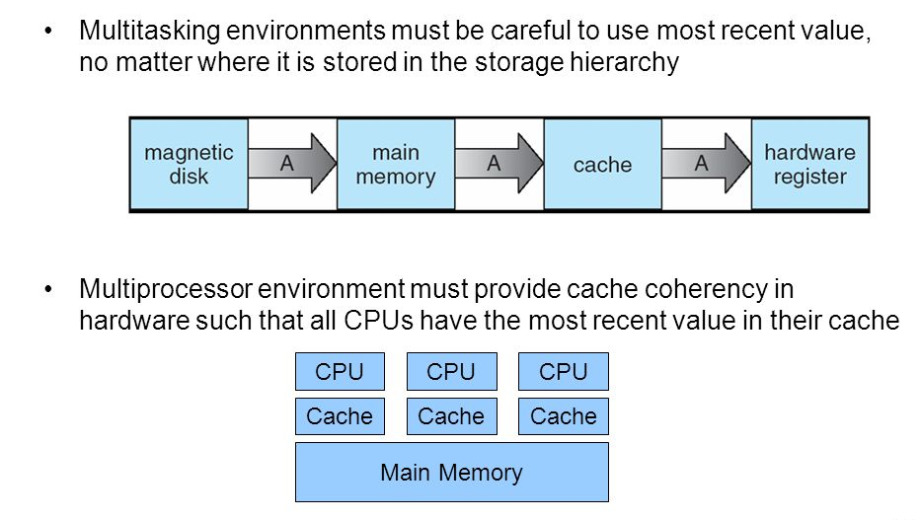
Migration of integer A From Disk to Register

Slide 42
I/O Subsystem
One purpose of OS is to hide peculiarities of hardware devices from the user
I/O subsystem is responsible for
Memory management of I/O including buffering (storing data temporarily while it is being transferred), caching (Storing parts of data in faster storage for performance)
General Device-Driver interface
Drivers for specific hardware devices
Buffering
Caching
I/Os Sub-system of kernel
Uniform driver interface
Device Drivers

Slide 43
Protection and Security
Protection-Any mechanism for controlling access of processes or users to resources defined by the OS
Security-Defense of the system against internal and external attacks.
-Huge range, including denial-of-service, worms, viruses, identify theft of service
Systems generally first distinguish among users, to determine who can do what
User Identities (User IDs, Security IDs) include name and associated number, one per user
User ID then associated with all files, processes of that user to determine access control

Slide 44

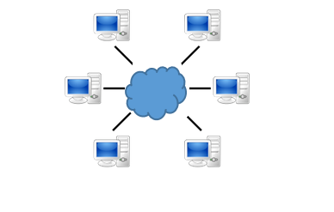
Distributed Computing
Earlier system executed tasks on a single system
Now days we have systems interconnected together,
enabling distributed computing, resource sharing, etc
Operating Systems have support now for networking multiple systems, distributing file storage , accessing remote resources, etc
Hence the computing environment computing environment is nolonger a single system.
-It can consist of many systems used in different ways

Slide 45
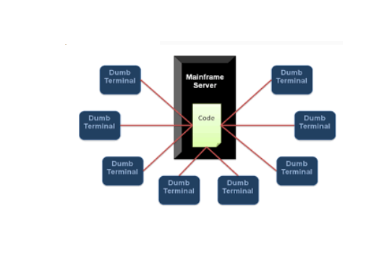

Computing Environments()
Computing and OS
On a single machine
Traditional computing
-Office environment
PCs connected to a network
Terminals attached to a mainframe or mini
Computers providing batch and timesharing,
awkward
Remote access and portability
Now portals allowing networked and remote
System Access to same resources
-Home Networks
Single System
With a User
The dumb terminal is an output
device
that accepts data from the
mainframe. And has no processing
capabilities

Slide 46
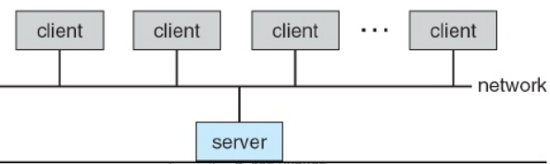
Computing Environments
Client Server Computing
-Dump Terminals are supplemented for PCs
-Server Systems to satisfy requests generated
by client systems
Computer-Server provides an interface to client to request services
(i.e database)
File-Server provides interface for clients to store and retrieve files

Slide 47
Peer to Peer computing
It is another model of distributed system
P2P does not differentiate clients and servers
Instead all nodes are considered peers
Each may act as a client, a server or booth
A node must join P2P network
Registers its service with central lookup service on network or
Broadcast request for services and respond to requests for service via resource discovery/lookup protocol
-Examples include Napster and Gnutella

Slide 48
Web based
Web is becoming ubiquitous
More devices becoming networked to allow web access
Oss run web servers and web client
Web based applications can be developed to run over web servers and Clients
Having a browser at the client is enough to run most of the application
No special client software required
Web
Browser
Web
Server
Applications
HTTP
Pages
User

