Slide 1

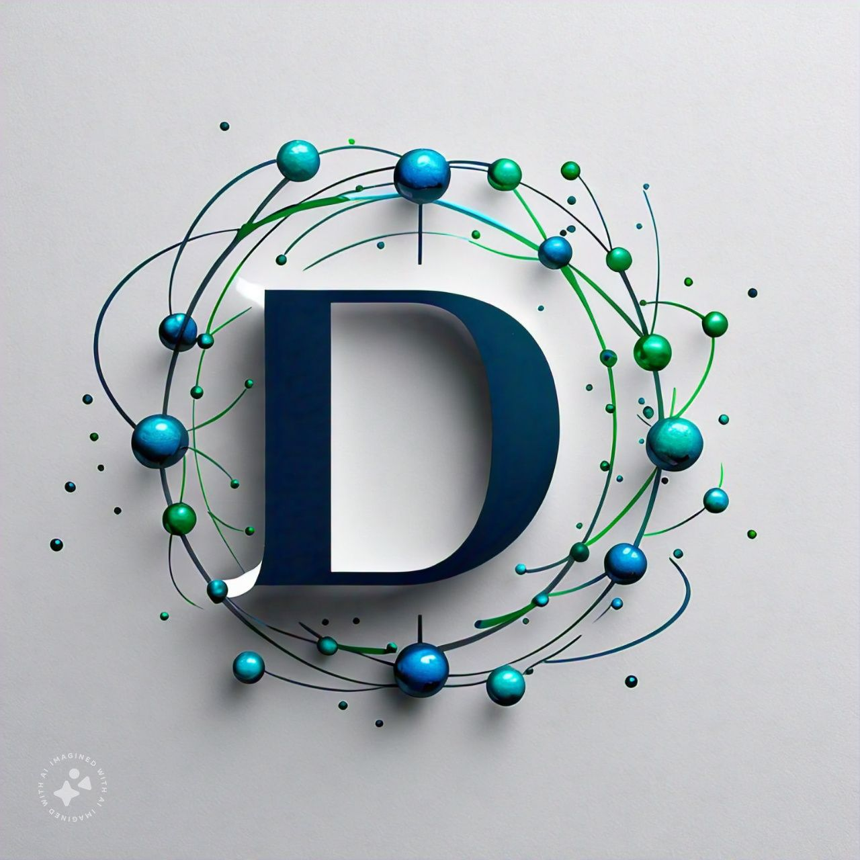
Derm
atter
A guide to skin cancer
Ateeb Gowhar
Jivansh Raghuvanshi
B.Tech Bioinformatics
sem III
Add a main point

Slide 2
Derm
atter

Slide 3
01
SKIN CANCER
Skin cancer in India is a growing health concern, primarily driven by factors such as increased UV exposure, lack of awareness, and changing lifestyles.

Slide 4
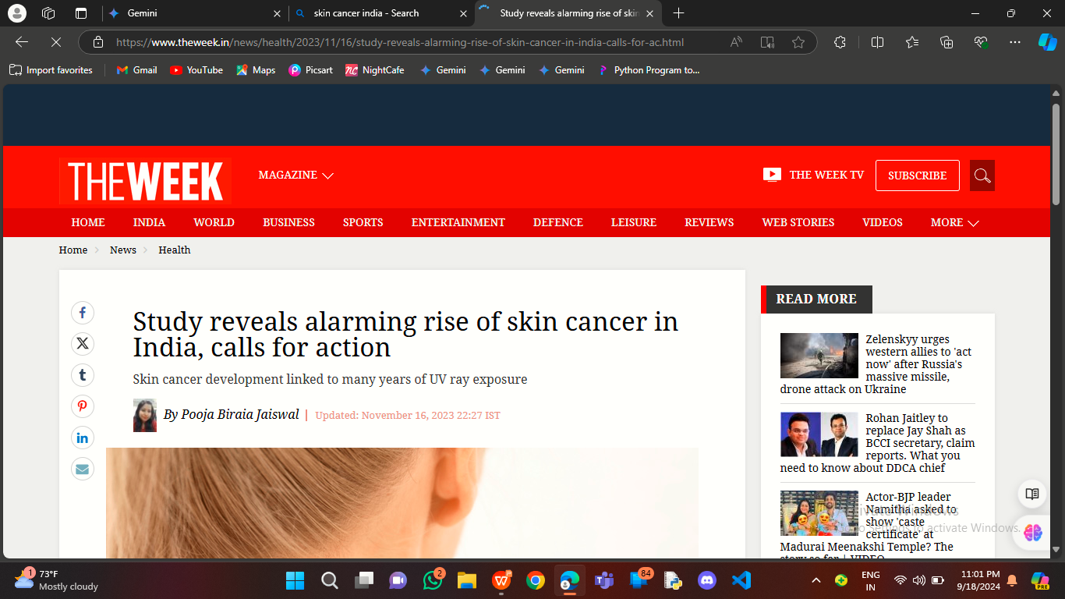
02
SKIN CANCER
Some estimates suggest that skin cancer accounts for about 5-10% of all cancers in India.

Slide 5
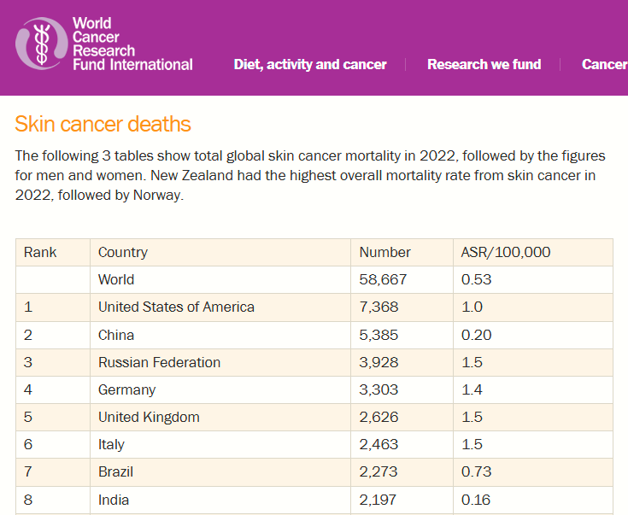
SKIN CANCER
02
India stands on 8th position on skin cancer deaths globally...

Slide 6

WHAT IS “DERMATTER”?
01
Imagine having a tool that could help you detect potential skin cancer early, right from the comfort of your home.
Our innovative app, Dermatter, uses advanced image recognition technology to analyze skin samples and compare them to a vast database of skin cancer images.
02

Slide 7
HOW IT WORKS?
CAPTURE
Simply take a photo of your skin concern
ANALYSE
Our app's powerful algorithms will quickly analyze the image and compare it to thousands of skin cancer cases.
RESULT
Within seconds, you'll receive the result indicating the most likely type of skin cancer and its similarity percentage.

Slide 8
RESOURCES USED:
Derm
atter
THIS APP IS SOLELY BUILD THROUGH PYTHON

Slide 9
RESOURCES USED:
Derm
atter
AN APP THROUGH PYTHON?
HOW IS THAT POSSIBLE?

Slide 10
RESOURCES USED:
Derm
atter
KIVY LIBRARY
IMAGE DATASET
OPENCV LIBRARY
Framework for app creation and UI
Contains many images of types of skin cancer
Comparison of user input image with other images in dataset.

Slide 11

FUTURE PLANS
USING LARGE DATASET FOR ACCURACY
The HAM10000 dataset is a large collection of dermatoscopic images of skin lesions, specifically for the purpose of training and validating machine learning algorithms in skin cancer detection.
It includes 10,000 images representing various skin conditions, such as melanoma.

Slide 12
HIGHLIGHTS
EFFICIENCY
The app's ability to process images quickly and provide results in a timely manner is crucial for user satisfaction.
App’s simple interface improves user engagement.

Slide 13
HIGHLIGHTS
CODE READABILITY
Since the app is build through Python, the code is very easy to modify and understand.
Kivy and CV2 libraries are convenient to use.

Slide 14
HIGHLIGHTS
FUNCTIONALITY
The app can handle increasing numbers of users and data without compromising performance.
Visual aids enhance the app.
Very user friendly.

Slide 15
LIMITATIONS
THE FOLLOWING ISSUES HAVE TO BE RESOLVED FOR BETTER EXPERIENCE:
Image quality: The quality of the skin sample image can significantly impact the accuracy of the detection.

Slide 16
LIMITATIONS
THE FOLLOWING ISSUES HAVE TO BE RESOLVED FOR BETTER EXPERIENCE:
Accuracy limitations: While machine learning can be highly accurate, there will always be potential for errors, especially in cases of unusual or rare skin conditions.

Slide 17
LIMITATIONS
THE FOLLOWING ISSUES HAVE TO BE RESOLVED FOR BETTER EXPERIENCE:
Lighting conditions: Poor lighting can impact the accuracy of the image analysis.

Slide 18
LIMITATIONS
THE FOLLOWING ISSUES HAVE TO BE RESOLVED FOR BETTER EXPERIENCE:
Skin variations: The app may struggle to accurately detect skin cancer in individuals with dark skin tones or unusual skin conditions.

Slide 19
LIMITATIONS
THE FOLLOWING ISSUES HAVE TO BE RESOLVED FOR BETTER EXPERIENCE:
False positives and negatives: There is a risk of false positives (identifying a benign lesion as cancerous) or false negatives (missing a cancerous lesion).

Slide 20
Derm
atter
THANK YOU

