Slide 1

Beyond Java 8 Unveiling the Latest Features
Zhivko Georgiev
Software Engineer at Paysafe

Slide 2


Why migrate?
What are the different versions
Features of Java 9 through 21
Look into the future and Java 23
Conclusions
QnA
Duke, the Java Mascot

Slide 3
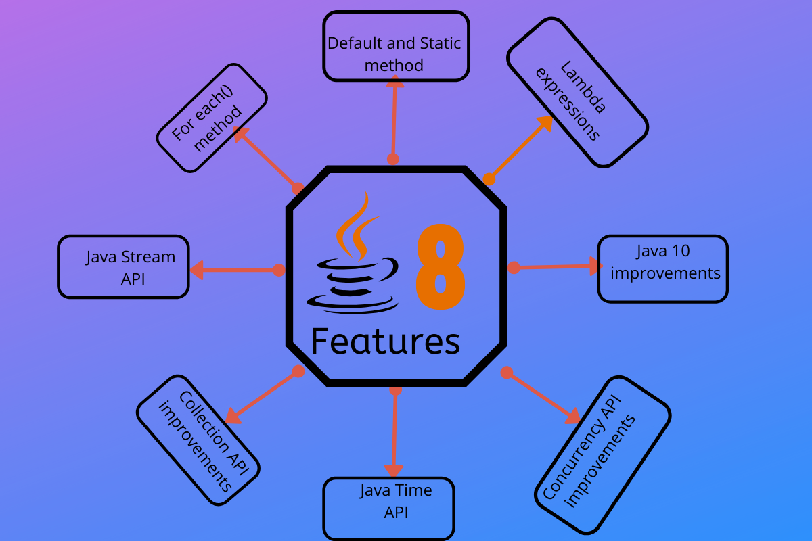

Introduction
Java 8 – the previous big thing
The new faster release cycle
What is an LTS?
Link to GitHub repo with the examples
https://github.com/Jivkomg/java-versions-demo

Slide 4
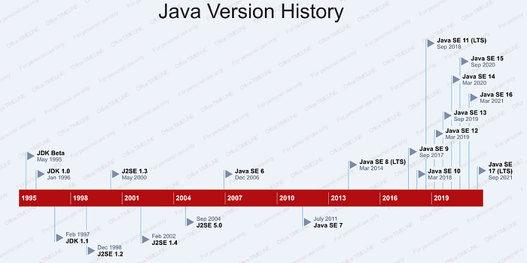

Slide 5
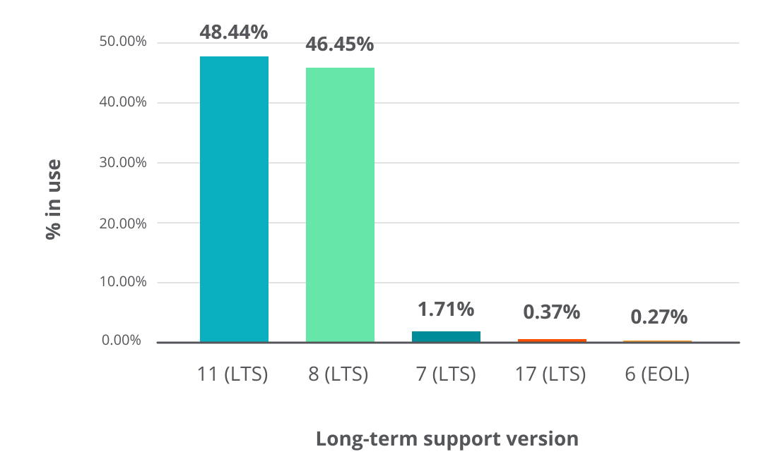
Why are you stuck with Java 8?
Stability and compatibility
Limited resources and time constraints
Dependance on older libraries
Source: https://newrelic.com/resources/report/2022-state-of-java-ecosystem

Slide 6

Why Migrate?
First rule of programming
If it works don’t touch it (not relevant here)
New features
Security improvements
Performance improvements

Slide 7
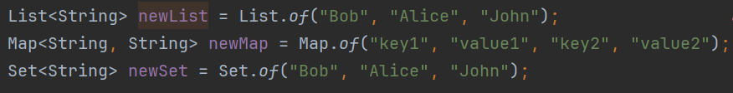
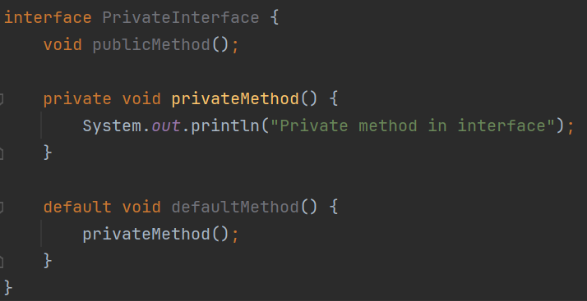
Java 9
Factory methods for Collections of()
Private methods in interfaces

Slide 8
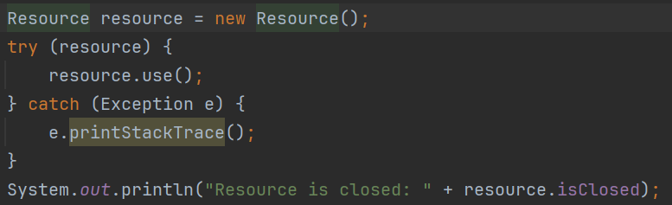
Java 9
Enhanced try with resources
Improved warnings

Slide 9
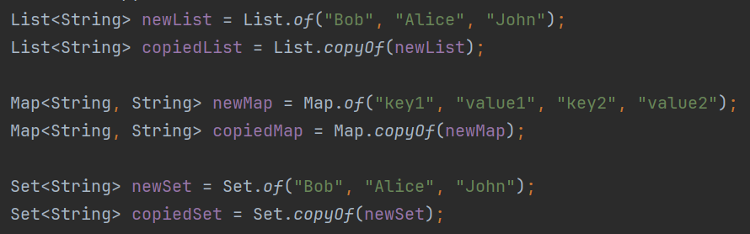



Java 10
Factory methods for Collections copyOf()
Optional orElseThrow()
Improved Docker Container integration

Slide 10
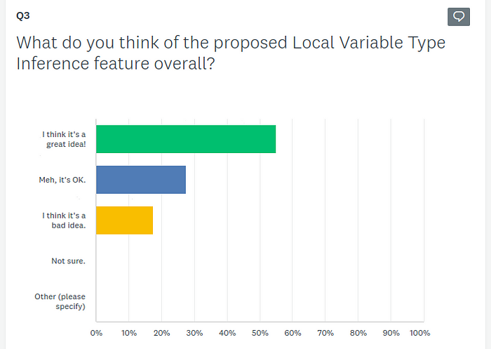
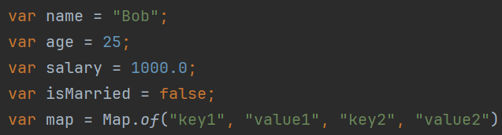
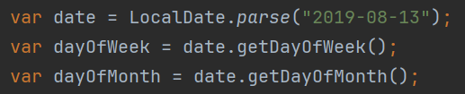
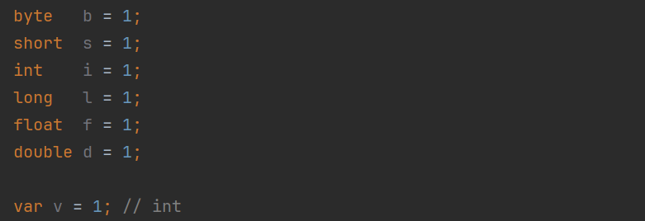
Java 11 LTS
Local-Variable Type Inference(Without lambda support in JDK 10)
JEP-286 proposal survey
vox populi vox Dei

Slide 11
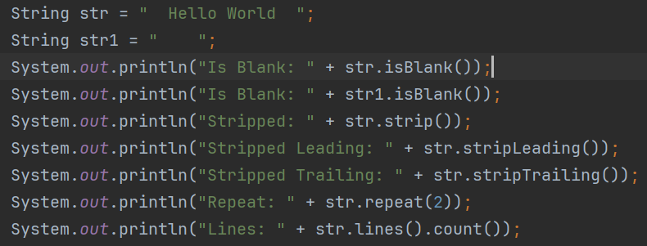
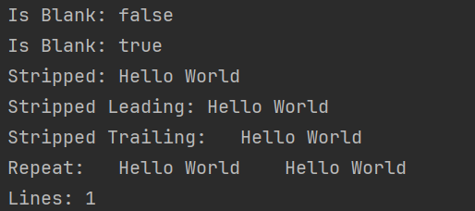
Java 11 LTS
String enhancements isBlank(), lines(), repeat() and strip()
Launching Single-File Source-Code Programs
TLS 1.3 support

Slide 12
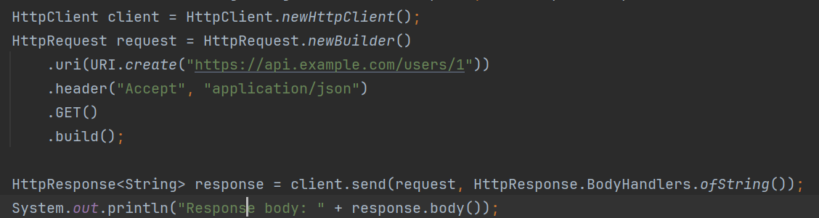
Java 11 LTS
Standard HTTP Client, which provides support for HTTP/2, WebSocket, and a non-blocking API
Two new garbage collectors
Epsilon GC – baseline for other gcs, for reference
ZGC - all expensive work concurrently, without stopping the execution of application

Slide 13
Java 12 and Java 13
New GC Shenandoah and GC improvements
Reimplemented TCP Socket API
Minor Collectors and String enhancements
Enable dynamic archiving of classes at the end of Java application execution

Slide 14
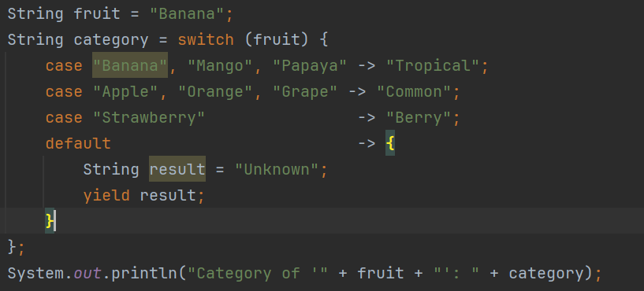
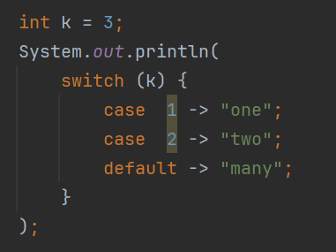
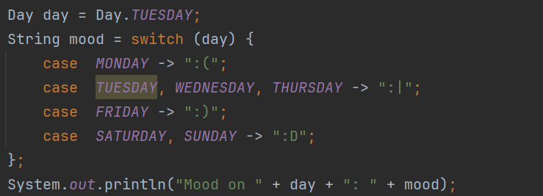
Java 14
Switch Expression
Can be used as expression
Cases don’t fall-through
Each case its own scope
Cases should be exhausted

Slide 15
Java 15
Helpful NullPointerExceptions describing precisely which variable was null
Enabled with -XX:+ShowCodeDetailsInExceptionMessages in JDK 14)

Slide 16
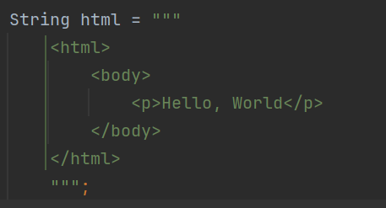
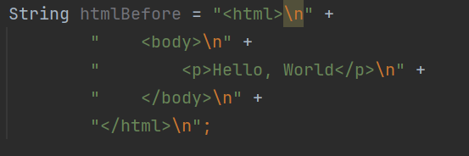
Java 15
Text blocks
Incidental indentation is automatically removed
Reimplemented UDP Sockets APIs

Slide 17
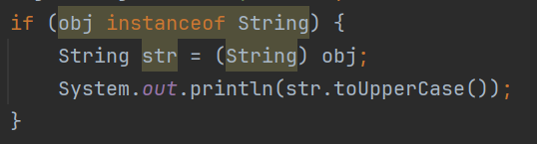
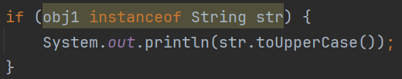
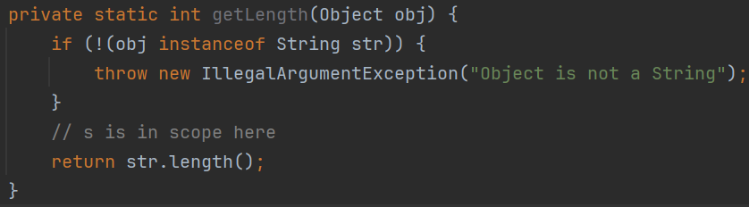
Java 16
Pattern Matching for instanceof

Slide 18
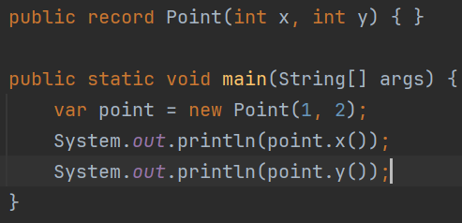
Java 16
Records
compact syntax
a regular class
immutable data
getters, hashCode, equals and toString
can't extend other classes, they can't declare native methods, and they are implicitly final and can't be abstract.

Slide 19
Java 17 LTS
Required by SpringBoot 3 and Jetty 12
Sealed classes
required that the listed classes directly extend the sealed class.
Options for subclasses
final: the subclass can not be extended at all
sealed: the subclass can only be extended by some permitted classes
non-sealed: the subclass can be freely extended
Mixes well with records, as they are implicitly final

Slide 20
Java 18, Java 19 and Java 20
Minor optimizations
Security improvements
@snippet tag in Javadoc
BigInteger.parallelMultiply

Slide 21
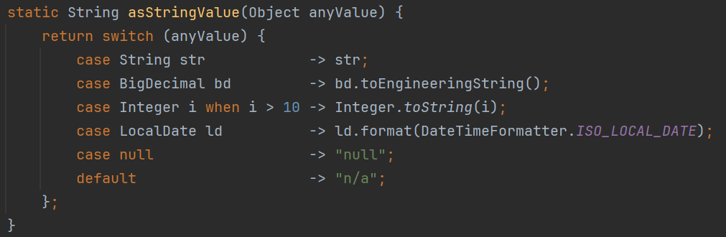
Java 21 LTS
Pattern matching for switch
enhances switch to work on any type and to match on more complex patterns.
can match null values
when guard expression

Slide 22
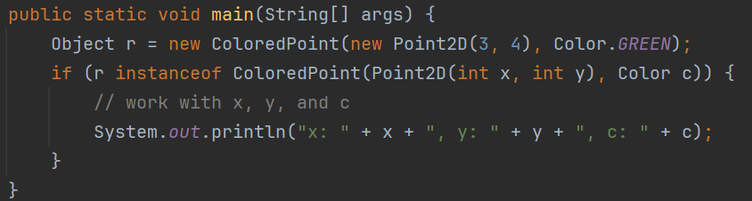
Java 21 LTS
Record Patterns
extends the pattern matching capabilities of Java beyond simple type patterns to match and deconstruct Record values
it supports nesting

Slide 23
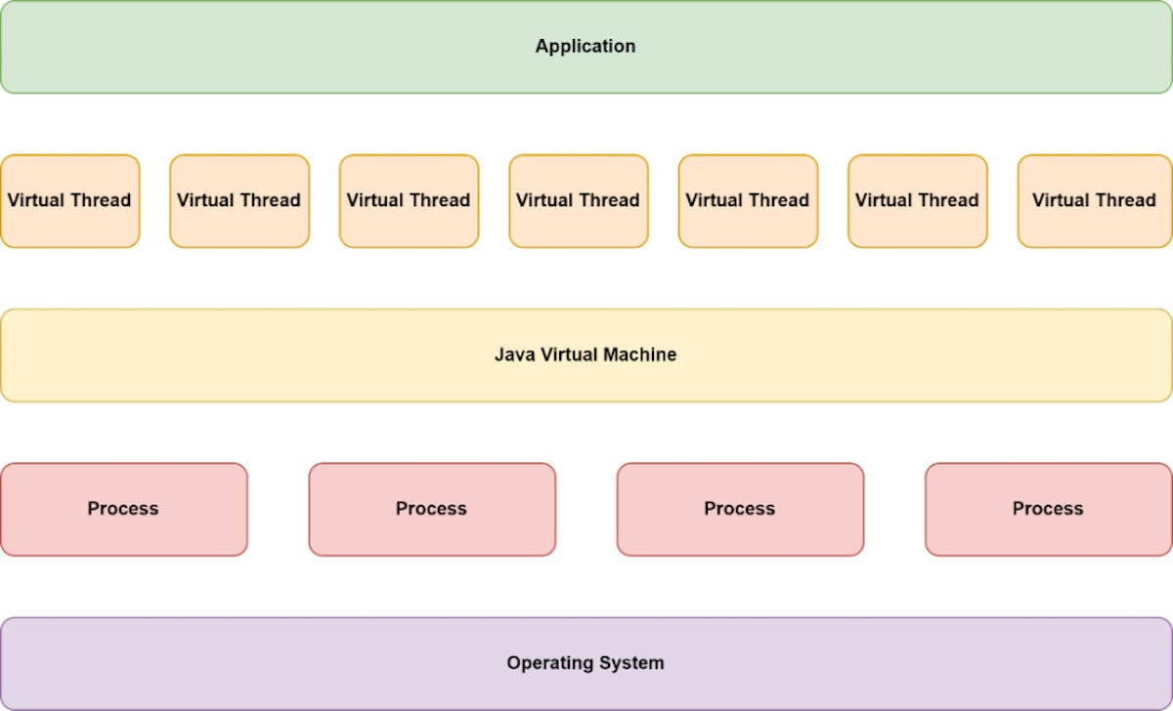
Java 21 LTS
Virtual Threads
lightweight user-mode threads that are cheap to create in huge numbers
abstraction layer between operating-system processes and application-level concurrency
the application instantiates virtual threads and the JVM assigns the compute resources to handle them(conventional threads are mapped directly onto operating system)

Slide 24


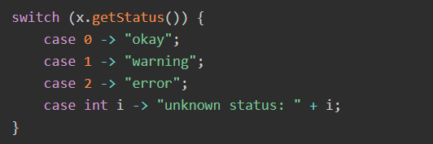
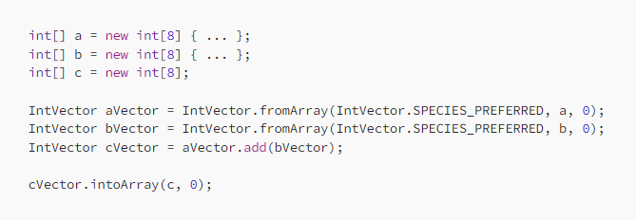
Java 22 and Java 23
String templates
Statements before super
Primitive types in patterns
VectorAPI - lets you write vector
computations in Java in a simple
and concise way

Slide 25
A glimpse into the future
JDK Enhancement Proposals
Project Loom explores JVM features
Structured Concurrency
Project Panama improves connections between JVM and non-Java API
Project Valhalla working on bringing value-based classes (aka user defined primitives) to Java and the JVM
Project Amber new language features
Implicitly Declared Classes and Instance Main Methods
Module Import Declarations

Slide 26
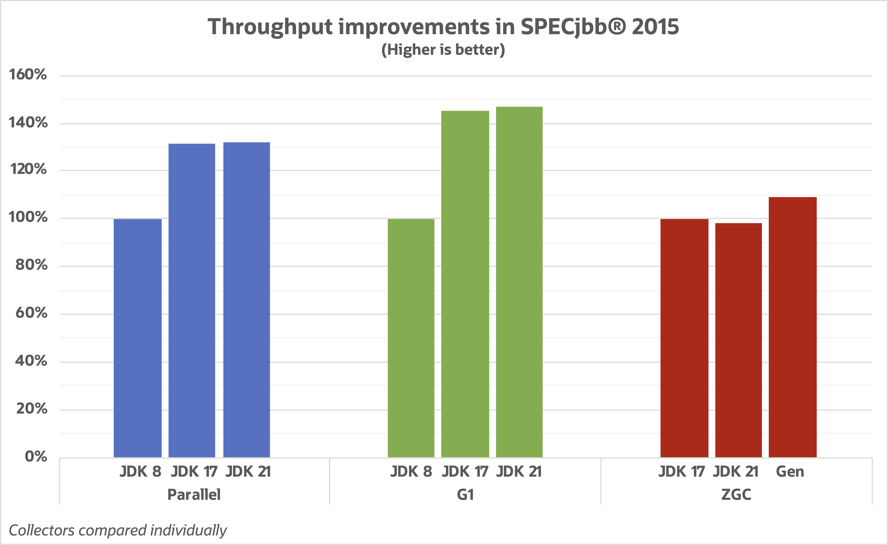
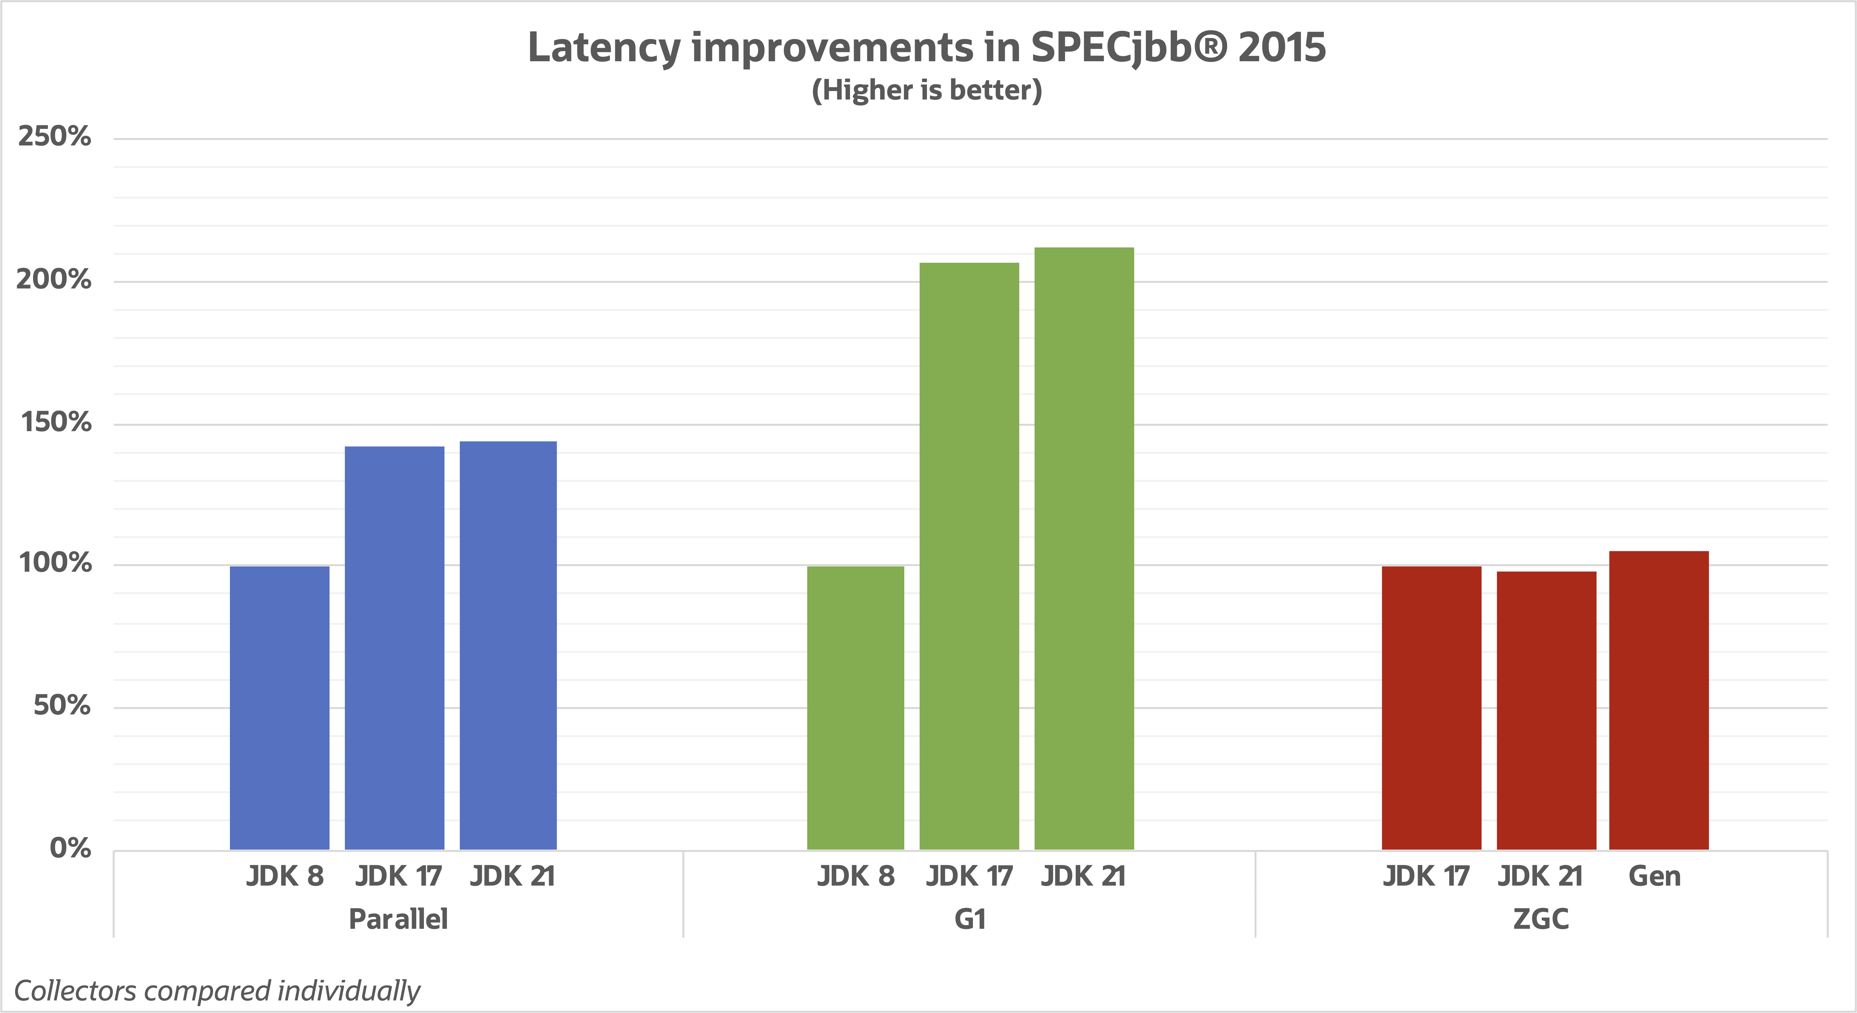
Java 21 Performance
Source

Slide 27

Conclusion and other benefits
Java in the Cloud
Fast LTS train
For companies: be hip with the kids

Slide 28
References and reading recommendations
VDTRIESTE22, Conference by Simone Bordet
https://advancedweb.hu/a-categorized-list-of-all-java-and-jvm-features-since-jdk-8-to-21/#deprecation-and-removal
https://kstefanj.github.io/2023/12/13/jdk-21-the-gcs-keep-getting-better.html
https://www.infoworld.com/article/3678148/intro-to-virtual-threads-a-new-approach-to-java-concurrency.html
https://coderoasis.com/java-23-new-features/

Slide 29
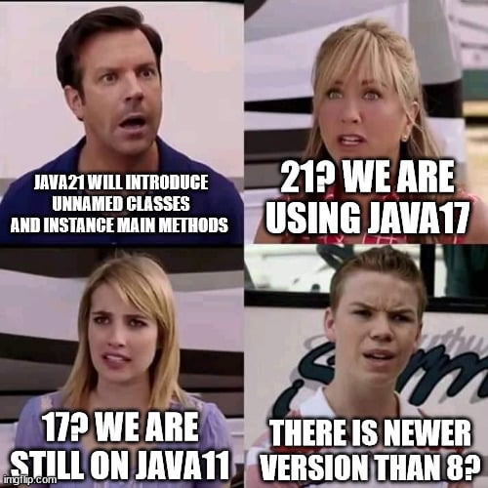
Thank you for your attention!
QnA Session

