Slide 1
Global Divergence in Tuberculosis Incidence Estimates
WHO Global TB Report vs. GBD 2021: A Comparative Analysis
Figure Set for Military Medical Research (IF 22.9)
217 countries · 211 with valid GBD estimates · Data: WHO 2025, GBD 2021

Slide 2
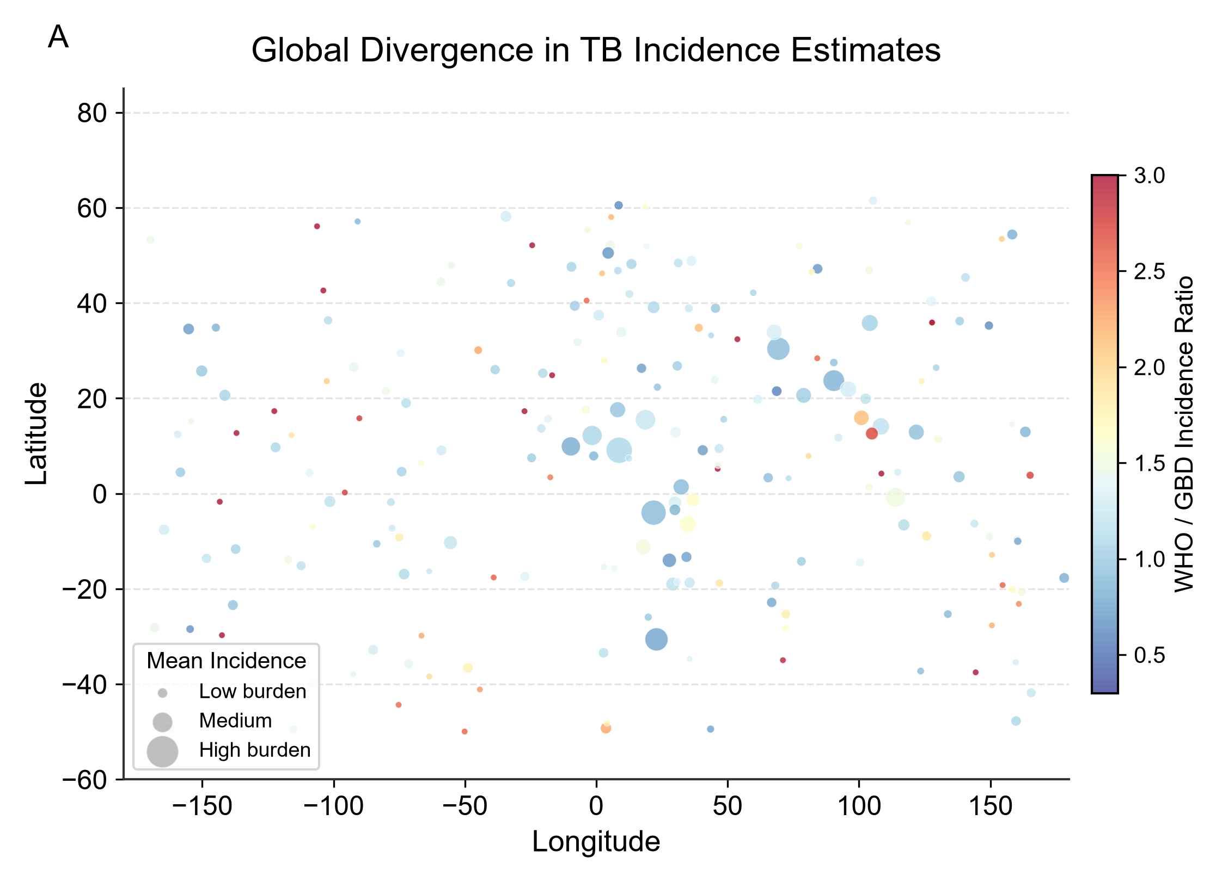
Figure 1 | Global Divergence in TB Incidence Estimates

Slide 3
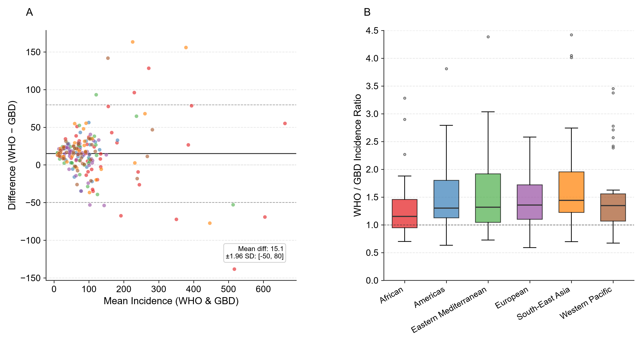
Figure 2 | Bland-Altman Decomposition & Regional Heterogeneity

Slide 4
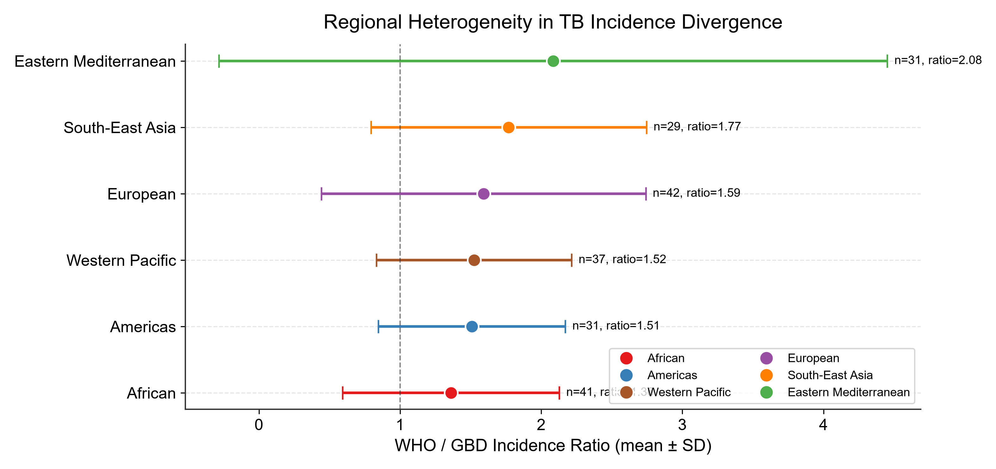
Figure 3 | Regional Heterogeneity in TB Incidence Divergence

Slide 5
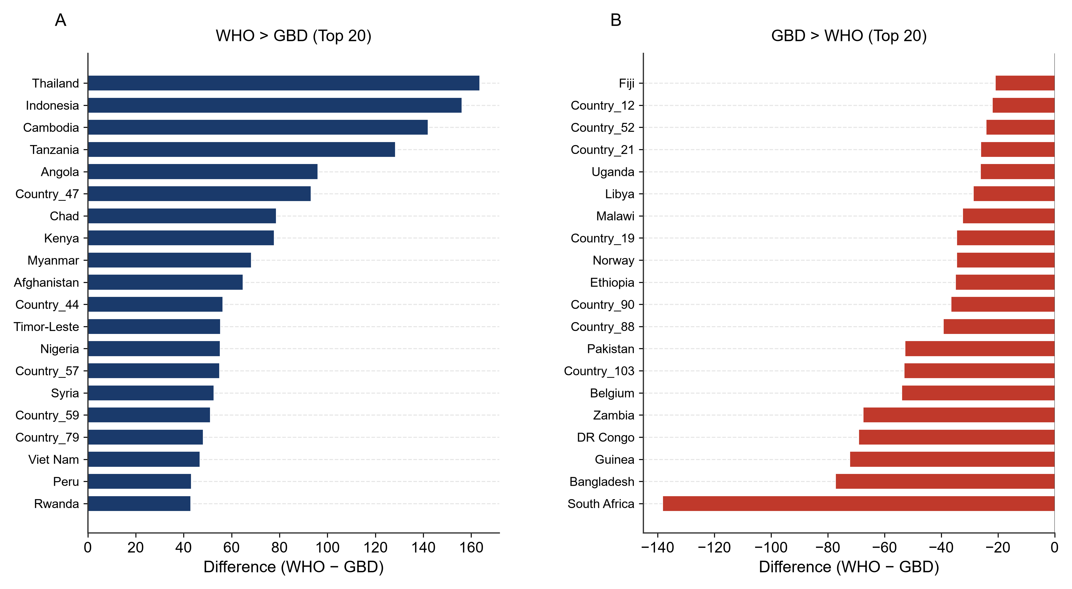
Figure 4 | Countries with Largest WHO-GBD Divergence

Slide 6
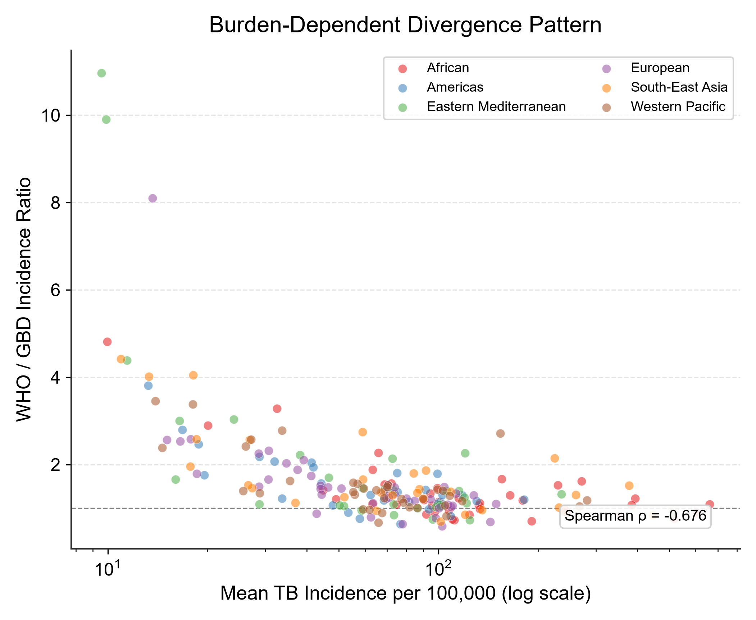
Figure 5 | Burden-Dependent Divergence Pattern

Slide 7
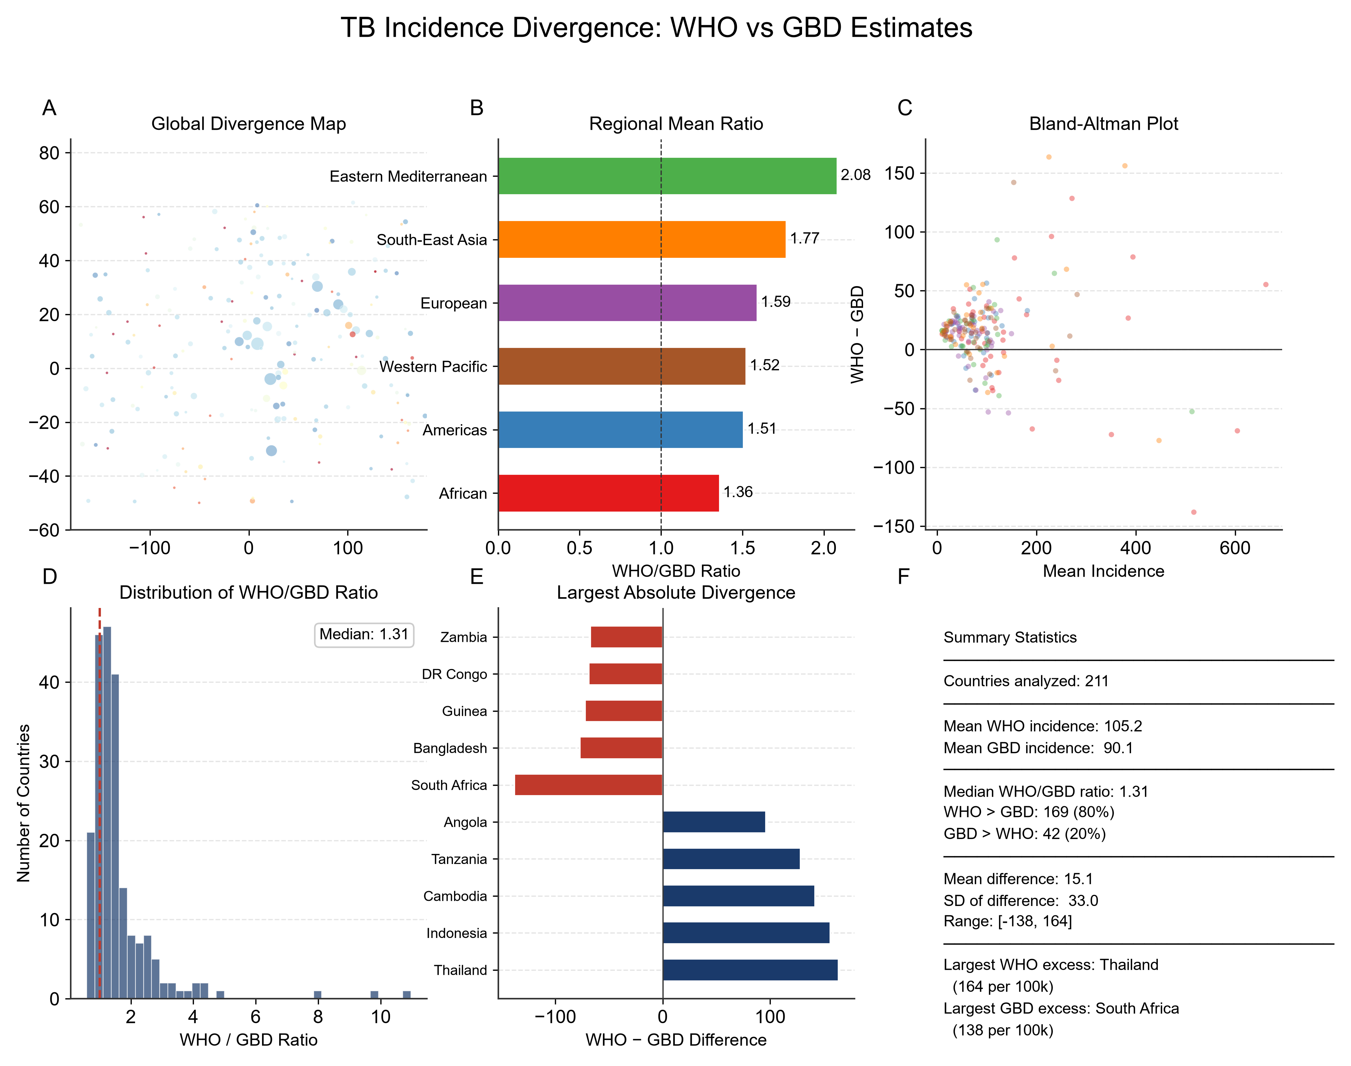
Figure 6 | Summary Dashboard

Slide 8
Table 1 | Regional Summary Statistics of TB Incidence Divergence
Region | N | WHO Mean | WHO SD | GBD Mean | GBD SD | Ratio Mean | Ratio SD | Diff Mean | Diff Median | WHO>GBD | GBD>WHO
African | 41 | 172.9 | 149.6 | 161.8 | 159.3 | 1.4 | 0.77 | 11.2 | 14.7 | 28 | 13
Americas | 31 | 78.1 | 40.8 | 63.1 | 38.7 | 1.5 | 0.66 | 15.0 | 15.9 | 26 | 5
Eastern Mediterranean | 31 | 94.8 | 89.5 | 80.8 | 96.6 | 2.1 | 2.4 | 14.0 | 14.4 | 25 | 6
European | 42 | 71.7 | 34.7 | 60.7 | 40.8 | 1.6 | 1.1 | 11.0 | 15.7 | 35 | 7
South-East Asia | 29 | 116.6 | 114.1 | 91.6 | 105.2 | 1.8 | 0.98 | 25.0 | 18.0 | 24 | 5
Western Pacific | 37 | 90.5 | 66.3 | 73.1 | 62.3 | 1.5 | 0.69 | 17.4 | 16.9 | 31 | 6

Slide 9
Table 2 | Top 30 Countries by WHO-GBD Incidence Divergence
Country | Region | WHO Inc | GBD Inc | Ratio | Difference | Mean Inc
Thailand | South-East Asia | 306.7 | 143.1 | 2.1 | 163.5 | 224.9
Indonesia | South-East Asia | 455.8 | 299.8 | 1.5 | 156.0 | 377.8
Cambodia | Western Pacific | 225.0 | 83.1 | 2.7 | 141.9 | 154.0
Tanzania | African | 335.5 | 207.1 | 1.6 | 128.4 | 271.3
Angola | African | 278.0 | 182.0 | 1.5 | 96.0 | 230.0
Country_47 | Eastern Mediterranean | 167.1 | 74.0 | 2.3 | 93.2 | 120.6
Chad | African | 433.3 | 354.7 | 1.2 | 78.6 | 394.0
Kenya | African | 194.4 | 116.6 | 1.7 | 77.8 | 155.5
Myanmar | South-East Asia | 294.3 | 226.1 | 1.3 | 68.2 | 260.2
Afghanistan | Eastern Mediterranean | 268.2 | 203.5 | 1.3 | 64.7 | 235.8
Country_44 | Americas | 127.6 | 71.2 | 1.8 | 56.4 | 99.4
Timor-Leste | South-East Asia | 119.4 | 64.1 | 1.9 | 55.3 | 91.7
Nigeria | African | 689.1 | 633.9 | 1.1 | 55.2 | 661.5
Country_57 | South-East Asia | 86.5 | 31.5 | 2.7 | 54.9 | 59.0
Syria | Eastern Mediterranean | 99.0 | 46.3 | 2.1 | 52.6 | 72.7
Country_59 | African | 91.5 | 40.3 | 2.3 | 51.2 | 65.9
Country_79 | South-East Asia | 108.1 | 60.0 | 1.8 | 48.1 | 84.1
Viet Nam | Western Pacific | 304.9 | 258.2 | 1.2 | 46.7 | 281.5
Peru | Americas | 96.6 | 53.5 | 1.8 | 43.2 | 75.0
Rwanda | African | 186.3 | 143.4 | 1.3 | 43.0 | 164.9
Netherlands | European | 124.4 | 83.9 | 1.5 | 40.5 | 104.1
Madagascar | African | 82.5 | 43.9 | 1.9 | 38.6 | 63.2
Sudan | Eastern Mediterranean | 134.5 | 96.4 | 1.4 | 38.1 | 115.4
Country_26 | African | 117.9 | 80.9 | 1.5 | 37.0 | 99.4
Tunisia | Eastern Mediterranean | 123.7 | 88.4 | 1.4 | 35.3 | 106.0
Country_68 | Western Pacific | 116.9 | 81.8 | 1.4 | 35.1 | 99.3
DPR Korea | South-East Asia | 126.5 | 91.6 | 1.4 | 34.9 | 109.0
Somalia | African | 49.8 | 15.2 | 3.3 | 34.6 | 32.5
Country_119 | Western Pacific | 120.4 | 85.8 | 1.4 | 34.5 | 103.1
Country_60 | European | 144.3 | 111.3 | 1.3 | 33.1 | 127.8

Slide 10
Table 3 | Bottom 30 Countries (GBD > WHO) by Incidence Divergence
Country | Region | WHO Inc | GBD Inc | Ratio | Difference | Mean Inc
South Africa | African | 447.5 | 585.6 | 0.76 | -138.2 | 516.5
Bangladesh | South-East Asia | 407.8 | 485.1 | 0.84 | -77.3 | 446.5
Guinea | African | 314.4 | 386.7 | 0.81 | -72.2 | 350.6
DR Congo | African | 569.6 | 638.7 | 0.89 | -69.1 | 604.1
Zambia | African | 157.5 | 225.0 | 0.70 | -67.5 | 191.3
Belgium | European | 116.4 | 170.3 | 0.68 | -53.9 | 143.4
Country_103 | European | 76.1 | 129.2 | 0.59 | -53.1 | 102.7
Pakistan | Eastern Mediterranean | 486.4 | 539.2 | 0.90 | -52.8 | 512.8
Country_88 | Eastern Mediterranean | 104.7 | 143.9 | 0.73 | -39.3 | 124.3
Country_90 | South-East Asia | 83.4 | 119.8 | 0.70 | -36.5 | 101.6
Ethiopia | African | 94.3 | 129.3 | 0.73 | -34.9 | 111.8
Norway | European | 60.6 | 95.1 | 0.64 | -34.5 | 77.8
Country_19 | Americas | 59.5 | 94.0 | 0.63 | -34.5 | 76.7
Malawi | African | 94.0 | 126.5 | 0.74 | -32.5 | 110.2
Libya | Eastern Mediterranean | 81.7 | 110.4 | 0.74 | -28.7 | 96.1
Uganda | African | 231.5 | 257.7 | 0.90 | -26.2 | 244.6
Country_21 | Western Pacific | 52.8 | 78.9 | 0.67 | -26.1 | 65.9
Country_52 | European | 85.9 | 110.0 | 0.78 | -24.1 | 98.0
Country_12 | Americas | 97.9 | 119.8 | 0.82 | -21.9 | 108.8
Fiji | Western Pacific | 95.3 | 116.2 | 0.82 | -20.9 | 105.7
Country_92 | South-East Asia | 110.6 | 130.4 | 0.85 | -19.8 | 120.5
Burundi | African | 114.2 | 133.8 | 0.85 | -19.6 | 124.0
Philippines | Western Pacific | 229.3 | 247.4 | 0.93 | -18.1 | 238.3
Country_102 | Americas | 49.8 | 65.7 | 0.76 | -15.9 | 57.8
Country_51 | European | 55.4 | 69.7 | 0.79 | -14.4 | 62.5
Ghana | African | 85.2 | 98.8 | 0.86 | -13.6 | 92.0
Country_28 | Eastern Mediterranean | 66.9 | 79.8 | 0.84 | -12.8 | 73.4
Niger | African | 236.2 | 245.3 | 0.96 | -9.1 | 240.7
Country_48 | African | 92.9 | 101.8 | 0.91 | -8.9 | 97.3
Australia | Western Pacific | 63.7 | 71.2 | 0.90 | -7.5 | 67.5

Slide 11
（内容由AI生成，仅供参考）

