Slide 1
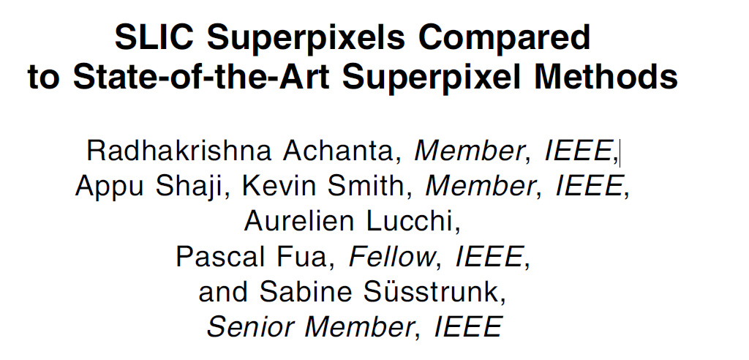
Reporter：Wei Ji
Notes:
幸运日素材 淘宝店：https://shop145643496.taobao.com

Slide 2
INTRODUCTION
Three properties are generally desirable:
1、adhere well to image bound
2、reduce computational complexity
3、both increase the speed and improve the quality of the result
Existing superpixel methods
1、graph-based algorithms
2、gradient-ascent-based algorithms
Algorithm procedure
Result

Slide 3
Existing superpixel methods
Graph-Base Algorithms
1、treat each pixel as a node, edge weight is the similarity between neighboring pixels,superpixels are created by minimizing a cost function defined over the graph
2、NC05(Normalized cuts algorithm)、GS04(Graph-based approach)、SL08、GCa10、GCb10
Gradient-Ascent-Based Algorithms
1、initial clustering of pixels, do gradient ascent methods iteratively refine the clusters until some convergence criterion is met to form superpixels
2、MS02(mean shift) 、QS08(quick shift)、WS91(watershed approach)、TP09(turbopixel)

Slide 4
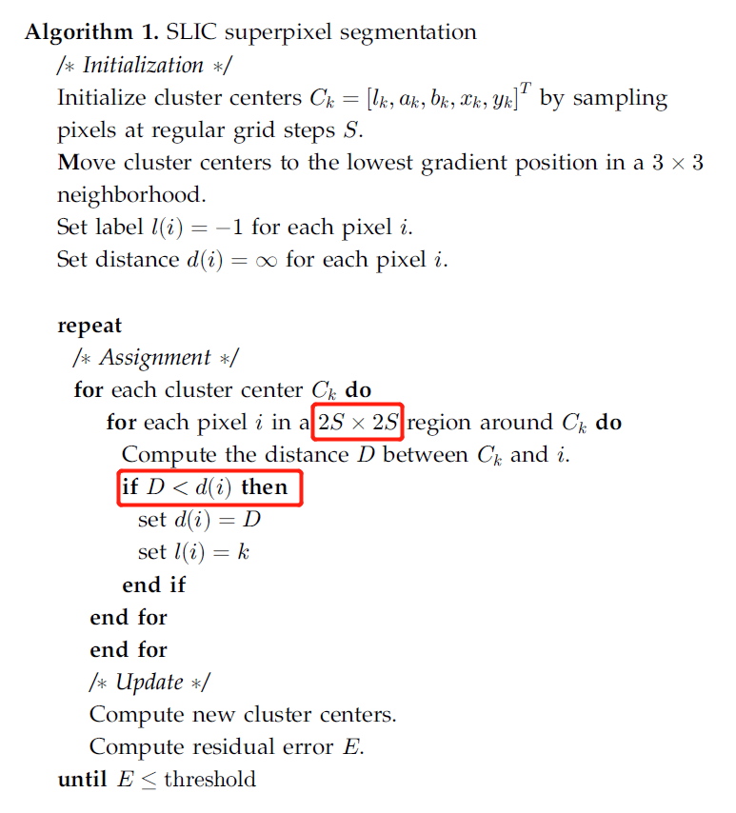
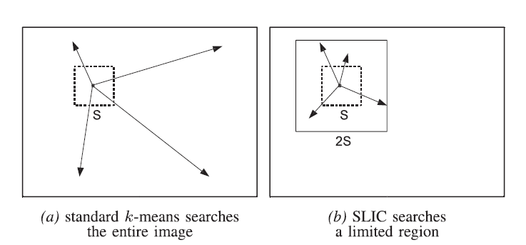
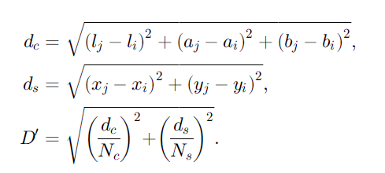
Algorithm procedure
LAB Image [l,a,b,x,y] :
l: luminosity,
a: red->green range
b: blue->yellow range
x,y:position

Slide 5
Algorithm procedure
Postprocessing
Objective function:

Slide 6
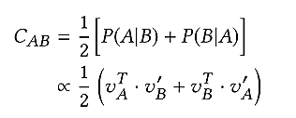
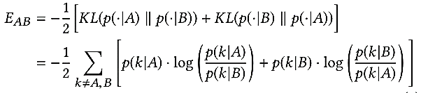
MODEL
Distinguishing Between Substitutes and Complements
Complementarity:
Two products are complements if they are very likely to be purchased together.
Exchangeability:
A and B are exchangeable if they interact similarly with other products.
Two products are substitutes if their exchangeability score is high and their complementarity score is low.

Slide 7


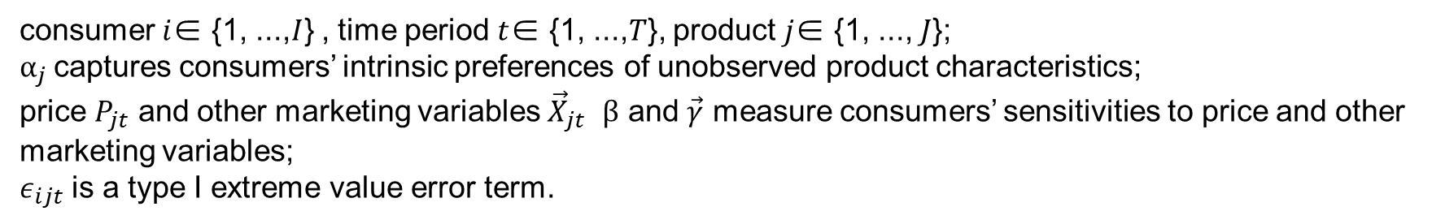
MODEL
Choice Model
Utility Model:
consumer $i$∈ {1, ...,$I$} , time period $t$∈ {1, ...,$T$}, product $j$∈ {1, ..., $J$};
$α_{j}$captures consumers’ intrinsic preferences of unobserved product characteristics;
price $P_{jt}$ and other marketing variables ${\vec{X}}_{jt}$ $β$ and $\vec{γ}$ measure consumers’ sensitivities to price and other marketing variables;
$ε_{ijt}$ is a type I extreme value error term.
$v_{mj}$ is the $m$th dimension of the M-dimensional product vector $v_{j}$, and $α_{m}$ is the model parameter corresponding to the $m$th dimension.

Slide 8


MODEL
Addressing Price Issues
Price Endogeneity
use the average price for the same product and week in other stores of the same chain as the
instrument variable $Z_{jt}$
$η_{jt}$represent the component correlated with unobserved pricing shocks
the choice model is estimated with the retained residuals as an additional variable

Slide 9
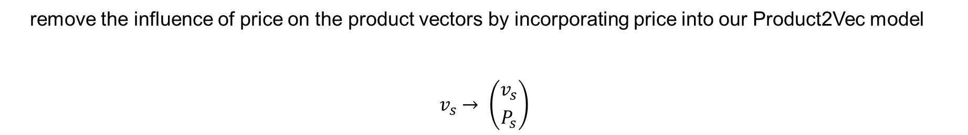
MODEL
Addressing Price Issues
Revised Product2Vec
remove the influence of price on the product vectors by incorporating price into our Product2Vec model
$$v_{s}→ \left({v_{s} \atop P_{s}}\right)$$
instead of updating the full vectors of $M+1$dimensions, we only update the first $M$ values, leaving the last dimension $(Ps)$unchanged

Slide 10
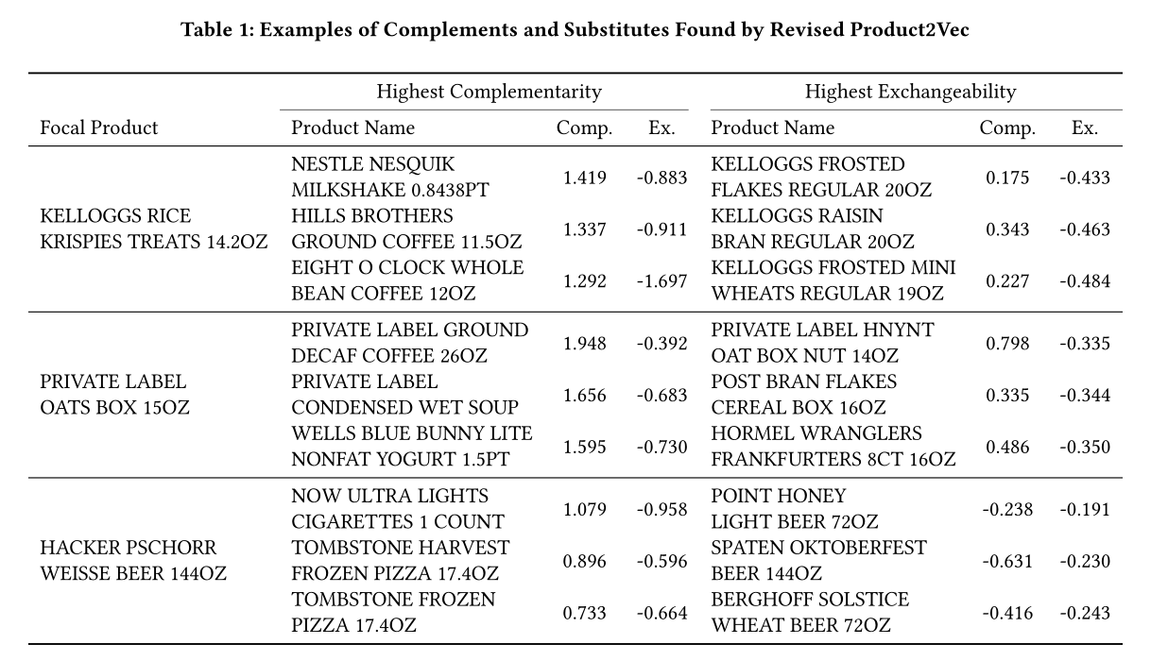
Model Performance
DATASET：IRI’s scanner panel data , which contains transaction information of 30 product categories and 13,124 unique products purchased by 5,214 households across 53 stores at the weekly level for 52 weeks. The total number of shopping baskets amounts to 280,052.

Slide 11
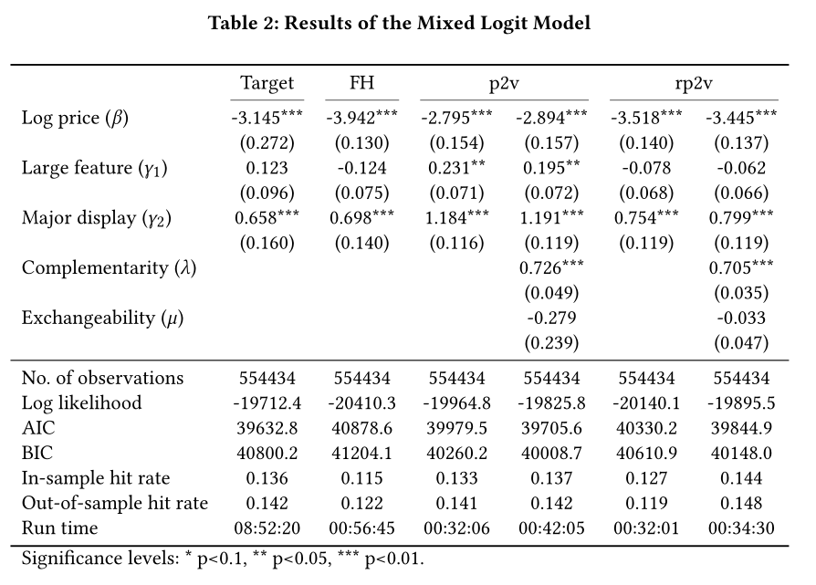
Model Performance

Slide 12
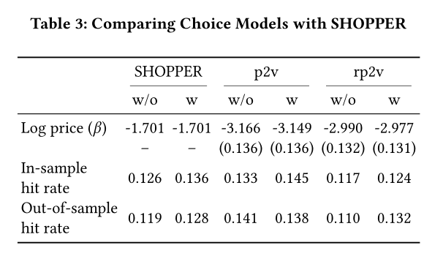
Model Performance

Slide 13
COCLUSION
Highly scalable and can be applied to millions of products because of the shallow model structure;
Differentiate substitutes and complements using two metrics, exchangeability and complementarity;
Forecast demand more quickly and accurately;
Estimate price elasticities more accurately by removing the influence of price from product vectors.

Slide 14
THANKS
Notes:
幸运日素材 淘宝店：https://shop145643496.taobao.com

