Slide 1
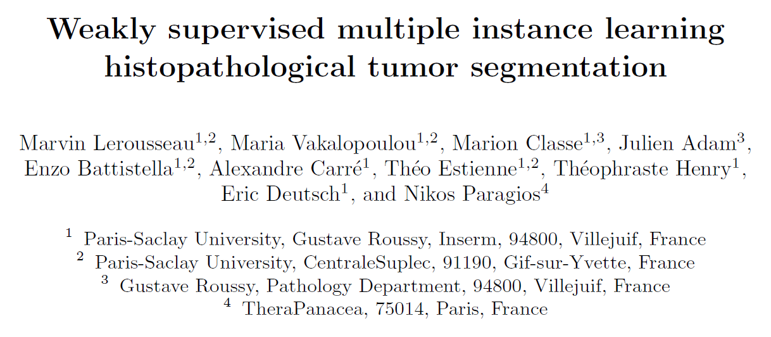
Reporter：Wei Ji
Notes:
幸运日素材 淘宝店：https://shop145643496.taobao.com

Slide 2
INTRODUCTION
WSI(whole slide images) is the gloden standard for primary diagnosis
Image segmentation is tackled by leveraging pixel-wise or patch-wise ground-truth annotations, but annotation process is considerably time-consuming, moreover, the high variance of clinical samples contributes on the deficiency of generalization
The MIL paradigm is particularly suited to histopathlogical image analysis due to its ability on reasoning on subsets of data that is often a computational necessity in histopathology
Result and conclusion

Slide 3

THREE PROPERTIES
Graph-Base Algorithms
1、adhere well to image bound
2、reduce computational complexity
3、both increase the speed and improve the quality of the result

Slide 4
EXISTING SUPERPIXEL METHODS
Graph-Base Algorithms
1、treat each pixel as a node, edge weight is the similarity between neighboring pixels,superpixels are created by minimizing a cost function defined over the graph
2、NC05(Normalized cuts algorithm)、GS04(Graph-based approach)、SL08、GCa10、GCb10
Gradient-Ascent-Based Algorithms
1、initial clustering of pixels, do gradient ascent methods iteratively refine the clusters until some convergence criterion is met to form superpixels
2、MS02(mean shift) 、QS08(quick shift)、WS91(watershed approach)、TP09(turbopixel)
Conclusion
no existing method is satisfactory in all regards

Slide 5
Algorithm Introduction
SLIC(Simple linear iterative clustering)
Adapt k-means clustering to generate superpixels
Yield state-of-the-art adherence to image boundaries on the Berkeley benchmark
Faster and more memory efficient

Slide 6
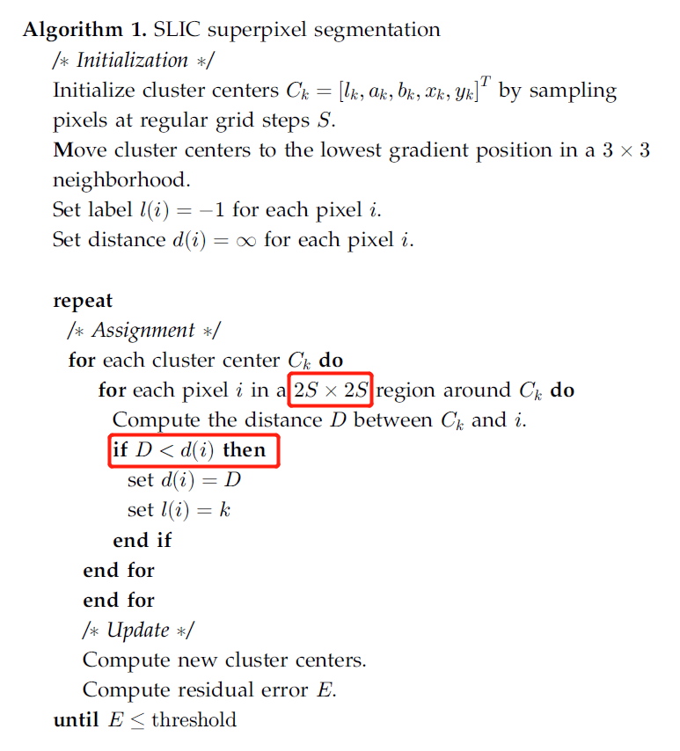
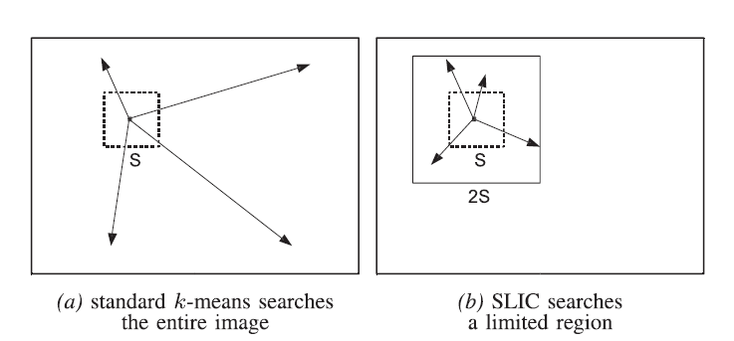
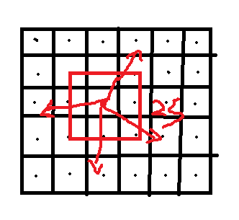
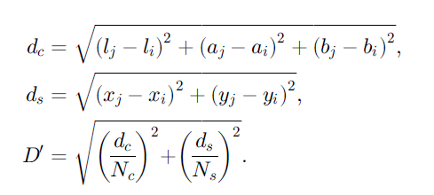
Algorithm procedure
LAB Image [l,a,b,x,y] :
l: luminosity,
a: red->green range
b: blue->yellow range
x,y:position
Residual error: the error of two cluster centers
Why not 5D euclidean distance?

Slide 7
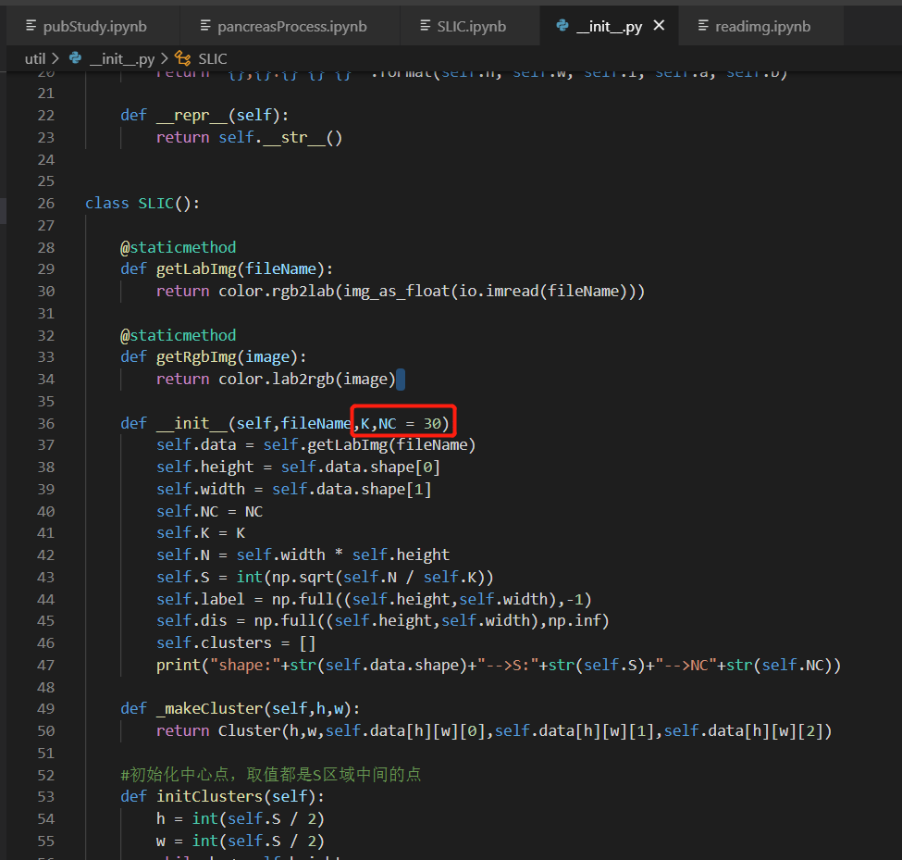
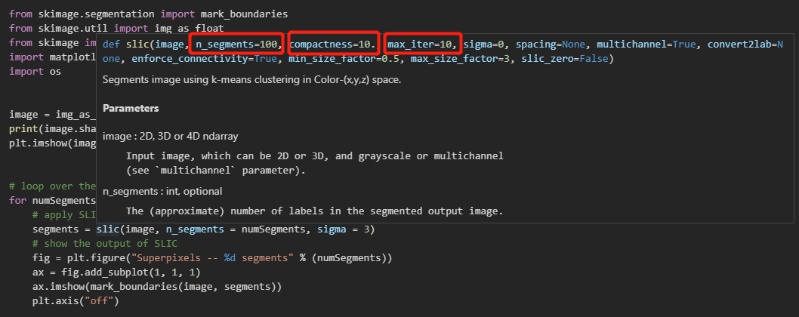
Algorithm Usage

Slide 8
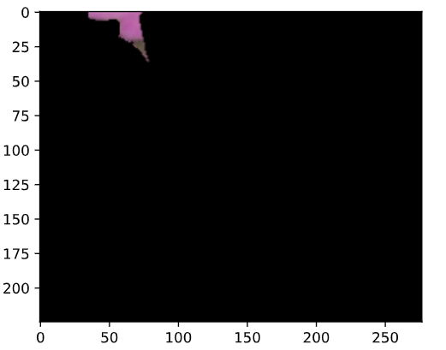
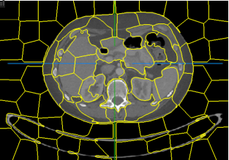
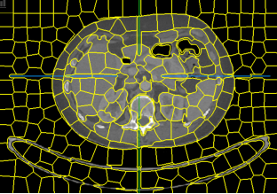
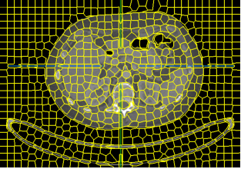
Algorithm Effect

Slide 9
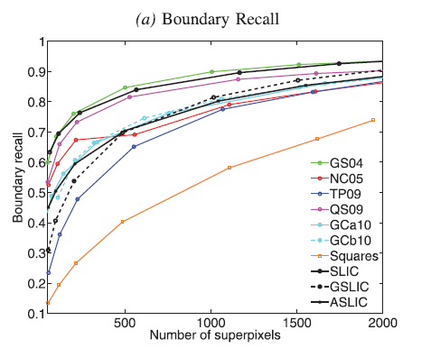
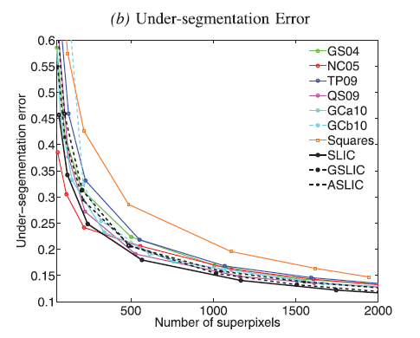
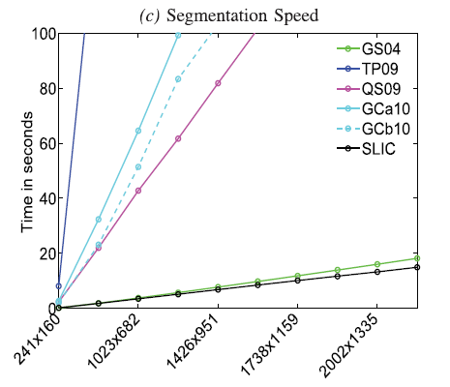
COCLUSION
Under-segmentation: get result pixels less than ground-truth

Slide 10
THANKS
Notes:
幸运日素材 淘宝店：https://shop145643496.taobao.com

