Slide 1
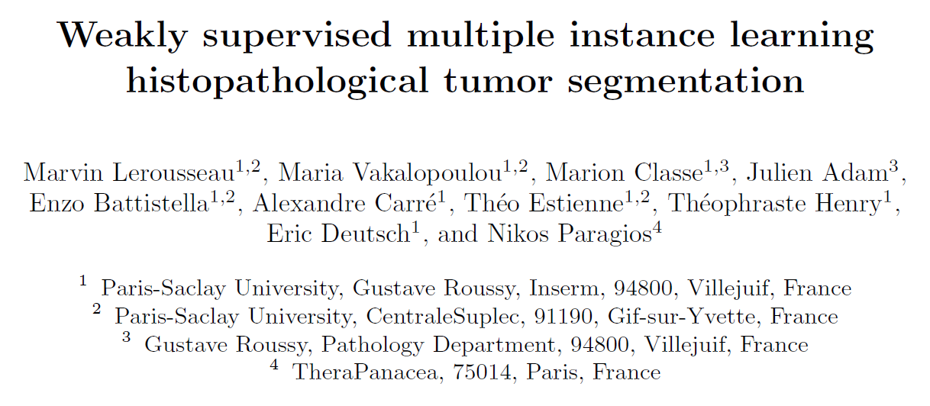
Reporter：Wei Ji
Notes:
幸运日素材 淘宝店：https://shop145643496.taobao.com

Slide 2
INTRODUCTION
WSI(whole slide images) is the golden standard for primary diagnosis
Image segmentation is tackled by leveraging pixel-wise or patch-wise ground-truth annotations, but annotation process is considerably time-consuming, moreover, the high variance of clinical samples contributes on the deficiency of generalization
The MIL paradigm is particularly suited to histopathological image analysis due to its ability on reasoning on subsets of data that is often a computational necessity in histopathology
Many studies lack extensive evaluation for a more detailed MIL-driven segmentation performance since slide-based classification measures could lead to erroneous assessment regarding instance-level performance
Propose a weakly supervised segmentation scheme that is able to generate tumor segmentation models using annotations from the conventional clinical practice of pathologists’ assessment

Slide 3





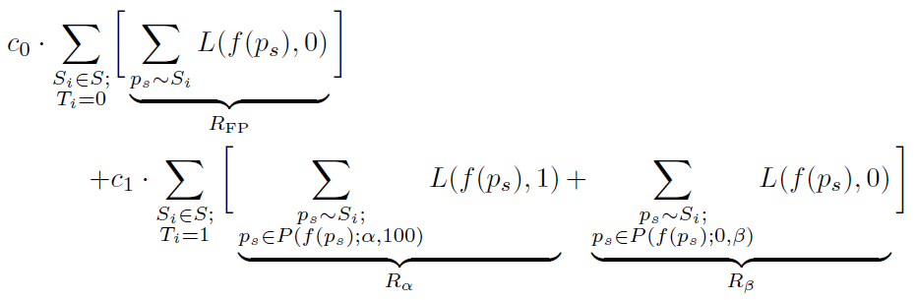
WEAKLY SUPERVISED LEARNING FOR TISSUE-TYPE SEGMENTATION
Parameter define
training whole slide images,
1 refers to tumor and 0 to normal of WSI
patches randomly sampled from a WSI
Aim
Generate a set of proxy path-level ground truth labels by exploiting properties from the available global Ti labels, when indicates that all extracted patches are normal, like a fully supervised learning scheme, when normal tissue can theoretically cover no pixel up to the entire region in the slide except one pixel
Minimizing this empirical risk will guide models into
recalling enough positive tumoral patches(Ra) per slide
but not too much (Rb) while maintaining a low level of
False positive in negative slides Rfp

Slide 4
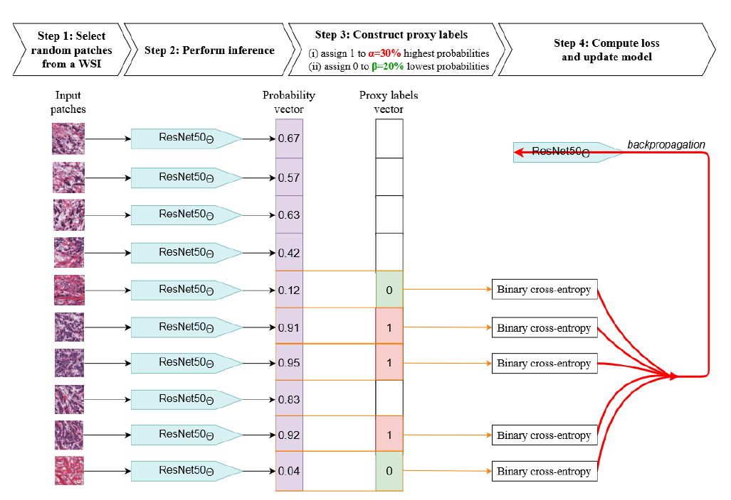
METHODS
1、ResNet50 architecture has been extensively used for histopathology image analysis in a multitude of task
2、Sample 150 patches of size 224*224 as a batch at 20x magnification randomly
3、Data augmentation is used independently on each patch
4、construct proxy-vector by a,b
5、

Slide 5
Algorithm Procudure
Sample 150 patches of size 224*224 as a batch at 20x magnification randomly
Data augmentation is used independently on each patch
Use ResNet50 which has been extensively used for histopathology image analysis
Binary cross-entropy loss

Slide 6
DATASET
TCGA issued from kidney, bronchus and ling and breast WSIs location, this dataset was divided in training, validation and testing sets on a case basis, with 65%, 15% and 20%
PatchCamelyon dataset, to further compare with results from the community, we infer all models on the PatchCamelyon dataset
To accommodate with the 224*224 input at 20x magnification of the learned models, these images were bi-linearly up-sampled twice and padded with 0

Slide 7
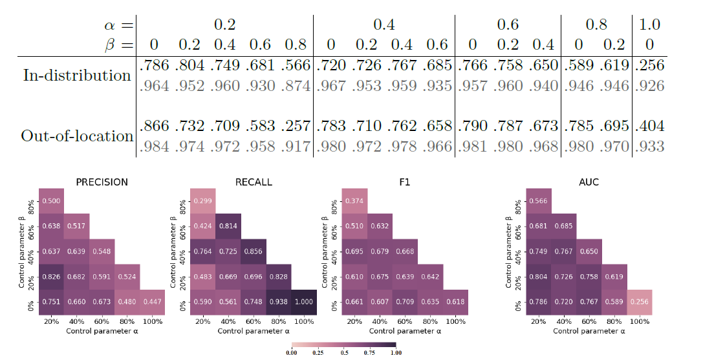

RESULT
All configurations are found to converge to sup-random In-distribution performance,
except for the two extreme configurations

Slide 8
RESULT
Although these results are far from report AUC of 0.963 obtained with fully supervised models
specifically trained on this dataset[17], the result suggest the presented framework could provide
Models which can grasp generic discriminative cancer features from multiple types of slide
in broad biological context
The findings in this paper highlight the potential of weakly supervised learning in histopathological
image segmentation which is known to be heavily impeded by the annotation bottleneck
There are many ways to fine-tune a segmentation model using the formulated framework

Slide 9
THANKS
Notes:
幸运日素材 淘宝店：https://shop145643496.taobao.com

