Slide 1
Final Presentation COMP30920
Jiwei Zhang
17200334
2020/07/03

Slide 2
Outline:
Display all graphs since week 3
Describe key production process
Clean data – week 2
Set up ticks – week 3
Doubling line – week 4
Non-positive values – week 5

Slide 3
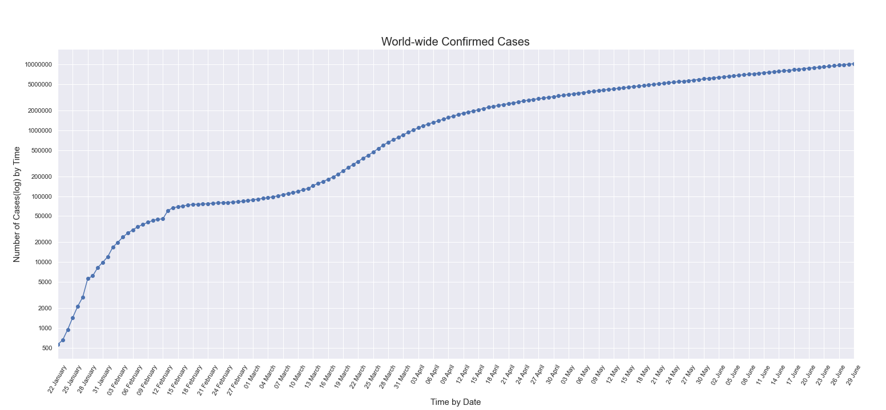
Graphs Display

Slide 4
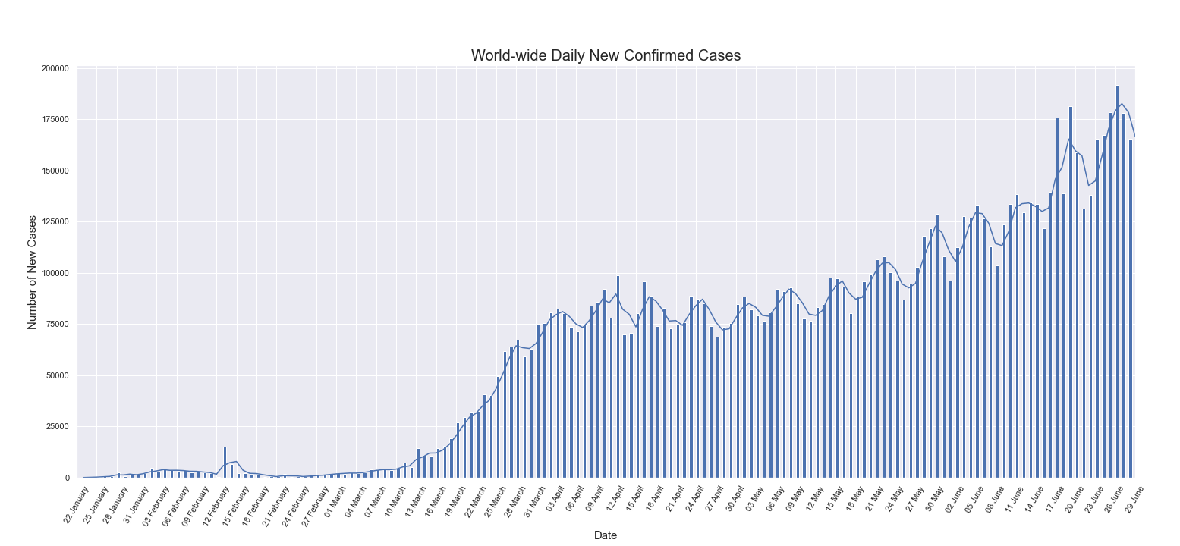
Graphs Display

Slide 5
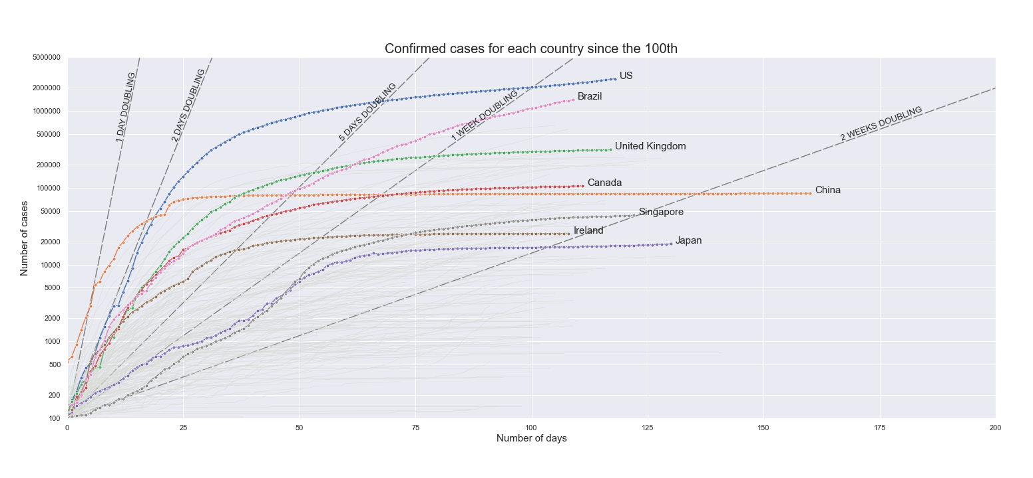
Graphs Display

Slide 6
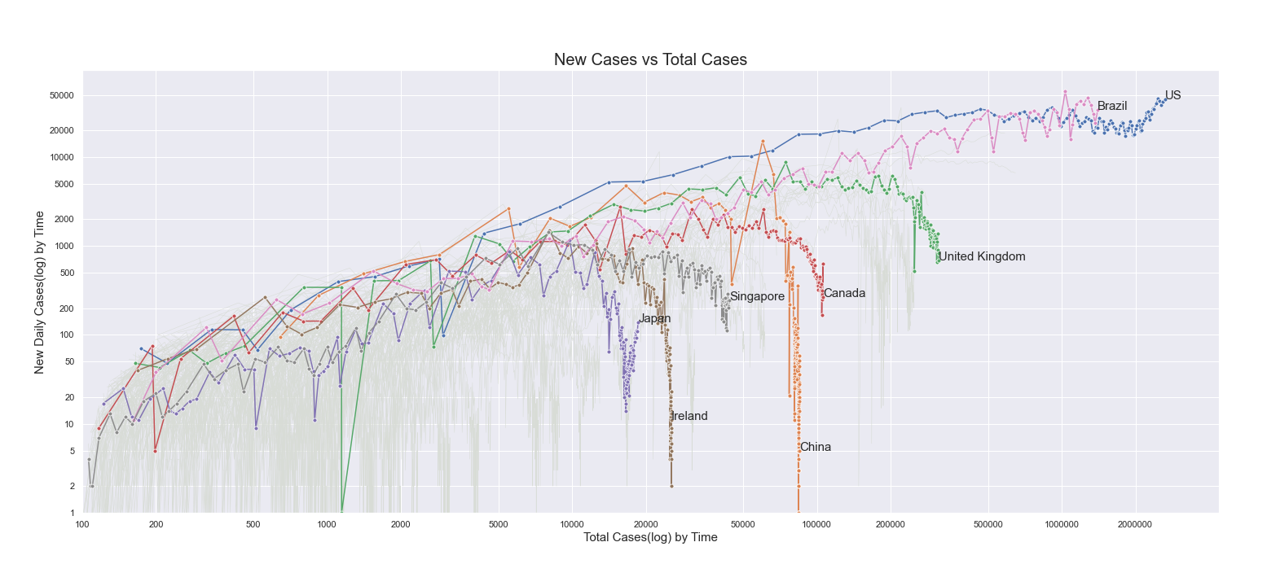
Graphs Display

Slide 7
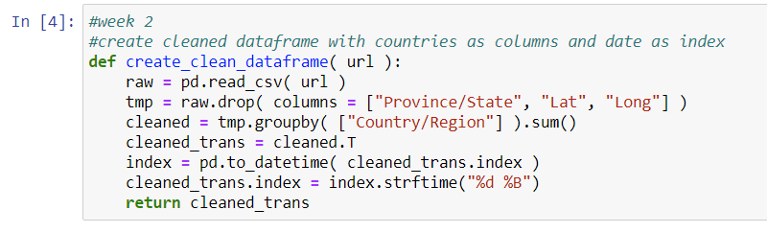
How did I clean up the dataset?
The original data has columns
Province/State, Country/Region, Lat, Long, and a sequence of dates
The cleaned data will use each country’s data as column and dates as index

Slide 8
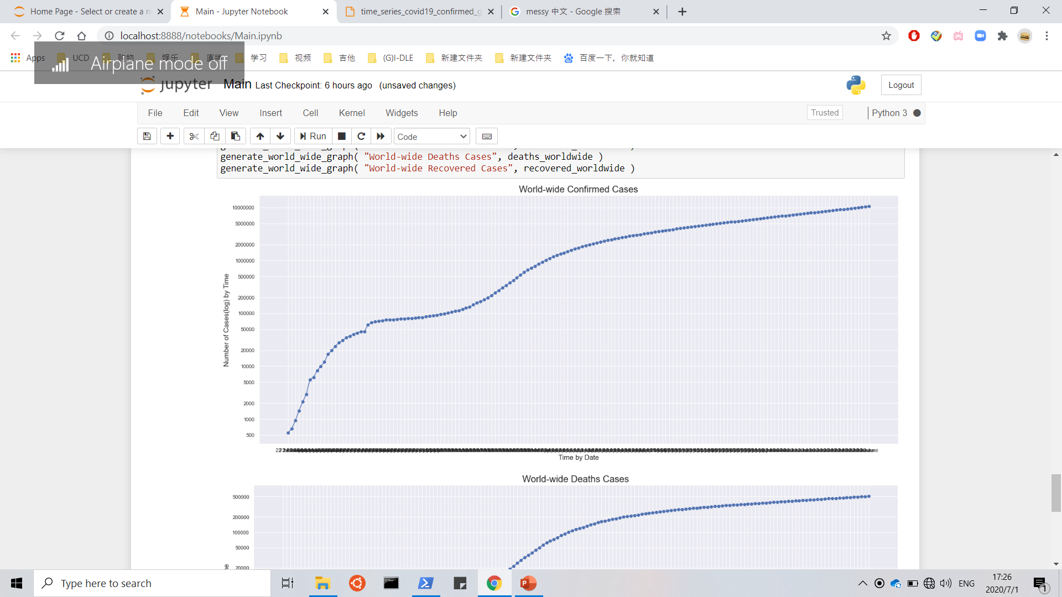
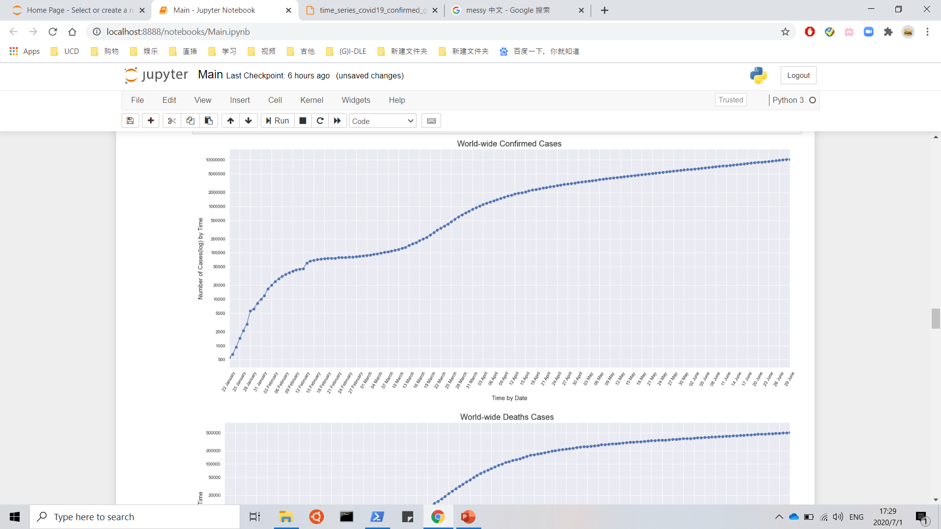
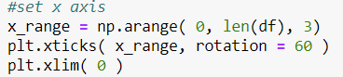
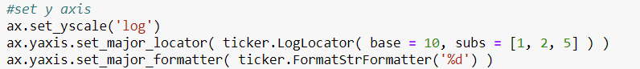
How did I change the x-axis ticks?
If every date is listed, it will be messy!
This is what I finally get:
Here is my code to set up x-axis and y-axis

Slide 9
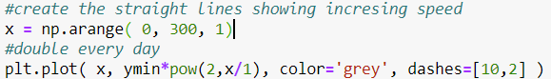
How to generate a doubling line with log yscale?
Step 1:
To generate a Natural Number array [0,1,2,3,4,…,n] as x values
Step 2:
To generate relative 2^n array [1,2,4,8,16,…,2^n]
So far, I can get a straight line in a log graph
Step 3:
To match the origin, for every y value, multiply the y-axis limit

Slide 10
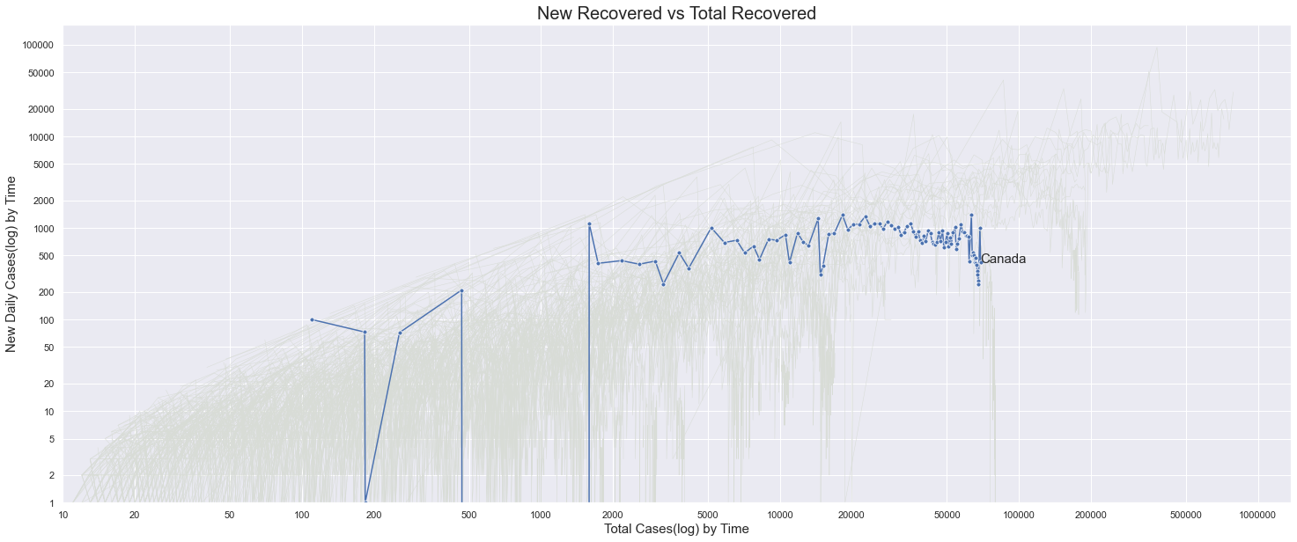

How did I deal with non-positive values?
Situation 1: When there is no increase, daily new case is 0
For this situation, to remove the vertical line, I just dropped duplicated total number
Situation 2: For some reasons, the number of daily new cases goes negative
For this situation, I sort the data to remove the significant jump of the graph.
Take Canada for example: (Before vs After)

Slide 11
Questions?

Slide 12
Thank you

