Slide 1
26-2 Special Topics in Naval Architecture · Team 5
Priority Zone Monitor
2024
AIS Track-based Traffic Analysis of a Port Approach Channel
& selection of monitoring priority zones — Norfolk / Hampton Roads, USA
Grid size
500 m
1st Proposal
Vessel groups
Cargo · Tanker
Candidate rule
Top 10% unique MMSI
고영조 · 김희선 · 백지원 · 조민제
Notes:
Title. Team 5 first proposal: AIS track-based traffic analysis of the Norfolk / Hampton Roads port approach and selection of monitoring priority zones. Members: Ko Youngjo, Kim Heeseon, Baek Jiwon, Cho Minje.

Slide 2

Meet the team
02 — TEAM
고
김
조
고영조
김희선
백지원
조민제
[Major / lab]
[Major / lab]
Ph.D. Candidate
[Major / lab]
[Research interest]
[Research interest]
Scheduling · MARL
[Research interest]
Role · TBD
Role · TBD
Role · TBD
Role · TBD
Notes:
Team introduction. Fill in each member's background and research interest; roles will be finalized after the initial data check.

Slide 3



Why port approach channels?
03 — PROBLEM OVERVIEW
Traffic converges at a chokepoint
Cargo ships, tankers, tugs and naval vessels all squeeze into the same approach lanes.
RESEARCH QUESTIONS
RQ1
Where do observed vessels concentrate around the approach channel?
Monitoring resources are limited
Patrol and VTS attention must go where — and when — traffic actually concentrates.
RQ2
How much do cargo and tanker routes overlap — and how does it shift by month?
AIS makes it measurable
RQ3
Do the priority zones hold when grid size and selection cut-off change?
A full year of open AIS tracks gives MMSI, time and vessel group for every track.
Notes:
Why this problem: approach channels are chokepoints shared by many vessel types; monitoring resources are limited, so we need evidence on where and when traffic concentrates; NOAA AIS Vessel Tracks 2024 makes this quantitative. Three research questions guide the work.

Slide 4
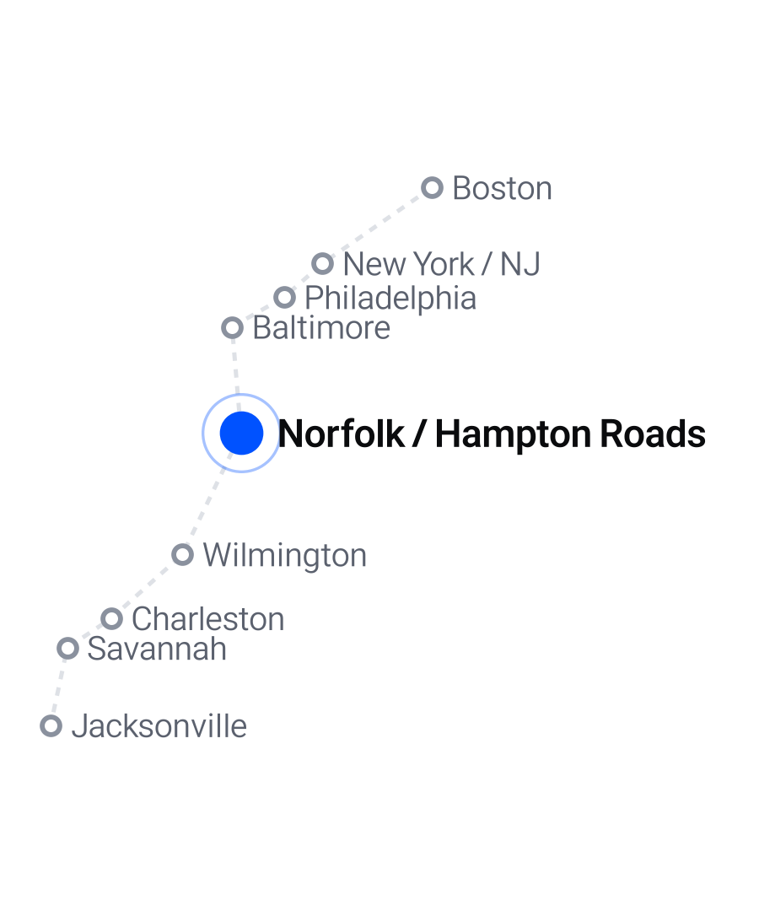


Why Norfolk / Hampton Roads?
03 — STUDY AREA
A major commercial gateway with busy, shared approaches
68.8M
3.50M
1,733
short tons of cargo
CY2023 · 9th among U.S. ports [a]
TEUs handled
FY2024 (Jul 2023 – Jun 2024) [b]
ship calls
FY2024 · + 283,817 t breakbulk [b]
Approach channel in focus
A wider channel opened in 2024 allows two-way ultra-large container ship passage — up to 15% less time at berth [c]
Shared, mixed-use waters
Cargo ships and tankers share the harbor with recreational, tug/tow, fishing and passenger traffic
Approximate port locations · no coastline layer
[a] USACE, 2023 Transportation Facts (2025) [b] Port of Virginia, FY2024 results (Jul 30, 2024) [c] Port of Virginia, wider channel (Mar 1, 2024). Different periods & units — context only.
Notes:
Hampton Roads is a regional harbor and port complex; the Port of Virginia is the commercial gateway associated with the study area. USACE reported 68.8 million short tons of waterborne cargo for the Port of Virginia statistical area in calendar 2023, 9th among U.S. ports. In fiscal 2024 (July 2023 – June 2024) the port handled 3,499,639 TEUs, 283,817 tons of breakbulk and 1,733 ship calls. In 2024 a wider channel opened for two-way passage of ultra-large container vessels; the port reported this could cut a large vessel's time at berth by up to 15%. These port-wide figures cover different periods and units from our calendar-2024 AIS tracks, so they are context, not validation of our counts. The channel milestone is relevant to approach movement but does not by itself establish a safety risk.

Slide 5
Four steps to priority zones
04 — WORK PLAN
01
02
03
04
Data build & preprocessing
Traffic characterization
Priority zone selection
Robustness check
Clip to study area
Check missing records
Reproject to UTM
Routes by group
Monthly unique ships
Tracks vs. MMSI
500 m grid count
Top 10% = candidates
Cargo–tanker overlap
Grid 250 m – 1 km
Cut-off 10% vs. 20%
Overlap area & shift
→ Clean dataset
→ Route maps · stats
→ Priority map + table
→ Stable vs. fragile zones
Owner · TBD
Owner · TBD
Owner · TBD
Owner · TBD
Notes:
Plan: (1) data build and preprocessing, (2) traffic characterization, (3) monitoring priority zone selection, (4) robustness check. Each step has an owner slot — role assignment to be finalized.

Slide 6
What is in the AIS track dataset
05 — AIS DATA OVERVIEW
GeoPackage
1 layer
HOW ROWS ARE FORMED
file format
SQLite container (.gpkg)
feature layer
AISVesselTracks2024
1 row = 1 track interval. One vessel (MMSI) appears in many rows.
11 fields
EPSG:4269
MMSI 563156300
Illustrative timeline
per row
10 attributes + Shape
coordinates
NAD83 lon / lat
gap
row 1
row 2
row 3
row 4
VesselGroup — 8 groups observed in our area
Raw AIS sampled to 1 min
→ new track when gap > 30 min or > 1 NM
→ built per month and per ocean basin
Cargo
Tanker
Pleasure
TugTow
Other
Dark = in scope · full mix on the next slide
Notes:
AIS Vessel Tracks 2024 is a GeoPackage — a SQLite database holding features, attributes, CRS metadata and spatial indexes. Its single feature layer, AISVesselTracks2024, has 11 fields: 10 attributes plus the Shape geometry, in EPSG:4269 (NAD83 lon/lat). Each row is a track for one time interval, so one vessel (MMSI) appears in many rows: raw AIS is sampled to one minute and a new track starts after a 30-minute or 1-nautical-mile gap. VesselGroup gives a broad category; we keep Cargo and Tanker.

Slide 7
Who uses the study-area waters?
05 — AIS DATA OVERVIEW
Cargo and tanker tracks are a focused study group within a mixed-use waterway
VesselGroup | Track rows | Share | Distinct MMSI
■ Pleasure Craft/Sailing | 40,666 | 43.76% | 4,713
■ Other | 15,920 | 17.13% | 453
■ TugTow | 11,825 | 12.73% | 321
■ Cargo | 10,311 | 11.10% | 1,865
■ Fishing | 7,018 | 7.55% | 306
■ Passenger | 5,654 | 6.08% | 99
■ Not Available | 901 | 0.97% | 98
■ Tanker | 632 | 0.68% | 138
Total | 92,927 | 100% | —
92,927
track rows
Why Cargo & Tanker? A question-driven scope — our RQs compare these two commercial groups, not because they dominate traffic. “Cargo” is a broad AIS label, not bulk carriers only.
Tracks intersecting the provisional rectangle (EPSG:4269), 2024 · shares by track row, not unique vessel or port call · MMSI counted within each group
Notes:
The provisional rectangle contains 92,927 intersecting track features across eight NOAA VesselGroup values. Pleasure Craft/Sailing is the largest group by track rows (43.76%), then Other (17.13%) and TugTow (12.73%). Cargo is 11.10% and Tanker 0.68%. Repeated tracks from one MMSI contribute multiple rows, so this answers what share of extracted track records falls in each source group — not fleet share, port-call share or tonnage. Distinct MMSIs are counted within each group and are not additive. We focus on Cargo and Tanker because our research questions compare these two commercial groups, not because they dominate traffic; the source label is Cargo, not Bulk_Carrier. The rectangle is temporary and will be replaced by the agreed boundary.

Slide 8
Inside the GeoPackage file
05 — AIS DATA OVERVIEW
AISVesselTracks2024.gpkg SQLite container
Spatial index
Feature layer
Metadata tables
rtree_AISVesselTracks2024_Shape
AISVesselTracks2024
gpkg_contents · gpkg_spatial_ref_sys
Bounding box of every track → fast candidate lookup
10 attributes + Shape (MULTILINESTRING) per row
Layer description and CRS: EPSG:4269
1
BBox lookup
2
Exact intersect
3
Cargo & Tanker
4
pandas chunks
5
CSV + Shape_WKT
RTree returns candidate tracks
Drop bbox-only false positives
Filter on VesselGroup
Read 100k rows at a time
Binary geometry → WKT text
Blue dashed arrows: which part of the file each step relies on
Notes:
The downloaded archive holds one GeoPackage, a SQLite container with three parts: the feature layer AISVesselTracks2024 (attributes plus MULTILINESTRING Shape geometry), GeoPackage metadata tables (layer and CRS, EPSG:4269), and an RTree spatial index on Shape. Our extract uses the RTree for a fast bounding-box candidate lookup, then an exact geometry intersection to remove false positives, filters Cargo and Tanker on VesselGroup, reads the result in pandas chunks, and writes a CSV where the binary Shape is converted to WKT text in Shape_WKT. The CRS label is carried in a Geometry_CRS column because CSV does not keep CRS metadata.

Slide 9
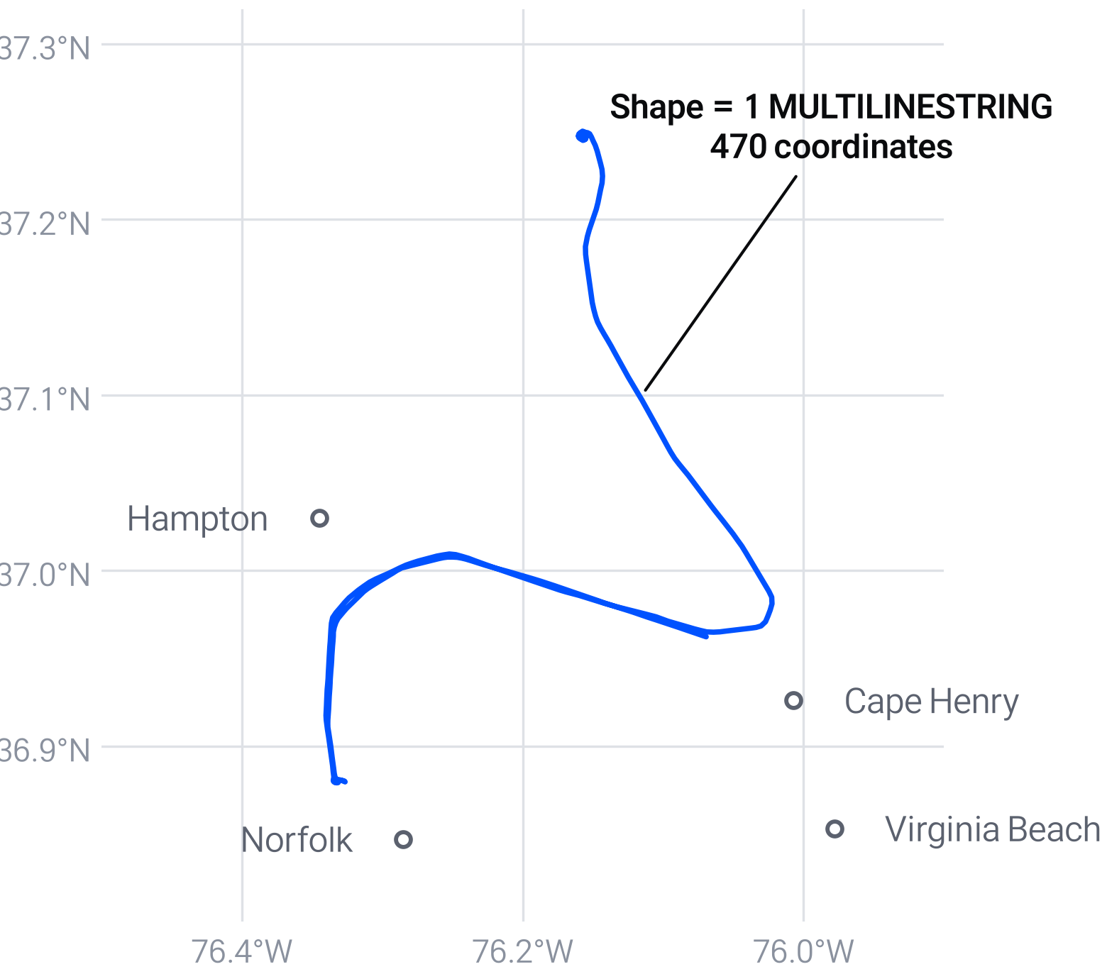
Structure of raw data — one row, one line
05 — AIS DATA OVERVIEW
Field | Type | Example row | Meaning | Use
Shape | MultiLineString | 1 line · 470 points | Track linework | CORE
MMSI | Medium int | 563156300 | Vessel ID, repeats | CORE
TrackStartTime | Date/time | 2024-01-01 00:02 | Interval start | CORE
TrackEndTime | Date/time | 2024-01-06 19:59 | Interval end | CORE
VesselGroup | Text (25) | Cargo | Broad category | CORE
VesselType | Medium int | 70 | Code (codebook) | SUPPORT
Length · Width · Draft | Double | 229 · 38 · 14.8 | Dimensions | SUPPORT
DurationMinutes | Medium int | 8,397 | Track duration | SUPPORT
OBJECTID | Integer | 50958 | Row ID (index) | DROP
MMSI 563156300 · Cargo
Jan 1 → Jan 6, 2024 (UTC) · 8,397 min
Example row = OBJECTID 50958 from example_trace.csv · 11 fields in total
Notes:
Each row carries one vessel track for a time interval. Shape holds the whole line; MMSI identifies the vessel and repeats across rows; start/end time bound the interval; VesselGroup gives the broad category. VesselType is only a numeric code and needs a codebook before we interpret it. OBJECTID is a row identifier used by the spatial index. The map shows one real row from our first-pass extract: OBJECTID 50958, MMSI 563156300, a Cargo track from 1 to 6 January 2024. Reference points are approximate and there is no coastline layer; the line was redrawn from the extract plot.

Slide 10
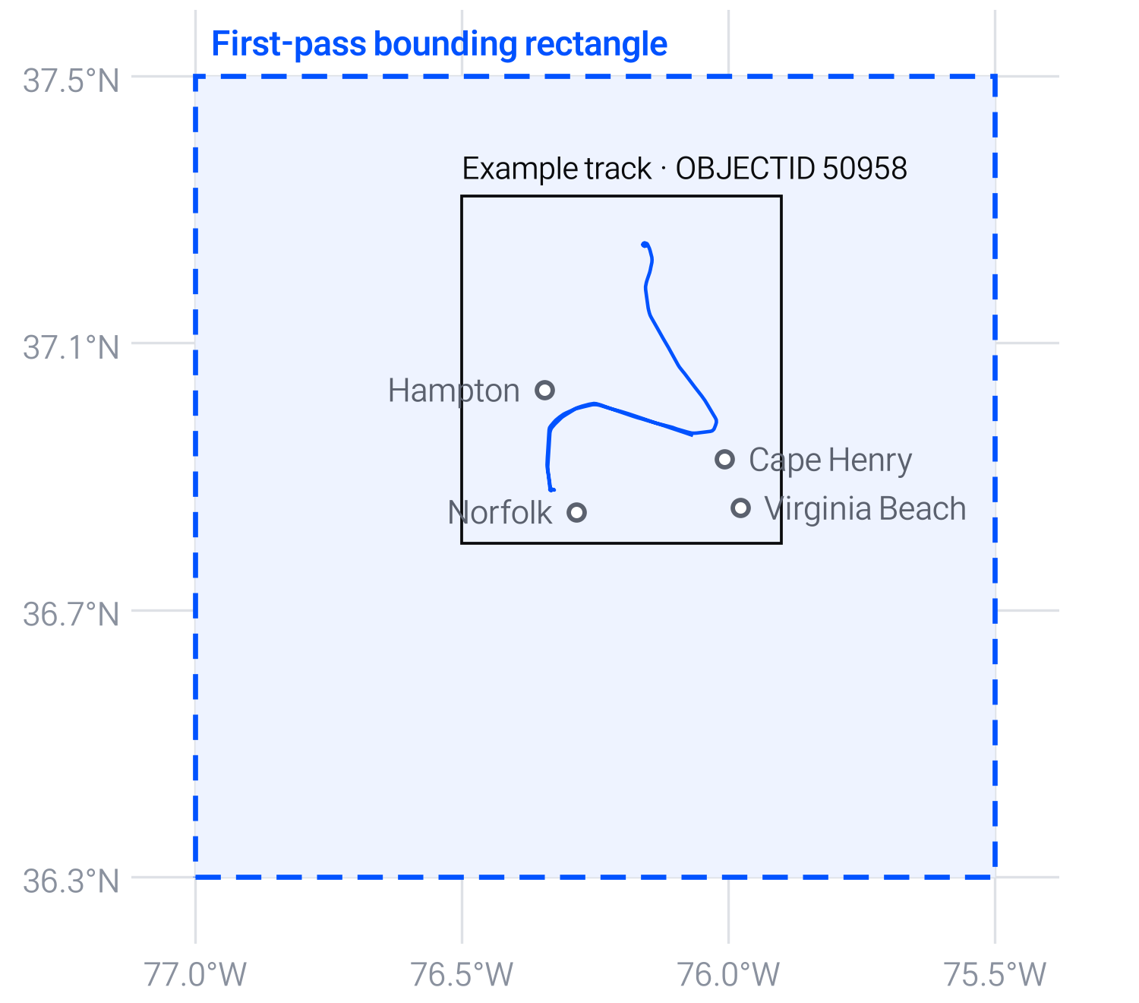
First-pass extract — Hampton Roads
05 — AIS DATA OVERVIEW
10,943
Cargo + Tanker rows
11.8% of 92,927 in area
CSV ≈ 373 MB
Cargo 94.2%
Tanker 5.8% of rows
CARGO
TANKER
1,865 vessels (MMSI)
138 vessels (MMSI)
10,311 rows · ≈5.5 rows / vessel
632 rows · ≈4.6 rows / vessel
Filter
lon −77.0 → −75.5, lat 36.3 → 37.5 (EPSG:4269)
Rule
Keep tracks that intersect — whole line kept, not clipped
CSV adds
Shape_WKT · Geometry_CRS · Subset_BBox
Temporary broad rectangle — not the final study boundary
Notes:
First-pass extract: we kept every Cargo or Tanker track whose geometry intersects a broad rectangle from longitude −77.0 to −75.5 and latitude 36.3 to 37.5. That gives 10,943 rows: 10,311 Cargo rows from 1,865 distinct vessels and 632 Tanker rows from 138 vessels — about five rows per vessel, which is why we count unique MMSI separately from tracks. The CSV is about 373 MB and adds Shape_WKT, Geometry_CRS and Subset_BBox. The rectangle is temporary, not the final study boundary, and tracks crossing its edge are kept whole.

Slide 11






From national tracks to a regional dataset
06 — DATA PREPROCESSING
1. Spatial-index extract
RTree + exact intersection on the rectangle
DONE
DATA SCOPE
Source
NOAA MarineCadastre AIS Vessel Tracks 2024 [1]
2. Filter vessel groups
Cargo & Tanker → 10,943 rows
DONE
3. Confirm study boundary
ENC-based approach area, then rerun the filter
NEXT
Period
Jan – Dec 2024
Area
Now: broad rectangle → next: NOAA ENC-based approach boundary [3]
4. Resolve vessel-type scope
VesselType codebook; all Cargo or a sub-type?
NEXT
Vessels
Cargo & Tanker — source label is “Cargo”, not Bulk_Carrier
5. Clip or keep whole + QC
Per analysis; missing MMSI / time, invalid paths
NEXT
Data
Raw .gpkg kept unchanged; CSV is a re-creatable interim file
6. Reproject & build dataset
EPSG:4269 → UTM 18N; GeoPandas → GeoParquet
NEXT
[1] NOAA OCM, AIS Vessel Tracks 2024 [3] NOAA OCS, Electronic Navigational Charts
Notes:
Main data: NOAA MarineCadastre AIS Vessel Tracks 2024, Jan–Dec 2024. Done so far: spatial-index extract on a broad rectangle and the Cargo/Tanker filter, giving 10,943 rows. Next: confirm the study boundary from NOAA ENCs and rerun the filter; decide whether we target all Cargo or a narrower type, using a VesselType codebook (the source says Cargo, not Bulk_Carrier); decide per analysis whether tracks are clipped or kept whole, and run quality checks; then reproject to UTM 18N and build the Python dataset. The raw GeoPackage stays unchanged and the CSV can be regenerated from the documented filter.

Slide 12

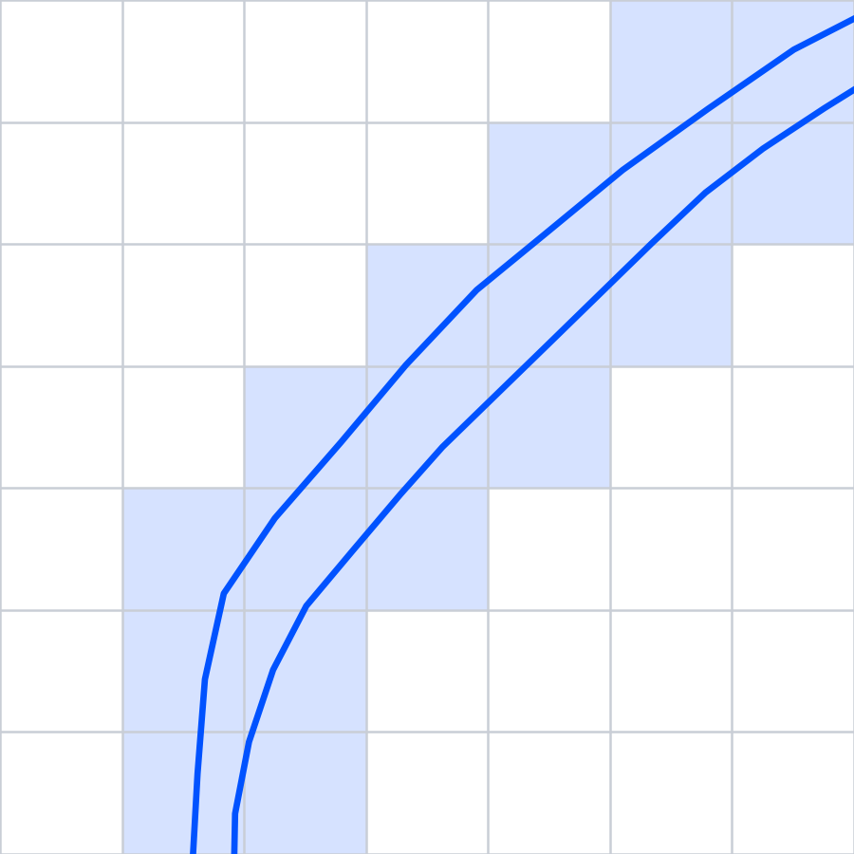
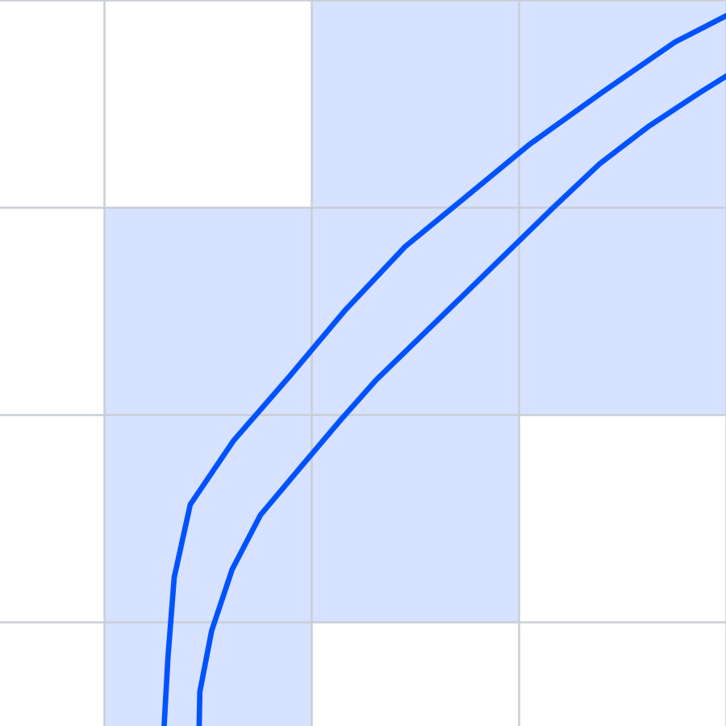
Why grid resolution matters
06 — ANALYSIS DESIGN
Finer cells show more detail — not automatically more accurate results
250 m
500 m
1 km
Primary
0.0625 km²
16 cells / km²
0.25 km²
4 cells / km²
1 km²
1 cells / km²
463
cells crossed by the whole track
210
cells crossed by the whole track
101
cells crossed by the whole track
+ Finer variation, narrow corridors
− More, sparser cells; fragmented hotspots
+ Intermediate detail — primary setting
− Nearby routes can still merge or split
+ Broad concentrations, smooth overview
− Distinct corridors merge; local detail hidden
Same 3.5 km window on the example track (OBJECTID 50958); shaded = cells the line crosses; grid origin arbitrary
PLAN 500 m primary → repeat at 250 m & 1 km · unique MMSI per cell, top 10% (20% as sensitivity) · compare overlap & location shift on a common reference
Notes:
Grid size is a scale choice. A 250 m cell is 0.0625 km², so 16 cells per km²; 500 m is 0.25 km², 4 per km²; 1 km is 1 km², 1 per km². Finer resolution separates nearby patterns — in the panels the inbound and outbound passes of the example track fall in partly different 250 m cells but the same 1 km cells — yet it also yields sparse, unstable counts and more cells to process. This single track crosses 463, 210 and 101 cells at the three resolutions. We use 500 m as the primary setting, repeat at 250 m and 1 km, select the top 10% of occupied cells by unique MMSI (20% as sensitivity), and compare overlap and location shifts on a common spatial reference. Counts summed across cells are not unique vessels for the whole area, since one track crosses many cells. Actual runtime depends on the boundary, geometries and implementation.

Slide 13




07 — EXPECTED OUTCOMES
What the priority-zone map enables
DELIVERABLES
Efficient maritime patrol
Spot ghost / illicit vessels
✓ Route maps by vessel group
✓ Monthly traffic statistics
Allocate patrol and VTS attention to zones that persist across months and criteria.
Use the normal-traffic baseline to flag tracks that vanish or stray in busy zones.
✓ Priority zone map & table
✓ Robustness report across criteria
Early collision-risk alerts
Channel maintenance
Zones where cargo and tanker lanes overlap become candidates for warnings.
Prioritize inspection, dredging and aids-to-navigation upkeep on busy lanes.
Scope note: priority zones are observation candidates from historical traffic — not collision probabilities or real-time decisions. Track counts ≠ port calls.
Notes:
Expected insights: efficient maritime patrol, detection of ghost / illicit vessels, early warning for collision-risk zones, and maintenance prioritization for heavily used lanes. Limitation: AIS tracks can be split by reception gaps, so track counts are not port calls; spatial overlap of paths does not mean simultaneous encounters. The priority zones are observation candidates, not collision probabilities.

