Slide 1
Term Project Proposal
Data Science, Team # 16
201835528 Jo Byeong Geun
201835538 Choi Ji Won
201931889 Jeong Da Hee

Slide 2
INDEX
01. Objective
Topic?
02. Used Data
Which Dataset?
03. Data preprocessing
How we will make?
04. Role
Role of members?
04. Schedule
How we proceed?

Slide 3

Objective
Used Data
Data Preprocessing
Role
Schedule
Objective
Predicting the future results of premier league based on DataSet

Slide 4
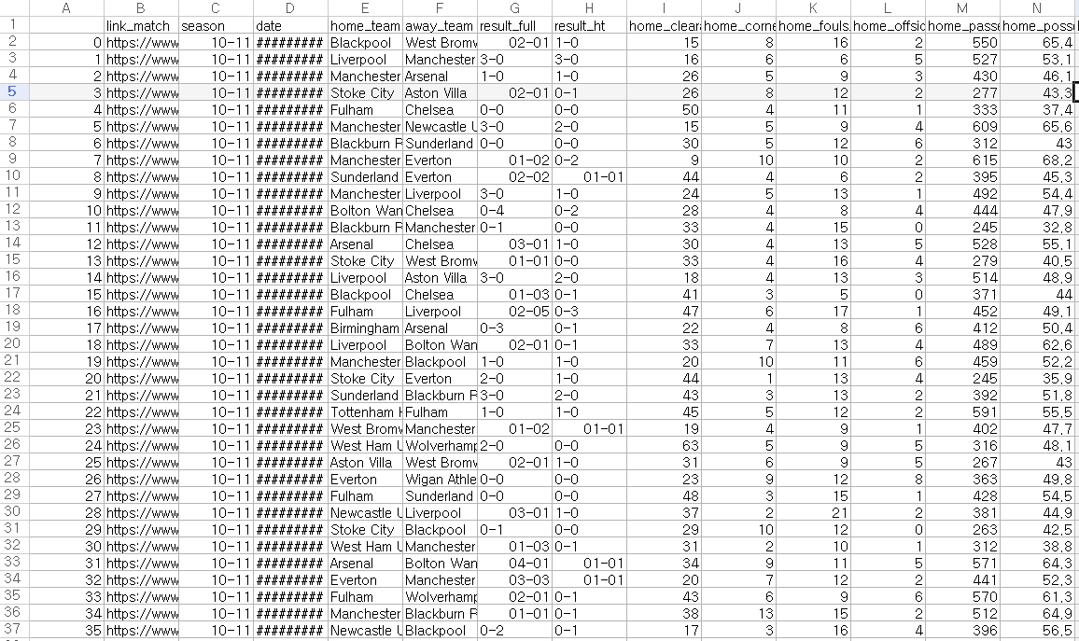
Objective
Used Data
Data Preprocessing
Role
Schedule
Used Data
DataSet
Data - 4,070 values
https://www.kaggle.com/pablohfreitas/all-premier-league-matches-20102021?select=df_full_premierleague.csv

Slide 5
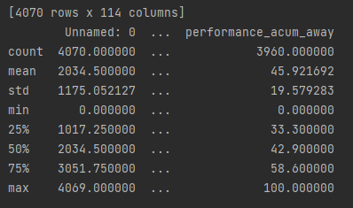
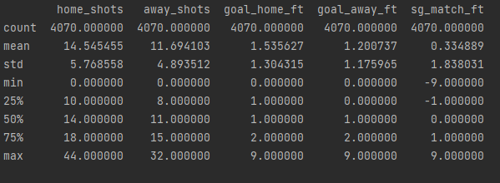
Objective
Used Data
Data Preprocessing
Role
Schedule
Used Data
[ Output all features ]
DataSet
feature - link_match, season, date, home_team, away_team, etc..
(114 features)
[ Output home_shots, away_shots, goal_home_ft, goal_away_ft, sg_match_ft features ]

Slide 6
Objective
Used Data
Data Preprocessing
Role
Schedule
feature description
goal_home_ft : home team goals scored in the match
goal_away_ft : away team goals scored in the match
sg_match_ft : goals difference between home team and away team in the match
goal_home_ht : home team goals scored in 1st time in the match
goal_away_ht : away team goals scored in 1st time in the match
sg_match_ht : goals difference between home team and away team in 1st time in the match
clearances_avg_H : average home team clearances in matches as host in the season;
corners_avg_H : average home team corners in matches as host in the season;
fouls_conceded_avg_H : average home team fouls conceded in matches as host in the season;
offsides_avg_H : average home team offsides in matches as host in the season;
passes_avg_H : average home team passes in matches as host in the season;
possession_avg_H : average home team possession in matches as host in the season;
red_cards_avg_H : average home team red cards in matches as host in the season;
shots_avg_H : average home team shots in matches as host in the season;
shots_on_target_avg_H : average home team shots on target in matches as host in the season;
tackles_avg_H : average home team tackles in matches as host in the season;
touches_avg_H : average home team touches in matches as host in the season;
yellow_cards_avg_H : average home team yellow cards in matches as host in the season;
goals_scored_ft_avg_H : average home team goals scored in matches as host in the season;
goals_conced_ft_avg_H : average home team goals conceded in matches as host in the season;
sg_match_ft_acum_H : goals difference in matches as host in the season;
goals_scored_ht_avg_H : average home team goals scored in 1st time in matches as host in the season;
goals_conced_ht_avg_H : average home team goals conceded in 1st time in matches as host in the season;
sg_match_ht_acum_H : goals difference in 1st time in matches as host in the season;
performance_acum_H : home team percentage of points gains in matches as host in the season;
clearances_avg_A : average away team clearances in matches as host in the season;
corners_avg_A : average away team corners in matches as host in the season;
fouls_conceded_avg_A : average away team fouls conceded in matches as host in the season;
offsides_avg_A : average away team offsides in matches as host in the season;
passes_avg_A : average away team passes in matches as host in the season;
possession_avg_A : average away team possession in matches as host in the season;
red_cards_avg_A : average away team red cards in matches as host in the season;
shots_avg_A : average away team shots in matches as host in the season;
* accumulated until the last match
link_match : page link of match in Premier League Official website
season : match season
date : match date
home_team : home team
away_team : away team
result_full : match result
result_ht : match result in 1st time
home_clearances : home team clearances in the match
home_corners : home team corners in the match
home_fouls_conceded : home team fouls conceded in the match
home_offsides : home team offsides in the match
home_passes : home team passes in the match
home_possession : home team possession in the match
home_red_cards : home team red cards in the match
home_shots : home team shots in the match
home_shots_on_target : home team shots on target in the match
home_tackles : home team tackles in the match
home_touches : home team touches in the match
home_yellow_cards : home team yellow cards in the match
away_clearances : away tem clearances in the match
away_corners : away team corners in the match
away_fouls_conceded : away team fouls conceded in the match
away_offsides : away team offsides in the match
away_passes : away team passes in the match
away_possession : away team possession in the match
away_red_cards : away team red cards in the match
away_shots : away team shots in the match
away_shots_on_target : away team shots on target in the match
away_tackles : away team tackles in the match
away_touches : away team touches in the match
away_yellow_cards : away team yellow cards in the match

Slide 7
Objective
Used Data
Data Preprocessing
Role
Schedule
feature description
shots_on_target_avg_A : average away team shots on target in matches as host in the season;
tackles_avg_A : average away team tackles in matches as host in the season;
touches_avg_A : average away team touches in matches as host in the season;
yellow_cards_avg_A : average away team yellow cards in matches as host in the season;
goals_scored_ft_avg_A : average away team goals scored in matches as host in the season;
goals_conced_ft_avg_A : average away team goals conceded in matches as host in the season;
sg_match_ft_acum_A : goals difference in matches as host in the season;
goals_scored_ht_avg_A : average away team goals scored in 1st time in matches as host
in the season;
goals_conced_ht_avg_A : average away team goals conceded in 1st time in matches as host
in the season;
sg_match_ht_acum_A : goals difference in 1st time in matches as host in the season;
performance_acum_A : away team percentage of points gains in matches as host in the season;
clearances_avg_home : average home team clearances in the season;
corners_avg_home : average home team corners in the season;
fouls_conceded_avg_home : average home team fouls conceded in the season;
offsides_avg_home : average home team offsides in the season;
passes_avg_home : average home team passes in the season;
possession_avg_home : average home team possession in the season;
red_cards_avg_home : average home team red cards in the season;
shots_avg_home : average home team shots in the season;
shots_on_target_avg_home : average home team shots on target in the season;
tackles_avg_home : average home team tackles in the season;
touches_avg_home : average home team touches in the season;
yellow_cards_avg_home : average home team yellow cards in the season;
goals_scored_ft_avg_home : average home team goals scored in the season;
goals_conced_ft_avg_home : average home team goals conceded in the season;
sg_match_ft_acum_home : goals difference in the season;
goals_scored_ht_avg_home : average home team goals scored in 1st time in the season;
goals_conced_ht_avg_home : average home team goals conceded in 1st time in the season;
* accumulated until the last match
sg_match_ht_acum_home : goals difference in 1st time in the season;
performance_acum_home : home team percentage of points gains in the season;
clearances_avg_away : average away team clearances in the season;
corners_avg_away : average away team corners in the season;
fouls_conceded_avg_away : average away team fouls conceded in the season;
offsides_avg_away : average away team offsides in the season;
passes_avg_away : average away team passes in the season;
possession_avg_away : average away team possession in the season;
red_cards_avg_away : average away team red cards in the season;
shots_avg_away : average away team shots in the season;
shots_on_target_avg_away : average away team shots on target in the season;
tackles_avg_away : average away team tackles in the season;
touches_avg_away : average away team touches in the season;
yellow_cards_avg_away : average away team yellow cards in the season;
goals_scored_ft_avg_away : average away team goals scored in the season;
goals_conced_ft_avg_away : average away team goals conceded in the season;
sg_match_ft_acum_away : goals difference in the season;
goals_scored_ht_avg_away : average away team goals scored in 1st time
in the season;
goals_conced_ht_avg_away : average away team goals conceded in 1st time
in the season;
sg_match_ht_acum_away : goals difference in 1st time in the season;
performance_acum_away : away team percentage of points gains in the season;

Slide 8
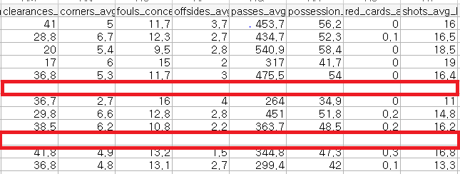
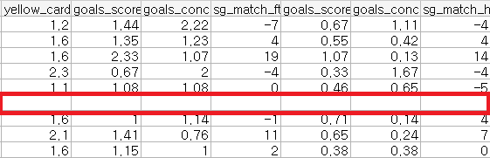
Objective
Used Data
Data Preprocessing
Role
Schedule
Used Data
DataSet
Missing Data (approximately 220 rows)

Slide 9
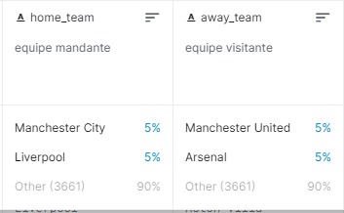
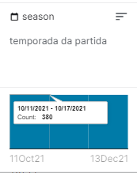
Objective
Used Data
Data Preprocessing
Role
Schedule
Used Data
DataSet
Categorical data
home_team
away_team
season

Slide 10
Objective
Used Data
Data Preprocessing
Role
Schedule
Data preprocessing
STEP 01
STEP 02
STEP 03
Detecting Missing Data
Standard Scaling
Logistic Algorithm
Finally, Predict Result!

Slide 11
Objective
Used Data
Data Preprocessing
Role
Schedule
Role
201835528
Jo Byung Geun
201835538
Choi Ji Won
201931889
Jeong Da Hee
Together
Cleaning dirty data
Data preprocessing
Data Analysis

Slide 12
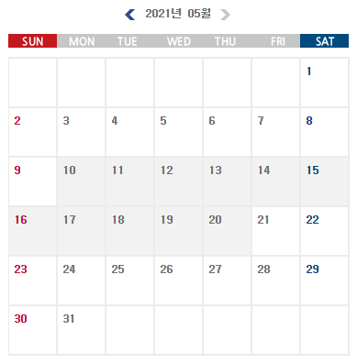
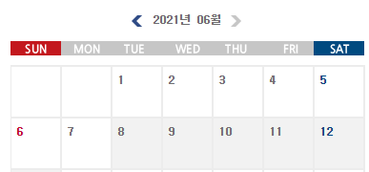
Objective
Used Data
Data Preprocessing
Role
Schedule
Schedule
Data analysis & Evaluation
Select Objective and proposal
Practice Fianl Presentation
Data preprocessing

Slide 13
Thank you :)

