Slide 1
가전기기하드웨어개발
부품선성하기
(아두이노)
전기전자과
Notes:
http://minheeblog.tistory.com/category/PPT

Slide 2
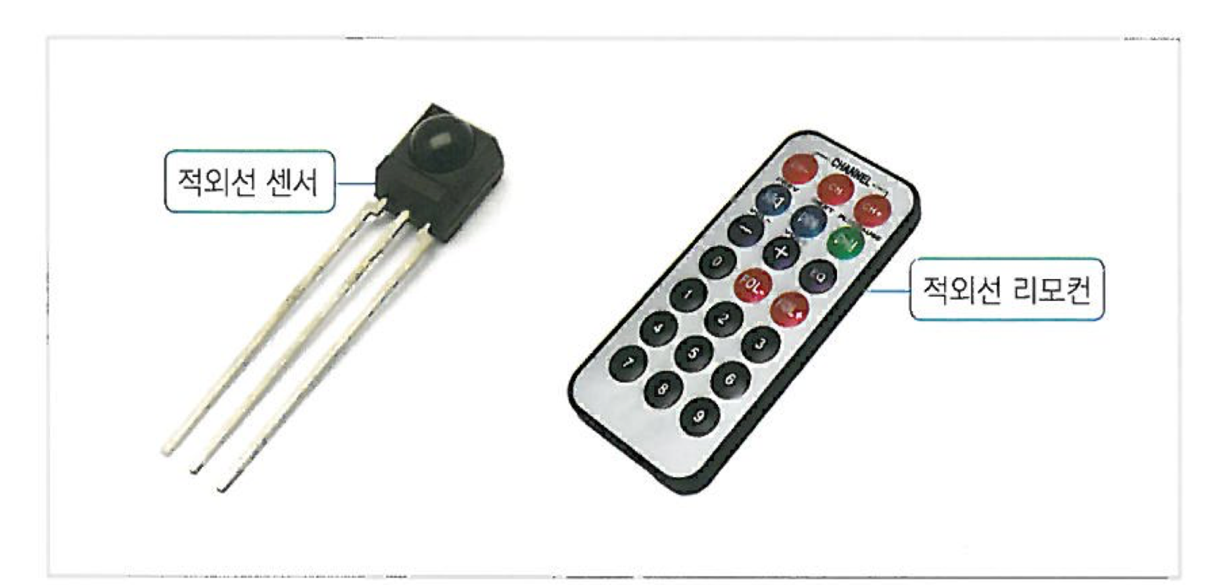
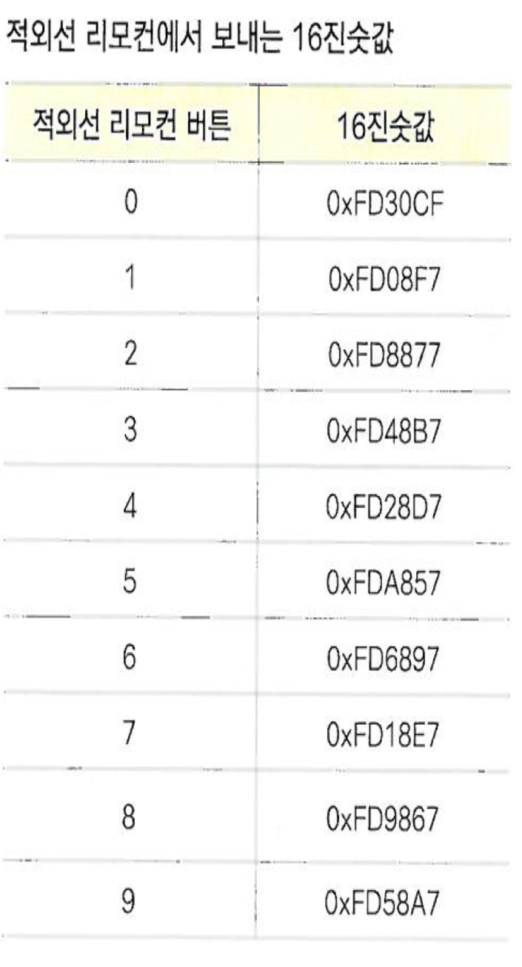
적외선센서 활용
Notes:
http://minheeblog.tistory.com/category/PPT

Slide 3
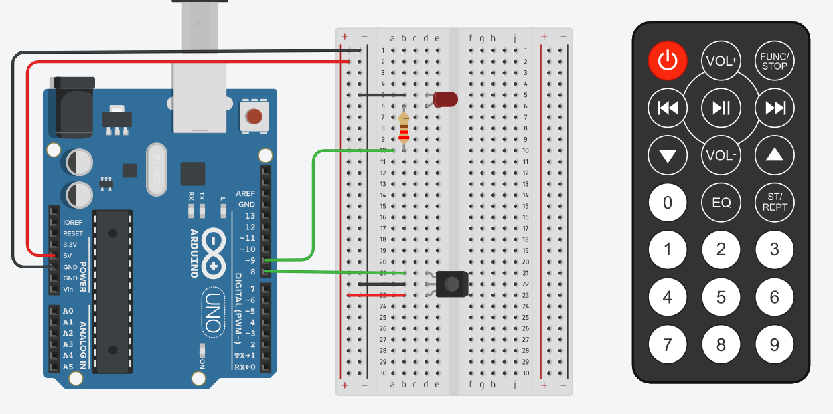
실습1-1: 적외선센서 활용1
Notes:
http://minheeblog.tistory.com/category/PPT

Slide 4
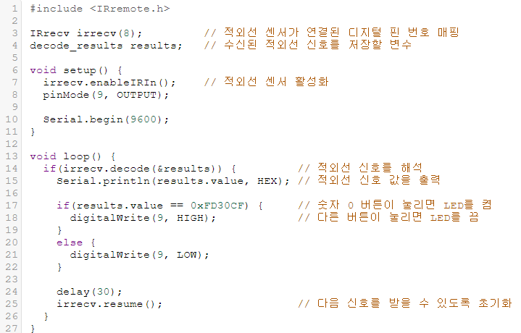
실습 1-1 : 코딩
Notes:
http://minheeblog.tistory.com/category/PPT

Slide 5
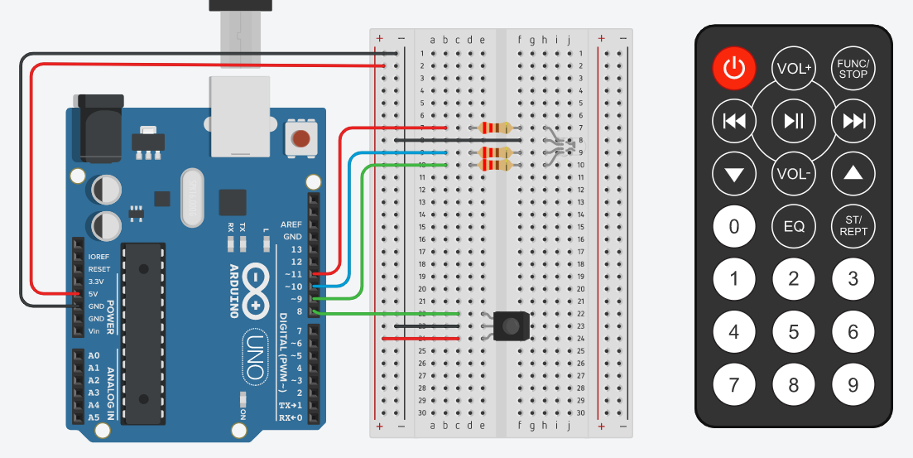
실습1-2: 적외선센서 활용2
Notes:
http://minheeblog.tistory.com/category/PPT

Slide 6
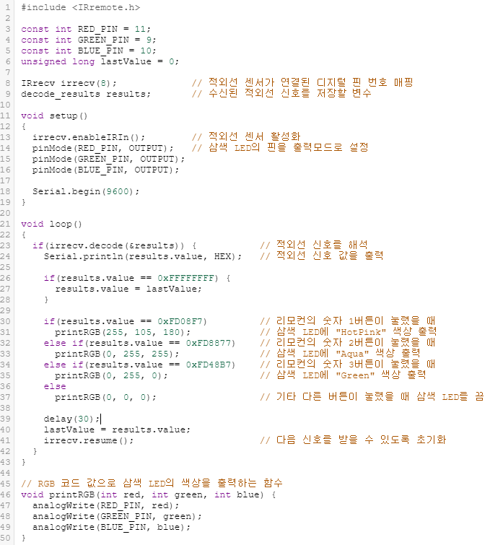
실습 1-2 : 코딩
Notes:
http://minheeblog.tistory.com/category/PPT

Slide 7
실습1-3: 적외선센서 활용3
Notes:
http://minheeblog.tistory.com/category/PPT

Slide 8
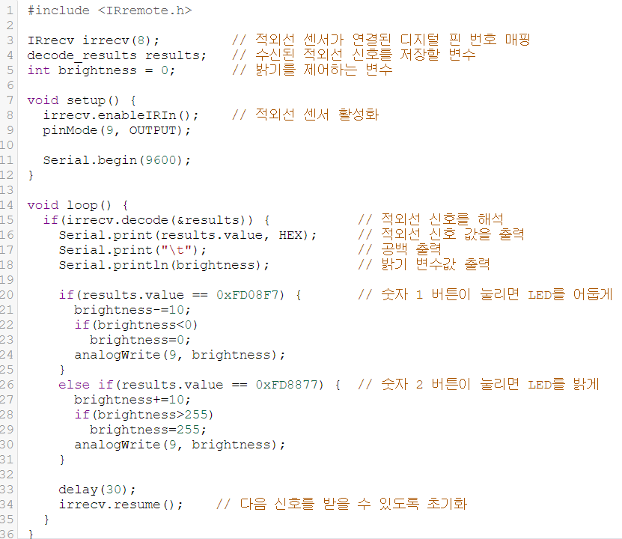
실습 1-3 : 코딩
Notes:
http://minheeblog.tistory.com/category/PPT

