Slide 1
How does whether an individual speaks a gendered language impact his or her gender ideology?
Gender and Society
Jiwon Kim

Slide 2
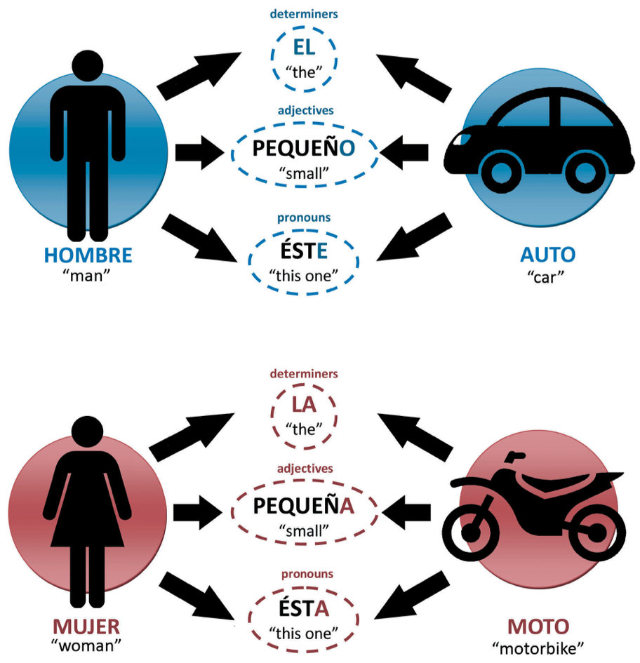
What is a Gendered Language?
All nouns in a language are grouped into classes
Grammatical agreement between nouns and their dependent words or elements
the class [membership of nouns]
shows a considerable semantic correlation with sex
Notes:
Grammatical gender of a language
http://www.thedefinitearticle.org/linguistics/gender-confused-grammatical-gender-explained
Gygax PM, Elmiger D, Zufferey S, Garnham A, Sczesny S, von Stockhausen L, Braun F and Oakhill J (2019) A Language Index of Grammatical Gender Dimensions to Study the Impact of Grammatical Gender on the Way We Perceive Women and Men. Front. Psychol. 10:1604. doi: 10.3389/fpsyg.2019.01604

Slide 3
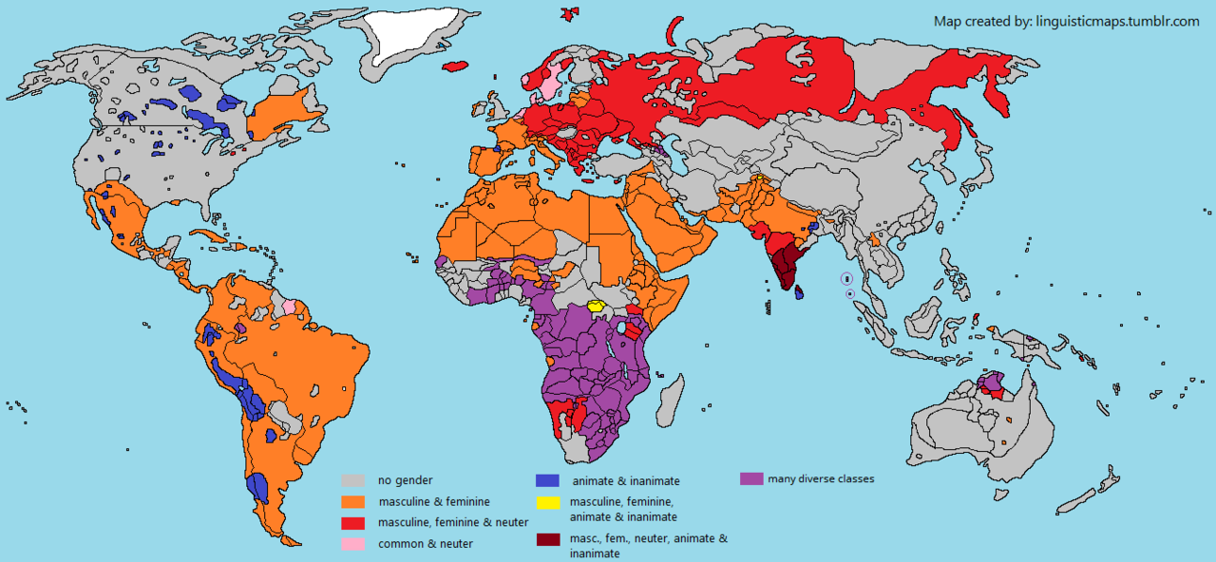
World distribution of Genderness of Languages
Notes:
https://linguisticmaps.tumblr.com/post/169273617313/grammatical-gender-or-noun-class-categories-new

Slide 4
Research Question
Hypothesis
Speaking a gendered language causes a less egalitarian view on female
How does whether an individual speaks a gendered language impact his or her gender ideology?
Notes:
language structure centered around gender could reinforce gender conception and potentially enhance any gender stereotypes a society has.

Slide 5
Data and Methods
Wave 6 of World Values Survey (WVS), collected from 2010 to 2014
Independent Variable
  “gender_lang”: a dummy variable to indicate if the language normally spoken at home (V247) is a gendered language
  Genderless Language (0): English, Chinese, Japanese, Turkish, Georgian, Mandarin, Armenian, Malay, Estonian, Cantonese, Azerbaijani
  Gendered Language (1): Arabic, Spanish; Castilian, Russian, German, Dutch; Flemish, Portuguese, Romanian, Swedish, Slovenian, Polish, Hindi
Dependent Variable
  Statements related to gender role on which the respondents had to indicate their positions: V45, V47-48 and V50-54
  Recoded each variable to be scaled into 0-10, where 10 represents the most egalitarian gender ideology and 0 represents the least egalitarian (Reverse-coded V48 and V54)

Slide 6
Table 1: Differences in Means for each Dependent Variable Components
Questions | Genderless Language | Gendered Language
V45: “When jobs are scarce, men should have more right to a job than women.” | 5.51* | 5.32*
V47: “If a woman earns more money than her husband, it's almost certain to cause problems.” | 5.96* | 5.81*
V48: “Having a job is the best way for a woman to be an independent person.” | 6.93 | 6.96
V50: “When a mother works for pay, the children suffer.” | 5.48* | 4.63*
V51: “On the whole, men make better political leaders than women do.” | 5.17* | 4.73*
V52: “A university education is more important for a boy than for a girl.” | 6.81* | 6.66*
V53: “On the whole, men make better business executives than women do” | 5.62* | 5.27*
V54: "Being a housewife is just as fulfilling as working for pay" | 6.16 | 6.11
Gender Ideology: Combined Factor | 5.98* | 5.64*

Slide 7
Data and Methods – Ordinary Least Squares (OLS) Regression
OLS regression models
Control Variable:
  “female”: a dummy variable for gender of the respondent
    0 - male & 1 - female
  “education_cat”: a dummy variable for education category
    Primary, Secondary, University (including incomplete education)
Interaction Variable:
  “female”
Model 1: Base case: Predicting Gender ideology based on genderness of language
Model 2: Base case + control for gender
Model 3: Base case + control for education category
Model 4: Base case + interaction of genderness of language and gender
Model 5: Base case + interaction of genderness of language and gender with control for education category
Notes:
1. whether gendered language has more of an effect on ideology for women
2. whether gendered language has more of an effect on ideology for higher education

Slide 8
Results

Slide 9
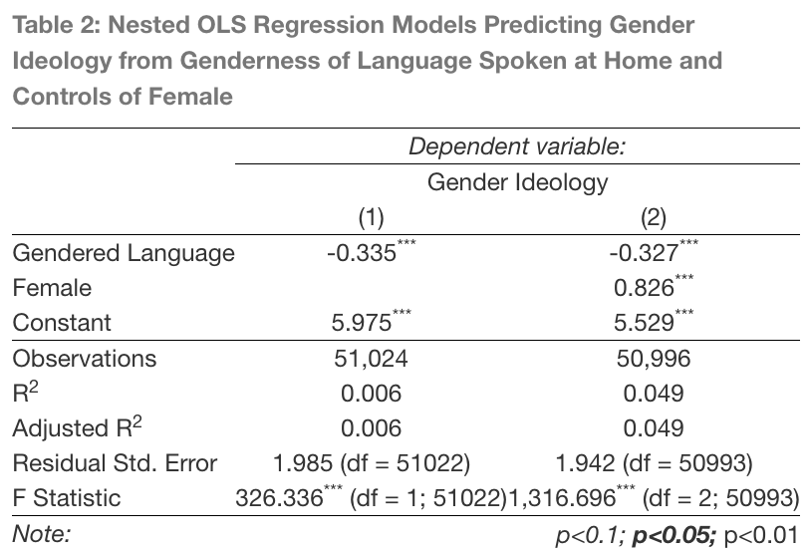
Control for Female
Gendered Language and Female are equally exogenous to gender ideology
The effect of gendered language after controlling for individual’s gender shows that people speaking gendered language are 0.327 point less egalitarian
On average, females are 0.826 point more egalitarian than males
Notes:
- Start with the base case and then go to the control

Slide 10
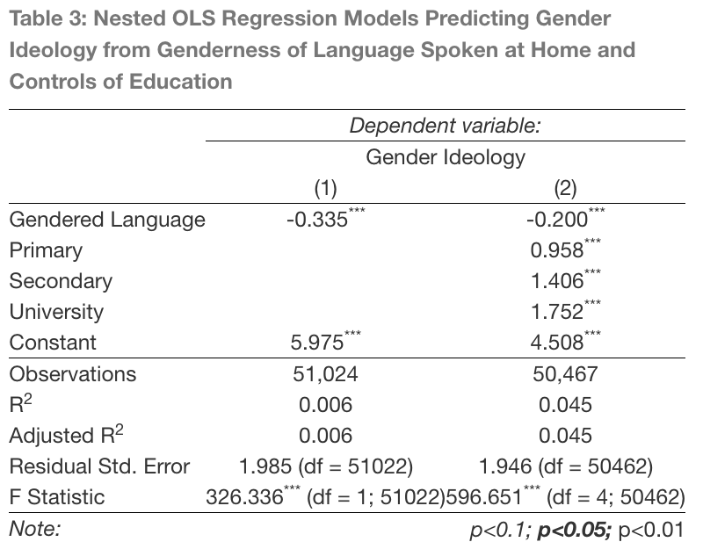
Control for Education Level
Gendered language is exogenous to education level.
Education mediates some of the effect of gendered language on gender ideology.
The best estimate of the direct effect of the genderness language to gender ideology would be -0.200, after control.
For the effect of education, as one’s education level gets higher, his or her gender ideology is more egalitarian.

Slide 11
Table 4: Distribution of Education between Gender
 |  | None | Primary | Secondary | University
Female | Genderless Language | 0.026 | 0.111 | 0.545 | 0.318
 | Gendered Language | 0.077 | 0.179 | 0.481 | 0.264
Male | Genderless Language | 0.013 | 0.099 | 0.551 | 0.337
 | Gendered Language | 0.048 | 0.173 | 0.492 | 0.288
Higher education among those who speak genderless than gendered languages for both genders
Bigger gender gap in education in gendered language than genderless language

Slide 12
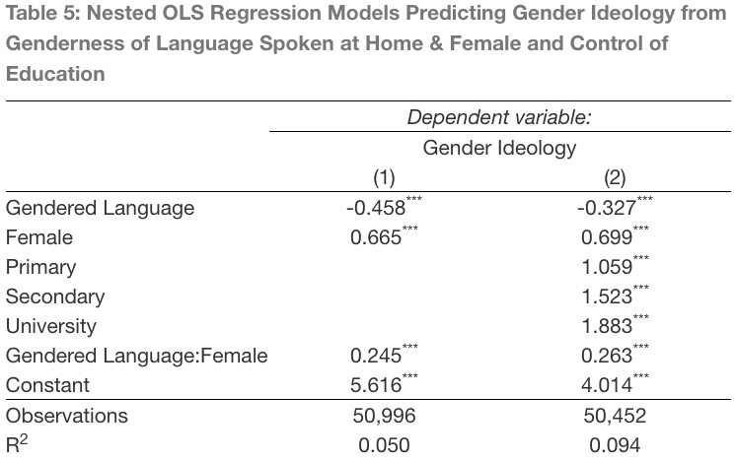
Interaction between Gender and Gendered Language with Control for Education
Holding education constant, a female who speaks a genderless language at home is 0.699 more egalitarian in gender ideology than a male who speaks a genderless language.
Speaking a gendered language increases the positive effect of being female by 0.263.
The net effect of speaking a gendered language is
-0.064 (= -0.327 + 0.263) in
female and -0.327 in male.
Notes:
Slope difference,
-0.458 and -0.213 – total effect
-0.327 and -0.064 – net effec

Slide 13
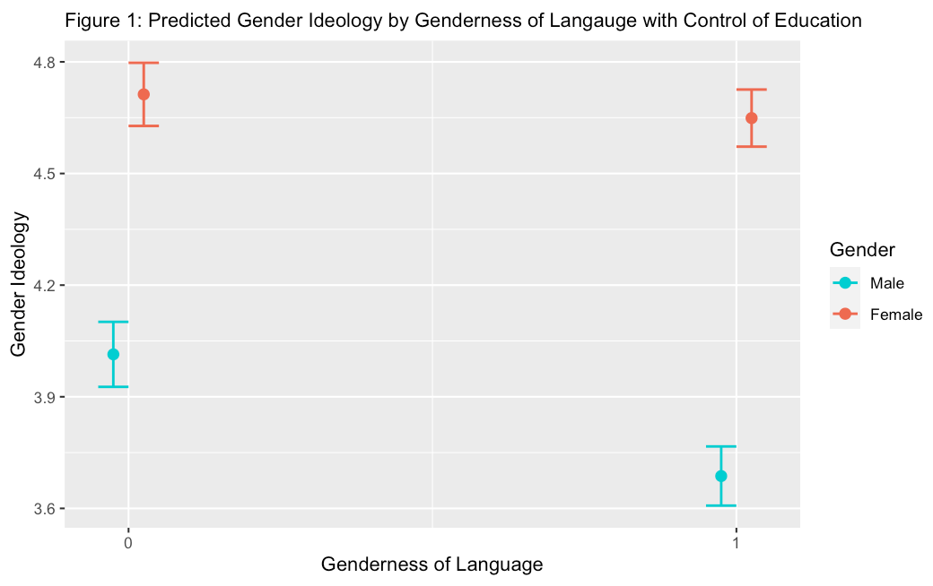
Notes:
Slope & intercept
The gender gap in ideology is larger in gendered or genderless languages.
Education is mediating the part of effect for both men and women, such that what is left is -0.064 in women and -0.327 in men.

Slide 14
Conclusion
Speaking a gendered language results in a less egalitarian view of gender
Females are more egalitarian than men in gender ideology
Education mediates the effect of speaking a gendered language at home, and higher education leads to a more egalitarian gender ideology
When interaction between genderness of language and gender controlled for education, education mediates the part of effect for both men and women, explaining all the net effect in women and not for men.

