Slide 1

小清新动物教学通用
Thank you for downloading, Bazhong City, Sichuan Province Spring and Autumn ads main graphic design, there are any questions, please contact the rice hull my business number.
老师：赵美丽

Slide 2

教材课程分析
Textbook Course Analysis
教学课程设计
Teaching Curriculum Design
教学整个过程
目 录
The Whole Process Of Teaching
Thank you for downloading, Bazhong City, Sichuan Province Spring and Autumn ads main graphic design,
课后教学反思
After-class Teaching Reflection

Slide 3

PART 01
教材课程分析
Textbook Course Analysis
Thank you for downloading, Bazhong City, Sichuan Province Spring and Autumn ads main graphic design, there are any questions,

Slide 4



添加标题
添加标题
添加标题
Thank you for downloading, Bazhong City, Sichuan Province Spring and Autumn ads main graphic design.
Thank you for downloading, Bazhong City, Sichuan Province Spring and Autumn ads main graphic design.
Thank you for downloading, Bazhong City, Sichuan Province Spring and Autumn ads main graphic design.

Slide 5

添加标题
I am from Chunqiu Advertising Design Studio in Bazhong City, Sichuan Province. I am from Chunqiu Advertising Design Studio in Bazhong City, Sichuan Province.
添加标题
添加标题
I am from Chunqiu Advertising Design Studio in Bazhong City, Sichuan Province. I am from Chunqiu Advertising Design Studio in Bazhong City, Sichuan Province.
I am from Chunqiu Advertising Design Studio in Bazhong City, Sichuan Province. I am from Chunqiu Advertising Design Studio in Bazhong City, Sichuan Province.

Slide 6

添加标题
添加标题
I am from Chunqiu Advertising Design Studio in Bazhong City, Sichuan Province. I am from Chunqiu Advertising Design Studio in Bazhong City, Sichuan Province.
I am from Chunqiu Advertising Design Studio in Bazhong City, Sichuan Province. I am from Chunqiu Advertising Design Studio in Bazhong City, Sichuan Province.

Slide 7
PART 02
教学课程设计
Teaching Curriculum Design
Thank you for downloading, Bazhong City, Sichuan Province Spring and Autumn ads main graphic design, there are any questions,

Slide 8
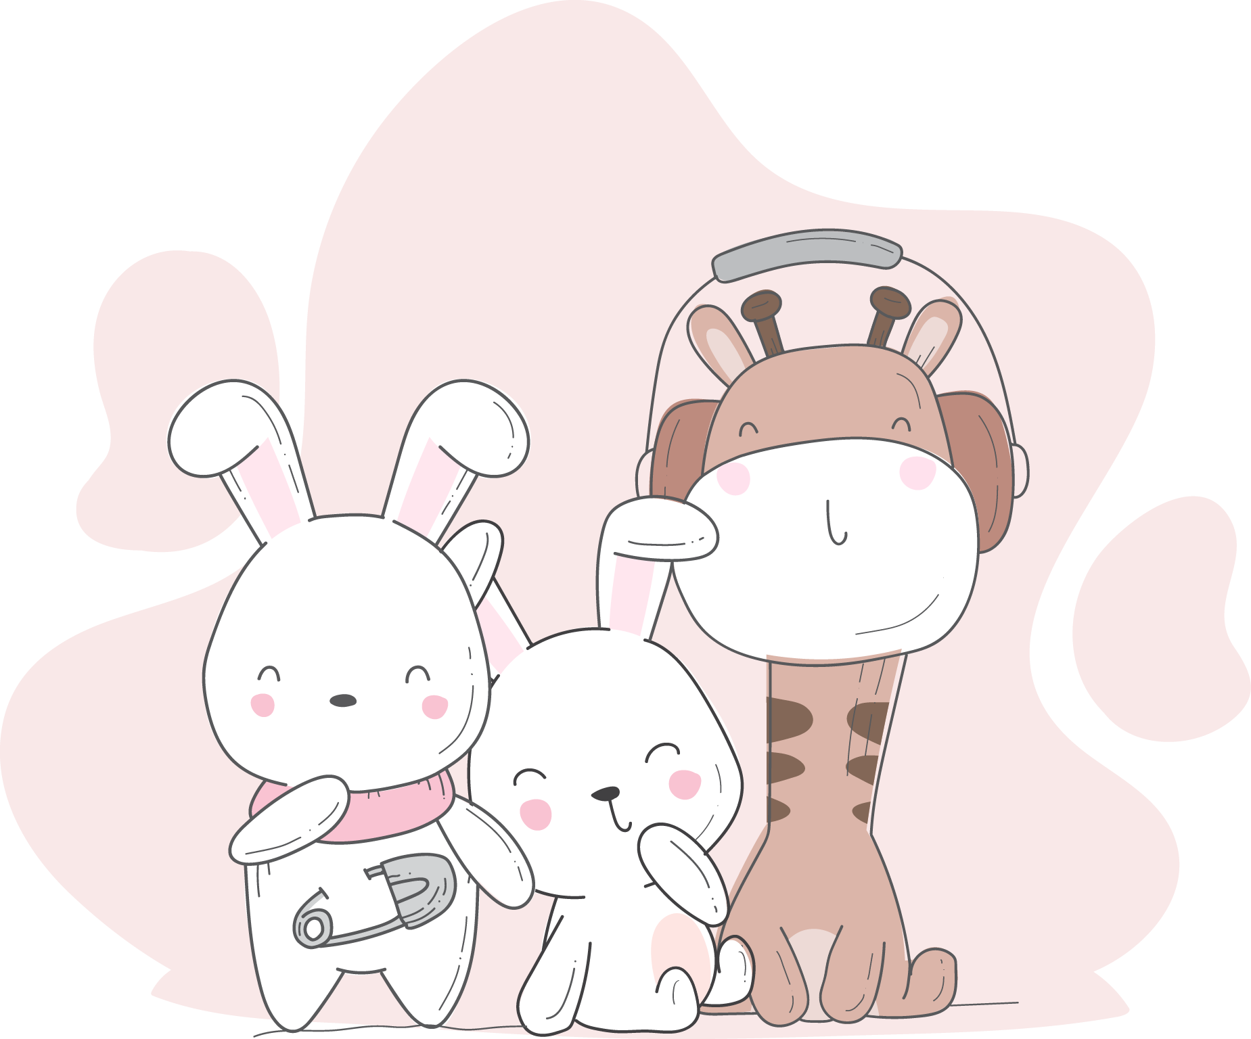
添加标题
I am from Chunqiu Advertising Design Studio in Bazhong City, Sichuan Province. I am from Chunqiu Advertising Design Studio in Bazhong City, Sichuan Province. I am from Chunqiu Advertising Design Studio in Bazhong City, Sichuan Province.
I am from Chunqiu Advertising Design Studio in Bazhong City, Sichuan Province.

Slide 9



添加标题
添加标题
添加标题
Thank you for downloading, Bazhong City, Sichuan Province Spring and Autumn ads main graphic design.
Thank you for downloading, Bazhong City, Sichuan Province Spring and Autumn ads main graphic design.
Thank you for downloading, Bazhong City, Sichuan Province Spring and Autumn ads main graphic design.

Slide 10
PART 03
教学整个过程
The Whole Process Of Teaching
Thank you for downloading, Bazhong City, Sichuan Province Spring and Autumn ads main graphic design, there are any questions,

Slide 11
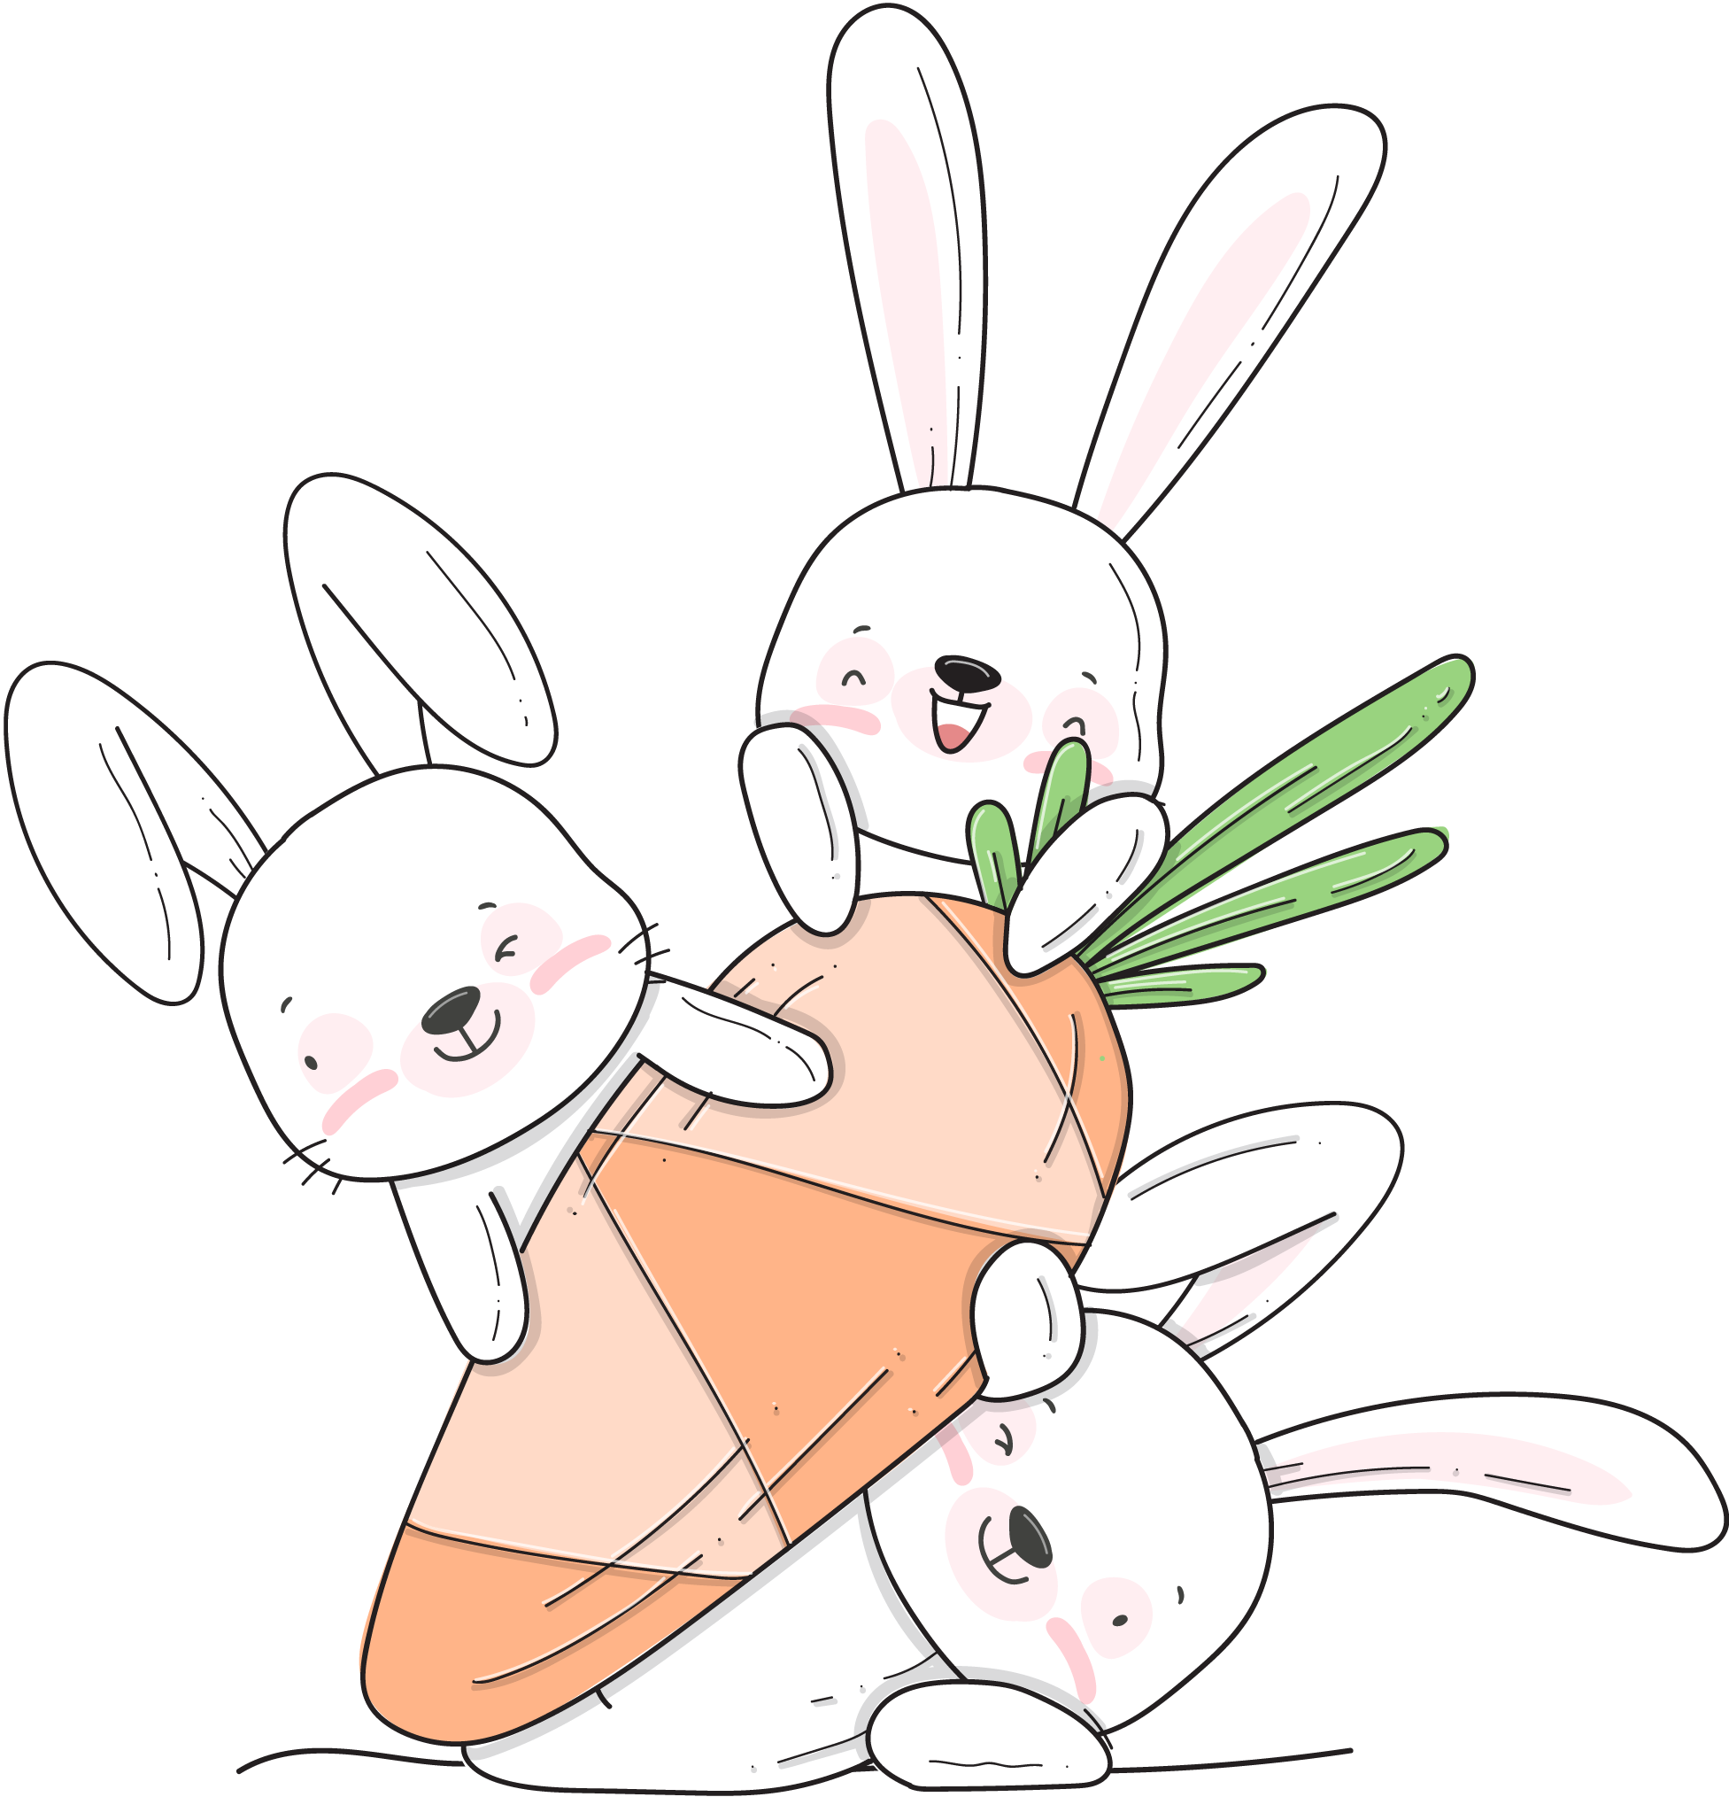
添加标题
I am from Chunqiu Advertising Design Studio in Bazhong City, Sichuan Province. I am from Chunqiu Advertising Design Studio in Bazhong City, Sichuan Province.
添加标题
I am from Chunqiu Advertising Design Studio in Bazhong City, Sichuan Province. I am from Chunqiu Advertising Design Studio in Bazhong City, Sichuan Province.
添加标题
I am from Chunqiu Advertising Design Studio in Bazhong City, Sichuan Province. I am from Chunqiu Advertising Design Studio in Bazhong City, Sichuan Province.

Slide 12

添加标题
添加标题
Thank you for downloading, Bazhong City, Sichuan Province Spring and Autumn ads main graphic design.
Thank you for downloading, Bazhong City, Sichuan Province Spring and Autumn ads main graphic design.
添加标题
添加标题
Thank you for downloading, Bazhong City, Sichuan Province Spring and Autumn ads main graphic design.
Thank you for downloading, Bazhong City, Sichuan Province Spring and Autumn ads main graphic design.

Slide 13
PART 04
课后教学反思
After-class Teaching Reflection
Thank you for downloading, Bazhong City, Sichuan Province Spring and Autumn ads main graphic design, there are any questions,

Slide 14

添加标题
I am from Chunqiu Advertising Design Studio in Bazhong City, Sichuan Province. I am from Chunqiu Advertising Design Studio in Bazhong City, Sichuan Province.
添加标题
I am from Chunqiu Advertising Design Studio in Bazhong City, Sichuan Province. I am from Chunqiu Advertising Design Studio in Bazhong City, Sichuan Province.

Slide 15



添加标题
添加标题
添加标题
Thank you for downloading, Bazhong City, Sichuan Province Spring and Autumn ads main graphic design.
Thank you for downloading, Bazhong City, Sichuan Province Spring and Autumn ads main graphic design.
Thank you for downloading, Bazhong City, Sichuan Province Spring and Autumn ads main graphic design.

Slide 16
感谢您们的观看支持
Thank you for downloading, Bazhong City, Sichuan Province Spring and Autumn ads main graphic design, there are any questions, please contact the rice hull my business number.
老师：赵美丽

Slide 17

SPRING AND AUTUMN ADVERTISEMENT
原创作品 盗版必究
WPS办公软件搜索
春秋广告店铺地址
模板使用字体
PPT官方定制QQ
春秋广告
http://chn.docer.com/works?userid=199329941
851tegakizatsu
（可下载更多优秀作品）
（此处网页可直接复制粘贴）
（自行下载，字体如商用请自行购买）
（此处数字可直接复制粘贴）

Slide 18
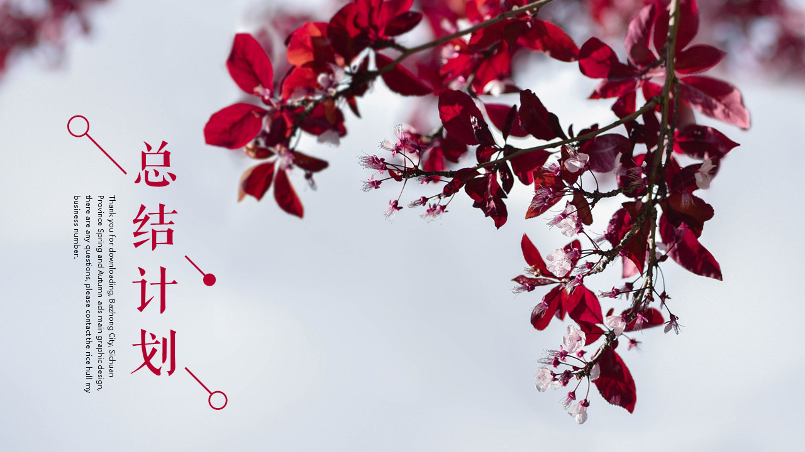





感谢您的购买，更多最新优质PPT模板，年卡会员免费下载哦！ 请复制下面稻壳儿春秋广告店铺网址访问
http://chn.docer.com/works?userid=199329941

Slide 19
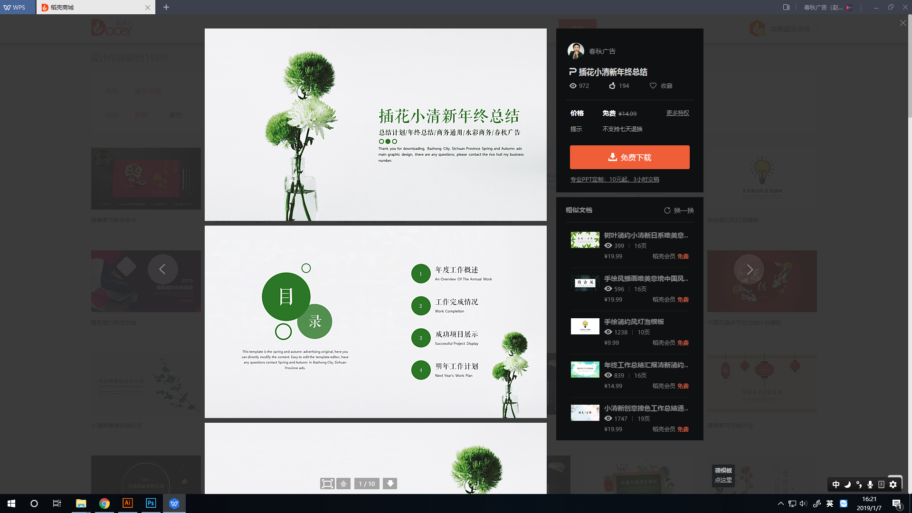
WPS客户端点击您下载模板右上角“春秋广告”可以获得更多最新精美模板

Slide 20
SPRING AND AUTUMN ADVERTISEMENT ICON
商务通用可编辑颜色图标

