Slide 1
COMP 472 – Assignment 1
Andrew Korolus (40055081)
Janghuk Boo (40005573)
Jixuan Li (40073785)

Slide 2
Contributions
Andrew:
Model 1 (GNB)
Model 2 (Base-DT)
Janghuk:
Model 3 (Best-DT)
Model 4 (PER)
Jixuan:
Model 5 (Base-MLP)
Model 6 (Best-MLP)
Link to GitHub:
https://github.com/AndrewK-7/Comp472-Assignment1.git
Note: Jupyter Notebook was used to develop and experiment with the different models in Python using the scikit-learn library.

Slide 3
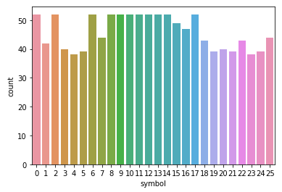
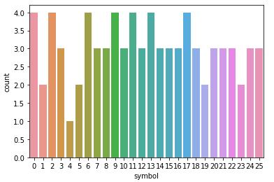
Dataset 1
Training Set
Testing Set (with labels)
1197 total records
80 total records

Slide 4
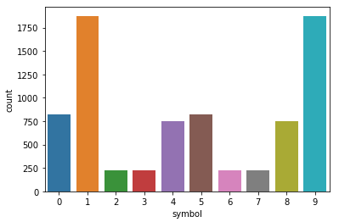
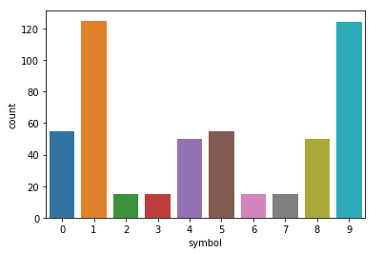
Dataset 2
Training Set
Testing Set (with labels)
7800 total records
520 total records

Slide 5
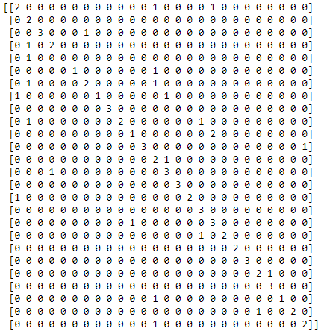
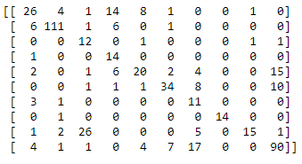
Model 1 - GNB
gnb = GaussianNB()
gnb.fit(X_training_features, y_training_targets)
pred_gnb = gnb.predict(X_testing_features)
Dataset 1
Dataset 2
 | Precision | Recall | F1-score
Macro average | 0.76 | 0.69 | 0.69
Weighted average | 0.77 | 0.70 | 0.70
 | Precision | Recall | F1-score
Macro average | 0.64 | 0.68 | 0.60
Weighted average | 0.75 | 0.67 | 0.68

Slide 6
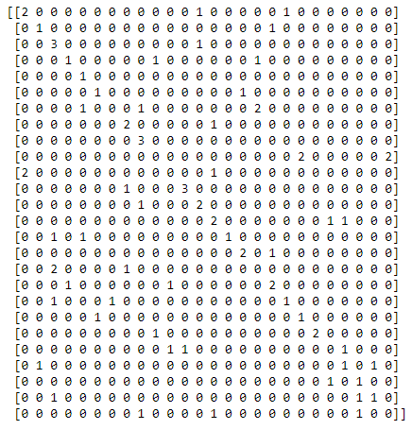
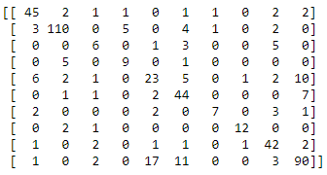
Model 2 – Base-dt
tree_model = tree.DecisionTreeClassifier()
tree_model.fit(X_training_features, y_training_targets)
pred_tree = tree_model.predict(X_testing_features)
Dataset 1
Dataset 2
 | Precision | Recall | F1-score
Macro average | 0.40 | 0.44 | 0.40
Weighted average | 0.40 | 0.42 | 0.39
 | Precision | Recall | F1-score
Macro average | 0.70 | 0.68 | 0.68
Weighted average | 0.75 | 0.75 | 0.75

Slide 7
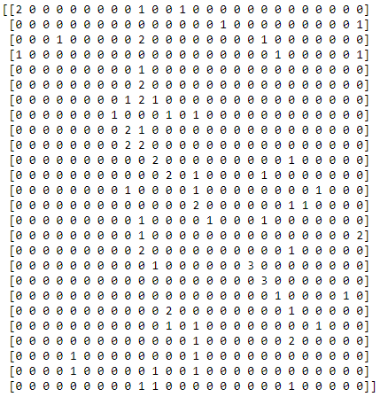
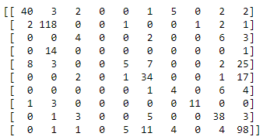
Model 3 – Best-dt
grid_search_cv = GridSearchCV(DecisionTreeClassifier(random_state=42), params, verbose=1, cv=3)
grid_search_cv.fit(Xtrain1, Ytrain1)
bestree1=grid_search_cv.predict(Xtest1)
Dataset 1
Dataset 2
 | Precision | Recall | F1-score
Macro average | 0.27 | 0.31 | 0.26
Weighted average | 0.26 | 0.29 | 0.24
 | Precision | Recall | F1-score
Macro average | 0.54 | 0.52 | 0.52
Weighted average | 0.64 | 0.68 | 0.64

Slide 8
Model 3 – Best-dt
Parameters & Validation Set Experiments:
Test_set:
Criterion: Entropy, Max_node:29, Min_impurity: 0, Min_smaples: 3
Val_set:
Criterion: Gini, Max_node:27, Min_impurity: 0, Min_smaples: 2

Slide 9
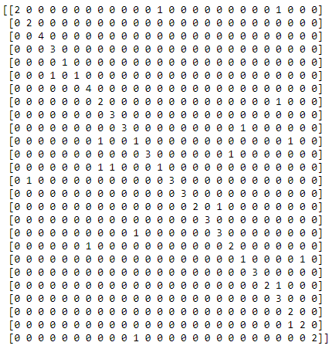
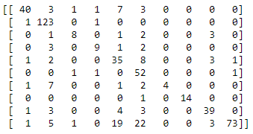
Model 4 – PER
clf = Perceptron(tol=1e-3, random_state=0)
clf.fit(Xtrain1, Ytrain1)
Per_test1=clf.predict(Xtest1)
Dataset 1
Dataset 2
 | Precision | Recall | F1-score
Macro average | 0.80 | 0.78 | 0.77
Weighted average | 0.82 | 0.77 | 0.77
 | Precision | Recall | F1-score
Macro average | 0.81 | 0.71 | 0.72
Weighted average | 0.81 | 0.76 | 0.76

Slide 10
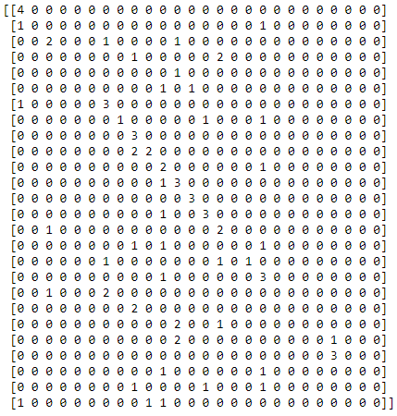
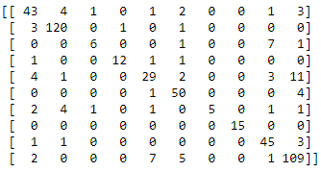
Model 5 – Base-mlp
base_MLP = MLPClassifier(hidden_layer_sizes=(100,), activation='logistic', solver='sgd’)
.fit(X_training_features, y_training_targets)
pred_base_MLP = base_MLP.predict(X_testing_features)
Dataset 1
Dataset 2
 | Precision | Recall | F1-score
Macro average | 0.30 | 0.38 | 0.30
Weighted average | 0.34 | 0.44 | 0.35
 | Precision | Recall | F1-score
Macro average | 0.85 | 0.75 | 0.78
Weighted average | 0.84 | 0.84 | 0.83

Slide 11
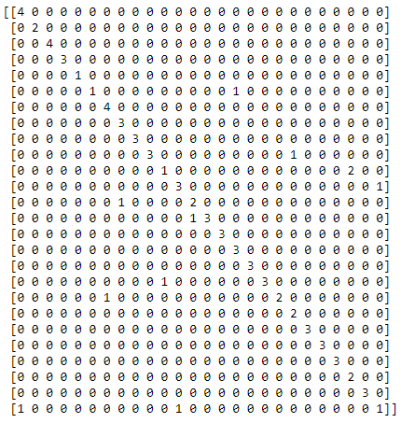
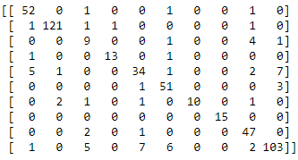
Model 6 – Best-mlp
mlp = MLPClassifier()
clf = GridSearchCV(mlp, param_grid, verbose=2)
.fit(X_training_features, y_training_targets)
pred_best_MLP = clf.predict(X_testing_features)
Dataset 1
Dataset 2
 | Precision | Recall | F1-score
Macro average | 0.87 | 0.87 | 0.85
Weighted average | 0.88 | 0.86 | 0.86
 | Precision | Recall | F1-score
Macro average | 0.86 | 0.84 | 0.84
Weighted average | 0.88 | 0.88 | 0.88

Slide 12
Model 6 – Best-MLP
Parameters & Validation Set Experiments:
By Implementing grid search,
we got the best hyperparameters:
'activation': 'tanh', 'hidden_layer_sizes': (30, 50), 'solver': 'sgd'

Slide 13
Results
Worst Performing Model
Best Performing Model
Dataset 1 | Dataset 2
Best-DT | Best-DT
Dataset 1 | Dataset 2
Best-MLP | Best-MLP
Overall, the decision tree models also performed relatively poorly compared to the rest, due to fact that it tended to overfit a lot of the data.
GNB also performed relatively poorly, especially on dataset 2 because of the nature of the naïve algorithm and the fact that the data is not normally distributed.

