Slide 1
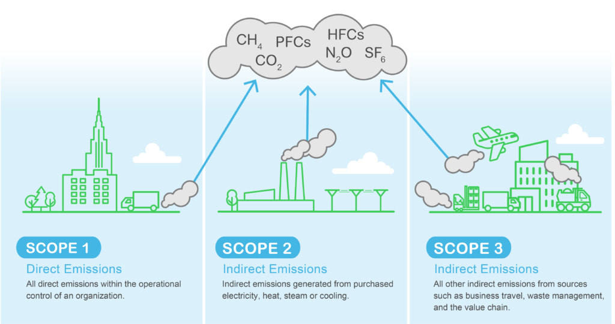

PCCOE International Grand Challenge: 2026
Pune, India
THEME: AI FOR CLIMATE CHANGE
TrueScope
An AI-Powered Scope 1–3 Carbon Ledger for SMEs
Team Members:
Name
Study (UG/PG)
Institute
Aditya Baviskar
UG (SY – CS)
Vishwakarma Institute of Technology, Pune
Jiya Barage
UG (SY – CS)
Vishwakarma Institute of Technology, Pune
Nikhil Bhandarkawathekar
UG (SY – CS)
Vishwakarma Institute of Technology, Pune
Shivani Bankar
UG (SY – CS)
Vishwakarma Institute of Technology, Pune
TrueScope | PCCOE International Grand Challenge 2026
1

Slide 2
Outline
01
Problem Statement / Idea
02
Objectives
03
Proposed Solution / Architecture
04
Unique Features / Innovation
05
Expected Outcomes
06
Conclusion
TrueScope | PCCOE International Grand Challenge 2026
2

Slide 3
Problem Statement / Idea
The Problem
SMEs lack ESG teams, expertise and affordable tools. Their existing invoices contain useful activity data, but it is rarely converted into carbon data.
Our Idea, in One Line
Upload an invoice → TrueScope extracts activity data → maps emissions → generates a carbon report.
Why it matters
Carbon reporting is increasingly important for green procurement. SMEs without credible emissions data may lose sustainability-focused business opportunities.
Makes green-procurement reporting accessible to businesses that cannot afford dedicated ESG support.
Current gaps
Existing tools are often expensive and enterprise-focused. Manual entry and consultants make reporting slow and difficult.
TrueScope | PCCOE International Grand Challenge 2026
3

Slide 4
Objectives
Enable self-serve carbon reporting
Cut turnaround from weeks to minutes
Keep SMEs eligible for green procurement
Upload invoices and automatically estimate Scope 1–3 emissions.
Automate extraction, classification and emission calculations.
Generate transparent, shareable carbon reports.
Expected Impact
End Beneficiaries
• Efficiency: weeks → minutes
• Cost: reduce consultant dependency
• Accessibility: no ESG expertise required
• Sustainability: better supply-chain visibility
• SMEs — easier reporting & green procurement
• Enterprise buyers — structured Scope 3 supplier data
• Regulators — improved emissions disclosure
TrueScope | PCCOE International Grand Challenge 2026
4

Slide 5
Proposed Solution / Architecture
Invoice Upload
OCR + AI Extraction
AI Classification & Validations
→
→
→
PDF / Image / CSV
Extract vendor, item, quantity, units
Identify activity + Scope 1/2/3 category
Emission Factor Mapping
Carbon Engine
Carbon Ledger + Report
→
→
→
GHG Protocol • India factor library
Calculate + aggregate kg CO₂e
Dashboard + shareable PDF
Tech Stack
Scalability & Feasibility
React
FastAPI
Python
Tesseract OCR
SQLite (PostgreSQL-ready)
WeasyPrint
• Modular and API-ready
• Public emission-factor sources
• Cloud-ready and horizontally scalable
• Fully software-based
TrueScope | PCCOE International Grand Challenge 2026
5

Slide 6
Unique Features / Innovation
How TrueScope differs from a consultant, spreadsheet, or generic ESG SaaS
Feature
Traditional Approach
TrueScope
Target Users
Large enterprises with ESG teams
SMEs with limited/no ESG expertise
Data Input
Manual data collection
Existing invoices
Processing
Spreadsheets / consultant-driven
AI-assisted extraction + classification + automated calculation
Turnaround & Cost
Weeks & high consulting costs
Minutes & low-cost
Output
Static periodic reports
Continuously updated carbon ledger
Reporting
Manual report preparation
Traceable buyer-ready PDF
Scalability
Consultant-dependent
API & cloud-ready
Key Innovation
Invoice → AI Extraction → Emission Mapping → Scope 1–3 Calculation → Carbon Ledger → Report
TrueScope | PCCOE International Grand Challenge 2026
6

Slide 7
Expected Outcomes
DELIVERABLES
Working Prototype (live demo)
Carbon Report
Dashboard
Invoice upload → OCR → AI classification → emission calculation
Scope 1–3 summary + emission factors + assumptions
Carbon ledger + category breakdown + trends
Short-Term Impact
Long-Term Impact & Scaling
TrueScope will convert SME invoices into a shareable carbon report within minutes, reducing manual effort without requiring new infrastructure.
Scale through verified regional/industry factor libraries (CEA, DESNZ), ERP and procurement APIs, and multi-supplier reporting across wider supply chains.
TrueScope | PCCOE International Grand Challenge 2026
7

Slide 8
Conclusion
Summary
TrueScope converts existing SME invoices into Scope 1–3 emission estimates within minutes. It removes cost, manual effort and expertise barriers, making carbon reporting accessible and improving supply-chain transparency.
Why This Idea Should Be Selected
• Real-world, regulation-driven problem
• AI directly reduces manual carbon-data work
• Working multi-company prototype, tested end to end
• Scalable across industries and supply chains
• Direct value for SMEs and enterprise buyers
“TrueScope makes carbon reporting as simple as uploading an invoice.”
TrueScope | PCCOE International Grand Challenge 2026
8

