Slide 1
Game Analytics: Unlocking Tennis Data with SportRadar API
Organization: Labmentix
Domain: Data Analytics/Business Analytics
Team Members:
Jiya Gupta
Bhargavi Behera
Sachin Patro
Ruxana Hisham

Slide 2
About the Project
• Centralized tennis analytics system
• Stores competitions, venues, competitors & rankings
• SQLite database with SQL analysis
• Interactive dashboard
Overview
Sports analytics helps organizations make informed decisions.
This project manages tennis competition data using a relational database.
The application stores, analyzes, and visualizes tennis-related information.
An interactive dashboard is developed using Streamlit.

Slide 3
Problem Statement
• Manual data handling is inefficient
• Difficult to analyze large datasets
• Need centralized database
• Interactive analytics solution
Problem Statement
Managing tennis data manually is inefficient.
Large datasets become difficult to organize and analyze.
A centralized system is required to store and retrieve information efficiently.
Solution
Develop a Tennis Analytics application using Python, SQLite, SQL, and Streamlit.

Slide 4
Objectives
• Design relational database
• Store structured tennis data
• Perform SQL analysis
• Develop Streamlit dashboard
• Enable search and rankings
Objectives
Design a relational database.
Generate structured tennis datasets.
Store data in SQLite.
Analyze data using SQL.
Develop an interactive dashboard.
Provide competitor search and rankings.
Display venue and competition details.

Slide 5
Technology Stack
Python
SQLite
SQL
JSON
VS Code
Technology | Purpose
Python | Programming
SQLite | Database
SQL | Data Analysis
JSON | Data Storage
Streamlit | Dashboard
VS Code | Development

Slide 6
Project Workflow
JSON Files → Python → SQLite → SQL Queries → Streamlit Dashboard
JSON Data
Python
SQLite Database
User
SQL Queries
Streamlit Dashboard

Slide 7
Database Design
Tables:
• Categories
• Competitions
• Complexes
• Venues
• Competitors
• Competitor_Rankings
[Insert ER Diagram]
Categories
Competitions
Complexes
Venues
Competitors
Competitor_Rankings

Slide 8
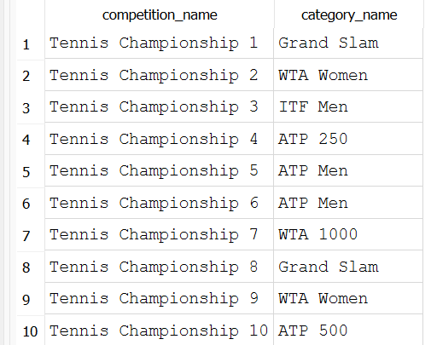
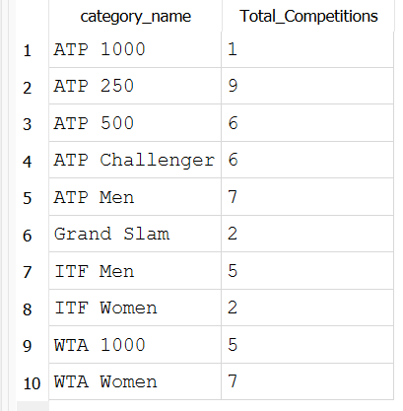
SQL Queries
• 20 analytical SQL queries
• JOIN
• GROUP BY
• ORDER BY
• Aggregate Functions
[Insert SQL screenshots]
20 SQL Queries Developed
Joins
GROUP BY
ORDER BY
Aggregate Functions
Filtering

Slide 9
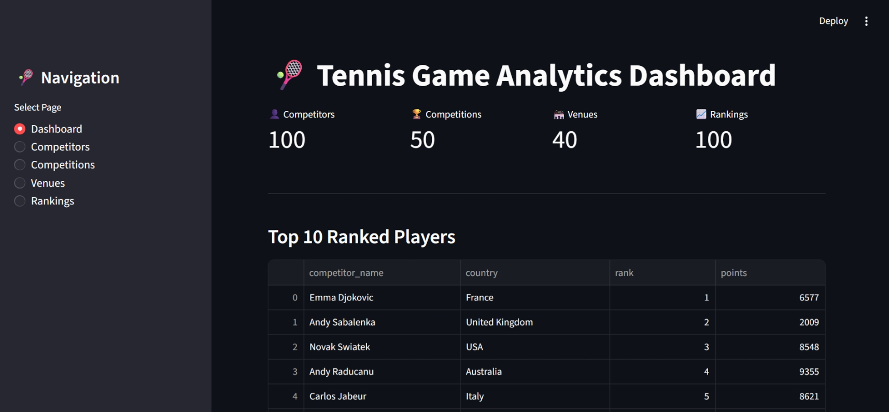
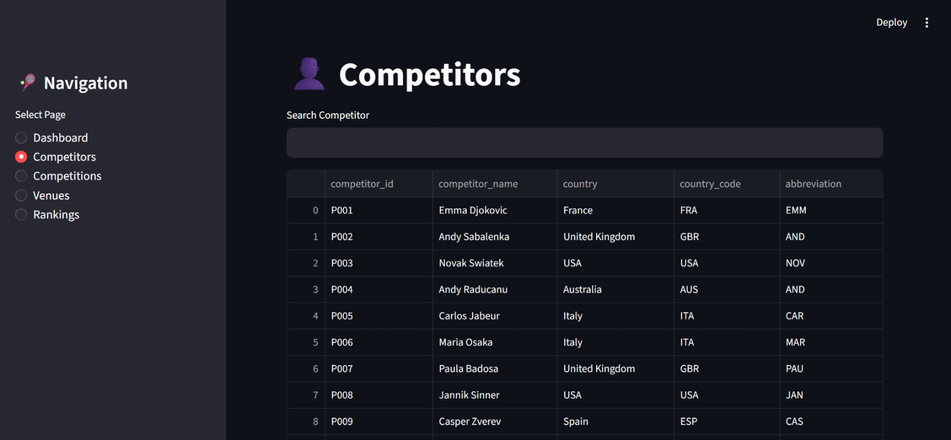
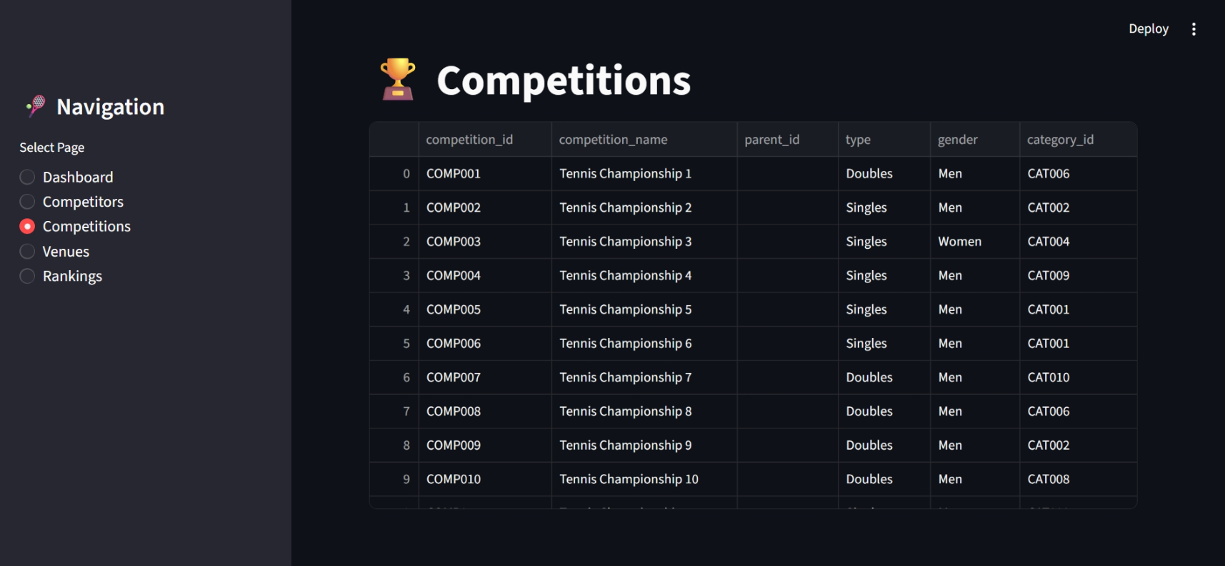
Dashboard Part 1
Dashboard Features
Overview of tennis analytics
Search competitors
View competitions
Interactive data tables
User-friendly interface
Home Dashboard
Competitors
Competitions

Slide 10
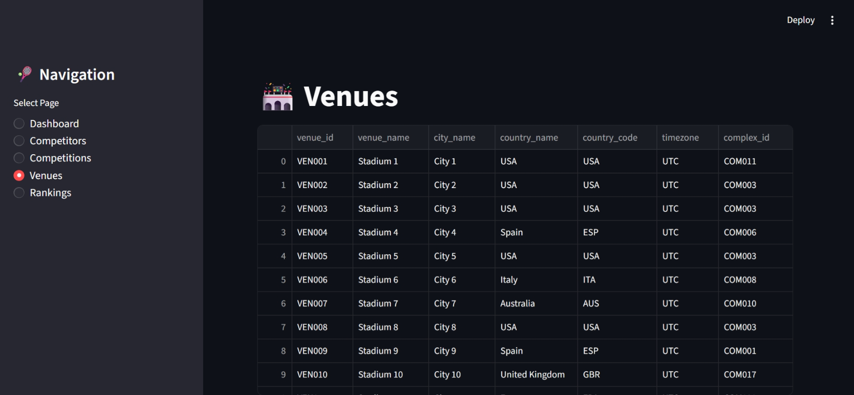
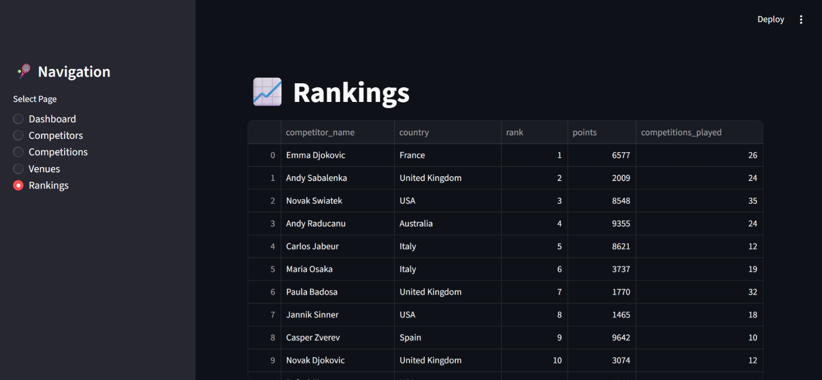
Dashboard Part 2
Additional Features
Venue information
Player rankings
Ranking points
Search and filtering
Venues
Rankings

Slide 11
Results
Results
Database created successfully.
JSON data loaded successfully.
SQL queries executed.
Interactive dashboard developed.
Search functionality implemented. Ranking analysis completed.

Slide 12
Challenges & Learning
Challenges:
• API unavailable
• Database relationships
Learning:
• Python
• SQL
• SQLite
• Streamlit
Challenges
API key was unavailable.
Designing relational database.
Data loading from JSON.
Dashboard development.
Learning Outcomes
Python Programming
SQL
SQLite
Streamlit
Data Analytics
Team Collaboration

Slide 13
Conclusion & Future Scope
Conclusion:
Project objectives achieved.
Future Scope:
• Live API
• Machine Learning
• Cloud Deployment
Conclusion
Successfully developed a complete Tennis Game Analytics application.
Integrated Python, SQLite, SQL, and Streamlit.
Achieved all project objectives.
Future Scope
Live API integration.
Machine Learning.
Cloud deployment.
More visualizations.
Multi-sport analytics.

Slide 14
THANK YOU
Thank you for your time and attention.
📂 GitHub Repository:
https://github.com/Jiya1001/Game-Analytics-Unlocking-Tennis-Data-with-SportRadar-API-.git

