Slide 1
PHP Basics Review
Lecture 1

Slide 2
About PHP
PHP is a stable, fast, loosely typed scripting language used to create dynamic content on the internet.
Because of this, PHP is the primary server side scripting language used by 82.7% of all websites. (https://w3techs.com/technologies/details/pl-php/all/all)

Slide 3
About PHP
PHP is an interpretive language
Code is processed by the scripting engine and only the output is sent to the browser
PHP code is embedded within a web page
Standard PHP script delimiters are used to identify a PHP code block
Starting with: <?php and ending with: ?>
Must have the .php extension
Individual lines of code are referred to as PHP statements.

Slide 4
PHP Data Types
A data type specifies the category of information contained within variables
Primitive types are data types contained within the PHP language
Data Type | Description
int (integer) | The set of all positive and negative whole numbers and zero
float (Floating Point Numbers) | Positive or negative numbers with decimal places
bool (Boolean) | Logical “true” or “false”
string | Text such as “Hello World”
NULL | An empty value

Slide 5
PHP Data Types
In addition, there exists two composite data types, which contain multiple values or complex types: arrays and objects
PHP is a loosely typed programming language. This means you are not required to declare the data types of variables.
Furthermore, PHP is dynamic which means variables can change data types after they have been declared and initialized.

Slide 6
PHP Data Types
PHP supports two numeric data types:
Integer
Positive or negative whole number including zero.
-27, 2, 0, 100
Floating-point number
Number containing a decimal or written in exponential notation
Ex. 3.14159265, 2.14e10
PHP supports Boolean Values:
A value of TRUE or FALSE
In PHP, the number 1 and 0 can also represent true and false respectively.

Slide 7
Strings
In PHP, a text string contains zero or more characters surrounded by double or single quotation marks
A string must begin and end with a matching quotation mark
In PHP, to concatenate two strings together, use the Concatenation operator ( . )
<?php
$firstName = "John";
$lastName = "Doe";
echo $firstName . " " . $lastName;
?>

Slide 8
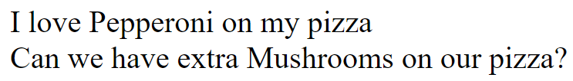
Strings
Variables can be included within text strings surrounded by double quotation marks
Curly braces can be placed around the variable to clearly define variable identifiers
<?php
$pepperoni = "Pepperoni";
echo "I love $pepperoni on my pizza";
$mush = "Mushroom";
echo "Can we have extra {$mush}s on our pizza?";
?>
Output:

Slide 9
PHP Data Types
An array contains a set of data represented by a single identifier
There are two ways to create an array within PHP:
An array can be created using the array() language construct which takes any number of comma-separated key => value pairs as arguments
As of PHP 5.4 you can also use the short array syntax, which replaces array() with [ ]
Arrays which contain integer keys are referred to as indexed arrays
Arrays which contain string keys are referred to as associative arrays
Note: PHP arrays can contain integer and string keys at the same time

Slide 10
PHP Indexed Arrays
<!DOCTYPE html>
<html lang="en">
<head> <title>PHP Basics</title> </head>
<body>
<?php
$provinces = [
"Ontario",
"Quebec",
"Alberta",
"British Columbia",
"Saskatchewan",
"Newfoundland and Labrador",
"Prince Edward Island",
"Nova Scotia",
"New Brunswick",
"Manitoba"
];
$territories = Array(
"Northwest Territories",
"Yukon",
"Nunavut"
);
?>
</body>
</html>

Slide 11
PHP Indexed Arrays
An element refers to each single piece information stored within an array.
An index is an element’s numerical position within the array (beginning at index 0).
An element is referenced by enclosing its index in square brackets at the end of the array name:
$territories[0]
$territories
Index | 0 | 1 | 2
Value | Northwest Territories | Yukon | Nunavut

Slide 12

Indexed Array Example
<!DOCTYPE html>
<html lang="en">
<head> <title>PHP Basics</title> </head>
<body>
<?php
$territories = Array(
"Northwest Territories",
"Yukon",
"Nunavut"
);
echo $territories[0];
?>
</body>
</html>
Output:

Slide 13

Appending to Indexed Arrays
Appending to the end of an array can be done by simply providing an empty square brackets at the end of the identifier
<!DOCTYPE html>
<html lang="en">
<head> <title>PHP Basics</title> </head>
<body>
<?php
$territories[] = "Northwest Territories";
$territories[] = "Yukon";
$territories[] = "Nunavut";
echo $territories[2];
?>
</body>
</html>
Output:

Slide 14
Associative Arrays
Associative arrays are arrays that use named keys that you assign to them.
Just like indexed arrays, there are two ways to create associative arrays
$MyInfo = [
"birthday" => "1980-05-29",
"age" => 26,
"eyecolor" => "brown"
];
$MyInfo2["birthday"] = "1980-05-29";
$MyInfo2["age"] = 26;
$MyInfo2["eyecolor"] = "brown";
named keys
values

Slide 15
Debugging Arrays
When debugging, it’s sometimes useful to display the entire contents of an array.
PHP provides two built-in functions to accomplish this: print_r() and var_dump()
In fact, var_dump() and print_r() will output information about any variable within PHP.

Slide 16
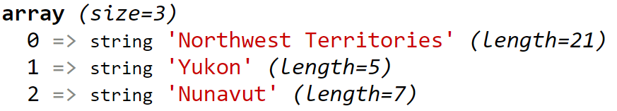
Debugging Arrays
<!DOCTYPE html>
<html lang="en">
<head> <title>PHP Basics</title> </head>
<body>
<?php
$territories[] = "Northwest Territories";
$territories[] = "Yukon";
$territories[] = "Nunavut";
print_r($territories);
var_dump($territories);
?>
</body>
</html>
Output:

Slide 17
Repetition Structures
A loop statement is a control structure that repeatedly executes a statement or a series of statements while a specific condition is TRUE or until a specific condition becomes TRUE
There are four types of loop statements:
while statements
do...while statements
for statements
foreach statements

Slide 18
Repetition Structures
foreach statements are used to iterate or loop through the elements in an array
Do not require a counter; instead, you specify an array expression within a set of parentheses following the foreach keyword
The syntax for the foreach statement is:
foreach ($arrayName as $variableName) {
statements;
}

Slide 19
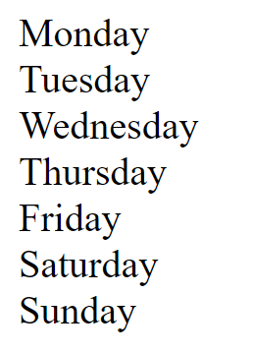
Repetition Structures
<!DOCTYPE html>
<html lang="en">
<head><title>PHP Basics</title></head>
<body>
<?php
$days = [ "Monday", "Tuesday", "Wednesday",
"Thursday", "Friday", "Saturday", "Sunday"];
foreach ($days as $day) {
echo $day;
echo "<br>";
}
?>
</body>
</html>
Output:

Slide 20
Including Files
PHP allows you to reuse content by inserting content from external files into multiple web pages
The include statement generates a warning if the include file cannot be found.
The require statement produces a fatal error if the included file cannot be found.
include_once and require_once statements ensure content is only inserted once.

Slide 21
Include Example
header.php
<!DOCTYPE html>
<html lang="en">
<head> <title>PHP Basics</title> </head>
<body>
<?php
include("header.php");
include("footer.php");
?>
footer.php
</body>
</html>

Slide 22
PHP Autoglobals
Autoglobals are predefined global arrays that provide information about server, environment and user input
Array | Description
$_COOKIE | An array of values passed to the current script as HTTP cookies
$_ENV | An array of environment information
$_FILES | An array of information about uploaded files
$_GET | An array of values from a form submitted with the “get” method
$_POST | An array of values from a form submitted with the “post” method
$_REQUEST | An array of all elements in the $_COOKIE, $_GET, $_POST arrays
$_SERVER | An array of information about the web server that served the current script
$_SESSION | An array of session variables that are available to the current script
$GLOBALS | An array of references to all variables that are defined with global scope

Slide 23
PHP Autoglobals
Autoglobals are simply associative arrays
To access their values, place the element’s key within quotations inside square array brackets
Web form information can be captured by PHP using the autoglobals
Web form information is placed within the $_POST and $_GET superglobals

Slide 24
Web Forms
A Web form is a standard HTML form with two required attributes in the opening <form> tag:
Action attribute: Identifies the program on the Web server that will process the form data when it is submitted
Method attribute: Specifies how the form data will be sent to the processing script

Slide 25
Web Forms
The value of the method attribute must be either “post” or “get”
The “post” method embeds the form data in the request message
The “get” method appends the form data to the URL specified in the form’s action attribute
When a Web form is submitted using the “post” method, PHP automatically creates and populates a $_POST array; when the “get” method is used, PHP creates and populates a $_GET array

Slide 26
Web Forms
Form fields are sent to the Web server as a name/value pair
The name portion of the name/value pair becomes the key of an element in the $_POST or $_GET array, depending on which method was used to submit the data
The value portion of the name/value pair is populated by the data that the user enters in the input control on the Web form

Slide 27
Form Handlers
A form handler is a program or script that processes the information submitted from a Web form
A form handler generally performs the following:
Verifies that the user entered the minimum amount of data to process the form
Validates form data
Works with the submitted data
Returns appropriate output as a Web page

Slide 28
Web Form Example
<!DOCTYPE html>
<html lang="en">
<head> <title>PHP Basics</title> </head>
<body>
<form action="phpbasics-webform2.php" method="post">
<label for="fname">First Name</label>
<input type="text" name="firstname" id="fname">
<input type="submit">
</form>
</body>
</html>

Slide 29
Form Handler Example
<!DOCTYPE html>
<html lang="en">
<head> <title>PHP Basics</title> </head>
<body>
<?php
$firstName = $_POST['firstname'];
echo $firstName;
?>
</body>
</html>

Slide 30
Self Referencing Web Form
Forms can be self-reference; combining the web form and the form handler into a single page.
Use the isset() function on the submit button to determine if the form is being viewed for the first time or not.

Slide 31
Self Referencing Web Form
<!DOCTYPE html>
<html lang="en">
<head> <title>PHP Basics</title> </head>
<body>
<?php
if (isset($_POST['submit'])) {
echo "The name you entered was: {$_POST['firstname']}";
?>
<?php
} else {
?>
<form action="phpbasics-webform3.php" method="post">
<label for="fname">First Name</label>
<input type="text" name="firstname" id="fname">
<input type="submit" name="submit">
</form>
<?php
}
?>
</body>
</html>

Slide 32
Working with Databases
A database is used to store related information about a particular subject
Each row in a database table is referred to as a record
Each column in a database table is referred to as a field
Fields are individual categories of information stored in a record
A relational database stores information across multiple related tables

Slide 33
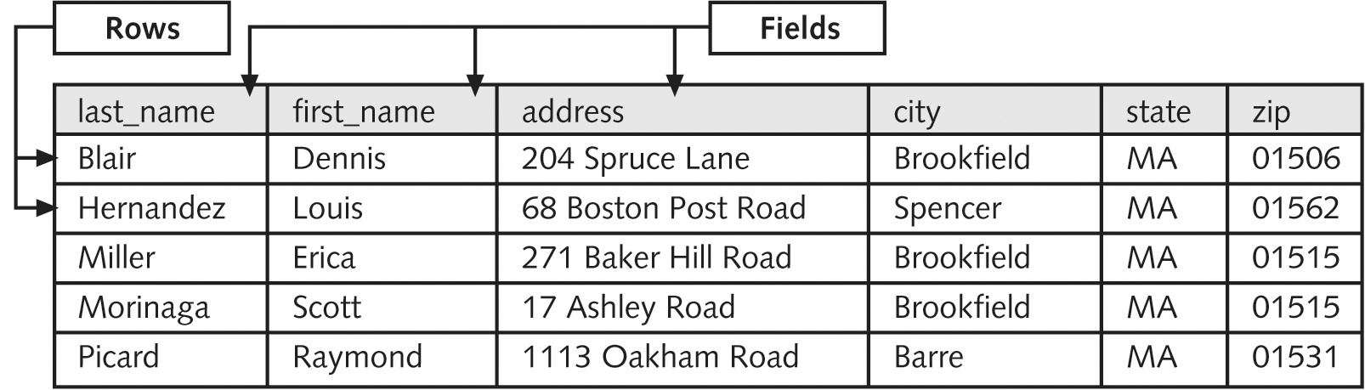
Working with Databases
PHP Programming with MySQL, 2nd Edition

Slide 34
Data Types
Data types that are assigned to fields determine how much storage space the database allocates for the data
As a general rule of thumb:
Choose the smallest data type possible for each field

Slide 35
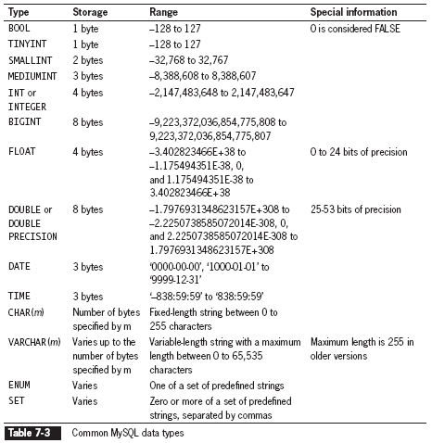
Data Types
PHP Programming with MySQL, 2nd Edition

Slide 36
SQL
SQL (Structured Query Language) is the standard language used by MySQL and other popular languages to interact with one or more database tables.
SQL is made up of several sub groups of commands
DDL – (Data Definition Language) which deals with database schemas and descriptions, of how the data should reside in the database. Some example SQL statements are CREATE, ALTER, DROP, RENAME
DML – (Data Manipulation Language) which deals with data manipulation, and includes most common SQL statements such SELECT, INSERT, UPDATE, DELETE etc, and it is used to store, modify, retrieve, delete and update data in database

Slide 37
SQL - DDL - Create
The CREATE command can be used to create a table within a database using the following syntax:
CREATE TABLE TableName (fieldname1 datatype,
fieldname2 datatype, etc.);

Slide 38
SQL - DDL - Create
Example:
CREATE TABLE `movies` (id INT NOT NULL AUTO_INCREMENT PRIMARY KEY, title varchar(255), production_company varchar(255), year_released YEAR, director varchar(255));
NOT NULL – this field is not allow to be left blank
AUTO_INCREMENT – when a new record is added, the id field will be automatically set to an incremented value

Slide 39
SQL - DML - Insert
To insert a record into a table, we use the INSERT statement
Syntax:
INSERT INTO `movies` VALUES ('0', 'Star Wars: The empire strikes back', 'Lucas Films', 1980, 'George Lucas');
Note: Order of the fields is important
Data values in SQL represented as text strings require quotes; numeric values do not.

Slide 40
SQL - DML - Select
Use the SELECT statement to retrieve records from a table:
Syntax:
SELECT fieldname FROM TableName;
Note: Use the * wildcard to retrieve all fields from at table
To return multiple fields, separate field names with a comma

Slide 41
SQL - DML - Select
You can also specify which records to return by using the WHERE keyword.
Example:
SELECT * FROM `movies` WHERE year_released = '1980';
Returns all fields for every movie which has the year_released field with a value equal to 1980

Slide 42
SQL - DML - Update
To update records in a table, use the UPDATE statement
The syntax for the UPDATE statement:
UPDATE TableName SET fieldname=value WHERE condition;
The SET keyword specifies the value to assign to the field in the records that match the condition in the WHERE keyword.

Slide 43
SQL - DML - Delete
Use the DELETE statement to delete records in a table
The syntax for the DELETE statement:
DELETE FROM TableName WHERE condition;
The delete statement deletes all records that match the condition
To delete all records in a table, remove the condition

Slide 44
SQL - Extras
To sort results using the SELECT statement, use the ORDER BY keyword
Example:
SELECT * FROM `movies` ORDER BY year_released;
Returns all records from the movie table sorted by the year_released field.
To reverse sort, add the DESC keyword after the name of the field to sort

Slide 45
SQL - Extras
Use the keywords AND and OR to specify more than one condition
Example:
SELECT * FROM `movies` WHERE year_released = '1980' AND production_company = 'Lucas Films'

Slide 46
MySQLi Example #1
<?php
require_once('connectvars.php');
$link = mysqli_connect( HOSTNAME, USERNAME, PASSWORD, DB );
$Title ="Star Wars Empire Strikes Back";
$ProductionCompany = "Lucas Films";
$YearReleased = "1980";
$Director = "George Lucas";
$query = "INSERT INTO `movies` values ('0', '$Title', '$ProductionCompany', '$YearReleased', '$Director')";
$result = mysqli_query($link, $query);
if (!$result) die('The query could not be executed!');
?>

Slide 47
MySQLi Example #2
<?php
require_once('connectvars.php');
$link = mysqli_connect( HOSTNAME, USERNAME, PASSWORD, DB );
$query = "SELECT * FROM `movies`";
$result = mysqli_query($link, $query);
if (!$result) die("The query could not be executed!");
while ($row = mysqli_fetch_array($result)){
echo "{$row['title']} <br/>";
echo "{$row['production_company']} <br/>";
echo "{$row['year']} <br/>";
echo "{$row['director']} <br/>";
}
?>

Slide 48
The end of Lecture 01

