Slide 1
Introduction to the Twin Support Vector Machine (TWSVM)
Jiyang Liu

Slide 2
Introduction
Twin support vector machine (TWSVM) is a new machine learning algorithm developed based on traditional support vector machine (SVM). It finds two non-parallel planes for each class by solving a pair of quadratic programming problems(QPPs). It improves calculation speed compared to traditional support vector machines (SVM).

Slide 3
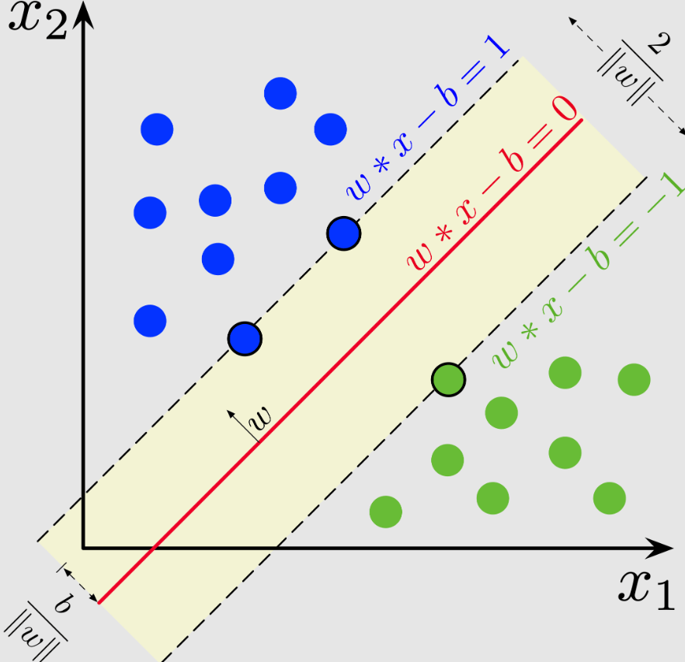
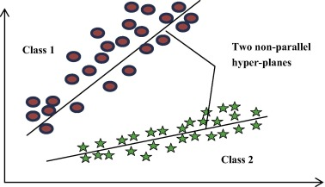
SVM
TWSVM

Slide 4
The goal of TWSVM is to construct two non-parallel planes for each category by optimizing a pair of Quadratic Programming Problems, such that each hyperplane is closer to the data of one class while being far away from the data of the other class.

Slide 5
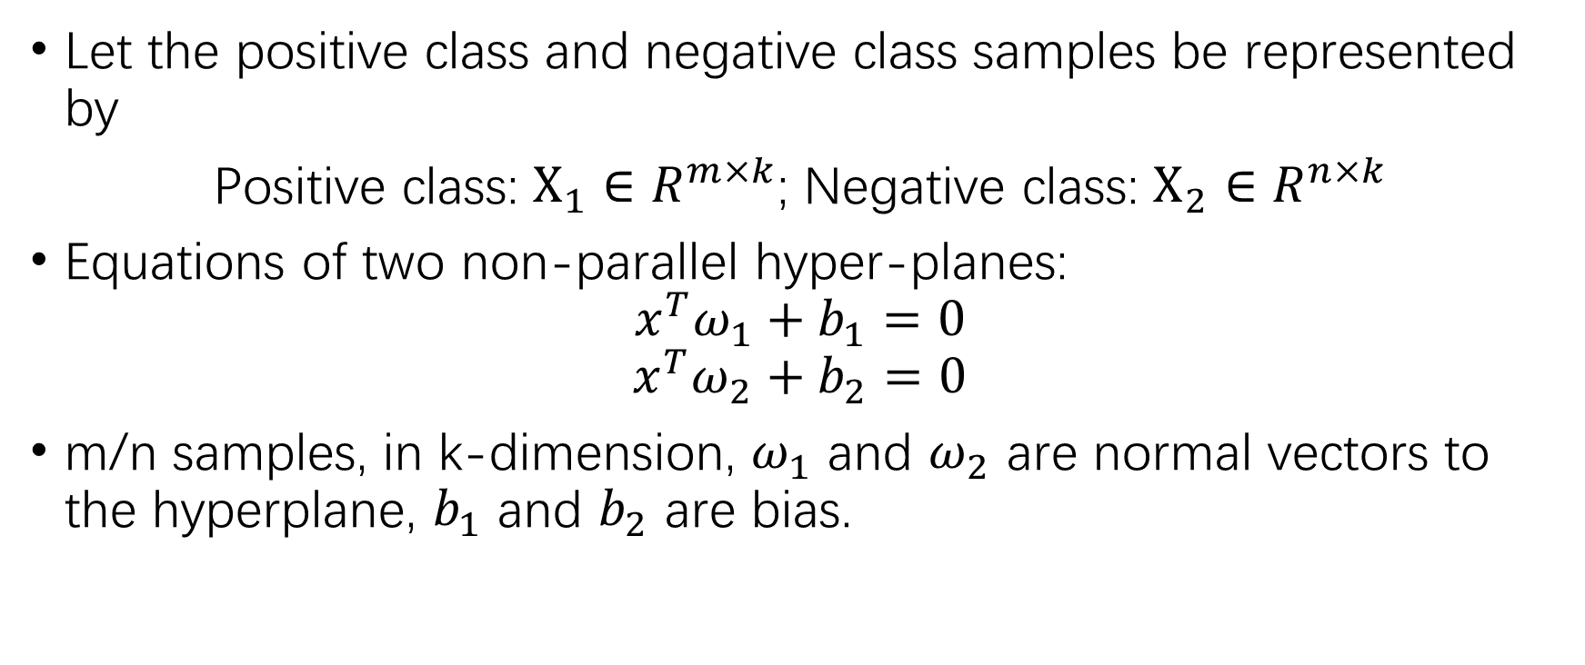
Linear Twin Support Vector Machine
Let the positive class and negative class samples be represented by
Positive class: $X_{1}∈R^{m×k}$; Negative class: $X_{2}∈R^{n×k}$
Equations of two non-parallel hyper-planes:
$$x^{T}ω_{1}+b_{1}=0$$
$$x^{T}ω_{2}+b_{2}=0$$
m/n samples, in k-dimension, $ω_{1}$ and $ω_{2}$ are normal vectors to the hyperplane, $b_{1}$ and $b_{2}$ are bias.

Slide 6
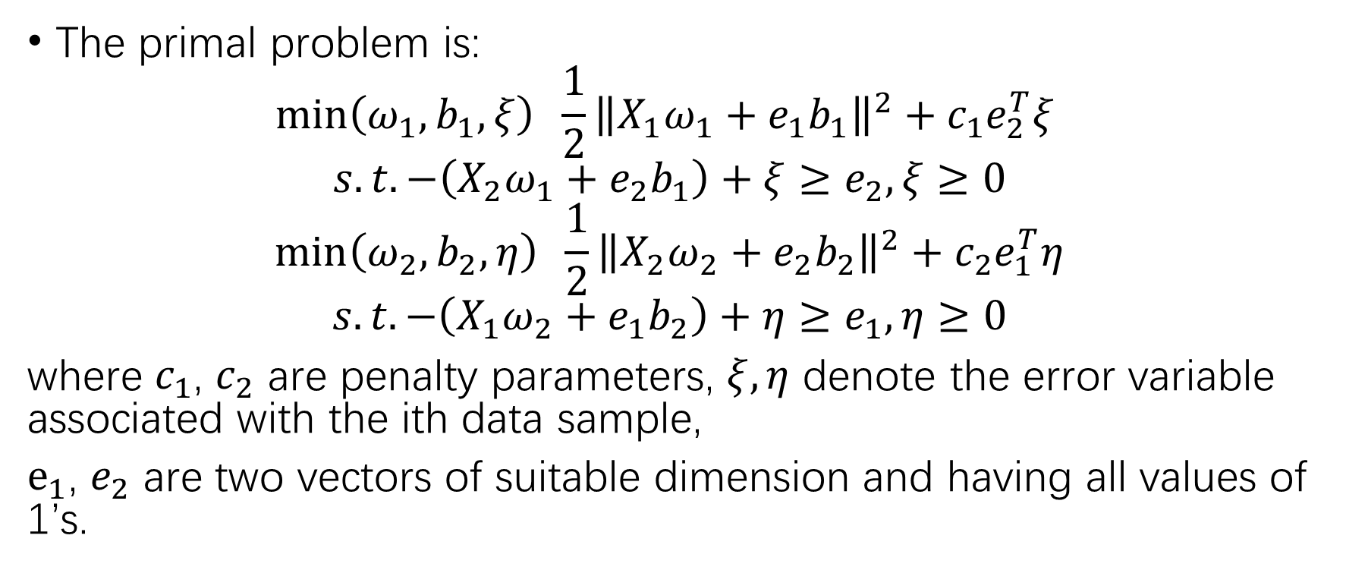
Linear Twin Support Vector Machine
The primal problem is:
$$\min\left(ω_{1},b_{1},ξ\right) \frac{1}{2}{\left\|X_{1}ω_{1}+e_{1}b_{1}\right\|}^{2}+c_{1}e_{2}^{T}ξ$$
$$s.t.−\left(X_{2}ω_{1}+e_{2}b_{1}\right)+ξ≥e_{2},ξ≥0$$
$$\min\left(ω_{2},b_{2},η\right) \frac{1}{2}{\left\|X_{2}ω_{2}+e_{2}b_{2}\right\|}^{2}+c_{2}e_{1}^{T}η$$
$$s.t.−\left(X_{1}ω_{2}+e_{1}b_{2}\right)+η≥e_{1},η≥0$$
where $c_{1}$, $c_{2}$ are penalty parameters, $ξ,η$ denote the error variable associated with the ith data sample,
$e_{1}$, $e_{2}$ are two vectors of suitable dimension and having all values of 1’s.

Slide 7
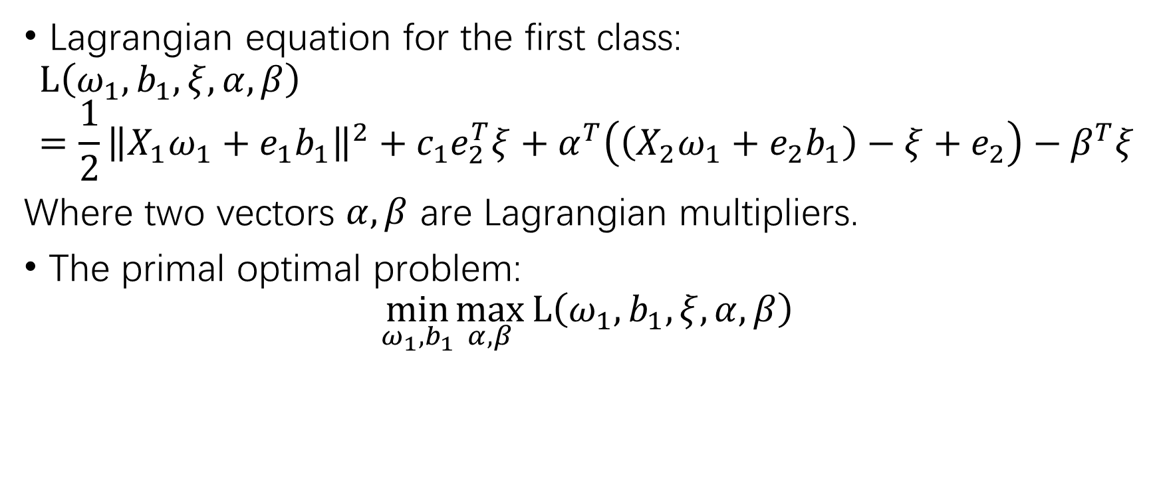
Linear Twin Support Vector Machine
Lagrangian equation for the first class:
$$L\left(ω_{1},b_{1},ξ,α,β\right)=\frac{1}{2}{\left\|X_{1}ω_{1}+e_{1}b_{1}\right\|}^{2}+c_{1}e_{2}^{T}ξ+α^{T}\left(\left(X_{2}ω_{1}+e_{2}b_{1}\right)−ξ+e_{2}\right)−β^{T}ξ$$
Where two vectors $α,β$ are Lagrangian multipliers.
The primal optimal problem:
$$\min_{ω_{1},b_{1}}\max_{α,β}L\left(ω_{1},b_{1},ξ,α,β\right)$$

Slide 8
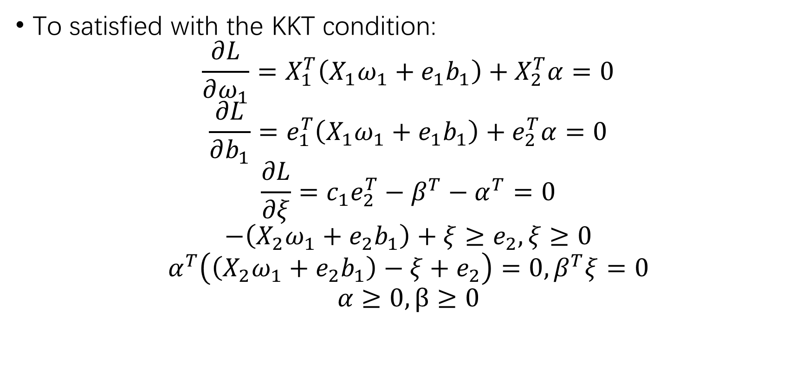
Linear Twin Support Vector Machine
To satisfied with the KKT condition:
$$\frac{∂L}{∂ω_{1}}=X_{1}^{T}\left(X_{1}ω_{1}+e_{1}b_{1}\right)+X_{2}^{T}α=0$$
$$\frac{∂L}{∂b_{1}}=e_{1}^{T}\left(X_{1}ω_{1}+e_{1}b_{1}\right)+e_{2}^{T}α=0$$
$$\frac{∂L}{∂ξ}=c_{1}e_{2}^{T}−β^{T}−α^{T}=0$$
$$−\left(X_{2}ω_{1}+e_{2}b_{1}\right)+ξ≥e_{2},ξ≥0$$
$$α^{T}\left(\left(X_{2}ω_{1}+e_{2}b_{1}\right)−ξ+e_{2}\right)=0,β^{T}ξ=0$$
$$α≥0, β≥0$$

Slide 9
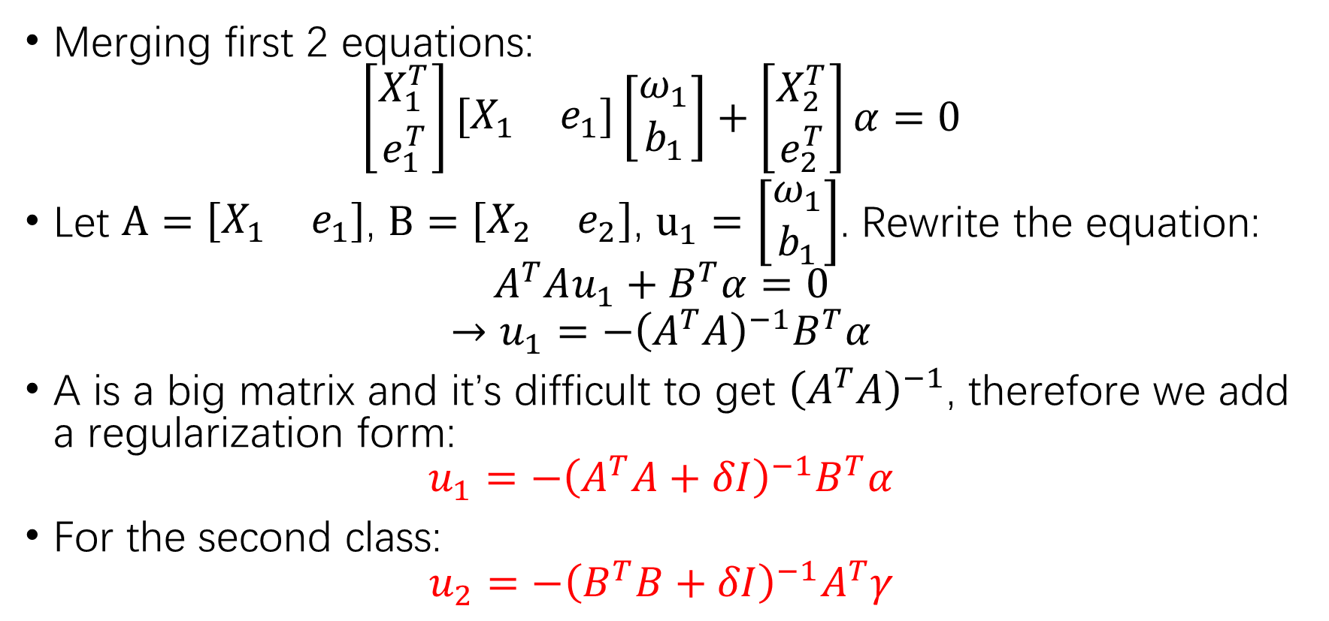
Linear Twin Support Vector Machine
Merging first 2 equations:
$$\left[\begin{matrix}X_{1}^{T} \\ e_{1}^{T}\end{matrix}\right]\left[\begin{matrix}X_{1} & e_{1}\end{matrix}\right]\left[\begin{matrix}ω_{1} \\ b_{1}\end{matrix}\right]+\left[\begin{matrix}X_{2}^{T} \\ e_{2}^{T}\end{matrix}\right]α=0$$
Let $A=\left[\begin{matrix}X_{1} & e_{1}\end{matrix}\right]$, $B=\left[\begin{matrix}X_{2} & e_{2}\end{matrix}\right]$, $u_{1}=\left[\begin{matrix}ω_{1} \\ b_{1}\end{matrix}\right]$. Rewrite the equation:
$$A^{T}Au_{1}+B^{T}α=0$$
$$→u_{1}=−{\left(A^{T}A\right)}^{−1}B^{T}α$$
A is a big matrix and it’s difficult to get ${\left(A^{T}A\right)}^{−1}$, therefore we add a regularization form:
$$u_{1}=−{\left(A^{T}A+δI\right)}^{−1}B^{T}α$$
For the second class:
$$u_{2}=−{\left(B^{T}B+δI\right)}^{−1}A^{T}γ$$

Slide 10

Linear Twin Support Vector Machine
After we have $u_{1}$ and $u_{2}$, we can determine hyperplanes for each class. The new data sample is assigned to class i by using the following decision function:
$$class i=min\left|x^{T}ω_{i}+b_{i}\right| for i=1,2$$
The pattern is assigned to the class which it’s distance is lesser.

Slide 11
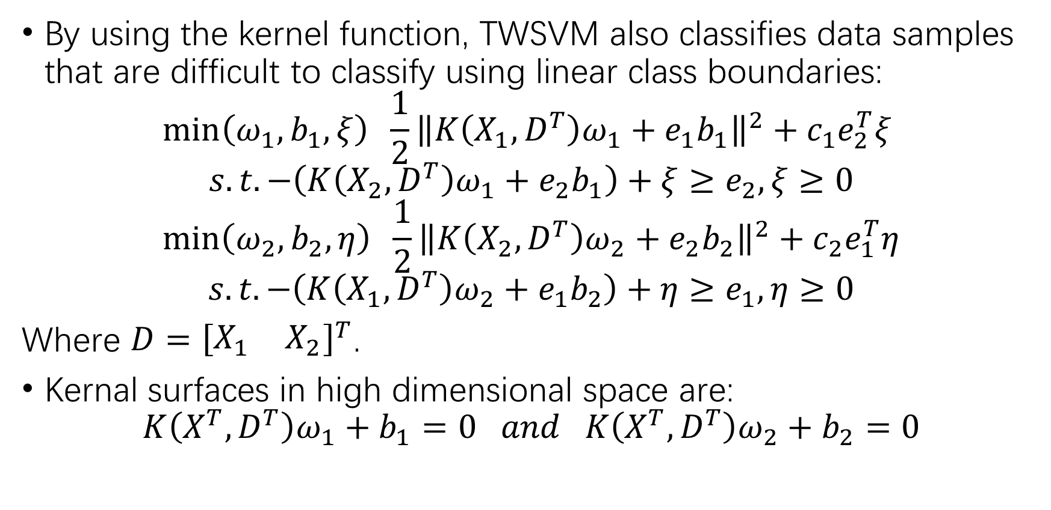
Non-linear Twin Support Vector Machine
By using the kernel function, TWSVM also classifies data samples that are difficult to classify using linear class boundaries:
$$\min\left(ω_{1},b_{1},ξ\right) \frac{1}{2}{\left\|K\left(X_{1},D^{T}\right)ω_{1}+e_{1}b_{1}\right\|}^{2}+c_{1}e_{2}^{T}ξ$$
$$s.t.−\left(K\left(X_{2},D^{T}\right)ω_{1}+e_{2}b_{1}\right)+ξ≥e_{2},ξ≥0$$
$$\min\left(ω_{2},b_{2},η\right) \frac{1}{2}{\left\|K\left(X_{2},D^{T}\right)ω_{2}+e_{2}b_{2}\right\|}^{2}+c_{2}e_{1}^{T}η$$
$$s.t.−\left(K\left(X_{1},D^{T}\right)ω_{2}+e_{1}b_{2}\right)+η≥e_{1},η≥0$$
Where $D={\left[\begin{matrix}X_{1} & X_{2}\end{matrix}\right]}^{T}$.
Kernal surfaces in high dimensional space are:
$$K\left(X^{T},D^{T}\right)ω_{1}+b_{1}=0 and K\left(X^{T},D^{T}\right)ω_{2}+b_{2}=0$$

Slide 12
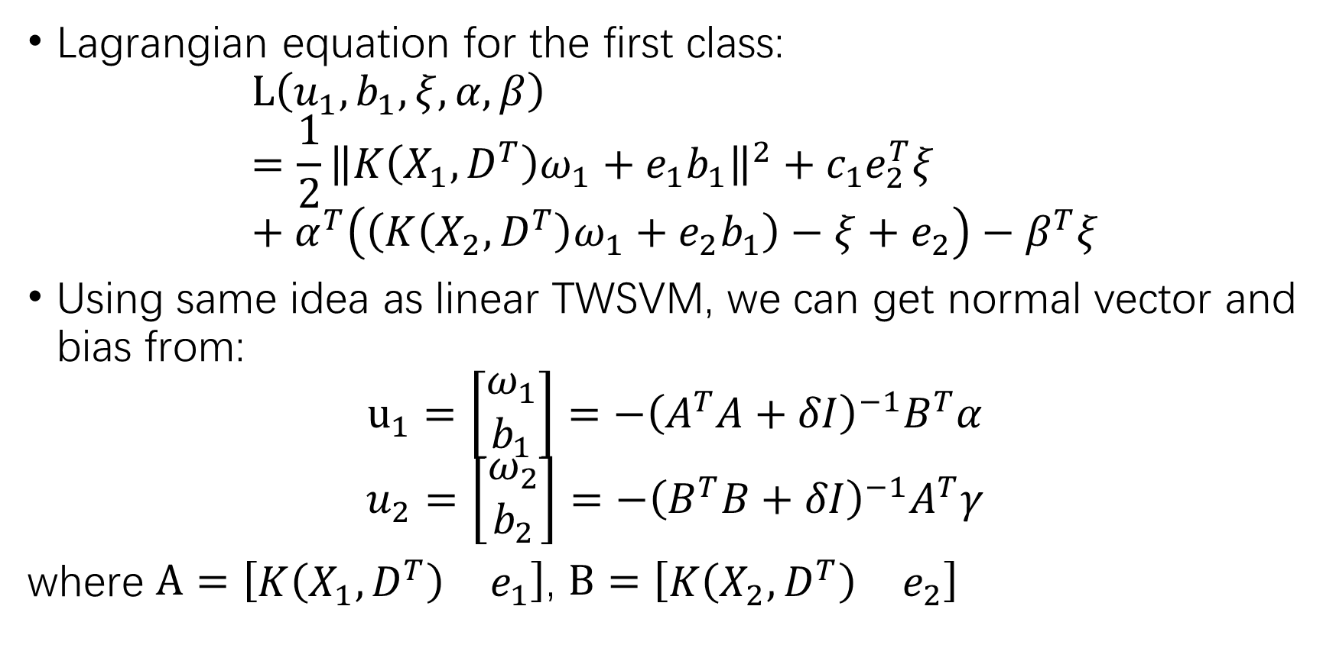
Non-linear Twin Support Vector Machine
Lagrangian equation for the first class:
$$L\left(u_{1},b_{1},ξ,α,β\right)=\frac{1}{2}{\left\|K\left(X_{1},D^{T}\right)ω_{1}+e_{1}b_{1}\right\|}^{2}+c_{1}e_{2}^{T}ξ+α^{T}\left(\left(K\left(X_{2},D^{T}\right)ω_{1}+e_{2}b_{1}\right)−ξ+e_{2}\right)−β^{T}ξ$$
Using same idea as linear TWSVM, we can get normal vector and bias from:
$$u_{1}=\left[\begin{matrix}ω_{1} \\ b_{1}\end{matrix}\right]=−{\left(A^{T}A+δI\right)}^{−1}B^{T}α$$
$$u_{2}=\left[\begin{matrix}ω_{2} \\ b_{2}\end{matrix}\right]=−{\left(B^{T}B+δI\right)}^{−1}A^{T}γ$$
where $A=\left[\begin{matrix}K\left(X_{1},D^{T}\right) & e_{1}\end{matrix}\right]$, $B=\left[\begin{matrix}K\left(X_{2},D^{T}\right) & e_{2}\end{matrix}\right]$

Slide 13

Non-linear Twin Support Vector Machine
The new data sample is assigned to class i by using the following decision function:
$$class i=min\left|K\left(X^{T},D^{T}\right)ω_{i}+b_{i}\right| for i=1,2$$
The pattern is assigned to the class which it’s distance is lesser.

Slide 14
Implementation
We implemented the TWSVM algorithm in matlab and classified the Synthetic3 and Synthetic4 (which has poor classification results in the homework). The ratio of the training set to the test set was 80:20.

Slide 15
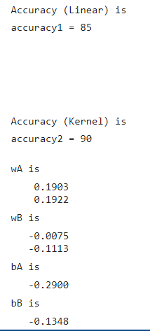
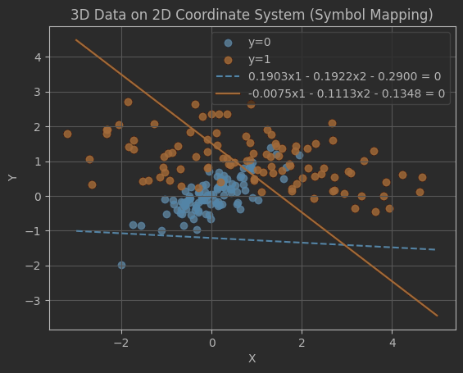
Synthetic3

Slide 16
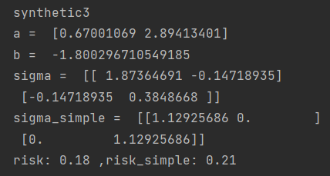
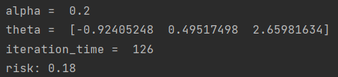

Synthetic3
LDA
TWSVM
Gradient descent
PLA

Slide 17
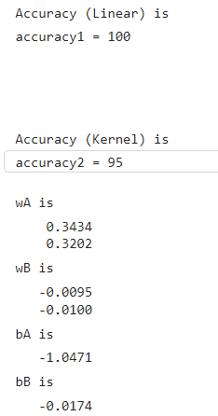
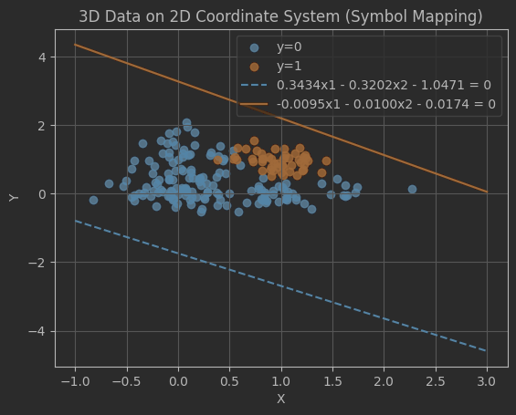
Synthetic4

Slide 18
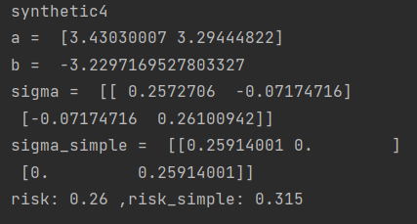
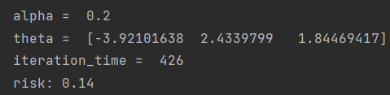

Synthetic4
LDA
TWSVM
Gradient descent
PLA

Slide 19
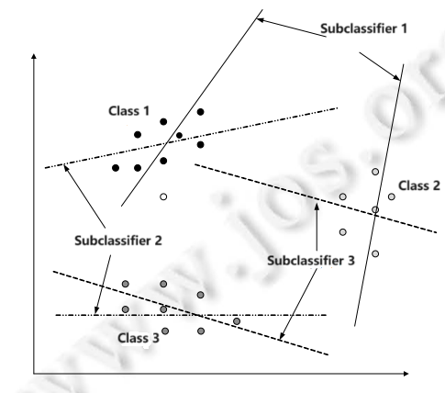
Pros
Good for multi-classification problems. For example: One versus One strategy.
If the classification function between class i and j classifies the given sample into class i, this binary classifier votes for category i. Otherwise, class j obtains the vote. Traversing all the binary classifiers, the given sample will be assigned to the class with the highest number of votes.

Slide 20
Pros
Less computation.
For SVM, we need to solve a large QPP, using all the data.
For TWSVM, we only need to solve two smaller QPPs, which is equivalent to decomposing the QPP of SVM, and the calculation amount is greatly reduced.

Slide 21
Cons
Class imbalance problem.
For multi-class data, if the number of samples in each class differs too much, the class imbalance problem may occur, and the classifier performs poorly when predicting a few classes.
We need to use class-balanced experimental data when using TWSVM.

