Slide 1
Overview of the Project
This project focuses on analyzing SpaceX rocket launch data to predict the success of rocket landings, which has significant implications for cost calculations and competitive bidding in space missions.

Slide 2
Project Background and Purpose
Space X, known for its cost-effective Falcon 9 rocket launches, demonstrates the financial benefits of reusable rockets. This project aims to develop a machine learning model to predict the success of these rocket landings, offering valuable data for potential competitors in the space industry.

Slide 3
Research and Data Handling Techniques
Data Collection: Utilized SpaceX's API and web scraping methods for data acquisition.
Data Preparation: Involved data cleaning and transformation, with techniques like one-hot encoding for categorical data.
Analysis Methods: Employed exploratory data analysis using SQL and visual tools, interactive analytics with Folium and Plotly Dash, and predictive modeling using classification algorithms.

Slide 4
Methodology
Executive Summary
Data collection methodology:
Data was collected using SpaceX API and web scraping from Wikipedia.
Perform data wrangling
One-hot encoding was applied to categorical features
Perform exploratory data analysis (EDA) using visualization and SQL
Perform interactive visual analytics using Folium and Plotly Dash
Perform predictive analysis using classification models
How to build, tune, evaluate classification models

Slide 5
Data Collection
The data was collected using various methods
Data collection was done using get request to the SpaceX API.
Next, we decoded the response content as a Json using .json() function call and turn it into a pandas dataframe using .json_normalize().
We then cleaned the data, checked for missing values and fill in missing values where necessary.
In addition, we performed web scraping from Wikipedia for Falcon 9 launch records with BeautifulSoup.
The objective was to extract the launch records as HTML table, parse the table and convert it to a pandas dataframe for future analysis.

Slide 6
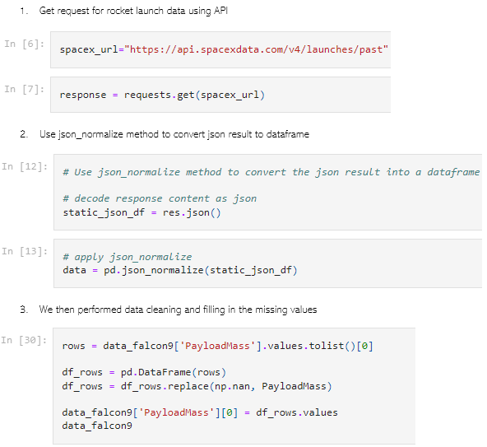
Data Collection – SpaceX API
We used the get request to the SpaceX API to collect data, clean the requested data and did some basic data wrangling and formatting.
The link to the notebook is https://github.com/chuksoo/IBM-Data-Science-Capstone-SpaceX/blob/main/Data%20Collection%20API.ipynb.

Slide 7
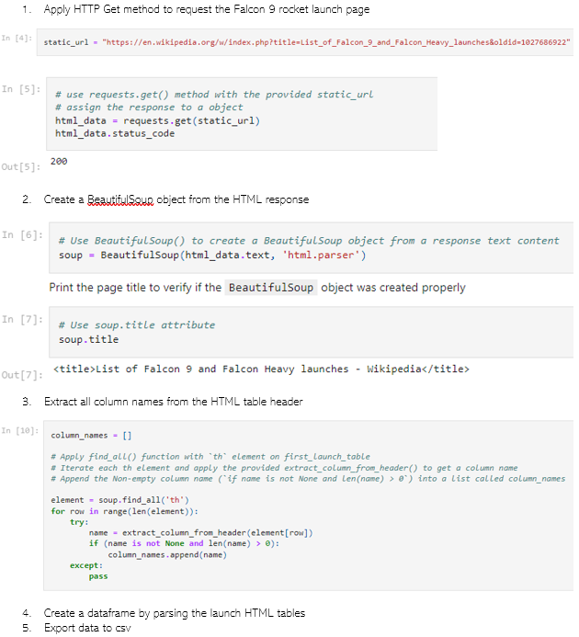
Data Collection - Scraping
We applied web scrapping to webscrap Falcon 9 launch records with BeautifulSoup
We parsed the table and converted it into a pandas dataframe.
The link to the notebook is https://github.com/chuksoo/IBM-Data-Science-Capstone-SpaceX/blob/main/Data%20Collection%20with%20Web%20Scraping.ipynb.

Slide 8
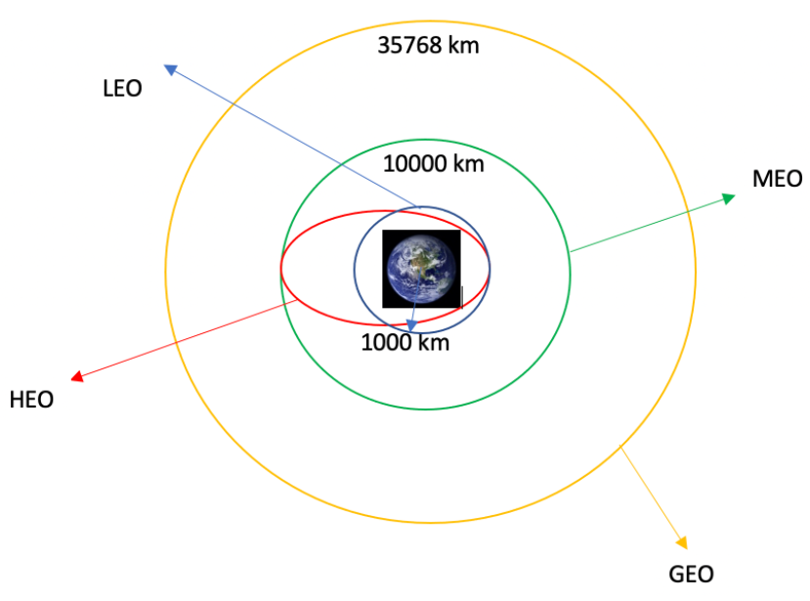
Data Wrangling
We performed exploratory data analysis and determined the training labels.
We calculated the number of launches at each site, and the number and occurrence of each orbits
We created landing outcome label from outcome column and exported the results to csv.
The link to the notebook is https://github.com/chuksoo/IBM-Data-Science-Capstone-SpaceX/blob/main/Data%20Wrangling.ipynb.

Slide 9
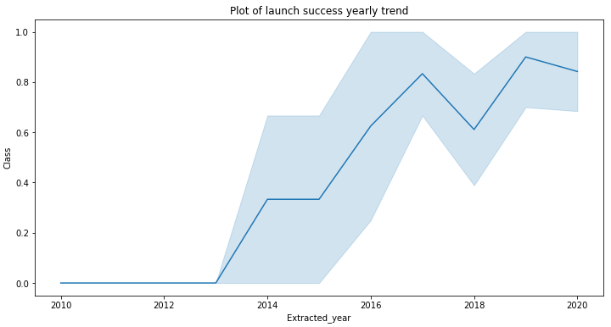
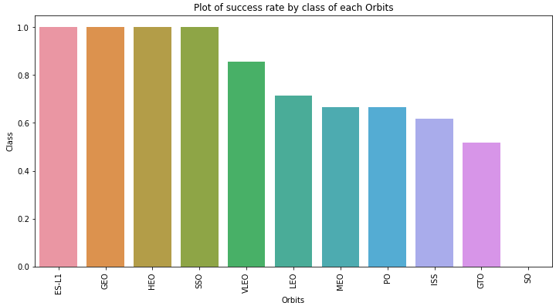
EDA with Data Visualization
We explored the data by visualizing the relationship between flight number and launch Site, payload and launch site, success rate of each orbit type, flight number and orbit type, the launch success yearly trend.
The link to the notebook is https://github.com/chuksoo/IBM-Data-Science-Capstone-SpaceX/blob/main/EDA%20with%20Data%20Visualization.ipynb

Slide 10
EDA with SQL
We loaded the SpaceX dataset into a PostgreSQL database without leaving the jupyter notebook.
We applied EDA with SQL to get insight from the data. We wrote queries to find out for instance:
The names of unique launch sites in the space mission.
The total payload mass carried by boosters launched by NASA (CRS)
The average payload mass carried by booster version F9 v1.1
The total number of successful and failure mission outcomes
The failed landing outcomes in drone ship, their booster version and launch site names.
The link to the notebook is https://github.com/chuksoo/IBM-Data-Science-Capstone-SpaceX/blob/main/EDA%20with%20SQL.ipynb

Slide 11
Build an Interactive Map with Folium
We marked all launch sites, and added map objects such as markers, circles, lines to mark the success or failure of launches for each site on the folium map.
We assigned the feature launch outcomes (failure or success) to class 0 and 1.i.e., 0 for failure, and 1 for success.
Using the color-labeled marker clusters, we identified which launch sites have relatively high success rate.
We calculated the distances between a launch site to its proximities. We answered some question for instance:
Are launch sites near railways, highways and coastlines.
Do launch sites keep certain distance away from cities.

Slide 12
Build a Dashboard with Plotly Dash
We built an interactive dashboard with Plotly dash
We plotted pie charts showing the total launches by a certain sites
We plotted scatter graph showing the relationship with Outcome and Payload Mass (Kg) for the different booster version.
The link to the notebook is https://github.com/chuksoo/IBM-Data-Science-Capstone-SpaceX/blob/main/app.py

Slide 13
Predictive Analysis (Classification)
We loaded the data using numpy and pandas, transformed the data, split our data into training and testing.
We built different machine learning models and tune different hyperparameters using GridSearchCV.
We used accuracy as the metric for our model, improved the model using feature engineering and algorithm tuning.
We found the best performing classification model.
The link to the notebook is https://github.com/chuksoo/IBM-Data-Science-Capstone-SpaceX/blob/main/Machine%20Learning%20Prediction.ipynb

Slide 14
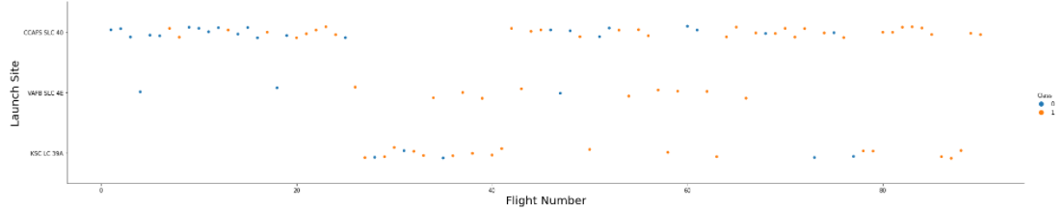
Flight Number vs. Launch Site
From the plot, we found that the larger the flight amount at a launch site, the greater the success rate at a launch site.

Slide 15

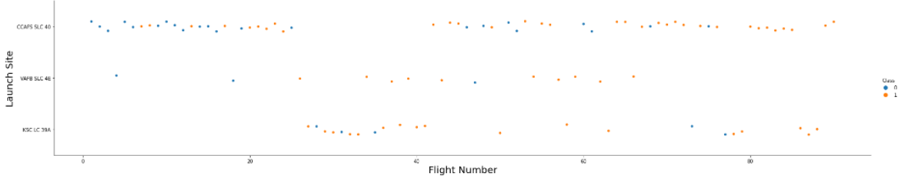
Payload vs. Launch Site

Slide 16

Success Rate vs. Orbit Type
From the plot, we can see that ES-L1, GEO, HEO, SSO, VLEO had the most success rate.

Slide 17
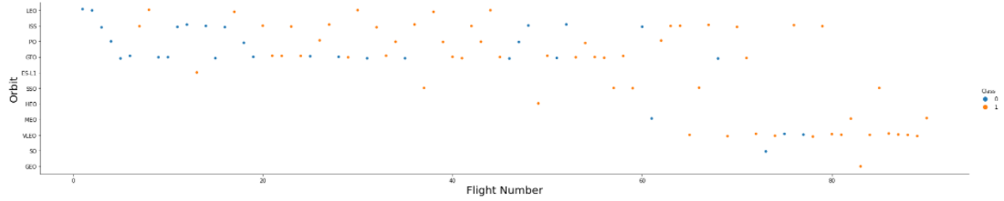
Flight Number vs. Orbit Type
The plot below shows the Flight Number vs. Orbit type. We observe that in the LEO orbit, success is related to the number of flights whereas in the GTO orbit, there is no relationship between flight number and the orbit.

Slide 18
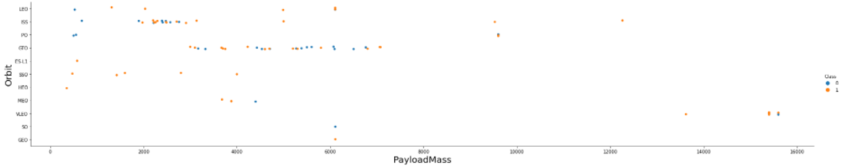
Payload vs. Orbit Type
We can observe that with heavy payloads, the successful landing are more for PO, LEO and ISS orbits.

Slide 19
Launch Success Yearly Trend
From the plot, we can observe that success rate since 2013 kept on increasing till 2020.

Slide 20
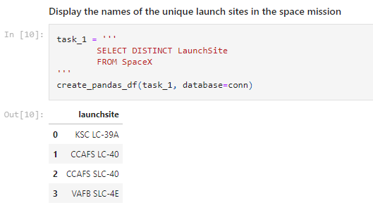
All Launch Site Names
We used the key word DISTINCT to show only unique launch sites from the SpaceX data.

Slide 21
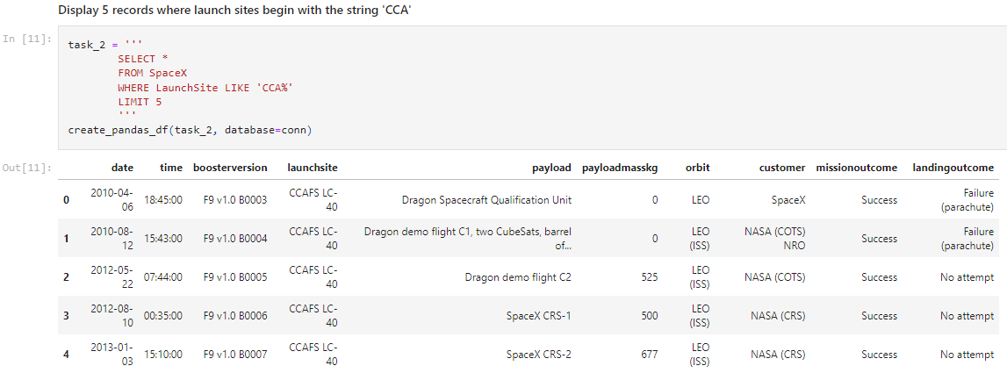
Launch Site Names Begin with 'CCA'
We used the query above to display 5 records where launch sites begin with `CCA`

Slide 22
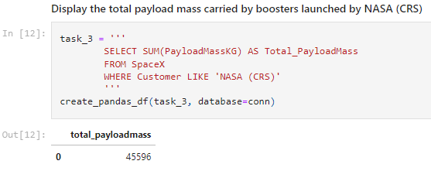
Total Payload Mass
We calculated the total payload carried by boosters from NASA as 45596 using the query below

Slide 23
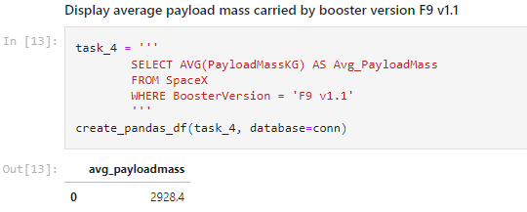
Average Payload Mass by F9 v1.1
We calculated the average payload mass carried by booster version F9 v1.1 as 2928.4

Slide 24
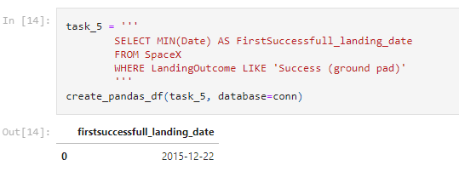
First Successful Ground Landing Date
We observed that the dates of the first successful landing outcome on ground pad was 22nd December 2015

Slide 25
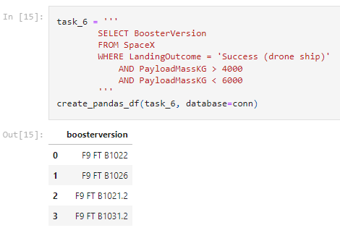
Successful Drone Ship Landing with Payload between 4000 and 6000
We used the WHERE clause to filter for boosters which have successfully landed on drone ship and applied the AND condition to determine successful landing with payload mass greater than 4000 but less than 6000

Slide 26
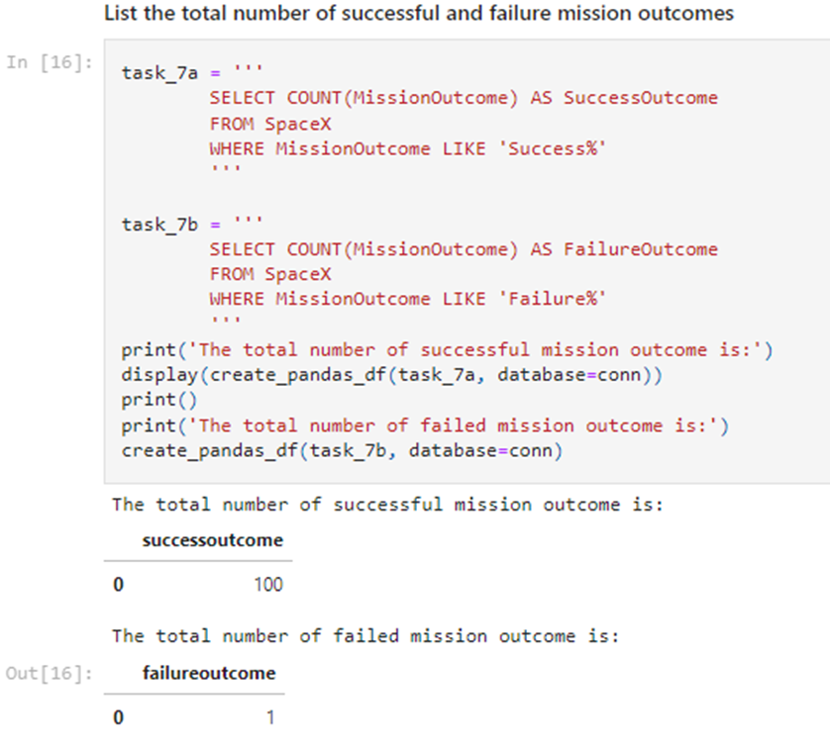
Total Number of Successful and Failure Mission Outcomes
We used wildcard like ‘%’ to filter for WHERE MissionOutcome was a success or a failure.

Slide 27
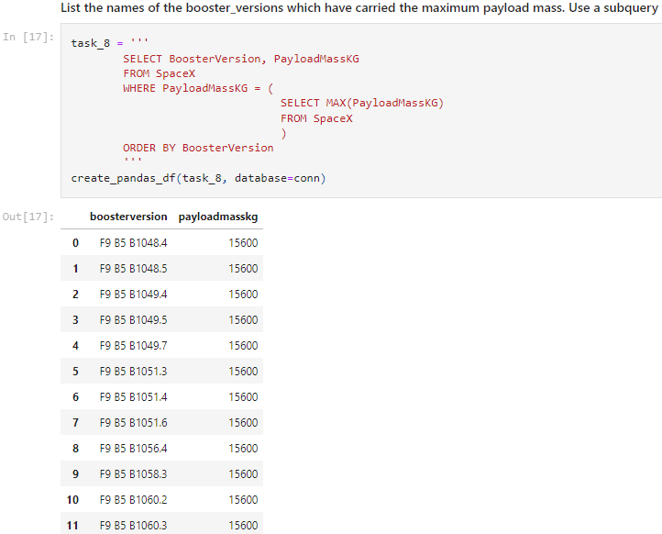
Boosters Carried Maximum Payload
We determined the booster that have carried the maximum payload using a subquery in the WHERE clause and the MAX() function.

Slide 28
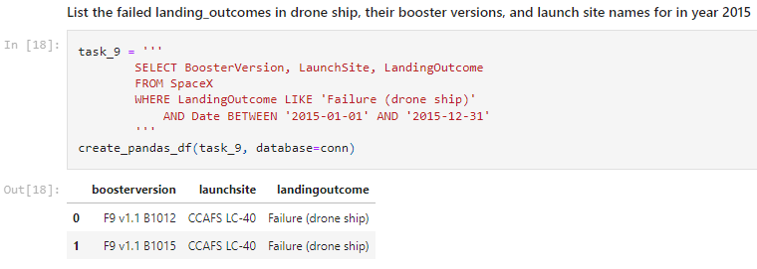
2015 Launch Records
We used a combinations of the WHERE clause, LIKE, AND, and BETWEEN conditions to filter for failed landing outcomes in drone ship, their booster versions, and launch site names for year 2015

Slide 29
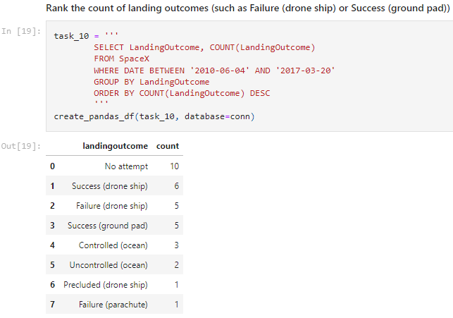
Rank Landing Outcomes Between 2010-06-04 and 2017-03-20
We selected Landing outcomes and the COUNT of landing outcomes from the data and used the WHERE clause to filter for landing outcomes BETWEEN 2010-06-04 to 2010-03-20.
We applied the GROUP BY clause to group the landing outcomes and the ORDER BY clause to order the grouped landing outcome in descending order.

Slide 30
Results
Exploratory data analysis results
Interactive analytics demo in screenshots
Predictive analysis results

Slide 31
Key Findings and Insights
Analytical Results: Presented findings from exploratory data analysis and visual analytics.
Predictive Modeling: Discussed the performance and outcomes of various machine learning models, highlighting the most effective model for this task.

Slide 32
Concluding Remarks
Summary of Insights: Concluded with the main takeaways about the relationship between launch conditions and success rates, the efficiency of the chosen machine learning model, and the potential applications of these findings in the space industry.

