Slide 1
Track A · Project Udyam Digital
Ek Baithak.
A digital-first journey that takes a small business from "what do I need?" to a live Accel Business bundle in one sitting, on a phone, in Hindi or English.
Team Jagh
Jiya · Hera Siddique
Notes:
Ek Baithak means 'one sitting'. The case asks for small businesses to go digital in one sitting; that is the product promise.

Slide 2
The journey, not price, loses 93% of SMB leads
PROBLEM · ROOT CAUSE
7.4%
17.6 days
₹15,054
6% → 28%
lead → activation (368 of 5,000)
lead to live, with 3 status chases
acquisition cost per SMB
6-month churn: 1 vs 5 chases
Stage | What goes wrong | Evidence in the data | Ek Baithak's fix
Contact | Discovery needs a sales visit; owners are busy | 827 lost: no time for a visit (531) or never scheduled (296) | 6-question advisor on WhatsApp/web, no visit
Quote | 3-5 day PDF full of product codes | 385 lost to slow or unreadable quotes; 621 to price or rivals | Instant single monthly price, a reason on every line
KYC | 4 documents collected by hand or email | 273 lost: missing docs, long forms, signatory, mismatch | GSTIN prefill + documents checked on upload
Install | No feasibility check, no dates | 98 lost to >21-day installs; 41 sites not fibre-feasible | Feasibility before quote, AirFiber fallback, ETA
After sale | Rep-picked bundles, nobody tells you the status | 56 of 368 sales (15%) broke catalogue rules; 22 on a cancelled GSTIN | Rules engine blocks mis-sells; live tracker
Source: smb_leads.csv (synthetic, 5,000 leads, Apr-Jun 2026), product_catalogue.csv, mock_gstin_registry.csv · reproduced by analysis/funnel_analysis.py
Notes:
Every number is computed from the provided CSVs. Mis-sell check applies tier, size, GSTIN and dependency rules from the catalogue to each activated bundle. Churn by number of status chases: 1 call 6%, 5 calls 28%.

Slide 3
Lead with professional offices and multi-site businesses
APPROACH · WHERE TO PLAY
Segment | Lead share | Conversion | CAC / sale | Median /mo | 6-mo churn | Payback | Priority & route
Professional offices | 25% | 11.1% | ₹10.7k | ₹6,575 | 14% | 1.6 mo | Wave 1 · advisor-led digital
Small multi-site | 15% | 11.0% | ₹15.6k | ₹28,080 | 11% | 0.6 mo | Wave 1 · digital + field
Small manufacturers | 6% | 12.8% | ₹15.3k | ₹15,910 | 8% | 1.0 mo | Wave 1b · field-assisted
Micro retail & services | 54% | 4.1% | ₹20.0k | ₹2,470 | 23% | 8.1 mo | Wave 2 · WhatsApp self-serve
Clinic & Office Pro
Professional offices · 5 people
Chain Connect
Small multi-site · 3 sites
Factory Connect
Small manufacturers
Dukaan Digital
Micro retail & services
₹4,316 /mo · 12 mo · ₹0 setup
₹10,532 /mo · 12 mo
₹13,791 /mo · 24 mo
₹1,797 /mo · 12 mo
Biz Fibre 300 · 2 × Postpaid 599 · Cloud email ×5 · Endpoint security ×5 · Cloud backup 1 TB
Per site: Fibre 100 + 4G/5G failover + 2 CCTV + Cloud POS. HQ: 3 × Postpaid 599, Cloud email ×10
Leased line 20 Mbps · Managed firewall · 3 × Postpaid 599 · Cloud email ×10 · Machine IoT ×5
5G AirFiber 100 (2-day install) · Postpaid 299 · Cloud POS & billing
Add: Static IP ₹200 · Toll-free ₹1,500*
Add: SD-WAN + firewall at 3+ sites, 10+ staff (24 mo)*
Requires active GSTIN and 10+ employees
Add: CCTV ₹199/cam · WhatsApp API ₹999*
CAC payback = CAC per activation ÷ median monthly bundle · bundle prices = catalogue floor prices · * needs an active GSTIN · source: smb_leads.csv, product_catalogue.csv
Notes:
Professional offices and multi-site pay back acquisition cost in under 2 months; micro takes 8 months with 23% churn, so it only gets the zero-visit WhatsApp route. Bundles pass every catalogue eligibility rule; the advisor scales quantities from the owner's answers.

Slide 4
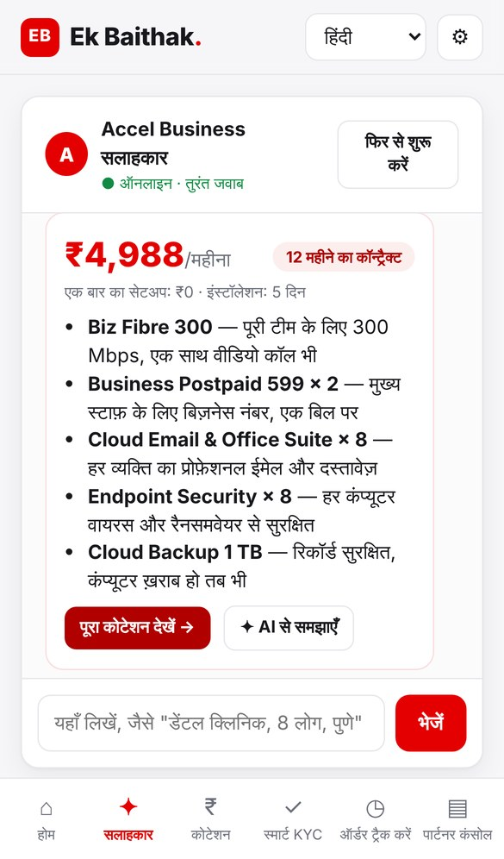
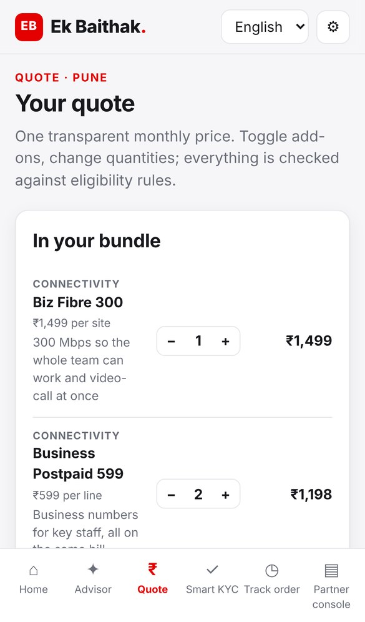
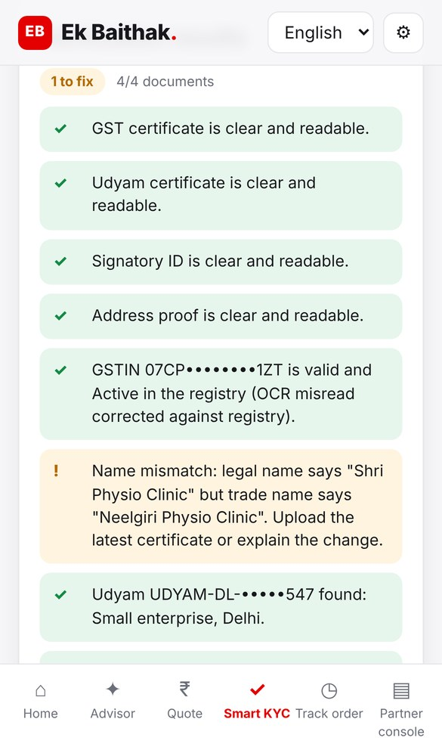
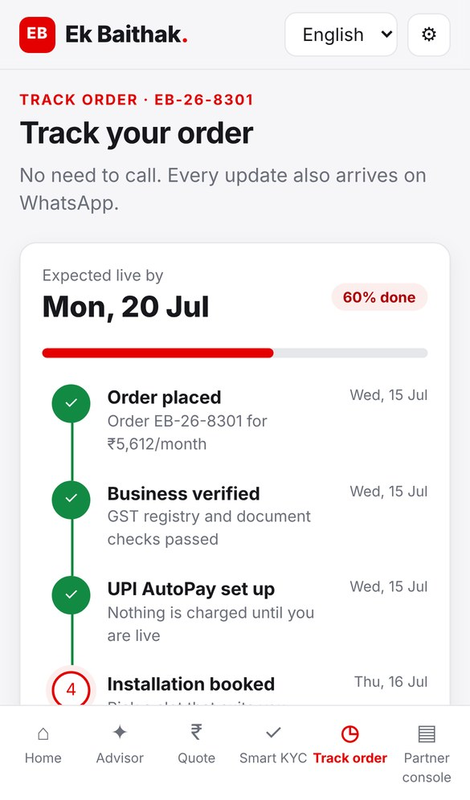
Discover, buy, verify and track on one phone screen
APPROACH · PRODUCT WALKTHROUGH
1
AI Advisor, in Hindi
6 questions or free text ("clinic, 8 staff, Pune"); bundle with a reason per line
2
One-price quote
Toggle add-ons and quantities; ineligible items greyed with the reason
3
Smart KYC
GSTIN prefill, on-device OCR; flagged 7 of 12 specimen applicants
4
Live tracker
Install date from catalogue days; every update on WhatsApp
Rules decide, AI explains. The eligibility engine picks products and prices from the catalogue; the LLM only writes the plain-language "why". Every recommendation is auditable.
Working prototype screens (synthetic data). Code, README and architecture: github.com/<your-username>/ek-baithak
Notes:
Screens are from the working prototype in the repo (frontend/). KYC flags on the 12 specimen applicants: cancelled GSTIN (K01), tilted scan auto-straightened (K02), blurred certificate (K04), missing Udyam (K05), GSTIN checksum fail (K06), name mismatch (K07), address proof 257 days old (K11).

Slide 5
Digital first, with a human where it matters
APPROACH · UNDER THE HOOD
1 · Rules
2 · Rules
3 · AI model
Understand the business
Decide bundle & price
Explain it
Type, staff, sites, city, current internet, needs, GSTIN: chat or free text
City tier, size, active GSTIN, dependencies from the catalogue. Mis-sells: 0
LLM writes the 'why' in the owner's language; cannot add, drop or re-price items
4 · AI + rules
5 · Rules
6 · AI + person
Verify documents
Track, don't chase
Hand off with context
On-device OCR, blur and tilt fix, GSTIN checksum, registry status, names, 90-day bill
ETA from catalogue install days, slot booking, WhatsApp push at each step
Unclosed leads ranked by propensity go to the local partner, who keeps full commission
Field force & partners: closers, not couriers
Privacy by design (DPDP Act, 2023)
Pin-code attribution: partners earn full commission on digital closes in their area, plus an install fee
Field sales focus on multi-site and manufacturers: 21% of leads, 73% of bundle value
Referral loop: best channel today (14.8% conversion, ₹4.1k CAC), paid in bill credits
Separate consent per purpose before KYC; marketing off by default
Minimum data: 4 documents, the rest prefilled from the GST registry
OCR on the device; IDs masked in UI and logs; LLM never sees documents
Images deleted 30 days after go-live; consent ledger and audit log
Propensity model: logistic regression on smb_leads.csv, hold-out AUC 0.74 · DPDP = Digital Personal Data Protection Act, 2023
Notes:
Architecture: channels (WhatsApp, web/PWA, voice IVR, partner app) -> advisor -> rules engine with catalogue -> LLM explainer -> Smart KYC (consent, GSTIN/Udyam lookup, OCR, DigiLocker/e-Sign) -> UPI AutoPay -> order and install management -> tracker. Unclosed leads go to the partner console. Full diagram in docs/architecture.png; 1-page privacy note in docs/PRIVACY.md.

Slide 6
Rivals sell products. Nobody sells the one-sitting bundle
COMPETITIVE ANALYSIS
Capability | Ek Baithak (Accel) | Jio Business | Vi Business | Tata Tele Business | Local ISP / reseller | Digital point players
Bundle breadth (connect, comms, cloud, security, IoT) | ● | ● | ● | ● | ● | ●
Fixed + mobile on one bill | ● | ● | ● | ● | ● | ●
Self-serve sign-up on a phone | ● | ● | ● | ● | ● | ●
Conversational advisor in regional languages | ● | ● | ● | ● | ● | ●
Instant KYC (GSTIN prefill, e-sign) | ● | ● | ● | ● | ● | ●
Self-serve order tracking | ● | ● | ● | ● | ● | ●
Local reach (field + partners) | ● | ● | ● | ● | ● | ●
Their edge | Accel network, mobile + fibre | Cheap fibre plus bundled work tools (Max 801) | Ready For Next: D&B digital assessment, state MoUs | SME focus, Smartflo cloud comms + WhatsApp | Lowest price, doorstep trust | Instant sign-up for one product
Our counter | Turns 1,505 mobile-only Accel SMBs into bundle buyers | Win on service: tracker, failover, one support line | An advisor that closes and activates, not just assesses | Own connectivity + mobile; comms on top | Recruit as install and referral partners | Same speed, whole bundle, one bill
● strong
● partial
● not evident
532
leads lost to rivals: locked in (325) or undercut (207)
38%
of leads already use Accel, mostly mobile-only: a warm cross-sell
5.4%
activation for local-ISP users, the lowest of any provider group
Team assessment from public information, Nov 2026: TelecomTalk on JioBusiness Max 801 (Mar 2026); YourStory on Vi Business Ready For Next; TTBS releases · lead facts: smb_leads.csv
Notes:
Ratings are our reading of public material, not a measured benchmark; 'not evident' means we found no public evidence. Digital point players = WhatsApp BSPs, cloud email / POS SaaS with instant online sign-up.

Slide 7
2x activations at half the CAC, live in under 7 days
IMPACT · ROLLOUT
Metric | Today | 12-mo target | Main lever
Lead → activation | 7.4% | 15% | Advisor replaces visits; instant readable quote
Days, lead → live | 17.6 | ≤ 7 | Quote + KYC in one session; install ETA
CAC per activation | ₹15,054 | ≤ ₹7,500 | Same spend, 2x sales; digital leads ₹112-274 vs ₹1,769 field
Status chases | 3.0 | ≤ 0.5 | Tracker + WhatsApp push
6-month churn | 15.2% | ≤ 10% | No mis-sells; 1-chase cohort churns 6%
368 → 751
activations per quarter
+1,533
more SMBs live per year
+₹22.7 cr
ARR (₹21.8 → ₹44.5 cr)
1
0-3 mo · Pilot
Professional offices, 4 tier-1 cities, Hindi + English, web + WhatsApp
2
3-6 mo · Scale
+ Multi-site & manufacturers; Marathi, Tamil, Telugu, Kannada
3
6-12 mo · Mass
Micro self-serve with AirFiber, tier-2 cities, voice front end
Key risks → mitigation
AI error → rules decide · Fake docs → checksum, registry, e-sign · Channel conflict → pin-code commission
Ek Baithak. Dukaan se digital, ek hi baithak mein.
Team Jagh
Jiya · Hera Siddique
Model: half of each addressable drop reason recovered (stage rates 68/58/44/68/63% → 71/67/56/79/73%); ARR at today's mean bundle ₹12,350/mo, 20,000 leads/yr · analysis/funnel_analysis.py
Notes:
Gate to each next phase: conversion at least 12% and live in 7 days or less in the previous cohort. Risks: GenAI mis-recommendation (rules decide), document fraud (checksum, registry, cross-document names, e-sign), DPDP (consent, minimisation), channel conflict (pin-code attribution), install capacity (feasibility before quote, AirFiber).

