Slide 1

Restaurant Review Analysis
Web Page
Team: Phoenix
Team No.: 5
Team leader: Seoyoung Jo (1976371)
Team member: Jiyoon Park (1876166)

Slide 2
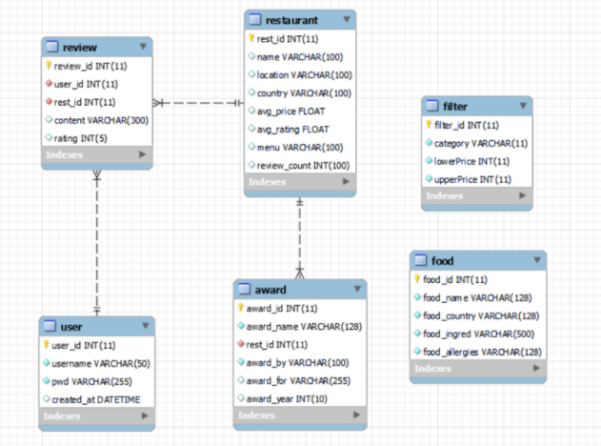
<Theme>
Based on restaurant review data
Provides various analysis (Ranking, recommendation, filter)
<Database Schema>
user: Saves users’ login information.
review: Saves restaurant review data.
restaurant: Saves the restaurant data.
food: Saves the food data.
award: Saves the award data.
filter: Saves filter data, which is user input.

Slide 3
Requirement satisfying points
<User Input>
Radio Buttons
Dropdown
Textbox
Button
<Used SQL syntax>
INSERT
DELETE
UPDATE
SELECT
GROUP BY
SUM, AVG
ORDER BY
RANK
LIKE
INNER JOIN
<Advanced Analysis>
Complex grouping
Window
Ranking
<Also included>
PHP sessions
Transaction

Slide 4
Website Structure
Main Login Page
jy_0_login_main
jy_0_login_register
Ranking
jy_1_avg_groupby
jy_1_rank_style
jy_1_rank_topic
jy_1_select_award
3) Edit Data
jy_2_allergic
jy_2_edit_award
sy_0_admin
4) Recommendation
sy_1_recommendation

