Slide 1



Oceanic Carbon Capture and Sequestration (OCCS): One of The Most Feasible Emergency Strategies Dealing With Climate Change and Global Warming.
By 谢济宇
2018.1.15

Slide 2

Thesis Statement
The clock is ticking on dealing with climate change
T
H
E
S
I
S
S
T
A
T
E
M
E
N
T
The level of carbon dioxide (CO₂) released into the atmosphere has increased significantly since the beginning of the industrial era.
Climate catastrophe may led to the earth as a result of the climate change and global warming, where human beings are unable to survive.
OCCS might be one of the best emergency strategies in dealing with climate change and global warming due to the large capacity of storing CO₂ when the situation is too worse tocontrol.

Slide 3
Contents
3. Analysis
3.1. Global Carbon Cycle
3.2. Greenhouse Gas(GHG) Emissions
3.3. Facts and Challenges
3.4. Carbon Capture and Sequestration(CCS)
3.5. Introduction of OCCS
3.6. Transportations of CO₂
3.7. CO₂ Sequestration
3.8. Costs Analysis
3.9. Risks, Impacts and Challenges
C
O
N
T
E
N
T
S
1. Thesis Statement
2. Background
3. Analysis
4. Prospective
5. Conclusion

Slide 4
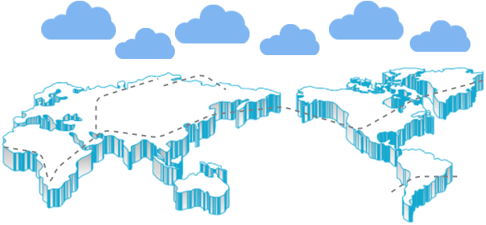

Units
All the data is shown in billion tonnes CO₂ (GtCO₂)
1 Gigatonne (Gt) = 1 billion tonnes = 1×10¹⁵g = 1 Petagram (Pg)
1 kg carbon (C) = 3.664 kg carbon dioxide (CO₂)
1 GtC = 3.664 billion tonnes CO₂ = 3.664 GtCO₂

Slide 5
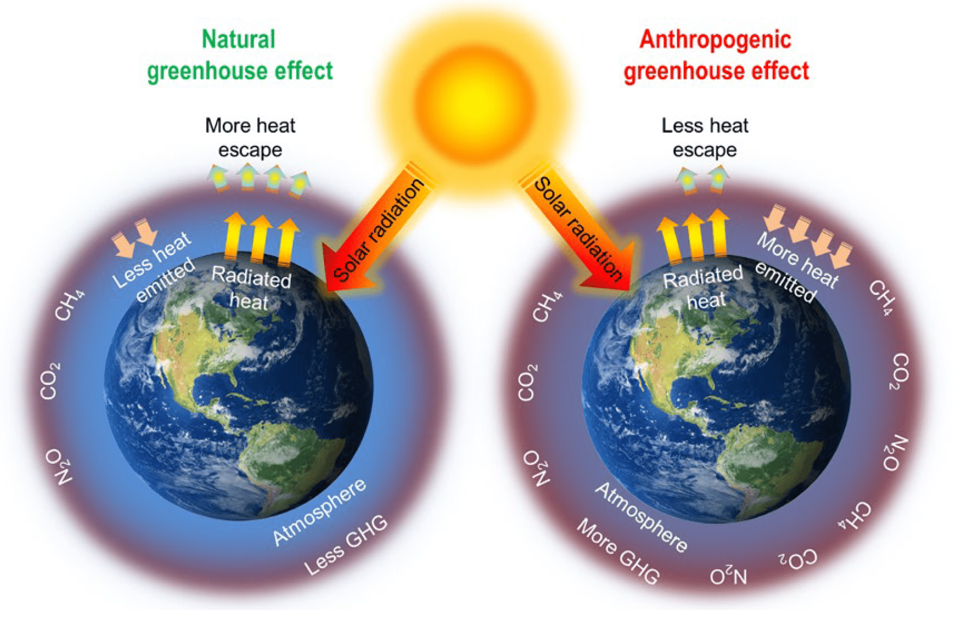
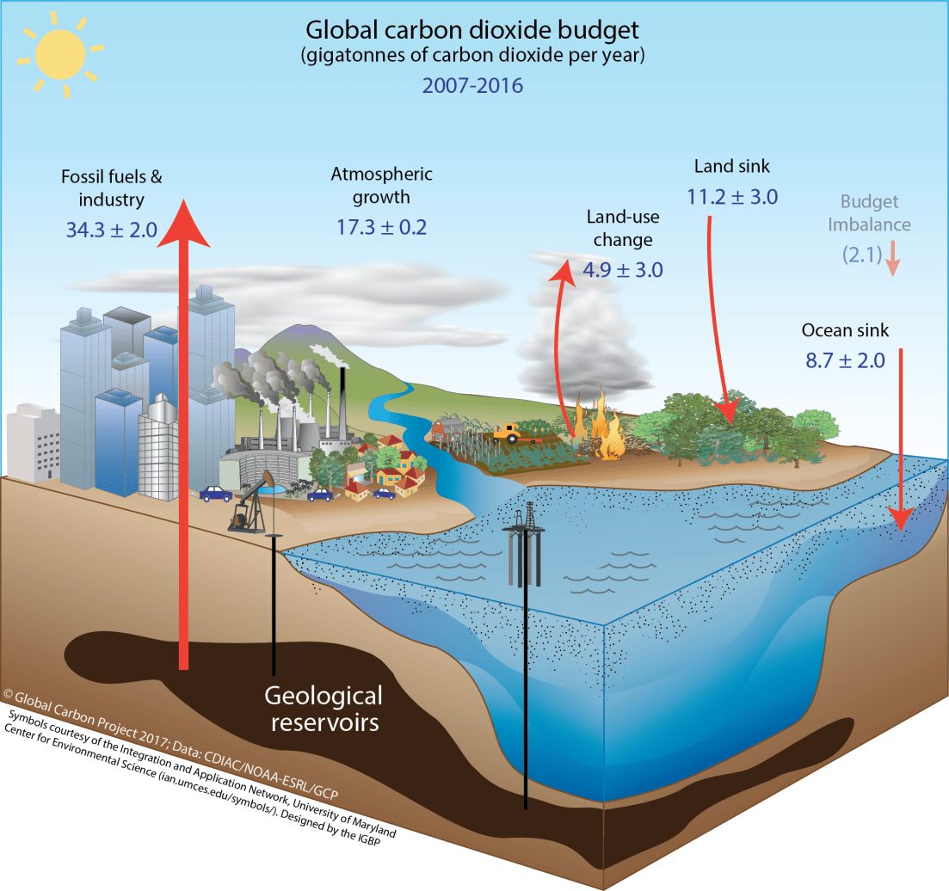
Anthropogenic Perturbation of the Global Carbon Cycle
Perturbation of the global carbon cycle caused by anthropogenic activities, averaged globally for the decade 2007–2016 (GtCO₂/yr)
Graphical illustration of natural and anthropogenic greenhouse effects.
GHG(greenhouse gases)
The budget imbalance is the difference between the estimated emissions and sinks. Source: CDIAC; NOAA-ESRL; Le Quéré et al 2017; Global Carbon Budget 2017
Nanda, S., Reddy, S. N., Mitra, S. K., & Kozinski, J. A. (2016). The progressive routes for carbon capture and sequestration. Energy Science and Engineering, 4(2), 99–122. https://doi.org/10.1002/ese3.117

Slide 6
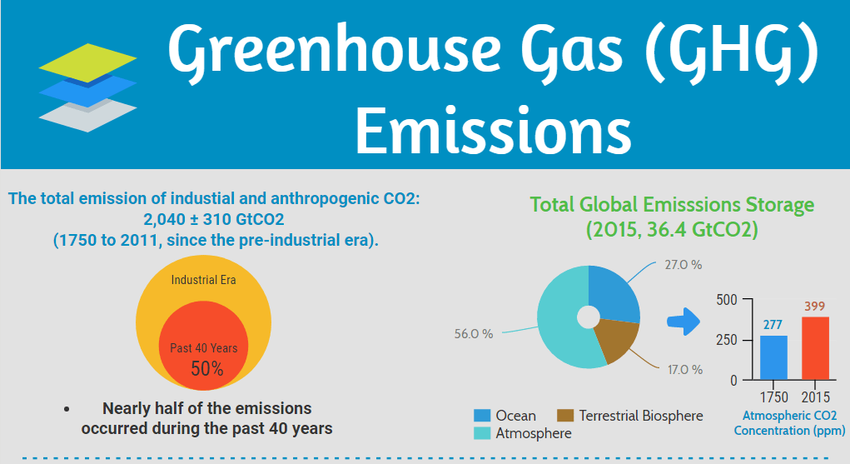

Slide 7
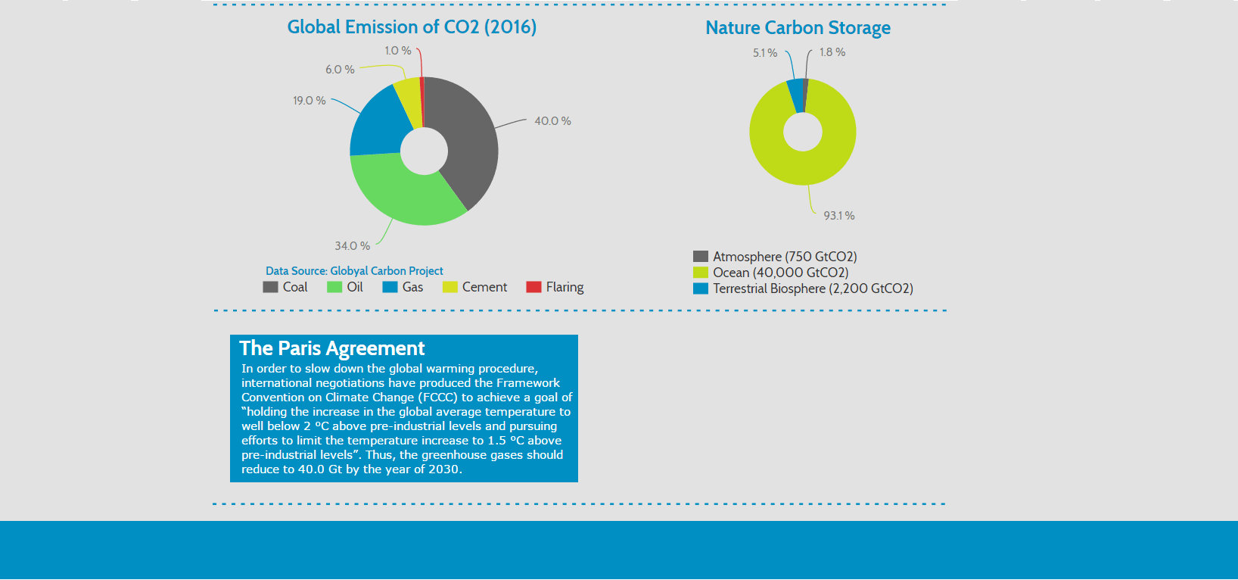
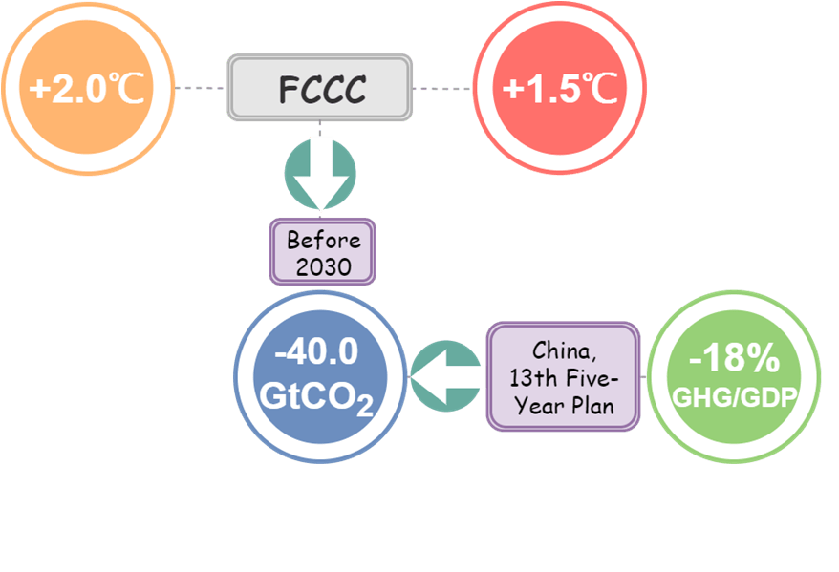


Slide 8
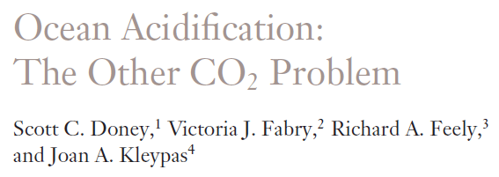
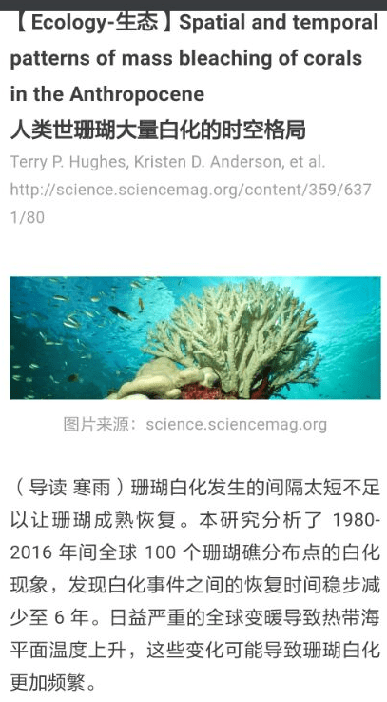
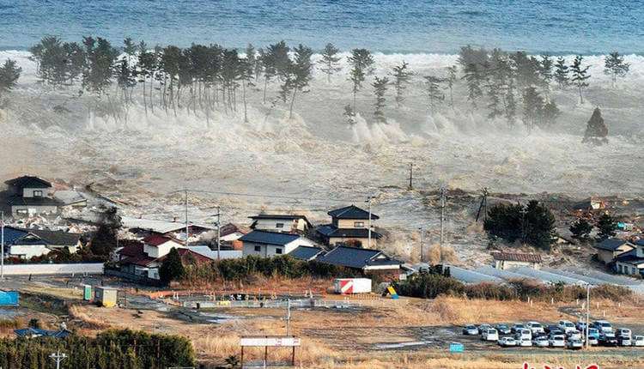
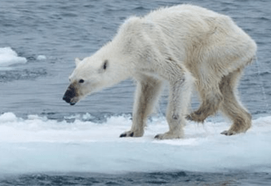

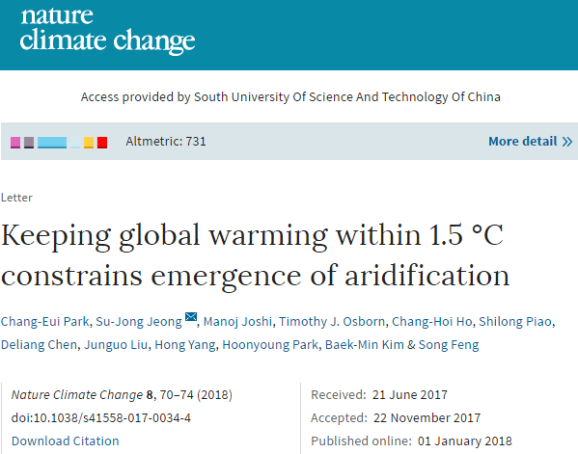
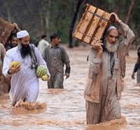

Less CO₂ !!!
_{Global Warming !!!}
……
Aridification
Acidification
Sea Level Rising
Polar Ice Melting
Islands Disappears
Food Crisis
Financial lost
Ecological Catastrophe
Climate Refugees
Economical Impacts
……
Facts and Challenges
Early action for accomplishing the 1.5 °C temperature goal can therefore markedly reduce the likelihood that large regions will face substantial aridification and related impacts.
–Prof. Sujong Jeong, SUSTech,
Park, C.-E., Jeong, S.-J., Joshi, M., Osborn, T. J., Ho, C.-H., Piao, S., … Feng, S. (2018). Keeping global warming within 1.5 °C constrains emergence of aridification. Nature Climate Change, 8(January). https://doi.org/10.1038/s41558-017-0034-4
http://www.twwtn.com/Upload/15/10/14180113195.jpg

Slide 9
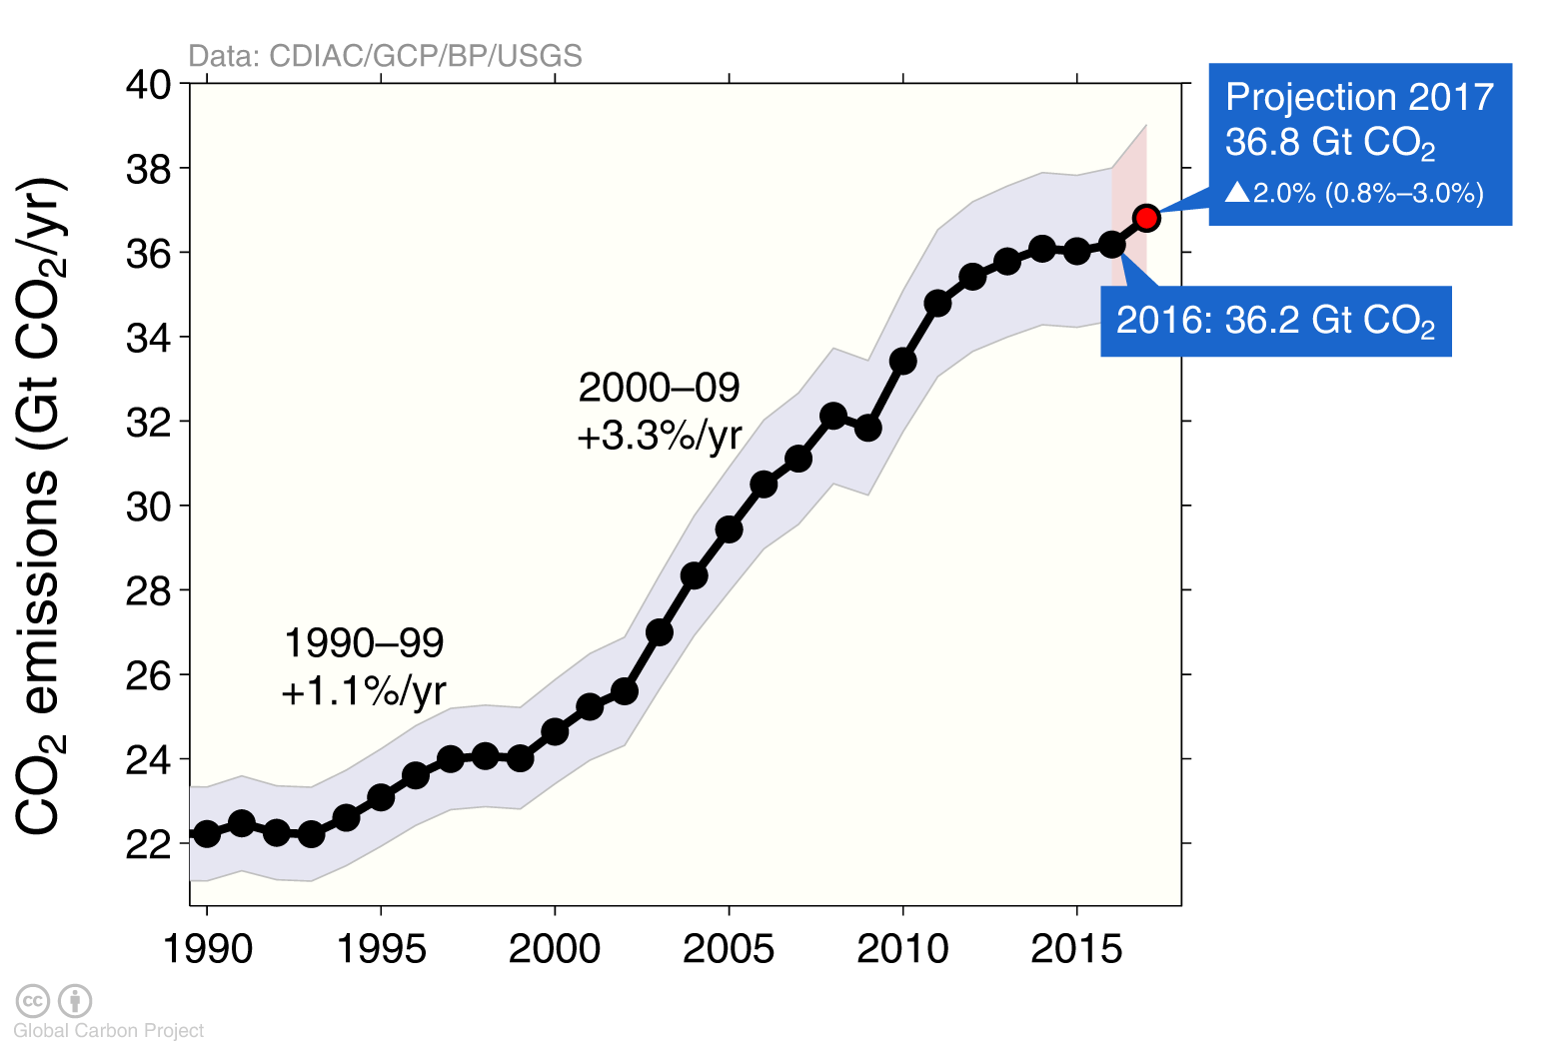
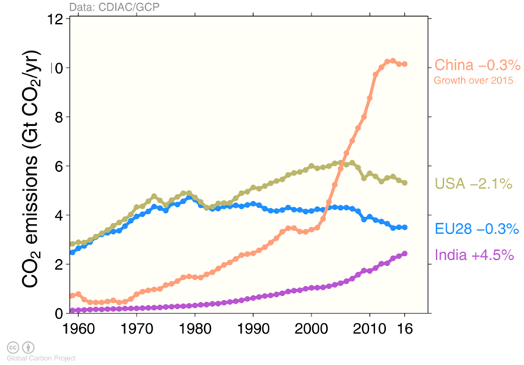
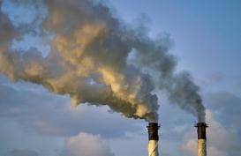
Emissions and Top Emitters from Fossil Fuel Use and Industry
Global emissions from fossil fuel and industry:
36.2 ± 2 GtCO2 in 2016, 62% over 1990.
Projection for 2017: 36.8 ± 2 GtCO2, 2.0% higher than 2016.
The top four emitters in 2016 covered 59% of global emissions China (28%), United States (15%), EU28 (10%), India (7%)
Uncertainty is ±5% for one standard deviation (IPCC “likely” range)
LEFT SIDE: Estimates for 2015 and 2016 are preliminary. Growth rate is adjusted for the leap year in 2016.
RIGHT SIDE: Bunker fuels are used for international transport is 3.1% of global emissions. Statistical differences between the global estimates and sum of national totals are 0.6% of global emissions. Source: CDIAC; Le Quéré et al 2017; Global Carbon Budget 2017

Slide 10
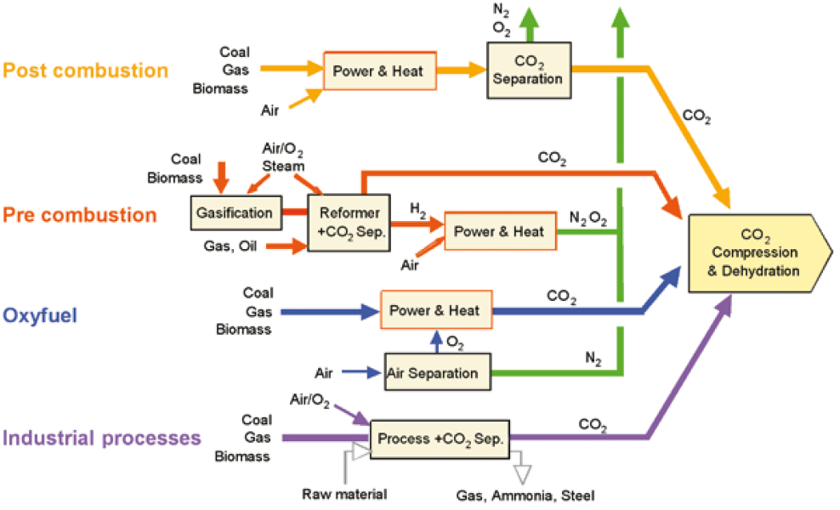
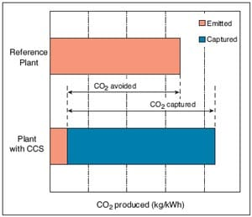
Carbon Capture and Sequestration (CCS)
Overview of CO₂ capture processes and systems
95% of CO2 emmissions
CO₂ capture and storage from power plants.
5%
The increased CO₂ production resulting from loss in overall efficiency of power plants due to the additional energy required for capture, transport and storage, and any leakage from transport result in a larger amount of “CO₂ produced per unit of product” (lower bar) relative to the reference plant (upper bar) without capture.
Source: IPCC Carbon Dioxide Capture and Storage: Technical Summary (2005) Ch8. Costs and economic potential, p. 41
Source: IPCC,Carbon Dioxide Capture and Storage: Technical Summary (2005) Ch3. Capture of CO2, p. 25

Slide 11
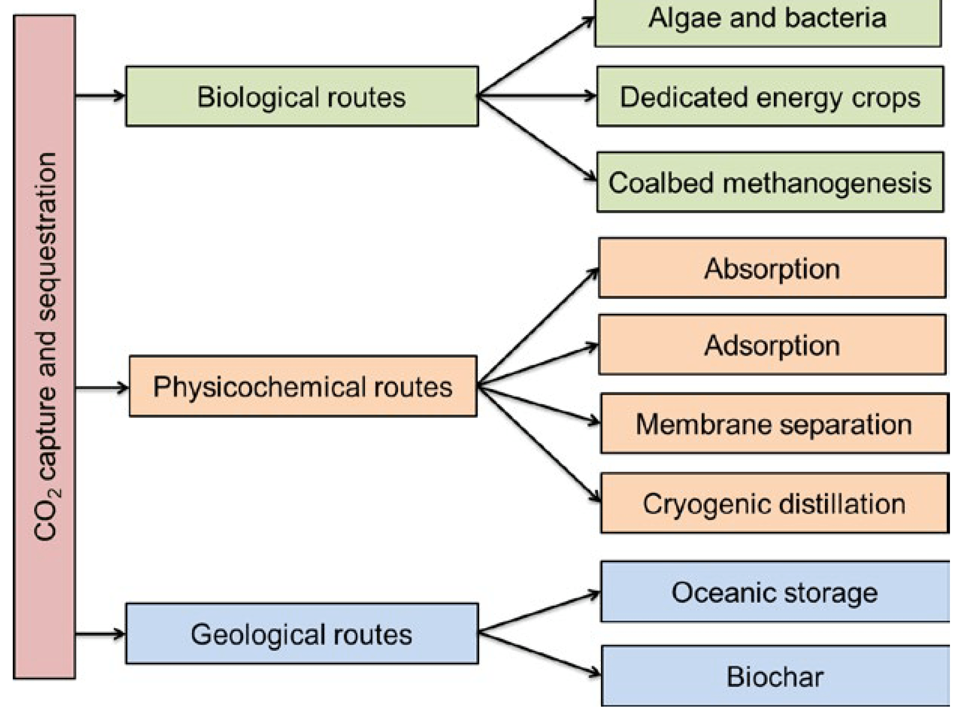
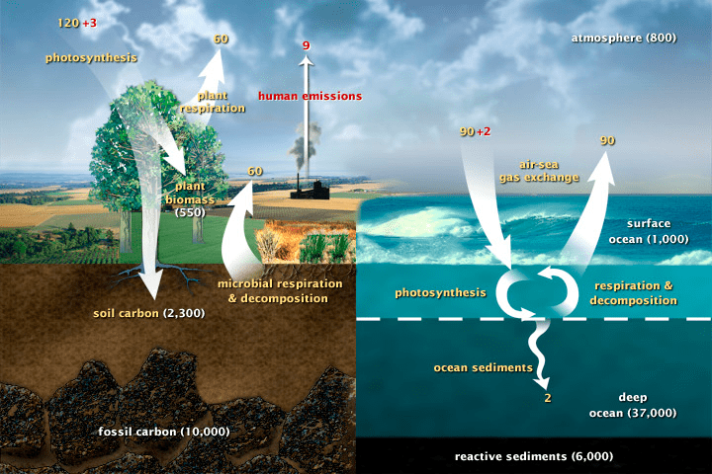
Carbon Capture and Sequestration (CCS)
Carbon Cycle
(natural fluxes & human contributions)
......
This diagram of the fast carbon cycle shows the movement of carbon between land, atmosphere, and oceans. Yellow numbers are natural fluxes, and red are human contributions in gigatons of carbon (GtCO₂) per year. White numbers indicate stored carbon.
Routes of carbon capture and sequestration.
http://www.ipcc.ch/report/srccs/
Nanda, S., Reddy, S. N., Mitra, S. K., & Kozinski, J. A. (2016). The progressive routes for carbon capture and sequestration. Energy Science and Engineering, 4(2), 99–122. https://doi.org/10.1002/ese3.117
Source: U.S. DOE, Biological and Environmental Research Information System.
http://genomicscience.energy.gov/

Slide 12
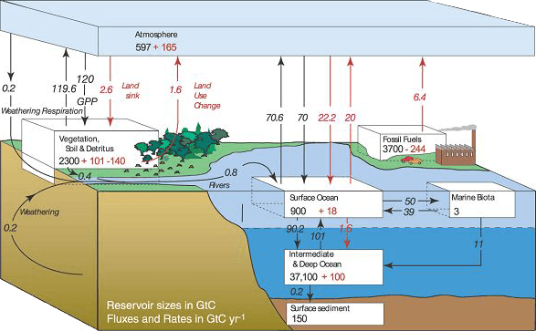
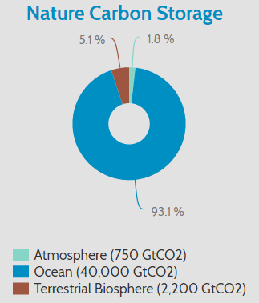
Why Ocean ？
Global Carbon Cycle shows the movement of carbon between land, atmosphere, and oceans.
Global Carbon Cycle: Distribution of Atmosphere、Ocean and Terrestrial Biosphere
https://timgsa.baidu.com/timg?image&quality=80&size=b9999_10000&sec=1515998452582&di=d3ed1ba7908534b365d1e8c8c252ab85&imgtype=jpg&src=http%3A%2F%2Fimg0.imgtn.bdimg.com%2Fit%2Fu%3D4052906540%2C3959475615%26fm%3D214%26gp%3D0.jpg

Slide 13
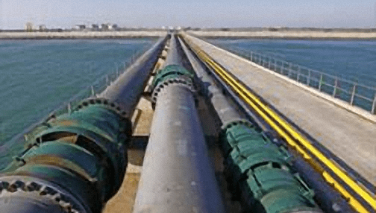
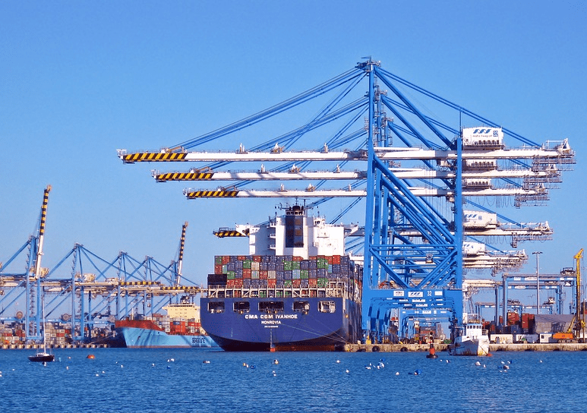

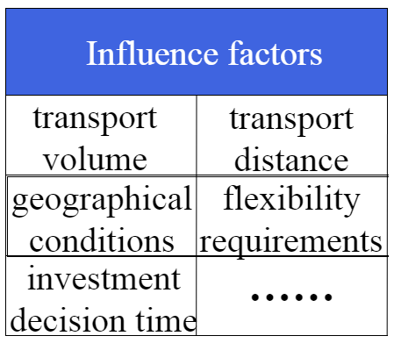
Transportations
• Transporting CO₂ from the capture site to the storage site is necessary for CCS projects.
• It is expected that we can sequester a large volumn of CO₂ in the deep ocean, thus pipelines and ships are feasible in this case, which are two of the most mature transportation systems for CO₂ at present. There also has some possibilities that transportation systems has been improved greatly in the future.
Pipeline
Pipelines:
• Large volumn, low costs.
• Over 3,100 km of CO₂ pipelines worldwide.
• Capacity: about 44.7 million tonnes per year of CO_{2.}
• Engineering Standardization: CFR part 195 (USA)、CSA Z662(Canada)、DNV-RP-J202(EU)、 DNV RP-J202(NOR)
Ships:
• More flexible.
•Transport of CO₂ by ship in smaller volume (i.e. <1500 m³) is currently practiced in the industry.
•Shipping at lower pressure is preferred.
Ships
http://www.eog-asia.com/dnv-gl-conducts-largest-controlled-release-of-co2-underwater-pipeline/

Slide 14
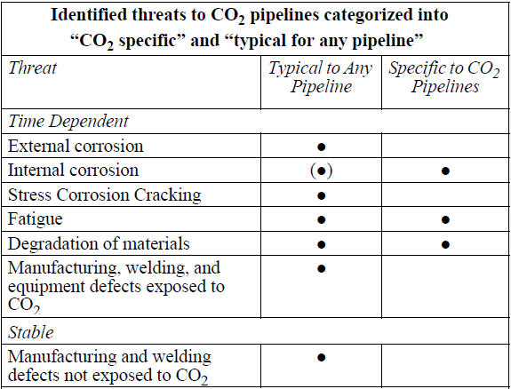
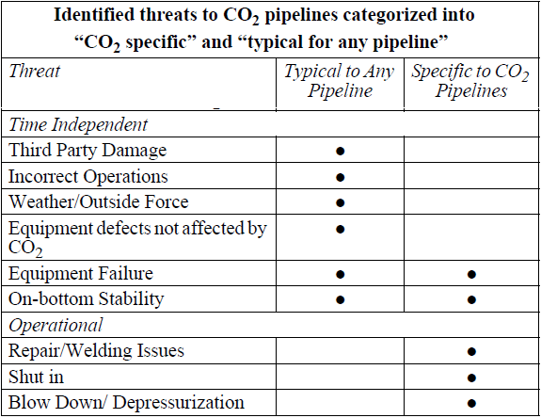
Threats while Transporting CO₂
Some of the threats listed in Table are shown as both "Typical to Any Pipeline" and "Specific to CO₂ Pipelines", as there are additional or different issues related to these threats for a CO₂ pipeline. The threats are divided into time-dependent, time-independent and operational.
Sources: Veritas, D. N. (2010). Design and Operation of Co 2 Pipelines. Practice, (April).

Slide 15
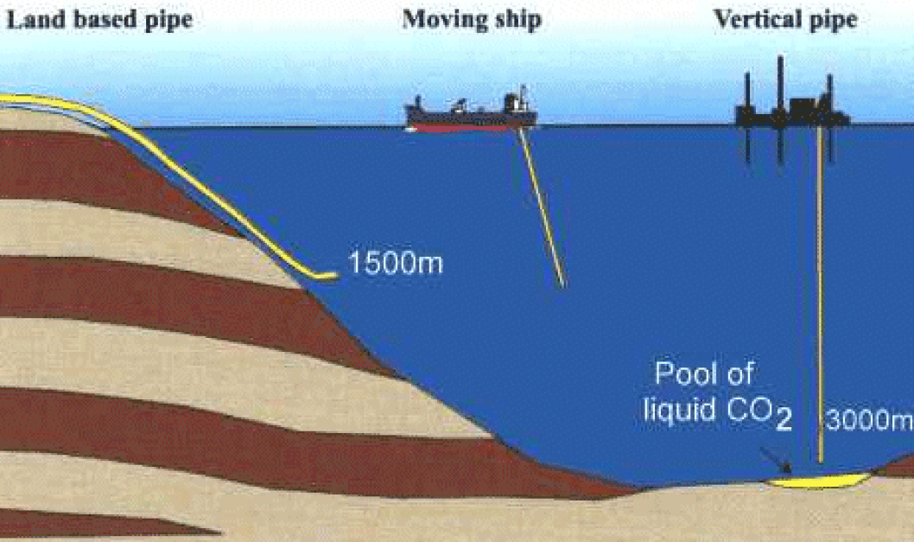
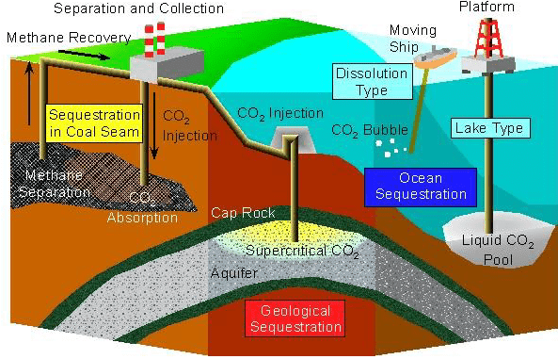
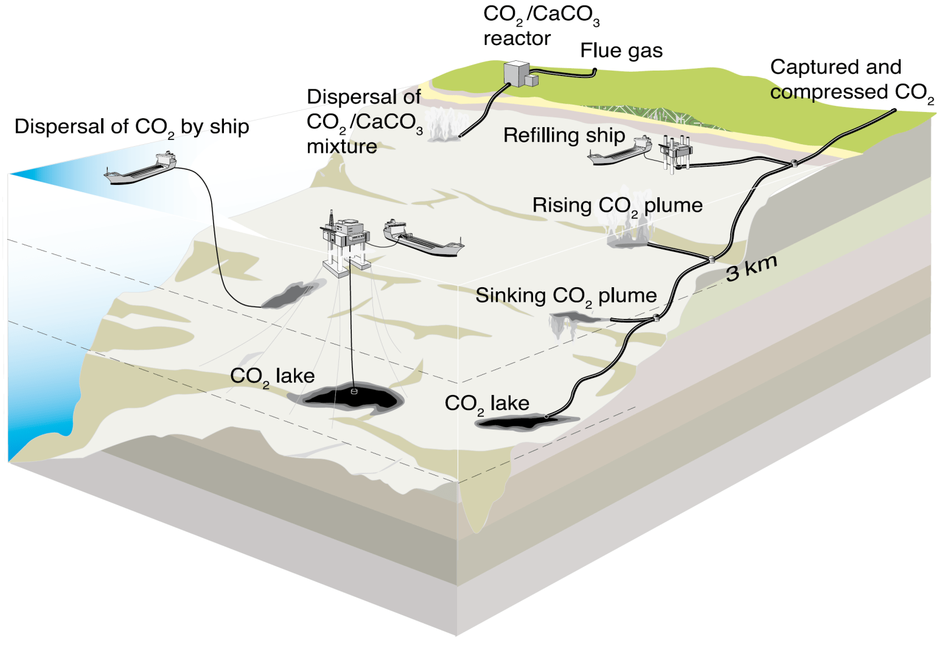
CO₂ Sequestration
Overview of CO₂ sequestration technologis
Illustration of Direct Injection Methods.
Why below 3000m？
Souce: Ke. Liu, Fundamentals of Energy Engineering
Artwork courtesy: Sean Goddard, University of Exeter.

Slide 16
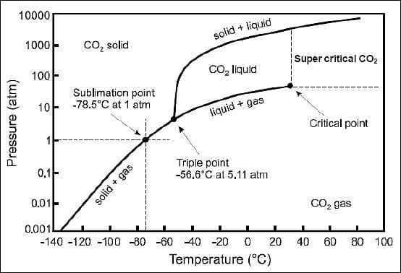
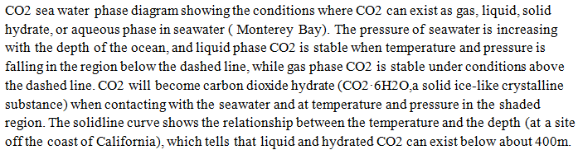
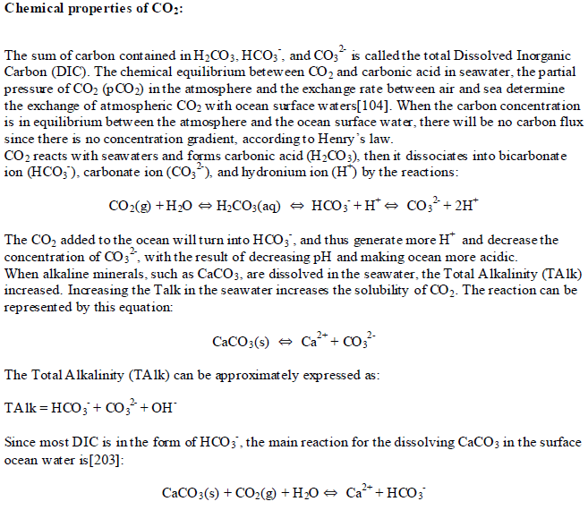
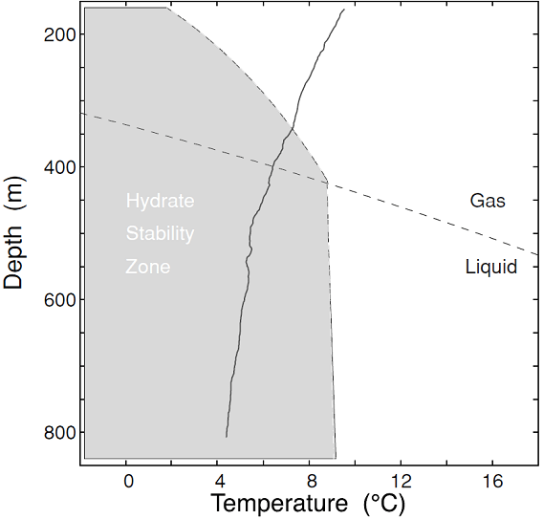
CO₂ Sequestration
The phase of CO₂ ?
How to sequester CO₂?
Overview of CO₂ sequestration technologis
Illustration of Direct Injection Methods.
What is the depth ?
<~500 m: gas
500~2,500 m: density < sea water
>3,000 m: : density > sea water
Souce: Ke. Liu, Fundamentals of Energy Engineering
Artwork courtesy: Sean Goddard, University of Exeter.

Slide 17
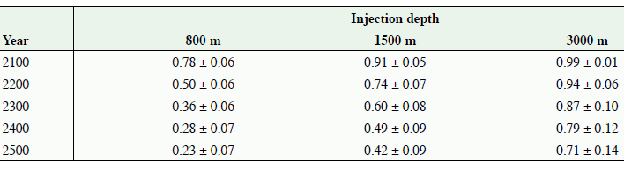
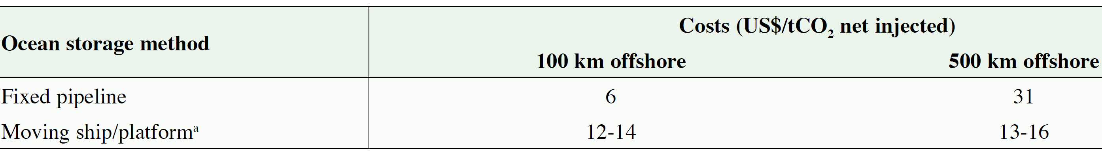
How much CO₂ retained ?
CO₂ Sequestration
Fraction of CO₂ retained for ocean storage as simulated by seven ocean models for 100 years of continuous injection at three different depths starting in the year 2000.
Costs for ocean storage at depths deeper than 3,000 m.
(The costs for the moving ship option are for injection depths of 2,000-2,500 m.)
Veritas, D. N. (2010). Design and Operation of Co 2 Pipelines. Practice, (April).

Slide 18
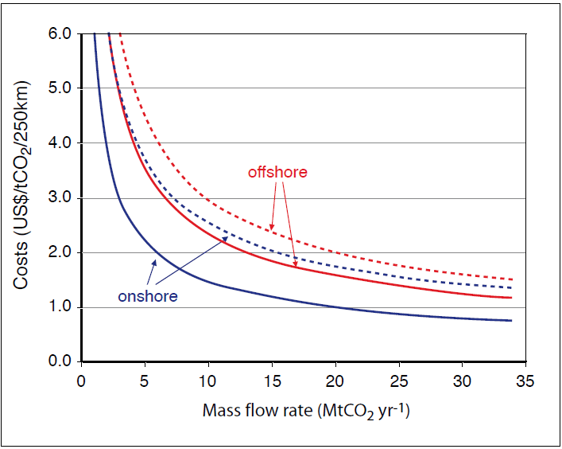
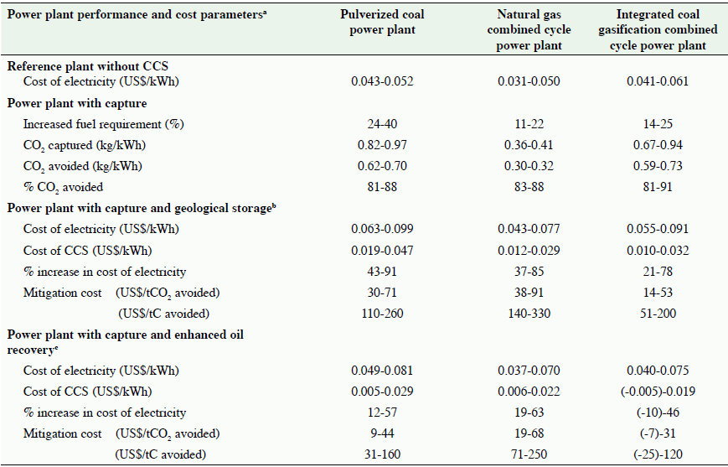
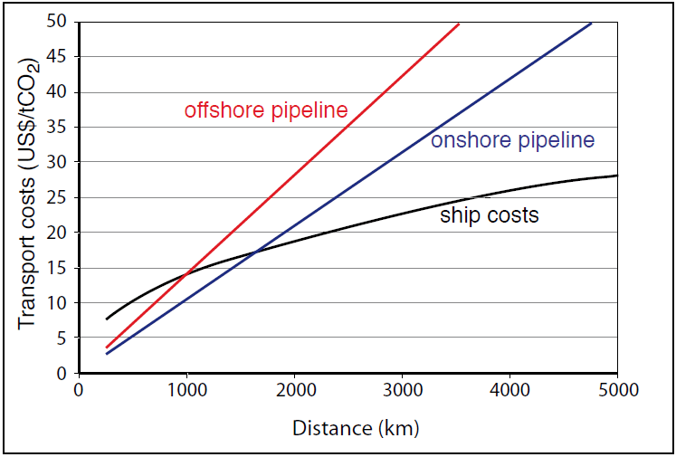
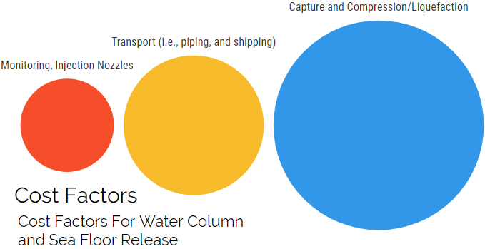
Costs Analysis
Range of total costs for CO₂ capture, transport and geological storage based on current technology for new power plants using bituminous coal or natural gas
Transport costs for onshore pipelines and offshore pipelines
Transport costs for onshore pipelines and offshore pipelines, in US$ per tCO₂ per 250 km as a function of the CO₂ mass flow rate. The graph shows high estimates (dotted lines) and low estimates (solid lines).
Costs, plotted as US$/tCO2 transported against distance, for onshore pipelines, offshore pipelines and ship transport
Costs, plotted as US$/tCO₂ transported against distance, for onshore pipelines, offshore pipelines and ship transport. Pipeline costs are given for a mass flow of 6 MtCO₂ yr-1. Ship costs include intermediate storage facilities, harbour fees, fuel costs, and loading and unloading activities. Costs include also additional costs for liquefaction compared to compression.
(a) All changes are relative to a similar (reference) plant without CCS. See Table TS.3 for details of assumptions underlying reported cost ranges.
(b)Capture costs based on ranges from Table TS.3; transport costs range from 0-5 US$/tCO2; geological storage cost ranges from 0.6-8.3 US$/tCO2.
(c)Same capture and transport costs as above; Net storage costs for EOR range from -10 to -16 US$/tCO2 (based on pre-2003 oil prices of 15-20 US$ per barrel).
Cost factors in comparison
Veritas, D. N. (2010). Design and Operation of Co 2 Pipelines. Practice, (April).

Slide 19
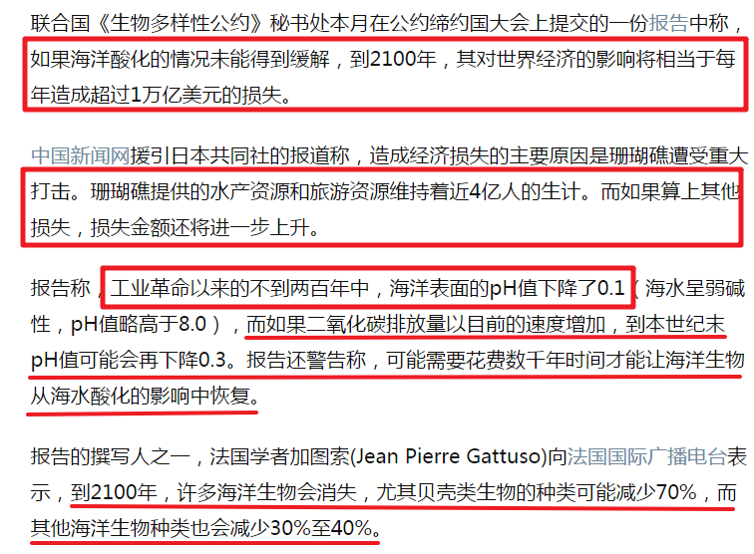
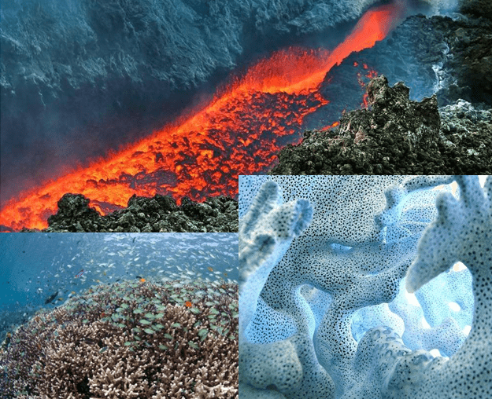
Risks, Impacts and Challenges
Major Concerns for OCCS
Common Risks: Acidification
……
Earthquakes
Geological Anomaly
CO₂ leakage
Acidification
Ecological Catastrophe
Economical Impact
……
http://www.jiemian.com/article/204283.html
How ph value would be influenced by the CO₂ leakage ?
Further study

Slide 20
Risks, Impacts and Challenges
Major Concerns for OCCS
Common Risks: Acidification
……
Earthquakes
Geological Anomaly
CO₂ leakage
Acidification
Ecological Catastrophe
Economical Impact
……
Ocean sequestration, in other words, would speed up the otherwise centuries- or millennialong process of establishing equilibrium between the atmosphere and the entire ocean. It would not decrease acidification of the entire ocean, but it might limit acidification in the surface waters that are of greatest economic interest to people. And giving people time to improve more efficiency technologies and strategies to reduce green house gas emissions. In a world of limited resources, it may represent the most efficient way to store a lot of carbon quickly.
How ph value would be influenced by the CO₂ leakage ?
Further study

Slide 21
Prospective
The clock is ticking on dealing with climate change
• There are no published papers specifically on site selection for intentional ocean storage of CO₂; hence, further study needs to be done in order to select sites for ocean storage.
• Monitoring and verification should be done in order to monitore the potential leakages from subsea geologic storage, or for verification that such leakage does not occur.
• Tmechanism behind oceanic carbon capture and sequestration and the consequences still need further studies.
• In view of public precaution toward the ocean, the strategy will require that all parties (private, public, non-governmental organizations) be included in ongoing research and debate.
P
R
O
S
P
E
C
T
I
V
E

Slide 22
Conclusion
The clock is ticking on dealing with climate change
C
O
N
C
L
U
S
I
O
N
Among all these considerations for OCCS are technical feasibility, environmental consequences, economical feasibility (costs,etc.), safety, and international issues (including cross border transport).
Ocean sequestration would speed up the centuries- or millennialong process of establishing equilibrium between the atmosphere and the entire ocean. It would not decrease acidification of the entire ocean, but it might limit acidification in the surface waters that are of greatest economic interest to people, gives people time to improve more efficiency technologies and strategies to reduce green house gas emissions.
In a world of limited resources, it may represent the most efficient way to store a lot of carbon quickly. So, OCCS might be one of the best emergency strategies in dealing with climate change and global warming when great climate catastrophe occurs.

Slide 23
Thanks for listening !
Q&A
Oceanic Carbon Capture and Sequestration (OCCS): One of The Most Feasible Emergency Strategies Dealing With Climate Change and Global Warming.

