Slide 1
기본 프로그래밍 Review02
자바에 삼 주만 빠져보자!
데이터융합SW과
김규석 교수
JAVA

Slide 2
R1
Drawing a line vertically or horizontally
User inputs 0s or 1s
The whole size is 4 x 3
Show “Pass” if 0s are connected vertically or horizontally
[Example]
0001
1101
1101
Pass
1010
1000
0110
Fail

Slide 3
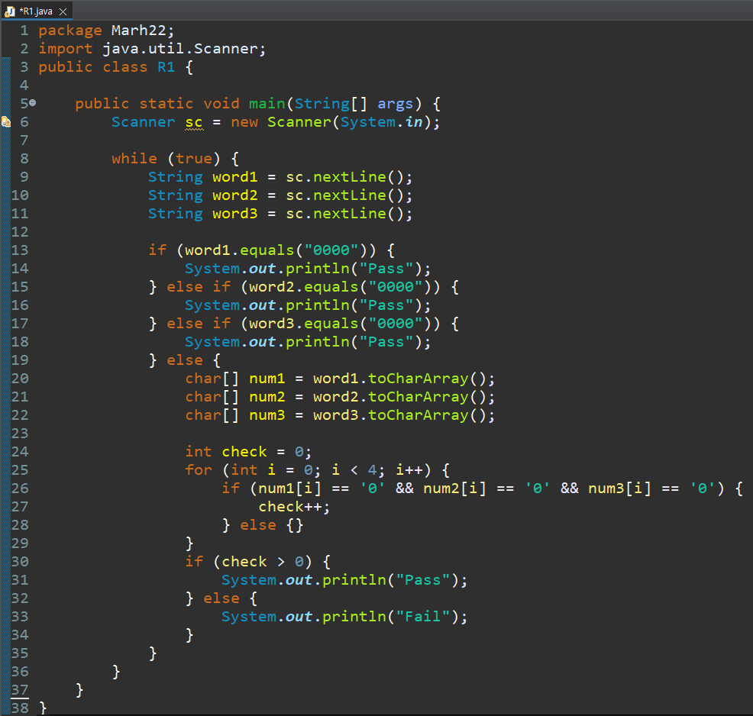
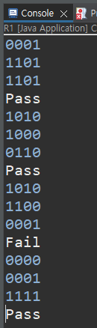
R1
Drawing a line vertically or horizontally
User inputs 0s or 1s
The whole size is 4 x 3
Show “Pass” if 0s are connected vertically or horizontally
[Example]
0001
1101
1101
Pass
1010
1000
0110
Fail

Slide 4
R2
Calculating ages in international age and in Korean age
User inputs the current date and birthday
Show the ages in international age and in Korean age
[Example]
Current Date :
20200902
Birthday :
20180904
3 years old in Korean age
2 years old in international age

Slide 5
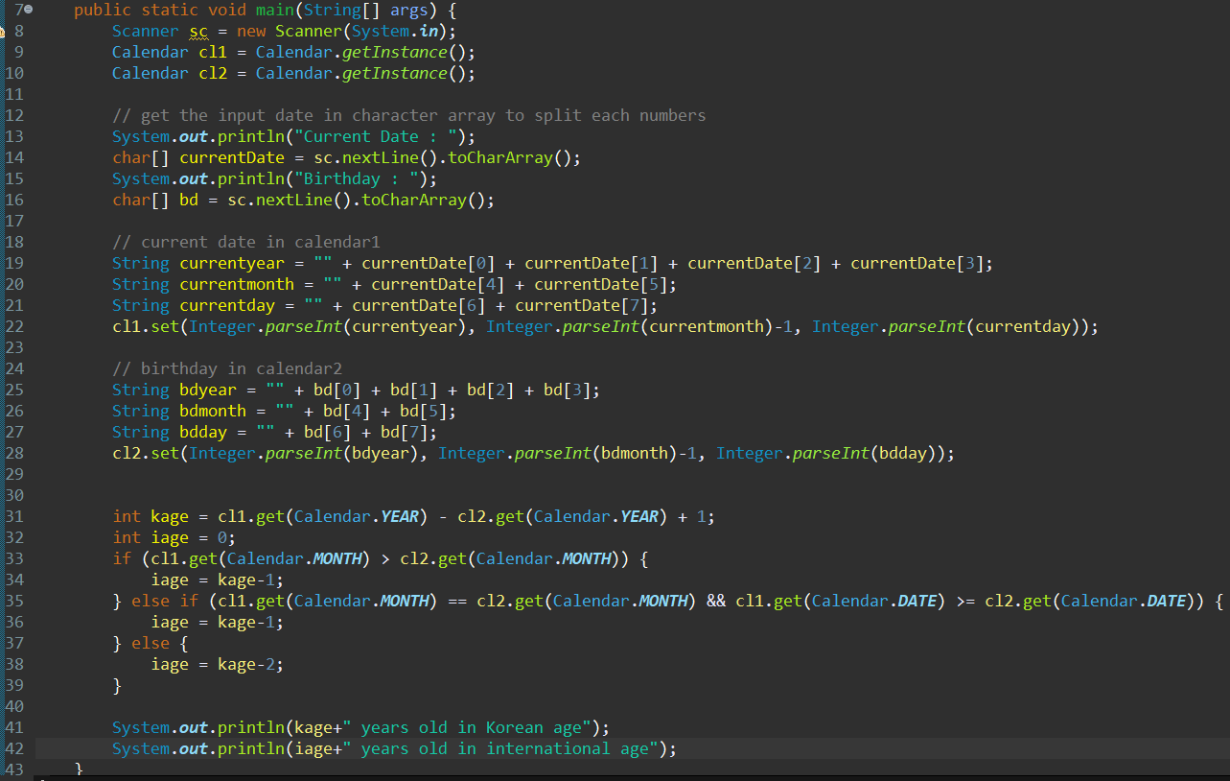
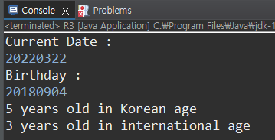
R2
Calculating ages in international age and in Korean age
User inputs the current date and birthday
Show the ages in international age and in Korean age
[Example]
Current Date :
20200902
Birthday :
20180904
3 years old in Korean age
2 years old in international age

