Slide 1
기본 프로그래밍 Review03
자바에 삼 주만 빠져보자!
데이터융합SW과
김규석 교수
JAVA

Slide 2
R1
Vedic Mathematics I
88 X 93 = 8184
100-88 100-93
12 + 7 = 19
12 X 7 = 84
First two digits : 100 – 19 = 81
Last two digits : 84
Result : 8184
Implement the function calculating this with the data type of integers
Show the calculating process

Slide 3
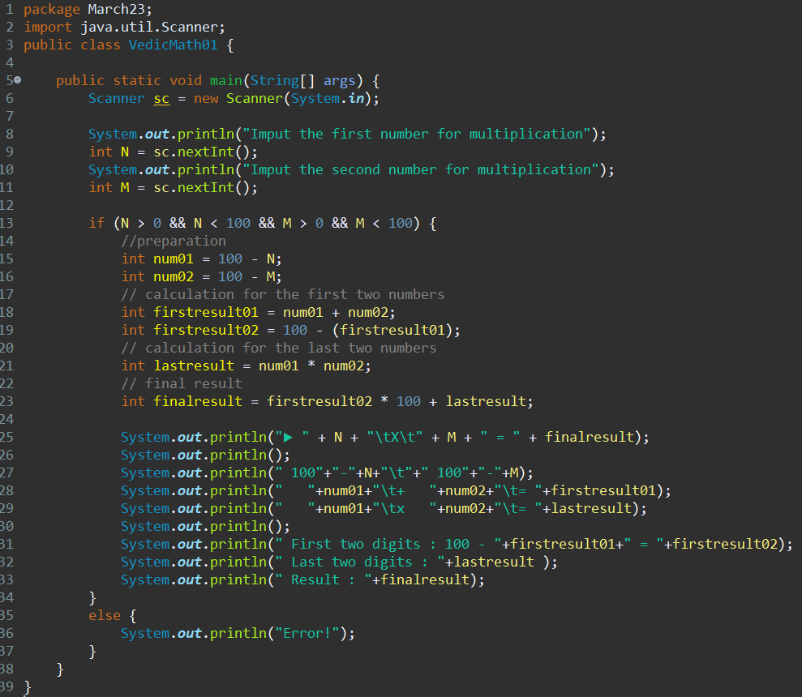
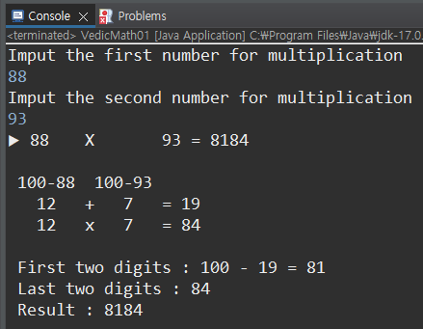
R1
Vedic Mathematics I

Slide 4
R2
Vedic Mathematics II
88 X 93 = 8184
100-88 100-93
12 + 7 = 19
12 X 7 = 84
First two digits : 100 – 19 = 81
Last two digits : 84
Result : 8184
Implement the function calculating this with the data type of strings
Show the calculating process

Slide 5
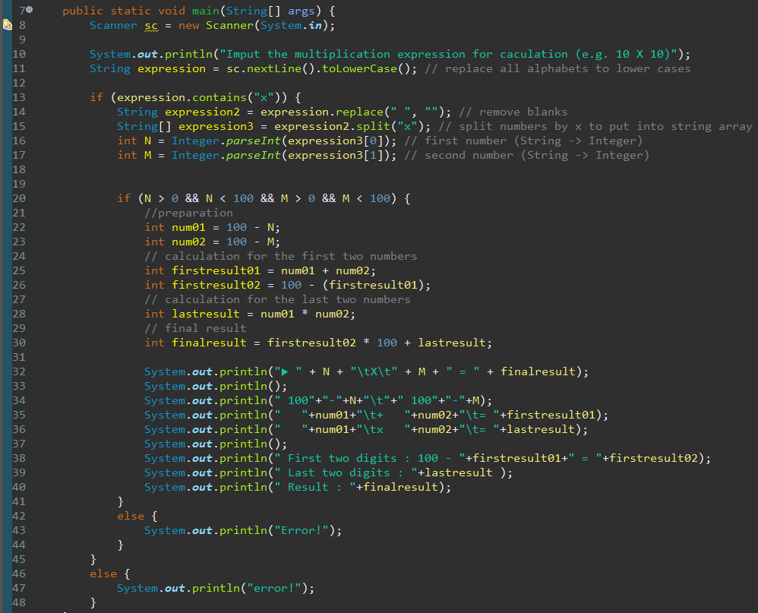
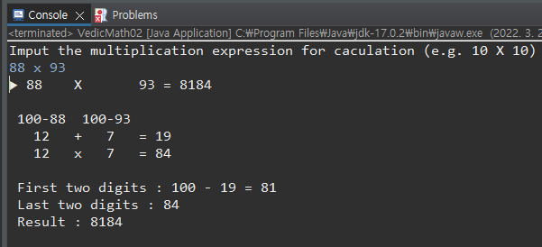
R2
Vedic Mathematics II

