Slide 1

An Ontology Matching System for Data Integration
Individual Dissertation Single Honours
(COMP3050 UNNC)
Jizhou Che (scyjc1 20032291)
Supervisor: Dr. Heshan Du

Slide 2
Table of Contents
Introduction
Related Work
Motivation and Objectives
Design
Implementation
Evaluation
Summary

Slide 3
Introduction
Data integration applications
The semantic heterogeneity problem [1]
Ontologies and ontology matching

Slide 4
Introduction
Biomedical records [2]
City infrastructure management [3]
Data integration applications
The semantic heterogeneity problem [1]
Ontologies and ontology matching

Slide 5
Introduction
Data integration applications
The semantic heterogeneity problem [1]
Ontologies and ontology matching

Slide 6
Introduction
Data integration applications
The semantic heterogeneity problem [1]
Ontologies and ontology matching

Slide 7
Related Work
Classification of methodologies
Existing ontology matching systems
OAEI campaigns and frameworks
Tools and applications

Slide 8
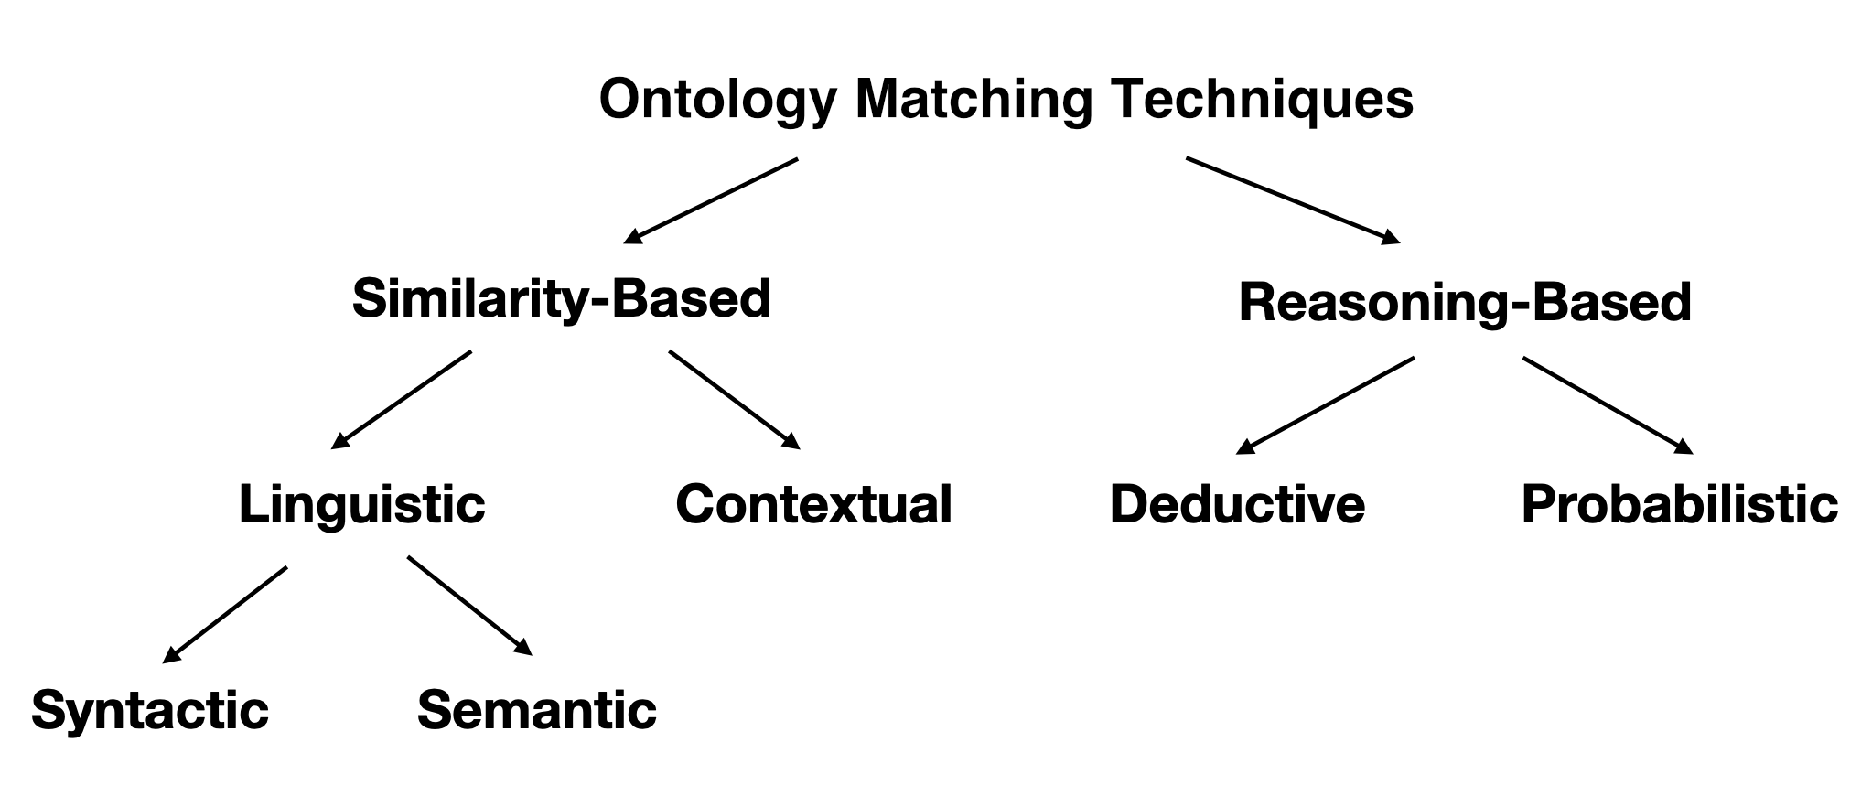
Related Work
Classification of methodologies
Existing ontology matching systems
OAEI campaigns and frameworks
Tools and applications

Slide 9
Related Work
Lily [4]
PARIS [5]
LogMap [6]
Classification of methodologies
Existing ontology matching systems
OAEI campaigns and frameworks
Tools and applications

Slide 10
Related Work
Classification of methodologies
Existing ontology matching systems
OAEI campaigns and frameworks
Tools and applications

Slide 11
Related Work
Classification of methodologies
Existing ontology matching systems
OAEI campaigns and frameworks
Tools and applications

Slide 12
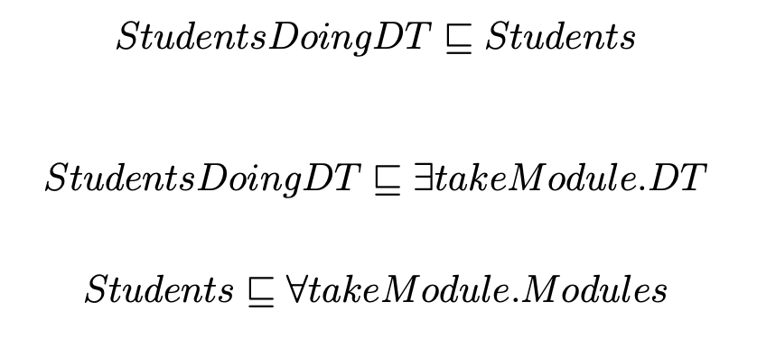
Motivation and Objectives
Description logic and reasoners
Utilisation of available information
Deduction of complex axioms
Matching classes, instances and properties

Slide 13
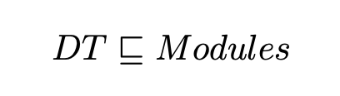
Motivation and Objectives
Description logic and reasoners
Utilisation of available information
Deduction of complex axioms
Matching classes, instances and properties

Slide 14
Design
Algorithm design
System design
LogMap: adaptation and differences

Slide 15
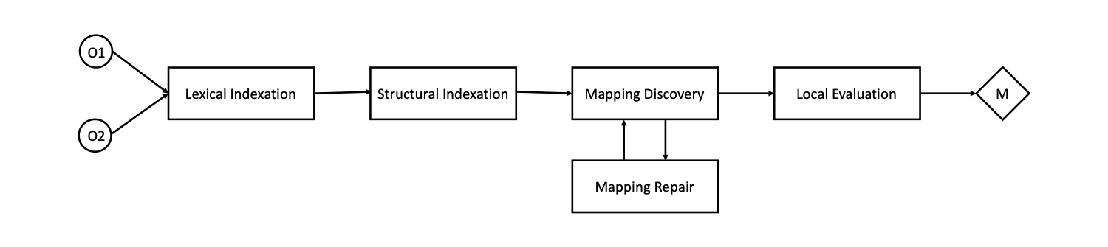
Design

Slide 16
Implementation
Project module structure
Use of APIs and code
Lexical and structural indexation
Mapping discovery
Reasoning
Input and output

Slide 17
Evaluation
OAEI tracks and frameworks
Anatomy dataset
FMA_NCI dataset
Local testing with general ontologies

Slide 18
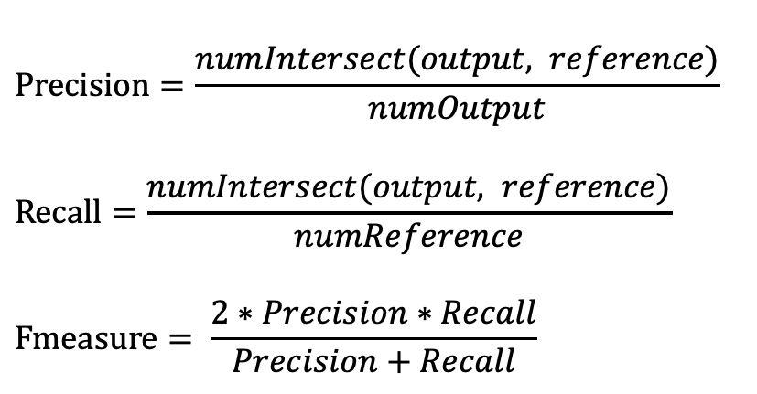
Evaluation
$$Precision=\frac{numIntersect(output, reference)}{numOutput}$$
$$Recall=\frac{numIntersect(output, reference)}{numReference}$$
$$Fmeasure= \frac{2∗Precision∗Recall}{Precision+Recall}$$

Slide 19
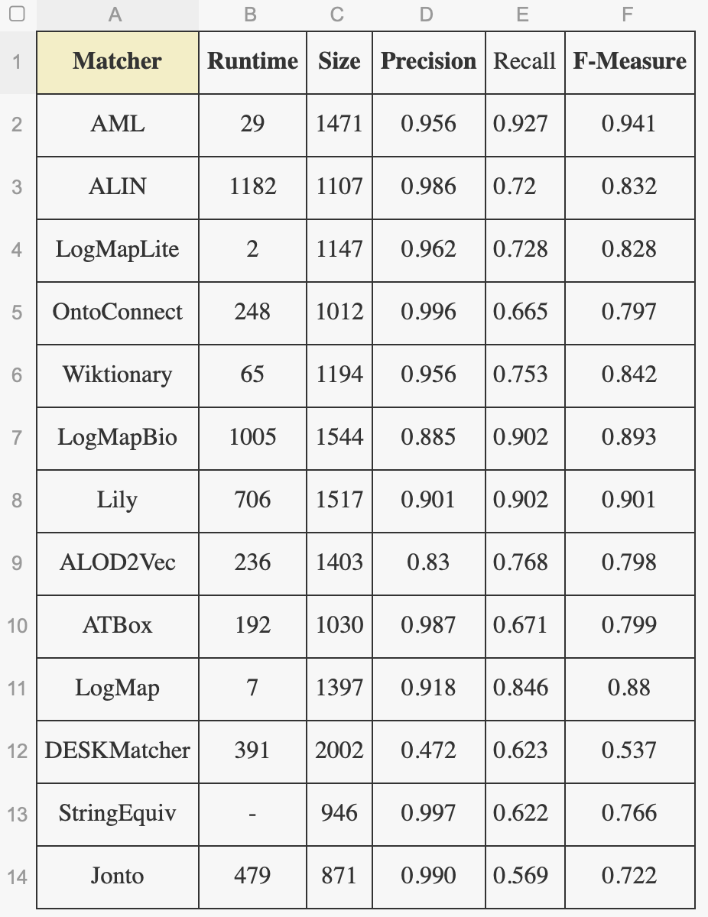
Evaluation
Anatomy Track Evaluation Result 2020
(http://oaei.ontologymatching.org/2020/results/anatomy/index.html)

Slide 20
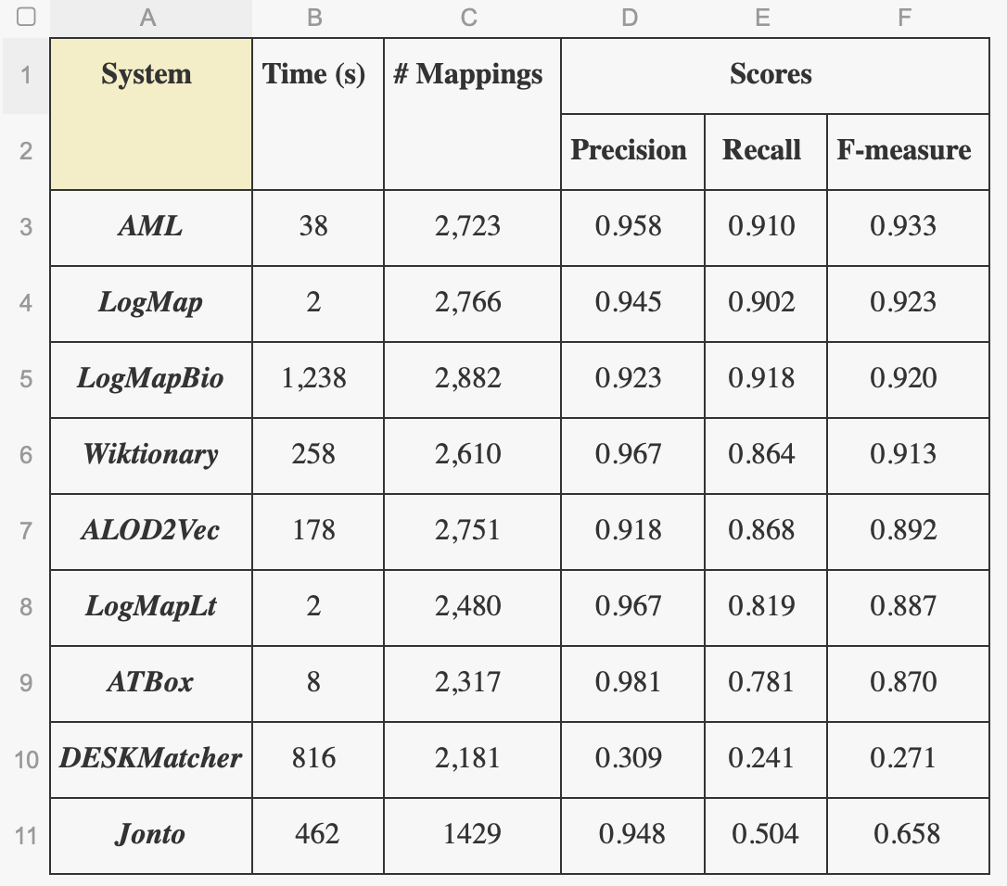
Evaluation
Largebio Track Evaluation Result 2020
(http://www.cs.ox.ac.uk/isg/projects/SEALS/oaei/2020/results/)

Slide 21
Summary
Time management
Resource management
Challenges
Outcome
Future work

Slide 22
References
[1] A. Nafissi, B. Bruns, and F. Fiorani, “Ontologies for resolving semantic heterogeneity in information integration among plant phenomics databases,” in Informatik in der Land-, Forst- und Ern ̈ahrungswirtschaft, Fokus: Digitale Marktpl ̈atze und Plattformen, Referate der 38. GIL-Jahrestagung, 26.-27. Februar 2018, Kiel, Germany, ser. LNI, A. Ruckelshausen, A. Meyer-Aurich, K. Borchard, C. Hofacker, J. Loy, R. Schwerdtfeger, H. Sundermeier, H. Floto, and B. Theuvsen, Eds., vol. P-278. GI, 2018, pp. 167–170. [Online]. Available: https://dl.gi.de/20.500.12116/23148
[2] X. Wang, L. Liu, J. Fackenthal, S. Cummings, O. I. Olopade, K. Hope, J. C. Silverstein, and O. I. Olopade, “Translational integrity and continuity: Personalized biomedical data integration,” J. Biomed. Informatics, vol. 42, no. 1, pp. 100–112, 2009. [Online]. Available: https://doi.org/10.1016/j.jbi.2008.08.002

Slide 23
References
[3] L. Wei, H. Du, Q. Mahesar, B. Clarke, D. R. Magee, V. Dimitrova, D. Gunn, D. Entwisle, H. Reeves, and A. G. Cohn, “ATU-DSS: knowledge-driven data integration and reasoning for sustainable subsurface inter-asset management,” in The Semantic Web: ESWC 2018 Satellite Events - ESWC 2018 Satellite Events, Heraklion, Crete, Greece, June 3-7, 2018, Revised Selected Papers, ser. Lecture Notes in Computer Science, A. Gangemi, A. L. Gentile, A. G. Nuzzolese, S. Rudolph, M. Maleshkova, H. Paulheim, J. Z. Pan, and M. Alam, Eds., vol. 11155. Springer, 2018, pp. 8–13. [Online]. Available: https://doi.org/10.1007/978-3-319-98192-5 2
[4] J. Euzenat and P. Shvaiko, Ontology matching, 2nd ed. Heidelberg (DE):
Springer-Verlag, 2013. [Online]. Available: http://book.ontologymatching.org
[5] F. M. Suchanek, S. Abiteboul, and P. Senellart, “Ontology alignment at the instance and schema level,” CoRR, vol. abs/1105.5516, 2011. [Online]. Available: http://arxiv.org/abs/1105.5516

Slide 24
References
[6] E. Jim ́enez-Ruiz and B. C. Grau, “Logmap: Logic-based and scalable ontology matching,” in The Semantic Web - ISWC 2011 - 10th International Semantic Web Conference, Bonn, Germany, October 23-27, 2011, Proceedings, Part I, ser. Lecture Notes in Computer Science, L. Aroyo, C. Welty, H. Alani, J. Taylor, A. Bernstein, L. Kagal, N. F. Noy, and E. Blomqvist, Eds., vol. 7031. Springer, 2011, pp. 273–288. [Online]. Available: https://doi.org/10.1007/978-3-642-25073-6 18

