Slide 1
Independency on choosing subject
for
Bangladeshi student

Slide 2



Introduction
“Education is backbone of a nation” since our childhood we are memorizing this universal statement. This statement is capable enough to be self-defined. However, in our cultural is has been widely practiced that our guardian selects everything for us sometimes even without knowing our desires, even though when it comes to choosing subject or field of studies the practice is remain same in most cases. That is the first steps makes a breakdown on the studies of a major group of students.

Slide 3


Research Objectives
My research objectives were to knew what percentage of people had the privilege to choose their subject for themselves. Moreover, how much they are enjoying their studies.

Slide 4
Description
To become an educated we must have to choose the field of studies according to our interest and available circumstances.
We couldn’t get the privilege of choosing our field of studies, and sometimes we can cooperate with the unwanted subject and sometimes we cannot.
Even from the institution point of view students aren’t happy with the curricular activities of their educational institute.
In the rural areas there aren’t equally available subjects of studies in educational institution which results dissatisfaction among students with their studies
j

Slide 5
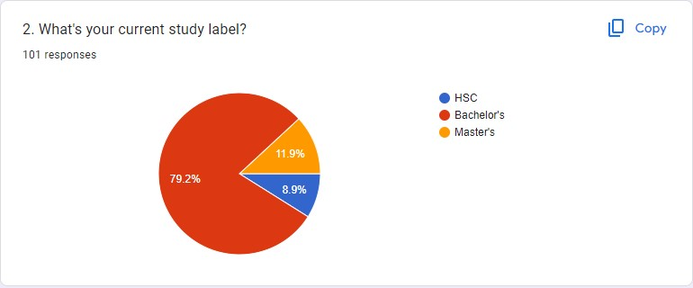
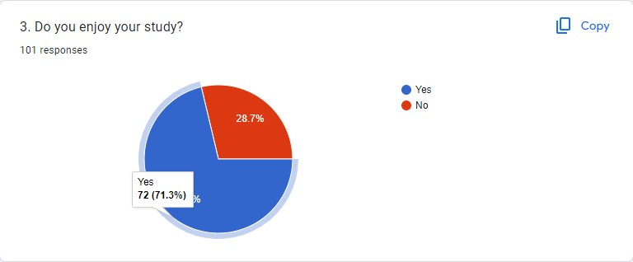
Data Presentations
01 - BRANDING
02 - WEBSITE

Slide 6
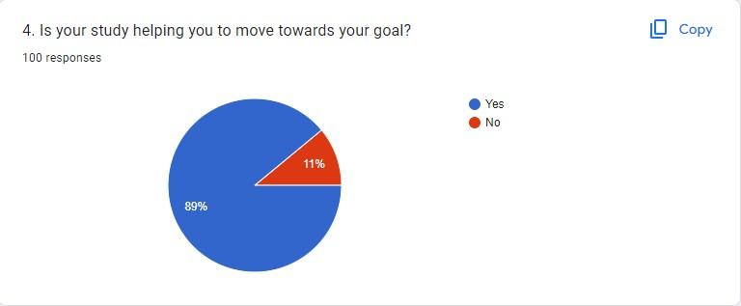
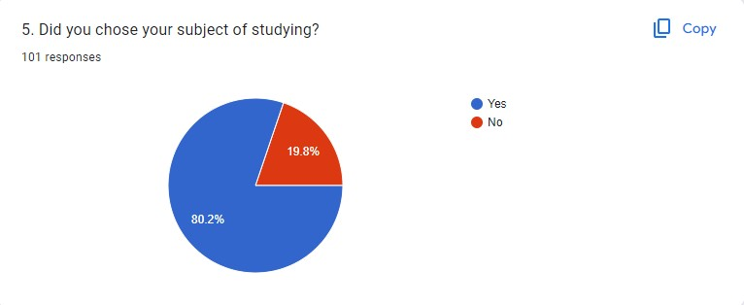
Data Presentations
01 - BRANDING
02 - WEBSITE

Slide 7
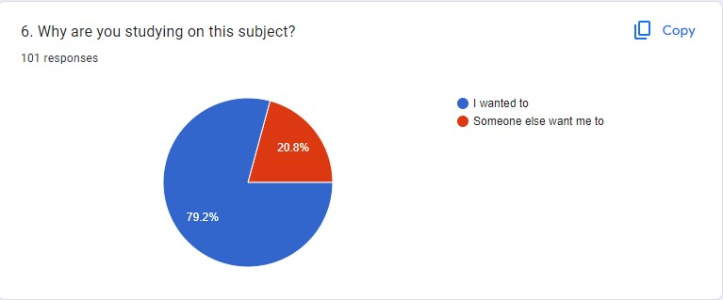
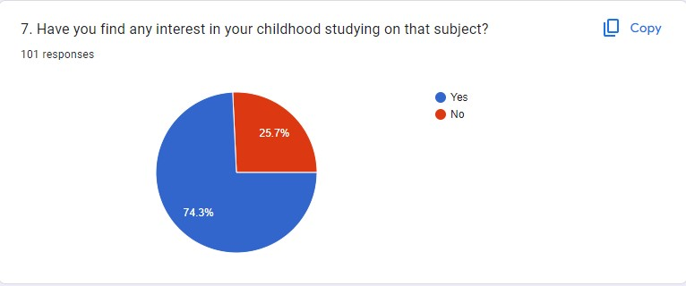
Data Presentations
01 - BRANDING
02 - WEBSITE

Slide 8
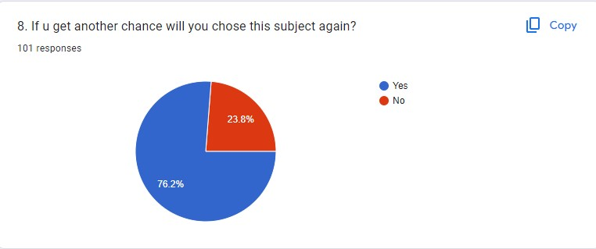
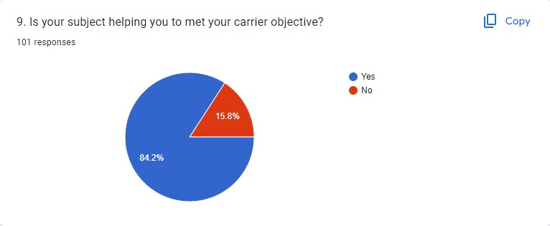
Data Presentations
01 - BRANDING
02 - WEBSITE

Slide 9

Data Presentations
01 - BRANDING
02 - WEBSITE

Slide 10
Learning Outcomes
The best part is I’m very glad to know that people becoming more attracted to their studies day by day if I compare my survey outcome with the previous analyzed data.
Overall, throughout my survey is gives me a good learning and teach me to gain someone’s response in a good way and use it to my project work. And I can say based on my survey that, education system of Bangladesh has gone so far on the competition of better education system throughout the world.
According to UNESCO, nowadays we are witnessing of the concept brain drain in our country. Some 70,000-90,000 Bangladeshi students travel overseas for higher studies every year,
Ultimately that’s a huge loss for the country, and the education should have some revolution to mitigate this problem and expect students from overseas countries to come in Bangladesh for their higher education.

Slide 11
THANK YOU

