Slide 1
NUTRITION AND SPORTS PERFORMANCE
CHAPTER FIVE

Slide 2
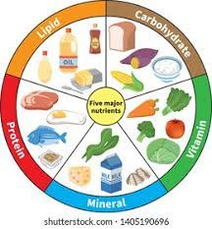
Objectives;
Describe a balanced diet.
Discuss Various macro and micro nutrients required by the human body during rest and exercise.
Highlight their functions.
Describe the energy value of the nutrients.
Explain how we can measure energy in different nutrients.

Slide 3
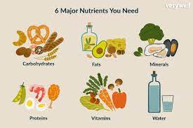
Balanced diet
When your diet is balanced, it means that your diet supplies you with all the required essential nutrients required by your body for maintenance, repair and growth.
Apart from the nutrients your body gets from this balanced diet, your body also receives adequate substrates that enable the body to produce adequate energy for maintenance of homeostasis, work and rest.
Energy intake must be balanced so that serious health problems do not arise.

Slide 4
NUTRIENTS
Carbohydrates (CHO),
Fats,
Proteins,
Vitamins,
Minerals and Water are the essential nutrients the human body requires.
The body’s fuels for work and normal functions come mostly from fuel nutrients (CHO, fats and Proteins) while the other nutrients are generally regulatory nutrients.
They have no caloric value but are necessary for the body to function normally and maintain good health.

Slide 5
Carbohydrates, fats and proteins are also referred to as Macronutrients, because the body requires them in large amounts daily.
Vitamins and Minerals also called micronutrients are usually required in lesser amounts by the body.
Food is classified according to its nutrient density because of the amount of nutrients and calories they contain.
A high nutrient density food is one that is packaged with nutrients containing a few or moderate number of calories.
On the other hand, food containing too many calories with few nutrients of low nutrient density is commonly called low nutrient density food or junk food.

Slide 6
A calorie is the unit of measure that indicates the consumed energy value of food or the energy usage through physical activity. A good example here is an apple could provide 80 calories while a kilometer walk requires 100 Calories.
There are two types of calories:
a kilo calorie (kcal/Cal) (large calorie) which is the amount of energy required to raise 1kg of water by 1⁰C.
a small calorie (cal) which is the amount of energy required to raise one gram of water by 1⁰C.

Slide 7
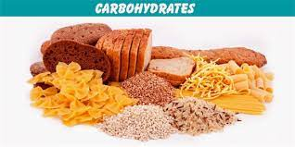
Role of Carbohydrates(CHO) in the body
They serve as energy fuel during high intensity exercise
Adequate CHO intake helps to preserve tissue protein.
Brain’s primary fuel

Slide 8
Depletion of glycogen reserves as a result of starvation, reduced CHO intake and strenuous exercise affect the metabolic processes mixture.
There is a significant important role that proteins play in the maintenance of tissues for repair, growth and energy production to a lesser extent. While stimulating fat catabolism, glycogen depletion triggers glucose synthesis from protein.
This strains the body’s proteins levels particularly muscle protein. This may significantly reduce lean tissue mass adding too much solute load on the kidneys through the excretion of nitrogenous byproducts of protein breakdown.
Carbohydrates serve as primers for fat catabolism. When CHO is insufficiently broken down-through limitations in glucose transport into the cell like in diabetes or in the depletion of glycogen through inadequate diet or prolonged exercise this results in fat mobilization exceeding fat oxidation. This leads to incomplete fat catabolism and accumulation of ketone bodies results.
Excessive ketone formation increases body fluid acidity.

Slide 9
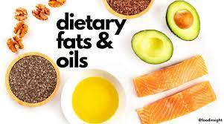
FATS
The human body also uses fats as a source of energy.
Fat is the most concentrated energy source.
Each gram of fat supplies 9 calories of energy to the body in contrast to the 4 calories from carbohydrates.

Slide 10
ROLE OF FATS
Fat’s roles are:
Part of the cell structure.
They are used as stored energy.
An insulator to preserve body heat.
They absorb shock/ protect body organs.
Supply essential fatty acids.
Carry the fat soluble vitamins A, D, E, and K.

Slide 11
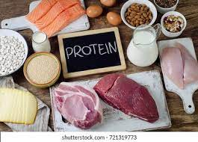
PROTEINS
An adult’s body contains 10 to 12kg protein with the largest quantity (6 – 8 kg) located within the skeletal muscles.
Protein contains oxygen, hydrogen and carbon atoms and about 16% nitrogen, sulphur, phosphorus, cobalt and iron.
Amino acids are the basic building blocks for protein.

Slide 12
Functions of Proteins
Amino acids provide the major building blocks for tissue synthesis including formation of plasma membranes and internal cellular materials.
Protein acts a source of energy if consumed in larger amounts than that needed for body tissue maintenance and other functions. This can also happen during prolonged exercise (beyond 2 hours) or during starvation.
Protein is involved in formation of hormones such as insulin.
Protein makes up enzymes which are the organic catalysts that speed up the rate of chemical reactions in the body.
Protein participates in the transportation of certain molecules e.g. hemoglobin is a protein that transports oxygen. It is also used to store certain molecules e.g. Ferritin is a protein that combines with iron for storage in the liver.
Proteins form antibodies that help prevent infection, illness and diseases by destroying antigens such as bacteria and viruses.
Building block of bones

Slide 13

Vitamins and minerals
Vitamins and minerals are micronutrients required by the body to carry out a range of normal functions. However, these micronutrients are not produced in our bodies and must be derived from the food we eat.
Vitamins are organic substances that are generally classified as either fat soluble or water soluble.
Minerals are inorganic elements present in soil and water, which are absorbed by plants or consumed by animals (calcium, sodium, and potassium, trace minerals (e.g. copper, iodine, and zinc) needed in very small amounts.

Slide 14
Role of vitamins and minerals
Boost the immune system
Support normal growth and development, and
Help cells and organs do their jobs.
For example, you've probably heard that carrots are good for your eyes. It's true! Carrots are full of substances called carotenoids that your body converts into vitamin A, which helps prevent eye problems.Vitamin K helps blood to clot, so cuts and scrapes stop bleeding quickly. You'll find vitamin K in green leafy vegetables, broccoli, and soybeans. And to have strong bones, you need to eat foods such as milk, yogurt, and green leafy vegetables, which are rich in the mineral calcium.

Slide 15
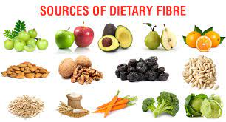
DIETARY FIBRE
Dietary fiber, also known as roughage or bulk, includes the parts of plant foods your body can't digest or absorb. Unlike other food components, such as fats, proteins or carbohydrates — which your body breaks down and absorbs — fiber isn't digested by your body. Instead, it passes relatively intact through your stomach, small intestine and colon and out of your body.
Fiber is commonly classified as soluble, which dissolves in water, or insoluble, which doesn't dissolve.
Soluble fiber. This type of fiber dissolves in water to form a gel-like material. It can help lower blood cholesterol and glucose levels. Soluble fiber is found in oats, peas, beans, apples, citrus fruits, carrots, barley and psyllium.
Insoluble fiber. This type of fiber promotes the movement of material through your digestive system and increases stool bulk, so it can be of benefit to those who struggle with constipation or irregular stools. Whole-wheat flour, wheat bran, nuts, beans and vegetables, such as cauliflower, green beans and potatoes, are good sources of insoluble fiber.

Slide 16
ROLE OF FIBRE
Normalizes bowel movements. Dietary fiber increases the weight and size of your stool and softens it. A bulky stool is easier to pass, decreasing your chance of constipation. If you have loose, watery stools, fiber may help to solidify the stool because it absorbs water and adds bulk to stool.
Helps maintain bowel health. A high-fiber diet may lower your risk of developing hemorrhoids and small pouches in your colon (diverticular disease). Studies have also found that a high-fiber diet likely lowers the risk of colorectal cancer. Some fiber is fermented in the colon. Researchers are looking at how this may play a role in preventing diseases of the colon.
Lowers cholesterol levels. Soluble fiber found in beans, oats, flaxseed and oat bran may help lower total blood cholesterol levels by lowering low-density lipoprotein, or "bad," cholesterol levels. Studies also have shown that high-fiber foods may have other heart-health benefits, such as reducing blood pressure and inflammation.
Helps control blood sugar levels. In people with diabetes, fiber — particularly soluble fiber — can slow the absorption of sugar and help improve blood sugar levels. A healthy diet that includes insoluble fiber may also reduce the risk of developing type 2 diabetes.
Aids in achieving healthy weight. High-fiber foods tend to be more filling than low-fiber foods, so you're likely to eat less and stay satisfied longer. And high-fiber foods tend to take longer to eat and to be less "energy dense," which means they have fewer calories for the same volume of food.
Helps you live longer. Studies suggest that increasing your dietary fiber intake — especially cereal fiber — is associated with a reduced risk of dying from cardiovascular disease and all cancers.

Slide 17
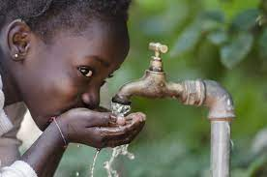
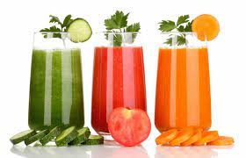
WATER AND HEALTHIER DRINKS
Getting enough water every day is important for your health.
Drinking water can prevent dehydration, a condition that can cause unclear thinking, result in mood change, cause your body to overheat, and lead to constipation and kidney stones.
Water has no calories, so it can also help with managing body weight and reducing calorie intake when substituted for drinks with calories, such as sweet tea or regular soda.

Slide 18
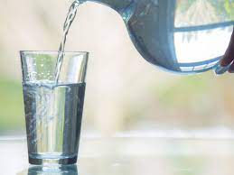
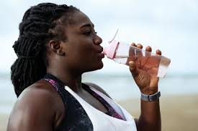
ROLE OF WATER
Water helps your body:
Keep a normal temperature.
Lubricate and cushion joints.
Protect your spinal cord and other sensitive tissues.
Get rid of wastes through urination, perspiration, and bowel movements.

Slide 19

Your body needs more water when you are:
In hot climates.
More physically active.
Running a fever.
Having diarrhea or vomiting.

Slide 20
Energy transfer at rest and exercise
The human body oxidizes CHO, fat and protein to produce energy.
Energy is needed for the following functions:
To maintain body functions such as breathing, heart beating, keeping the body warm etc.
For physical activity
For growth and repair which require new tissue to be made.

Slide 21
Basal metabolic rate
Also known as the resting metabolic rate, it is the minimum number of calories the body needs to use in order to fuel essential body processes and keep the organs and tissues in working order.
Basal energy expenditure is energy expended by a human to fulfill their essential bodily functions such as cell repair and maintenance and respiration at rest.
It is the energy which an individual would expend on a daily basis if they did no physical activity at all.

Slide 22
Factors influencing resting metabolic rate
Genes: some people have naturally faster metabolism than others
Age: as one ages, the caloric needs decrease. On average it drops 2% each decade
Muscle /fat ratio: muscle cells are about 7 times more metabolically demanding than fat cells.
So, if the muscle has a greater the proportion than fatty tissue, the rate of metabolism becomes faster.

Slide 23
Activity level: exercise burns calories. Even after the exercise stops, the effect continues. So, calories are used up faster for several hours afterwards.
Feeding: during the ingestion of food the metabolic rate increases and this process is known as thermal effect of food
Health and nutrition: the constant supply of nutrients to the body maintains the metabolism which is governed by thousands of separate chemical reactions. To perform this process efficiently, the body needs a constant supply of nutrients. Without these nutrients such as vitamins and minerals, metabolism can become inefficient.

Slide 24
Factors influencing energy expenditure
Essential functions
A person who is resting in bed and does not do any form of physical activity, (e.g. walking), will still require about 1200 calories in a 24 hour period to maintain their essential functions.
This energy expenditure is known as Basal Energy Expenditure (BEE) and is typically the largest single component of energy expenditure.

Slide 25
Physical activity and exercise
Apart from energy expended during rest for vital functions, an individual expends most of their energy performing a wide range of physical activities, and Total Energy Outflow ( basal energy outflow) plus all other energy outflow therefore depends largely on the amount of physical activity an individual performs.
In individuals who perform a lot of physical activity such as athletes, the amount of energy used during physical activity is often more than the amount used performing essential body functions. Even in individuals who do not perform vigorous physical tasks, physical activities which are for daily living consume energy.

Slide 26
Physical activity is the only factor influencing energy use which can be controlled by an individual as opposed to sex and age.
Individuals who wish to increase their energy use must increase either the amount or intensity of physical activities they perform.
The amount of energy used during physical activity depends mainly upon the type and intensity with which the exercise is performed.
More intense physical activity requires more energy. For instance, an individual who jogs for 30 minutes would use more energy than an individual who walks for 30 minutes. This is because jogging is more intense than walking.
Body weight is a factor that influences energy use. Heavier individuals use slightly more energy than lighter individuals undertaking the same tasks. For instance, an individual who weighs 57kg would use 135 calories in a brisk walk of 30 minutes. The same physical activity would result in energy use equal to 165 calories, in an individual who weighed 70kg.

Slide 27
After physical activity
The effects of physical activity on energy use are experienced long after the physical activity is completed.
This is because of the increased oxygen requirements after exercise.
The extent of the increase in use of energy after exercise is related to the intensity of the exercise. An individual expends an additional 15% of the energy expended during exercise, in the post activity period.
Since more vigorous activities use more energy while they are being performed, they also cause an individual to use more energy in the post exercise period. Depending on the exercise intensity, an individual may use additional energy for a period of 24 hours after exercise.

Slide 28
Growth, pregnancy and lactation
During growth tissues are synthesized by the body, hence the body requires additional energy compared to periods where there is no growth. Therefore, growing requires additional energy to maintain this growth.
Such tissue growth occurs during childhood, adolescence, gestation or lactation.
The growth of placental and foetal tissues also requires additional energy, and thus pregnant women have increased energy requirements.
This is particularly significant in the second and third trimesters of pregnancy, when foetal growth is rapid.
Lactation also creates a higher energy requirement due to the additional energy required for breast milk production.

Slide 29
Sex
Energy use in females is approximately 16% lower than energy use in male. This is because men require more energy because of the different hormonal environment of male and female bodies, with total muscle mass in female lesser than that of males.

Slide 30
Diet induced thermogenesis
This is the amount of energy used in the digestion, absorption and transportation of nutrients.
Eating increases the body's energy use slightly, as the body must work harder and thus use more energy, to digest and process food. This is referred to as the thermic effect of food.
The extent to which food consumption increases energy use above resting levels depends on the type of food.
For instance, the thermal effect of carbohydrates raises the body's energy use by 5-10% for the period taken to digest the food on the other hand, fat raises energy expenditure by <5%, while proteins raise energy expenditure by up to 30%. This reflects the more energy intensive process required to breakdown protein in the body.

Slide 31
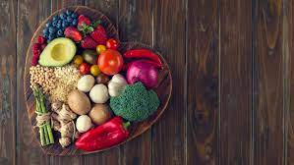
The end

