Slide 1
IBM BOB HACKATHON • TRACK: AI
Chip Design Knowledge Assistant
Grounded AI Assistance for Semiconductor Design Rules & Verification Specs
Team Name: TODO: Enter Team Name | Technology: watsonx.ai + IBM Bob (MCP) + ChromaDB
Notes:
Good day judges. Today we present the Chip Design Knowledge Assistant, built for the IBM Bob Hackathon under the AI Track. Semiconductor design requires managing thousands of precise physical design rules. Our project brings grounded AI intelligence into the engineer's workflow to make spec discovery fast, accurate, and fully traceable.

Slide 2
CHIP DESIGN KNOWLEDGE ASSISTANT | IBM BOB HACKATHON
The Problem — Information Fragmentation in Chip Design
Fragmented Knowledge
PDK rules, DRC decks, latchup specs, and timing guidelines are spread across multi-page PDFs, wikis, and Markdown files.
Workflow Friction
Physical design engineers constantly switch context between EDA layout tools and documentation viewers to locate specific rule tolerances.
Hallucination Risk
Generic ungrounded AI models frequently hallucinate numeric values—a major risk when verifying nanometer design tolerances.
Notes:
Physical design and layout engineers face a major documentation challenge. PDK rules, DRC decks, and latchup specs are scattered across multi-page manuals. Engineers spend significant time searching through PDFs, causing context switching. Senior leads are interrupted for routine lookups, while using general ungrounded AI models carries the dangerous risk of hallucinated numeric tolerances.

Slide 3
CHIP DESIGN KNOWLEDGE ASSISTANT | IBM BOB HACKATHON
The Solution — Grounded Chip Design Assistant
Semantic Vector Search
Indexes PDF, Markdown, and TXT specs into ChromaDB vector storage.
Grounded RAG Intelligence
Engineers ask natural-language questions and receive answers strictly grounded in indexed semiconductor documentation.
Source Document Citations
Attaches exact document titles, sections, and similarity scores to answers.
Anti-Hallucination Safeguards
Low-confidence thresholding (0.30) returns an explicit fallback message when evidence is missing.
IBM Bob MCP Server
Native Model Context Protocol integration for in-IDE querying directly within IBM Bob.
Notes:
Our solution is a domain-specific retrieval-augmented generation platform. Engineers query design specs in natural language and receive answers grounded in indexed documents. Crucially, the system includes source citations down to document sections, and enforces an anti-hallucination threshold—if no supporting context is found, it explicitly refuses to guess.

Slide 4
CHIP DESIGN KNOWLEDGE ASSISTANT | IBM BOB HACKATHON
System Architecture — Decoupled Dual-Interface RAG
Decoupled Architecture Flow:
1. Client Layer: React 18 SPA (Web UI) AND IBM Bob IDE (via STDIO MCP Transport)
2. Server Layer: FastAPI Backend Core (/health, /search, /documents, /categories)
3. RAG Engine: PyMuPDF Document Parser + LangChain Heading Splitter + Thresholding (0.30)
4. Vector Store: ChromaDB Persistent Storage (103 Chunks Indexed)
5. IBM Cloud AI: watsonx.ai Slate 125m (Embeddings) + Granite 13b Instruct v2 (LLM Generation)
Notes:
Architecturally, a single FastAPI backend core powers both our React Web UI and our IBM Bob MCP server. Ingested PDFs and Markdown files are chunked with PyMuPDF and embedded using watsonx.ai Slate embeddings into ChromaDB. During queries, ChromaDB retrieves top matching chunks, applies similarity thresholding, and passes verified context to the watsonx.ai Granite 13B model for grounded synthesis.

Slide 5
CHIP DESIGN KNOWLEDGE ASSISTANT | IBM BOB HACKATHON
Load-Bearing IBM Bob Model Context Protocol (MCP) Integration
Tool: search_knowledge_base
Executes top-k vector search in ChromaDB, applies thresholding, and runs watsonx.ai grounded generation.
In-IDE Knowledge Access
IBM Bob acts as the engineer-facing orchestration layer, connecting directly to our FastAPI backend using standard Model Context Protocol (MCP) STDIO tools.
Tool: get_document_sections
Retrieves table of contents and section headings for specific indexed specification documents.
Tool: list_ingested_documents
Lists all indexed documents, category metadata, and active chunk counts.
Tool: check_backend_status
Verifies FastAPI health status, ChromaDB liveness, and model configuration.
Notes:
The IBM Bob Model Context Protocol integration is load-bearing. Instead of leaving the editor to open a browser, engineers query design specs directly inside IBM Bob. Bob recognizes the intent and calls our custom MCP tools—such as search_knowledge_base and get_document_sections—delivering grounded answers and citations straight into the coding workflow.

Slide 6
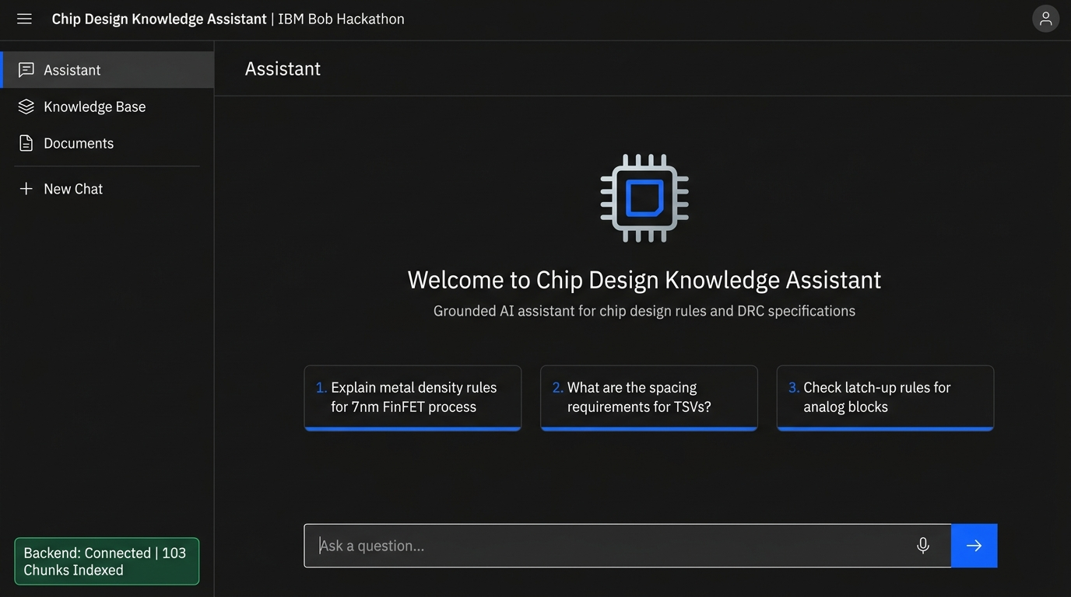
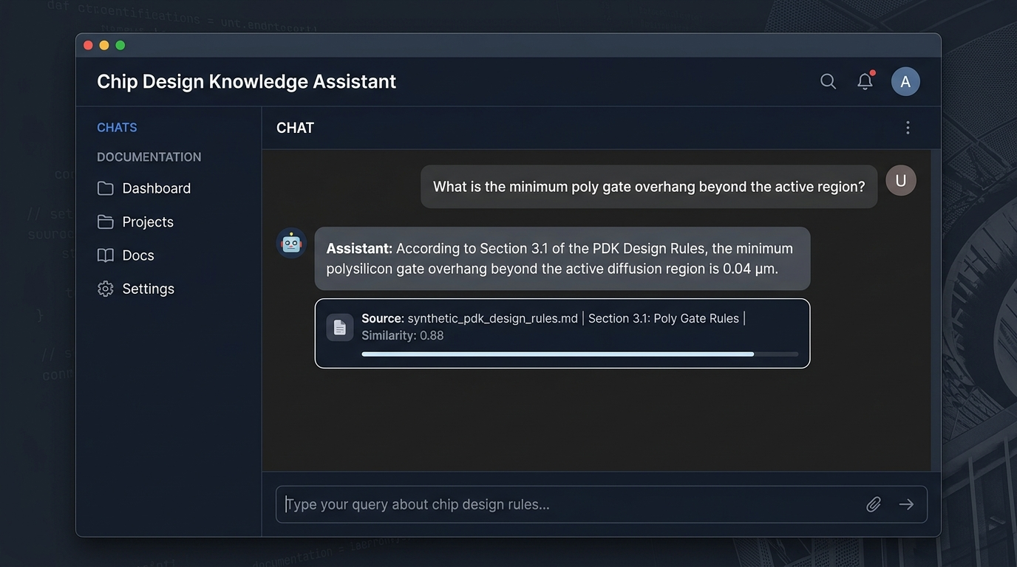
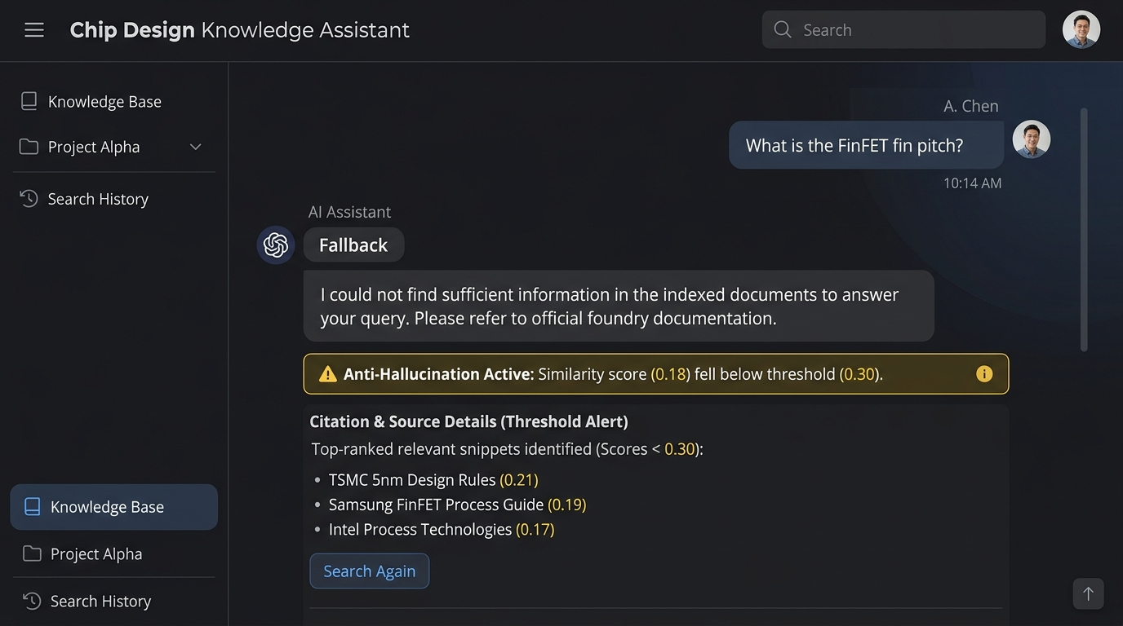
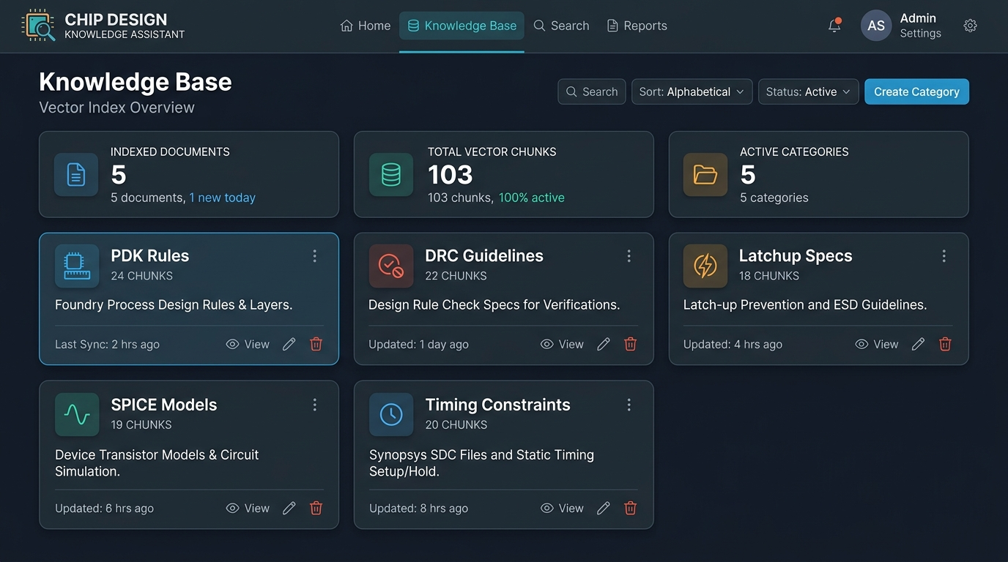
CHIP DESIGN KNOWLEDGE ASSISTANT | IBM BOB HACKATHON
Working Product Verification — Interface Screenshots
Assistant Home View (Healthy Backend Status)
Grounded Query & Document Citation Result
Anti-Hallucination Fallback Safeguard
Knowledge Base Overview & Metrics
Notes:
Here we see the working application in action. Screenshot 1 displays our Assistant dashboard with green backend liveness status. Screenshot 2 shows a grounded answer for a poly gate overhang query with its source citation. Screenshot 3 demonstrates our anti-hallucination safeguard in action on an unindexed query, and Screenshot 4 shows our Knowledge Base and Document management interface.

Slide 7
CHIP DESIGN KNOWLEDGE ASSISTANT | IBM BOB HACKATHON
Key Differentiation — Grounded Rigor vs Generic AI
Dimension | Generic AI Chatbot | Chip Design Knowledge Assistant
Knowledge Source | Broad web pre-training memory | Approved local PDK & spec documents
Numeric Accuracy | May invent plausible tolerances | Answers constrained strictly to retrieved context
Source Traceability | None or generic web links | Section-level document citations
Missing Knowledge | Guesses or hallucinates values | Returns explicit low-confidence fallback response
Developer Workflow | External browser tab context switch | Embedded in IDE via IBM Bob MCP integration
Notes:
Unlike generic AI chatbots that answer from unverified model memory and risk hallucinating numbers, the Chip Design Knowledge Assistant searches approved documents first. Answers are strictly grounded, fully cited, and backed by automated fallback protection when information is missing—all delivered natively inside IBM Bob via MCP.

Slide 8
CHIP DESIGN KNOWLEDGE ASSISTANT | IBM BOB HACKATHON
Impact & Future Roadmap
Qualitative Value Delivered
• Faster Discovery: Eliminates manual PDF searching for physical design rules and DRC tolerances.
• Reduced Interruption: Reduces routine reference questions directed at senior layout leads.
• Verifiable Auditability: Attaches section-level document metadata to every answer for peer verification.
Future Roadmap (Planned Extensions)
• Enterprise PDK Connectors: Connectors for proprietary foundry rulebooks & internal CAD wikis.
• Access Control & RBAC: Multi-tenant role-based security for proprietary design projects.
• Version-Aware Knowledge: Process node tagging to distinguish 7nm vs 5nm rule decks.
Notes:
In terms of qualitative impact, this system reduces lookup friction, minimizes senior engineer interruptions, and provides verifiable document auditability. For future work, we plan to add enterprise PDK connectors, role-based access control, and version-aware process node indexing. Thank you!

