Slide 1
Pharmacovigilance Safety Analysis Project
FAERS 2025 Adverse Event Analysis
MedDRA Coding, Signal Detection & Aggregate Reporting
Prepared by: Jijau Mohan Khandale
Slide 1

Slide 2
Introduction to Pharmacovigilance
Pharmacovigilance focuses on detection, assessment, and prevention of adverse drug reactions.
Drug safety monitoring helps improve patient safety and regulatory compliance.
Spontaneous reporting systems are widely used for post-marketing surveillance.
Slide 2

Slide 3
Project Objective
Analyze FAERS adverse event dataset.
Perform MedDRA PT and SOC coding.
Conduct seriousness and causality assessment.
Identify potential safety signals.
Develop aggregate safety dashboards and narratives.
Slide 3

Slide 4
Dataset Overview
Dataset Source: FAERS 2025 safety data
Included case IDs, suspect drugs, adverse reactions, seriousness criteria,
and patient demographics.
Focused on biologics, oncology drugs, antivirals, and corticosteroids.
Slide 4

Slide 5
Pharmacovigilance Workflow
Data Cleaning and Validation
MedDRA Coding (PT & SOC)
Seriousness Assessment
WHO-UMC Causality Assessment
Signal Detection
Narrative Writing
Aggregate Reporting & Dashboard Creation
Slide 5

Slide 6
MedDRA Coding Process
Mapped primary reactions to MedDRA Preferred Terms (PT).
Assigned System Organ Classes (SOC) for standardization.
Examples:
• Pneumonia → Infections and infestations
• Neutropenia → Blood and lymphatic system disorders
• Cerebrovascular accident → Nervous system disorders
report_id | primary_reaction | meddra_pt | meddra_soc
10136674 | Pneumonia | Pneumonia | Infections and infestations
10233235 | Cerebrovascular accident | Cerebrovascular accident | Nervous system disorders
10285496 | Alopecia | Alopecia | Skin and subcutaneous tissue disorders
10356309 | Pneumonia | Pneumonia | Infections and infestations
Slide 6

Slide 7
Causality Assessment
Used simplified WHO-UMC methodology.
Probable: strong temporal and clinical association.
Possible: reasonable relationship with suspected drug.
Unlikely: insufficient or weak evidence.
Assessment supported signal prioritization.
Slide 7

Slide 8
Signal Detection Analysis
Repeated infection-related adverse events identified.
Observed immune-mediated and hematologic safety signals.
Biologic therapies showed serious infection-related trends.
Potential signals require continuous pharmacovigilance monitoring.
Primary Reaction | Suggested Causality | Signal Type
Pneumonia | Probable | Infection signal
Immune-mediated adverse reaction | Probable | Immune signal
Drug hypersensitivity | Probable | Hypersensitivity signal
Slide 8

Slide 9
Narrative Writing
Prepared professional ICSR-style case narratives.
Included serious infection, neurologic, renal, and hematologic cases.
Narratives documented patient history, drug exposure, adverse events,
outcomes, and assessment.
case_id | narrative
10136674 | A 23-year-old female patient with a medical history of psoriasis received Ustekinumab (STELARA) therapy. During the course of treatment, the patient developed pneumonia accompanied by staphylococcal infection and sepsis. The adverse events were considered serious due to hospitalization requirement. Appropriate medical management was initiated, and the patient subsequently recovered. Considering the temporal association between drug administration and onset of the adverse events, along with the known immunosuppressive profile of Ustekinumab, the causality assessment was determined to be probable. Continuous monitoring for serious infection-related adverse events is recommended during biologic therapy.
Slide 9

Slide 10
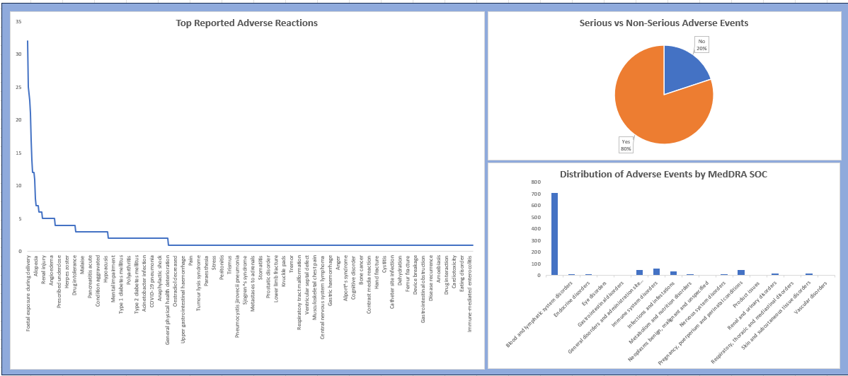
Aggregate Reporting Dashboard
Slide 10

Slide 11
Key Findings
Pneumonia and infection-related reactions were frequently reported.
Hypersensitivity and hematologic adverse events were identified.
Serious adverse events were commonly associated with biologic therapies.
Signal detection supported ongoing safety monitoring recommendations.
Slide 11

Slide 12
Conclusion
Successfully completed a pharmacovigilance workflow simulation project.
Applied MedDRA coding, signal detection, causality assessment, and aggregate reporting concepts.
Developed practical understanding of drug safety data analysis and PV workflows.
Slide 12

