Slide 1


Indian Institute of Information Technology Senapati, Manipur
PORTFOLIO MANAGER
Presented by
Guided by
Guthy Saiteja (19010104)
Dr Kaushal Bhardwaj
&
Submitted for the course named Project - II (CS300)
Computer Science and Engineering
May - 2022

Slide 2
Content
Abstract
Introduction
Theory and fundamentals
Literature review
Methodology
Tools and technologies
Testing / Experimentation
Limitations
Conclusion
Future scope
References
Portfolio Manager
May - 2022
‹#›

Slide 3
1. Abstract
I have developed an android application so that, instead of hard coding content onto the live website to display, the data can be fetched from a hosted database, which contains the object model for the data that will be rendered on the site and then I have connected the app to the hosted database so that users can change content from the app.
Portfolio Manager
May - 2022
‹#›

Slide 4
2. Introduction
The Portfolio Manager android application allows the users to easily edit or update the content on their personal portfolio website using their mobile phones.
Each time users want to update or edit the content that is being displayed on their websites, rather than making changes to the code, they can simply tap into this Portfolio Manager application and achieve the same.
Portfolio Manager
May - 2022
‹#›

Slide 5
3. Theory and fundamentals
An existing system has the following disadvantages
As the content on the website is hard-coded, we are unable to change it unless we change its original code.
The process of changing the code whenever something on a website needs to be updated is tedious.
A user with no programming expertise cannot modify the code to update the live website.
If the code is altered, there is a possibility that it will be corrupted
Portfolio Manager
May - 2022
‹#›

Slide 6
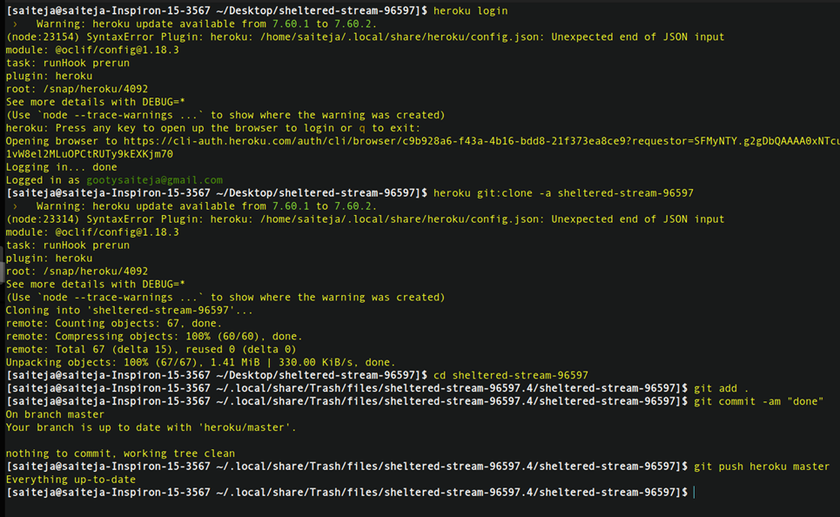
3. Theory and fundamentals
Portfolio Manager
May - 2022
‹#›

Slide 7
3. Theory and fundamentals
Advantages of the Proposed System
Time Saving: By editing the database, a user can quickly modify live website content.
Easy to Use: Even people without programming skills can edit a live website's data by editing the database.
All in one service: Once the database has been edited, users will be able to see the reflected changes within the app by clicking on the View Portfolio button.
Portfolio Manager
May - 2022
‹#›

Slide 8
4. Literature review
Sr. No. | Author | Title | Source | Remarks
1 | IEEE (1998) | IEEE 830-1998 standard for writing SRS document. | IEEE | A good template for SRS documentation.
2 | Huyen Trang Chau | Use case narration template | Creately | Use case template that's easy to follow.
3 | Google | Dart documentation | https://dart.dev/guides | This is a great resource for gaining an understanding of Dart concepts
4 | R.S. Pressman | Software Engineering: A Practitioner's Approach | Software Engineering: A Practitioner's Approach | A great book to learn about software development
Portfolio Manager
May - 2022
‹#›

Slide 9
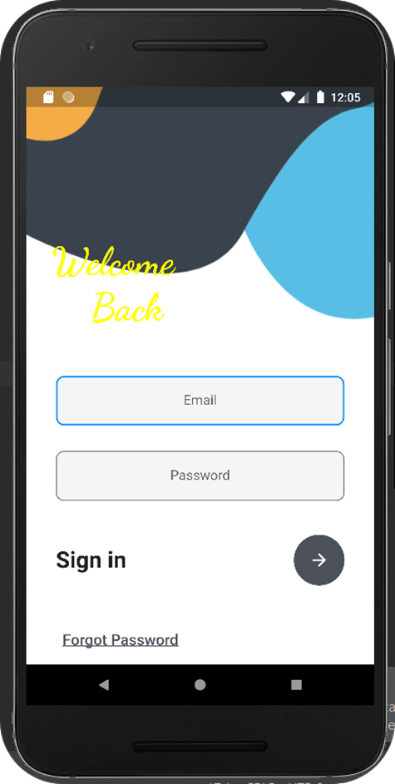
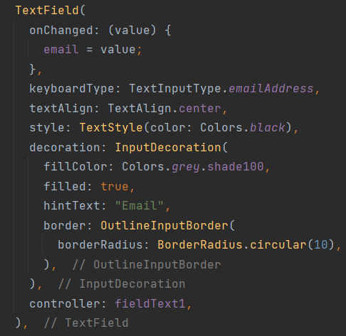
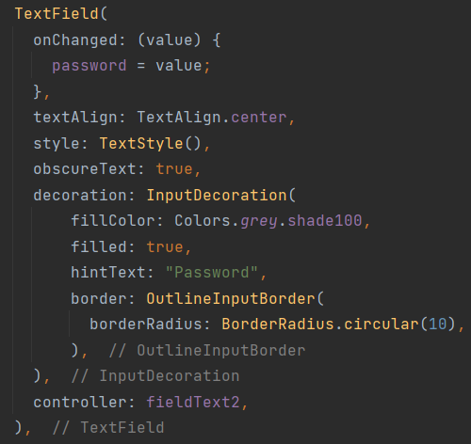
5. Methodology
Login Page for the user
The initial screen is the login screen through which users would be able to access the application.
Portfolio Manager
May - 2022
‹#›

Slide 10
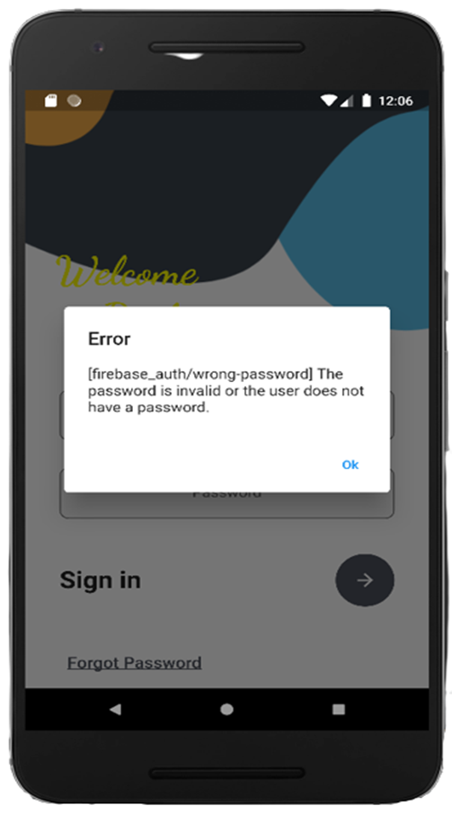
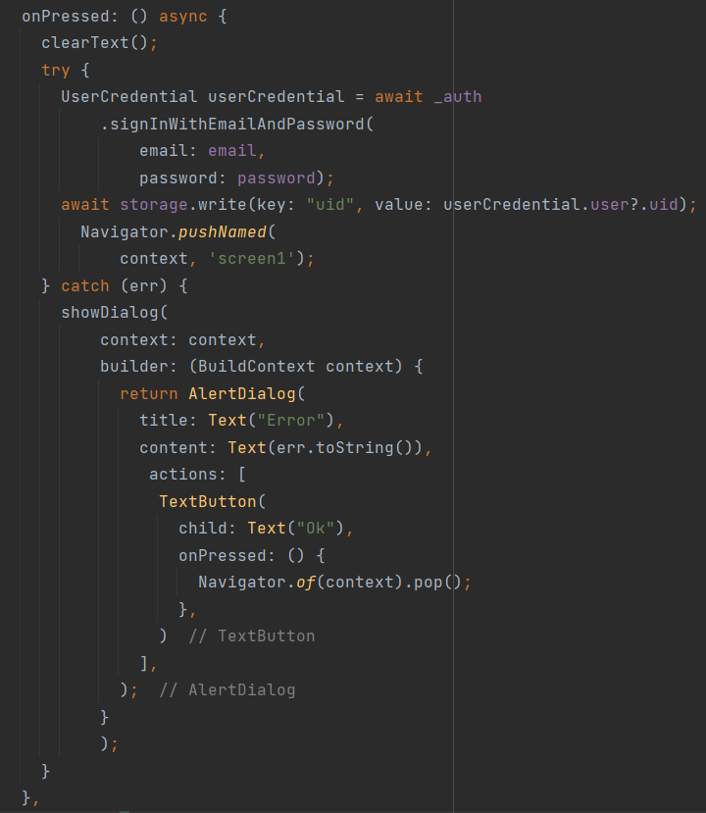
5. Methodology
Authentication
An error message will appear when the user enters the wrong email address or password.
Portfolio Manager
May - 2022
‹#›

Slide 11
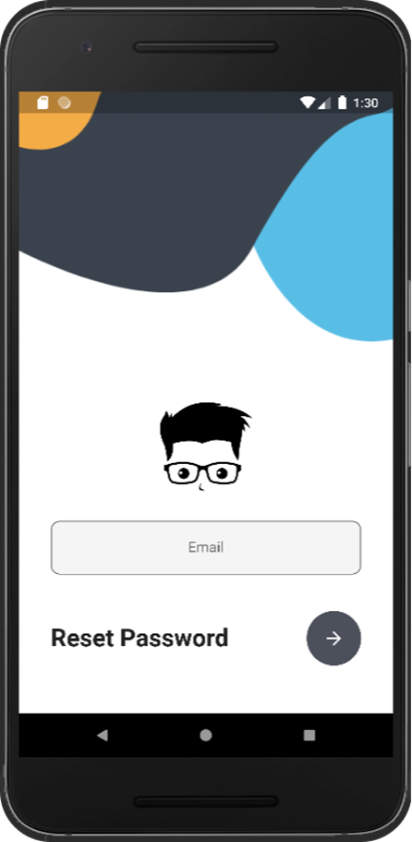
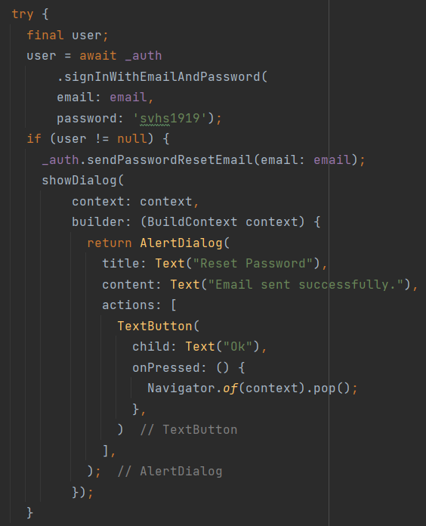
5. Methodology
Reset Password
If a user forgets his/her password then by clicking on Forgot Password user will get a reset password link on his/her registered email id.
Portfolio Manager
May - 2022
‹#›

Slide 12
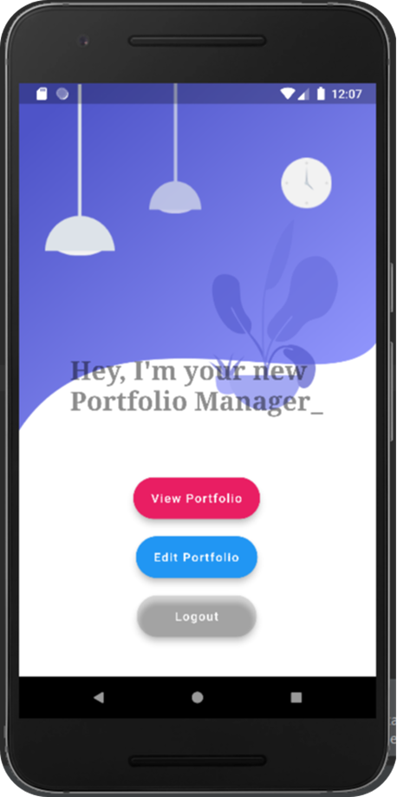
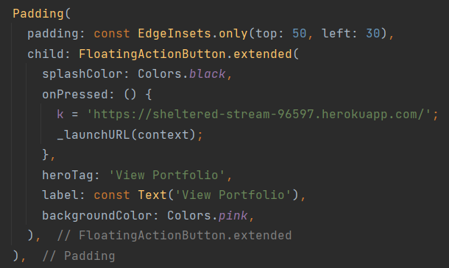
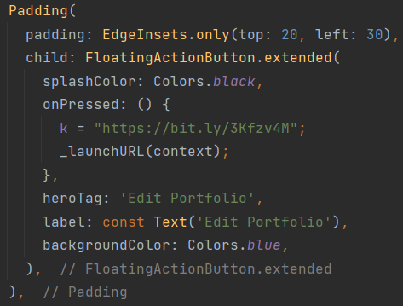
5. Methodology
Launch Screen
Portfolio Manager
May - 2022
‹#›

Slide 13
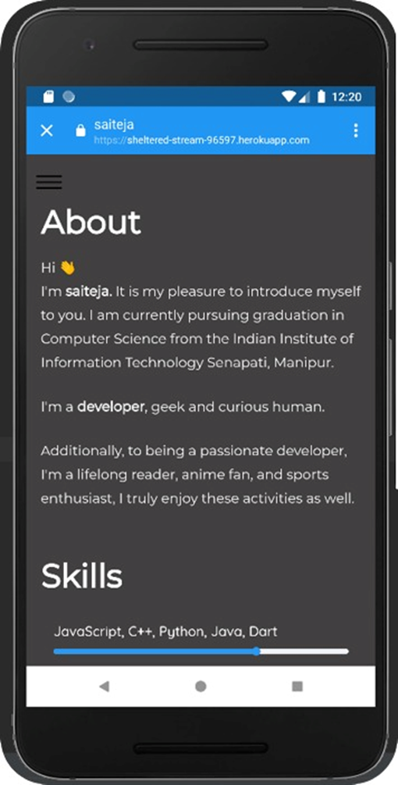
5. Methodology
Portfolio
Portfolio Manager
May - 2022
‹#›

Slide 14
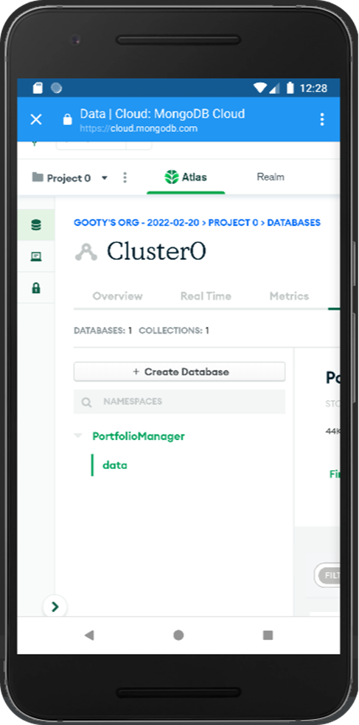
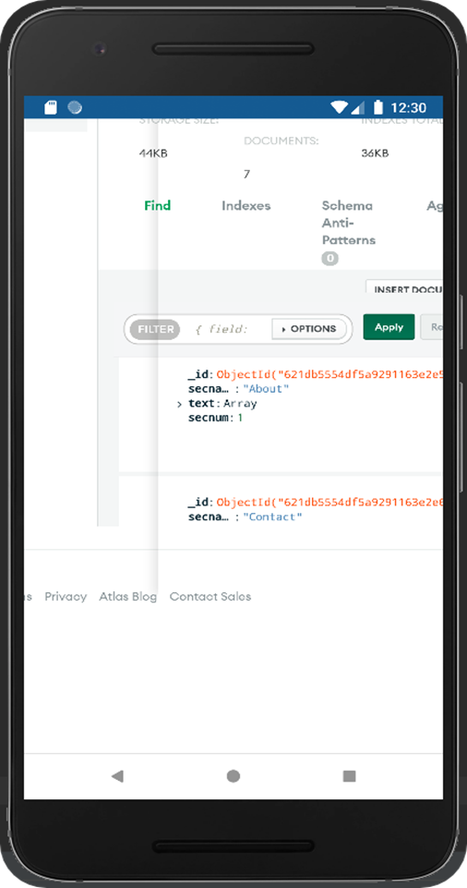
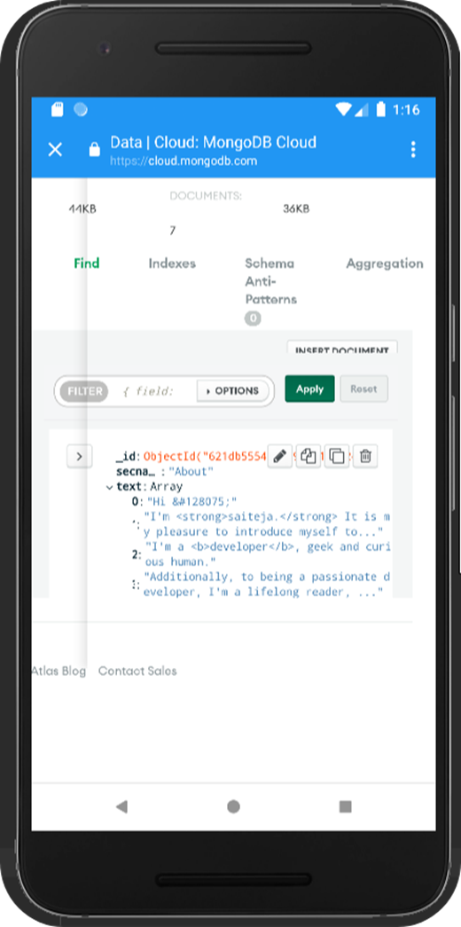
5. Methodology
Edit Portfolio
Portfolio Manager
May - 2022
‹#›

Slide 15
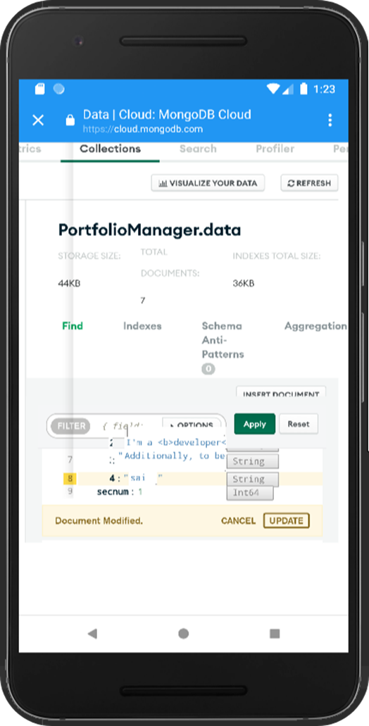
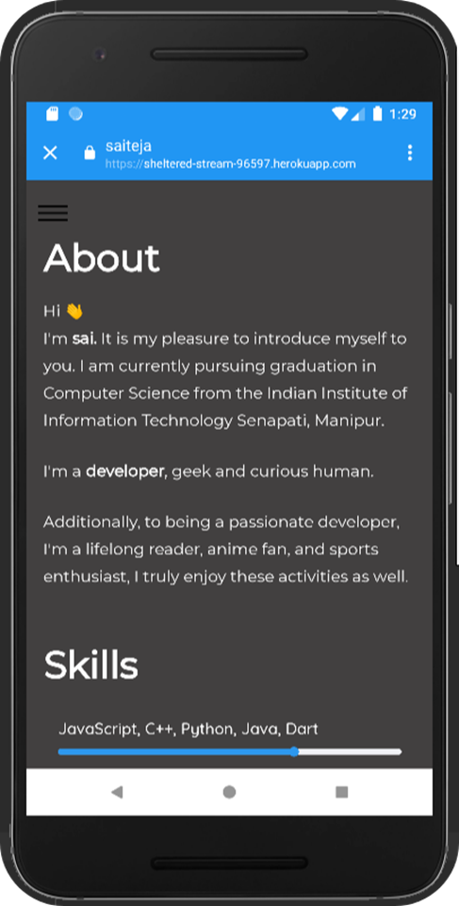
5. Methodology
Edit Portfolio
Portfolio Manager
May - 2012
‹#›

Slide 16
6. Tools and technologies
Dart
Mongo DB
MongoDB Atlas
Swift
Android Studio
Flutter
JSON
Portfolio Manager
May - 2022
‹#›

Slide 17
7. Testing / Experimentation
I have implemented all the mentioned functionality in my app using different types of stateful, stateless widgets and functions. I have manually tested functionality of the app and below I am providing a drive link for your reference of testing which consists of all the required excel sheets.
Click Here: Manual Testing
Portfolio Manager
May - 2022
‹#›

Slide 18
8. Limitations
Although I have put our best efforts to make this software flexible, easy to operate, we cannot rule limitations out even. Though the software presents a broad range of options to its users, some intricate options could not be covered on it.
The application is only for Android and will not work for other mobile O S like blackberry, Symbian, IOS, etc.
Only the content that appears on the website can be edited, but the style or new elements cannot be added to the website.
Portfolio Manager
May - 2022
‹#›

Slide 19
9. Conclusion
I have successfully completed all phases of the analysis and the design process of the Portfolio manager app development, meeting the minimum requirements. I am aware, however, that there are still many shortcomings in My design and that the processes need a great deal more reviews, feedbacks, and comments in order to come up with a very clean and optimized design.
Portfolio Manager
May - 2022
‹#›

Slide 20
10. Future scope
In future, I will give you the ability to change the style and add new elements to the website from the app itself.
I can make a web version of the current application.
Portfolio Manager
May - 2022
‹#›

Slide 21
11. References
Manual Testing
GitHub
Link to Apk
Working Application
Portfolio Manager
May - 2022
‹#›

Slide 22


