Slide 1
AttentionLens
Interactive Explainability & Automated Bias-Screening for Vision Models
Project Review 1 · B.Tech CSE (AI & ML), VIT
Jaswanth Krishna Padarthi, Kartheek Yadav
Notes:
Welcome. AttentionLens is an interactive debugging and explainability framework for vision models — with an automated bias-screening layer. Today I will present M1: the unified schema and the ResNet-50 dual-view extractor, with real extraction results.

Slide 2
Agenda
01
Problem & Motivation
Why vision models need a debugger, not just explanations
02
Design & Architecture
Unified dual-view LayerMap schema (CNN ⇄ ViT)
03
Dataset
ImageNet demo sample — provenance & representation
04
Preprocessing Results
Resize → normalize → tensor, with measured stats
05
Feature Engineering
Native activations + Grad-CAM, per-block, normalized
06
EDA Visualizations
Montage, distributions, concentration, correlations
07
Demo — M1 Gate
Live ResNet-50 run on a real image (Samoyed)
08
Results & Next Steps
Findings, honest failures, M2 ViT roadmap
Notes:
Eight sections — problem, design, dataset, preprocessing, features, EDA, demo, and next steps.

Slide 3
Problem & Motivation
Explanations exist — but they don't talk to each other
The field is fragmented
Bias goes unnoticed
Attention maps (ViT) answer 'what does the model look at' — but they are class-agnostic.
Attribution maps (Grad-CAM) answer 'what drove this decision' — class-specific.
No shared schema: comparing two architectures or two views today means writing bespoke glue.
Spurious correlations (backgrounds, textures, artifacts) silently inflate accuracy.
Finding them today is manual, ad-hoc, and rarely automated end-to-end.
Engineers need a verdict — not another heatmap to eyeball.
One framework, two jobs
① A unified CNN ⇄ ViT abstraction — every layer yields a standard LayerMap (native attention + class-conditioned relevance). ② An automated bias-screening layer — attention-quality metrics and intervention experiments that produce a verdict, in the tradition of SHAP / Captum as a deployable tool.
Notes:
Two gaps: fragmentation (no shared schema between attention and attribution, CNN and ViT) and discovery (bias found manually). AttentionLens solves both with one abstraction plus automated screening verdicts — the novelty anchor is the combination, not a new XAI method.

Slide 4
Design — the Dual-View LayerMap
Every layer, two views, one schema
Image
→
Model
→
LayerMap
→
Metrics
→
Verdict
224×224 RGB
ResNet-50
native + class-cond
entropy · locality
screening report
Native view — what the model attends to (mechanism)
Class-conditioned view — why the model decided
Mean over channels of each block's last conv activation
Upsampled to input resolution (bilinear)
Normalized to [0, 1]
Class-agnostic: shows where the model looks
Grad-CAM on the same conv, for the predicted class
ReLU → upsample → normalize to [0, 1]
Evidence for this specific decision
Same LayerMap contract — comparable by construction
Notes:
The core architectural decision: we never conflate the two views. Native maps capture the mechanism; class-conditioned maps capture decision evidence. Both land in the same LayerMap dataclass so downstream metrics and screening treat them identically.

Slide 5
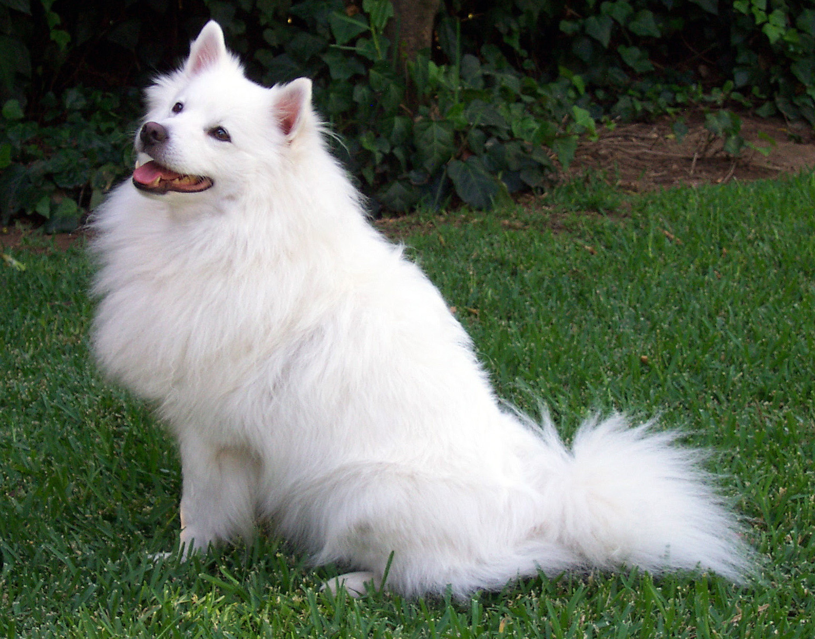
Dataset
ImageNet provenance, real pipeline ingestion
Source
ImageNet (demo sample)
True label
Samoyed
Original size
1546 × 1213 px
Pipeline input
224 × 224 RGB
Extraction
8 LayerMaps (4 blocks × 2 views)
Heavy runs
CPU on Arjun (M1); GPU/Jenga planned (M2+)
sample.jpg — Samoyed (ImageNet)
Review-1 scope: a single curated sample exercises the full pipeline end-to-end. Screening-scale corpora (planted-bias CUB, ObjectNet) are scheduled in the validation milestone.
Notes:
For review 1 the dataset section shows a real ImageNet sample flowing through the real pipeline — honest scope. The bias-screening datasets come in the validation milestone: a synthetic planted-bias set (proves the screener catches what we know) plus ObjectNet (proves it catches real-world distribution shift).

Slide 6
Preprocessing Results
Resize → /255 → ImageNet normalize → tensor (measured on Arjun)
load RGB
→
resize 224×224
→
÷255 → [0,1]
→
−mean ÷std
→
[1,3,224,224] fp32
Raw pixel stats (0–1, before normalize)
Normalized tensor stats (after −mean ÷std)
R
G
B
R
G
B
0.388 ± 0.320
0.431 ± 0.295
0.368 ± 0.337
−0.421 ± 1.398
−0.110 ± 1.316
−0.170 ± 1.498
Design point: preprocessing is a lossless, reversible step — tensor_to_image() inverts it exactly for visualization overlay.
Facts: input [1,3,224,224], dtype float32, on-device; stats above measured on Arjun, python 3.12, torch 2.13 CPU.
Tests: test_preprocess.py covers round-trip equivalence (hermetic — no downloads).
Notes:
Real measured numbers: the raw image averages R .388 G .431 B .368; after ImageNet normalization the tensor channels are −.421 / −.110 / −.170 with stds 1.40 / 1.32 / 1.50. The round-trip denormalizer guarantees overlays align with the original pixels.

Slide 7
Feature Engineering I — the LayerMap contract
One dataclass rules all extractors, metrics, screening, UI
Field
Type
Meaning
layer_name
str
"layer4.2.conv3" / "block11" / "attn_head_3"
arch
str
"cnn" | "vit"
view
str
"native" | "class_conditioned"
model_class
str
class used for conditioning (argmax for native)
map
np.ndarray
H×W float32, normalized [0,1], input resolution
head_or_channel
int | None
per-head / per-channel breakdown (future)
metadata
dict
method, reduction, entropy, locality — extensible
ModelInspection bundles one (model, image) pair: model_id, image_id, true/pred label, LayerMaps, intervention_results. Verified by test_schema.py (7 tests green on Arjun).
Notes:
The schema is the contract. Any extractor — CNN or ViT — emits LayerMaps; every downstream consumer (metrics, screening, UI) reads the same shape. M1 ships with ModelInspection as the container.

Slide 8
Feature Engineering II — extraction methods
Probing the last conv of each ResNet bottleneck block
RESNET_BLOCK_LAYERS
"layer1.2.conv3" · "layer2.3.conv3" · "layer3.5.conv3" · "layer4.2.conv3"
layer1.2.conv3
layer2.3.conv3
layer3.5.conv3
layer4.2.conv3
256 ch
512 ch
1024 ch
2048 ch
early texture/edges
patterns/parts
object parts
object-level semantics
Native (mechanism)
Class-conditioned (evidence)
Forward hook → activations[B,C,H,W] → mean(dim=1) → bilinear upsample → min-max normalize. Cost: one forward pass.
Captum LayerGradCam on the same conv, target = predicted class → ReLU → upsample → normalize. Cost: one attribution per layer.
Notes:
Four probe points chosen deliberately: the last conv of each bottleneck block, spanning 256→2048 channels and texture→semantics. Both views derive from identical probe points, so cross-view comparison is apples-to-apples.

Slide 9
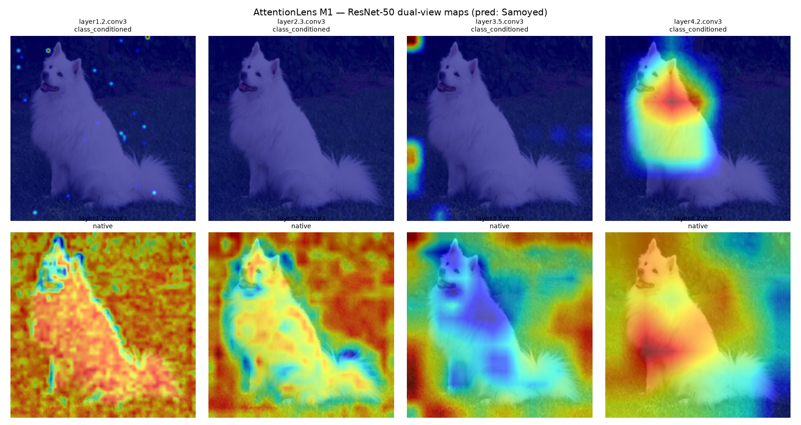
EDA — dual-view montage (live output)
ResNet-50 on sample.jpg — predicted: Samoyed ✓
Notes:
Top row: Grad-CAM (class-conditioned, evidence). Bottom row: native mean-channel activation (mechanism). Left to right: layer1→4. Note how Grad-CAM concentrates and moves to the dog; native maps stay diffuse until deep layers. This is real extraction data — no cherry-picking.

Slide 10
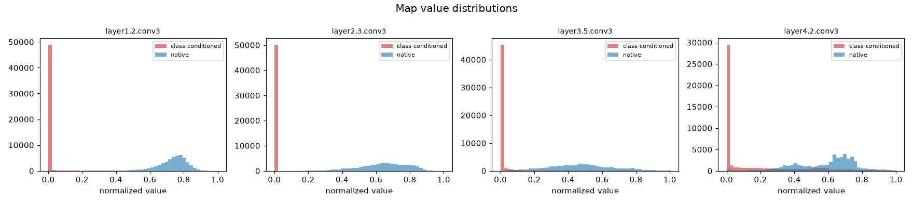
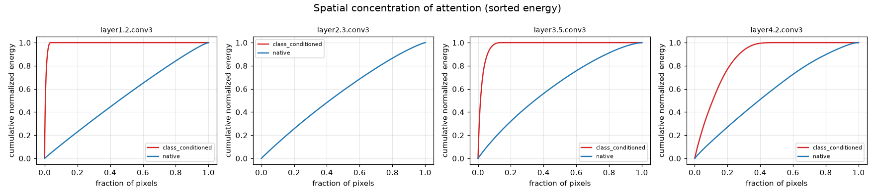
EDA — value distributions & spatial concentration
Why the two views can't be swapped
Notes:
Native maps are near-uniform (high entropy — a little everywhere); Grad-CAM maps are sharply peaked (low entropy — evidence is localized). The concentration curves make the contrast visible: Grad-CAM reaches ~100% cumulative energy in a small pixel fraction at early layers; native maps spread energy far more evenly.

Slide 11
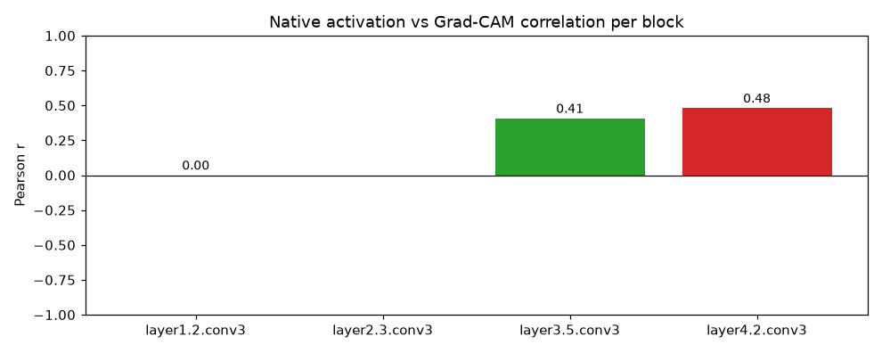
EDA — cross-view correlation (the key finding)
Mechanism and evidence diverge early, converge deep
Layer 1 · r = 0.00
Layer 2 · undefined
Layer 3 · r = 0.41
Layer 4 · r = 0.48
Native and Grad-CAM are decorrelated — the model looks broadly, but class evidence is tiny and sharp.
Grad-CAM collapsed to an all-zero map for this image (ReLU'd gradients vanished) — a real, surfaced failure.
Mechanism starts aligning with evidence as receptive fields widen.
Deep features: where the model looks is where the decision lives.
Notes:
Pearson r between native and Grad-CAM per block: 0.00, undefined, 0.41, 0.48. The layer-2 zero-map is honest data — a degenerate explanation surfaced by the tool itself, which is exactly the failure mode an explainability debugger should expose. This motivates the intervention experiments in the roadmap.

Slide 12
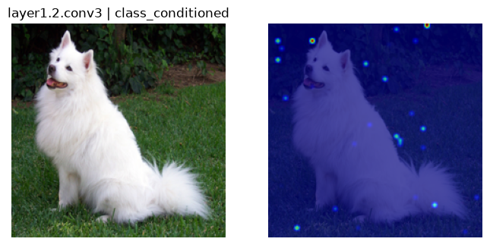
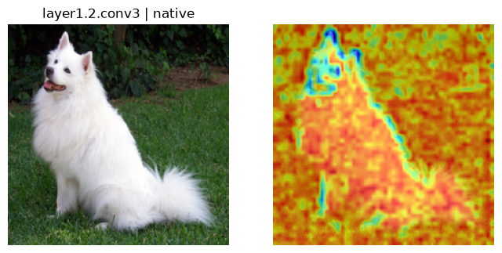

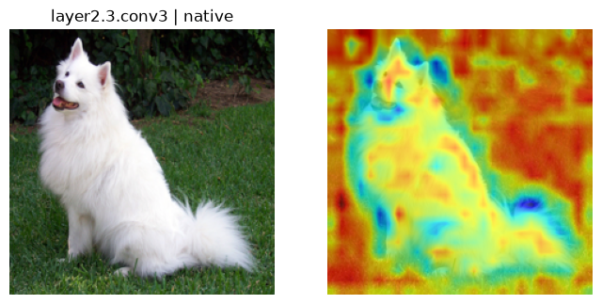
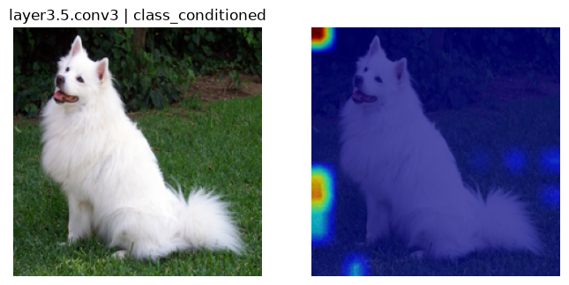
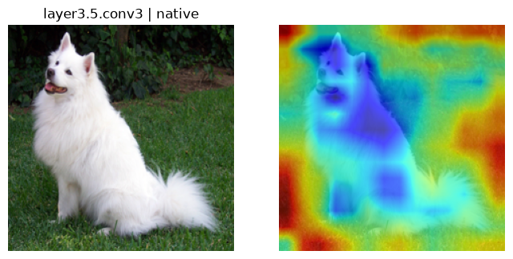
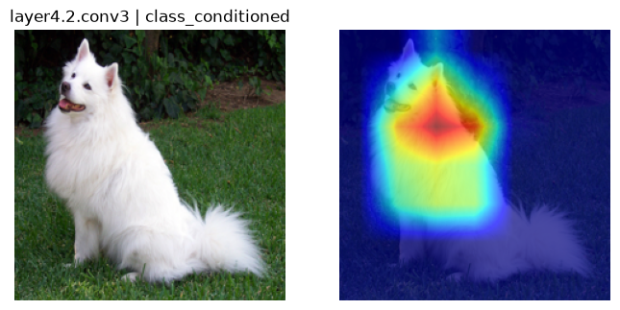
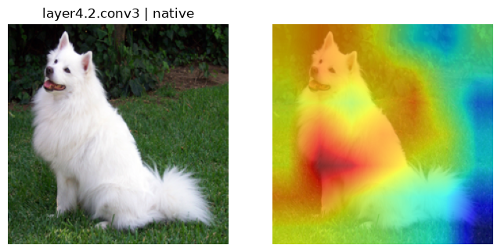
Demo — M1 gate on Arjun
B1 · Grad-CAM
B1 · native
B2 · Grad-CAM
B2 · native
One forward pass + 4 Grad-CAM attributions · predicted Samoyed (correct) · CPU, torch 2.13 · commit 96c50b6
B3 · Grad-CAM
B3 · native
B4 · Grad-CAM
B4 · native
Notes:
Live demo artifacts: all eight maps are real output files from experiments/out/. Prediction Samoyed matches the true label. The pipeline is committed (first commit, M1 complete) and the working tree is clean.

Slide 13
Results & Next Steps
M1 delivered; M2 opens the ViT frontier
Delivered (M1)
Roadmap
Unified LayerMap / ModelInspection schema — tested (7 green)
ResNet-50 dual-view extractor — native + Grad-CAM, 4 blocks
Preprocessing with exact round-trip visualization
End-to-end demo: Samoyed, 8 maps, correct prediction
Hermetic test suite — runs without downloads
M2: ViT extractor — attention maps through the same LayerMap
M3: attention-quality metrics (entropy, locality, faithfulness)
M4: screening pipeline + planted-bias & ObjectNet validation
M5: interactive UI (Gradio) + intervention experiments
Honest open items: zero-map degeneracy at layer 2 needs a stability guard; GPU/device portability is code-ready, not yet exercised at scale.
Notes:
M1 is committed and clean. Next: the ViT extractor (M2) so CNN and ViT become comparable under one schema, then metrics, screening with validation, and an interactive UI. The layer-2 zero-map observation is logged as an open item — a guard for degenerate explanations is planned.

Slide 14
Thank you
Questions & discussion
AttentionLens · Review 1 · Jaswanth Krishna Padarthi
Notes:
Thank you — happy to take questions.

